Slide 1
Caves
A.Slivková II.A

Slide 2
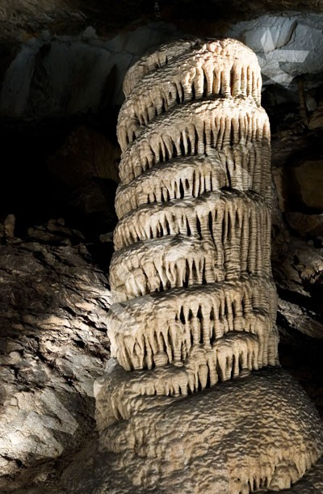
Belianska cave - is a stalactite cave in the Slovak part of the Tatra mountains - it is located above Tatranská Kotlina - the cave have been persisting for 125 years - it belongs among the most visited show caves in Slovakia

Slide 3
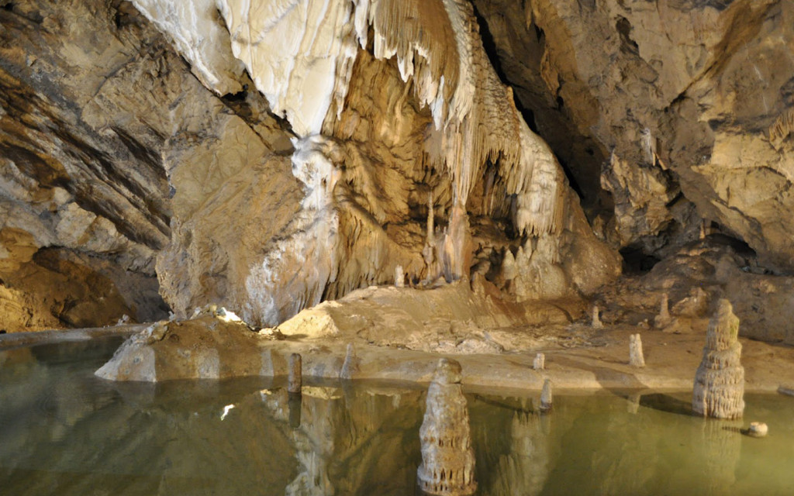
- the water is going into the cave and it formed underground spaces - the primary caverns were filled with water - large cupolas and smaller kettle hollows were modelled on the ceilings - the largest underground spaces were formed already before the main glaciation of the Tatras

Slide 4
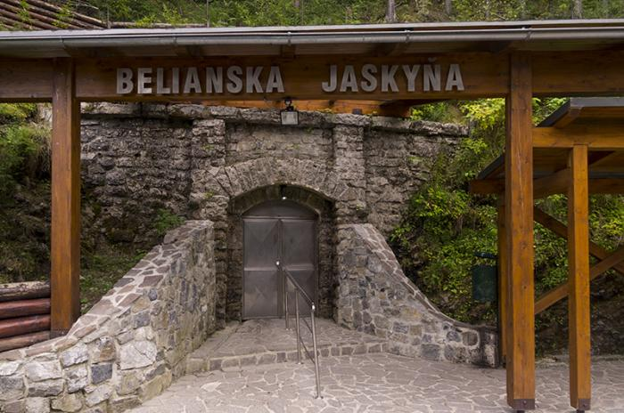
- its length is 3,829 m and it is 168 m deep - the original entrance is situated 82 m above the current one - the entrance parts contain chimneys - oval shapes of water modelling are preserved in several places

Slide 5
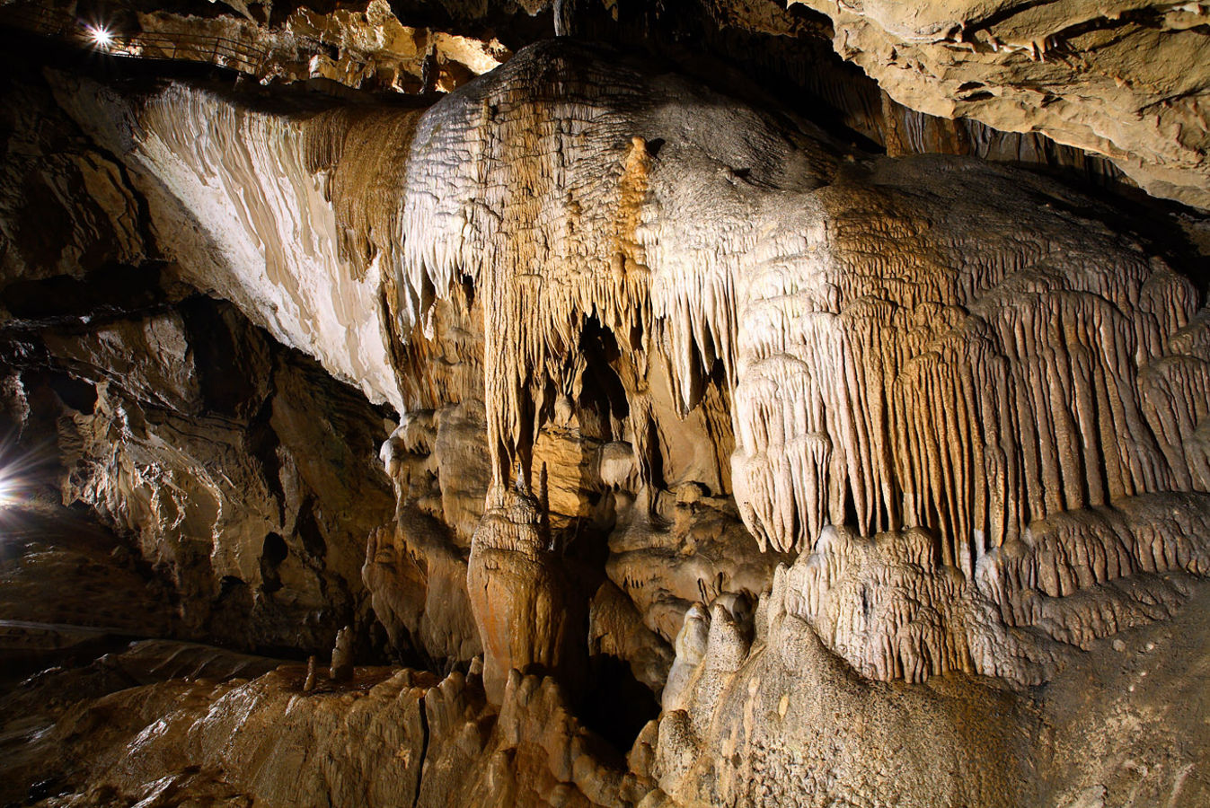
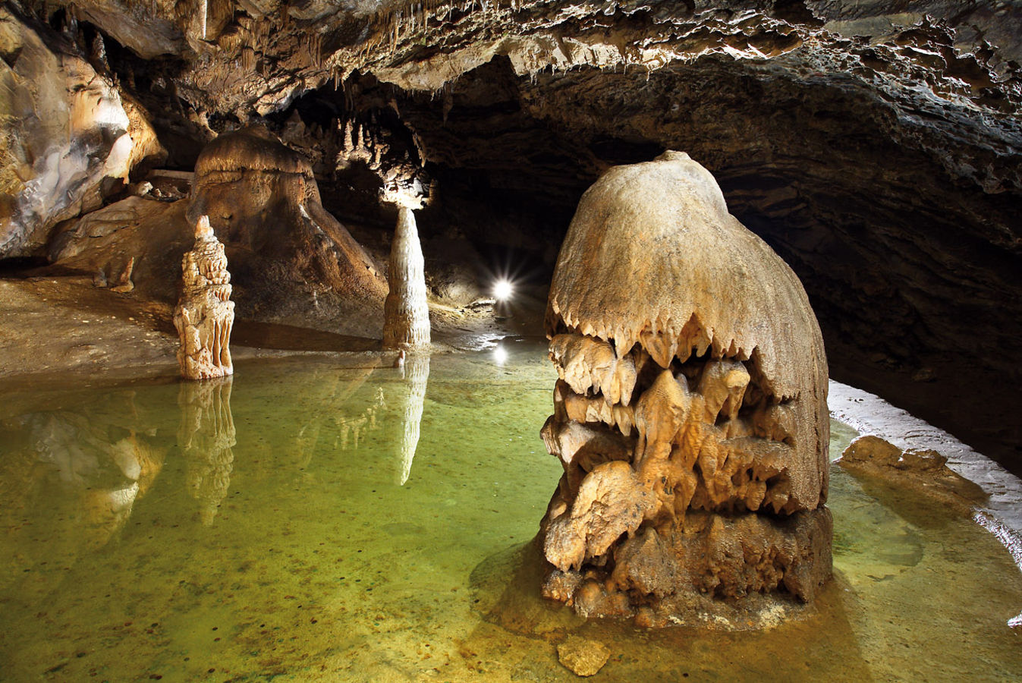
- attractive are the flowstone waterfalls and stalagmites - air temperature reaches 5,0 to 6,3 °C and humidity 90 to 97 % - seven bat species were found in the cave

Slide 6
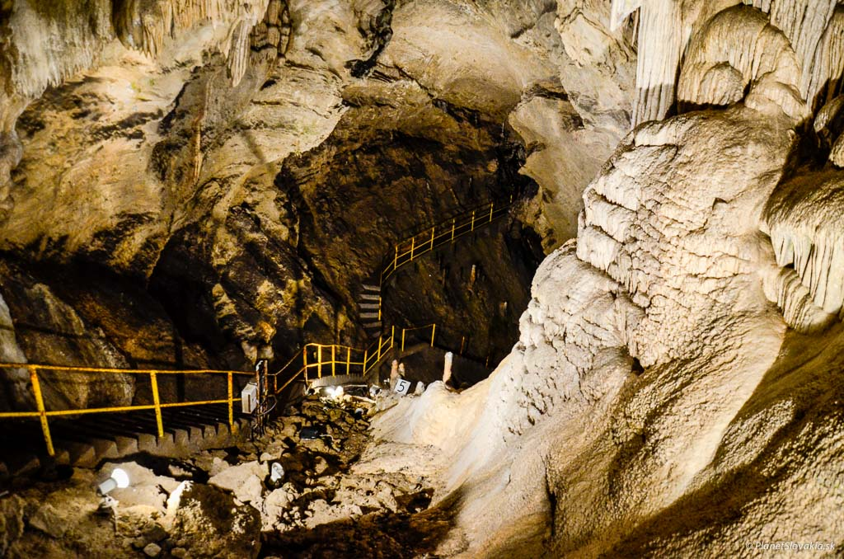
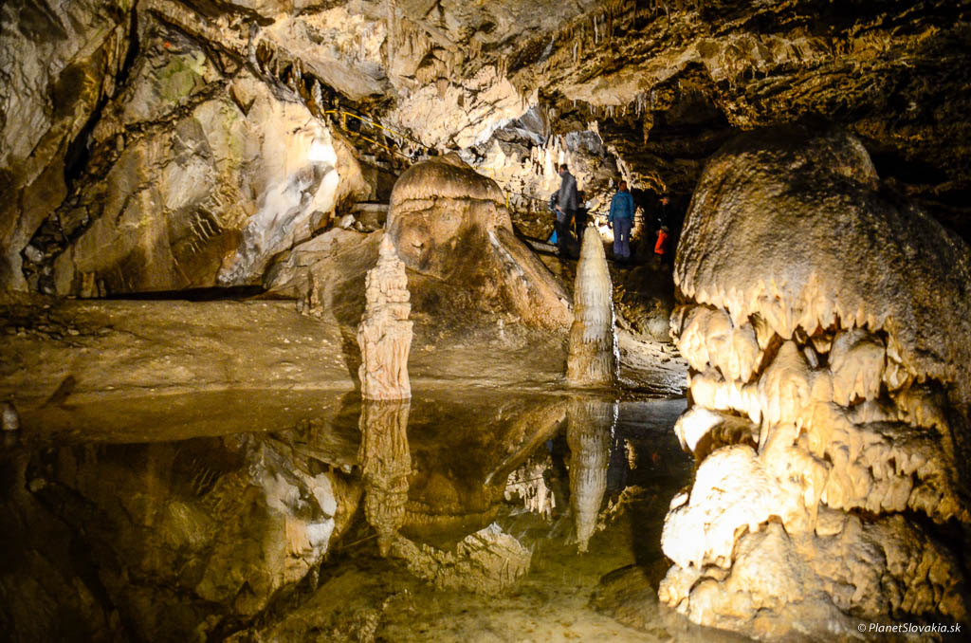
- The entrance parts were known by gold seekers in the18th century - there is electricity in the cave (1896) - reconstruction work were done in the fifties of the last century - The cave is used for healing speleoclimatic stays in the last years

Slide 7
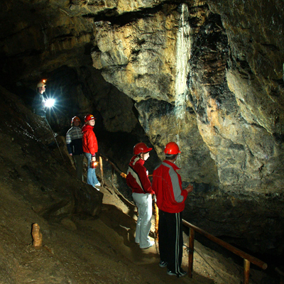
Bad-Hole cave - the only well-known in the Prešov district - visitor must have a helmet on the head and he goes through a underground with guide - There is no electricity, so visitors can use they own light

Slide 8
- the basic route takes approximately 40 minutes - it is suitable for young children too - good shoes and warmer clothes are required - the youngest person was 6 weeks old, the oldest 84 years

Slide 9
Resources: •http://www.ssj.sk/sk/jaskyna/2-belianska-jaskyna#prirodne-pomery •http://zladiera.sk/

Slide 10
Thanks for paying attention!

