Slide 1
The Krásna Hôrka Castle
A. Slivková III.A

Slide 2
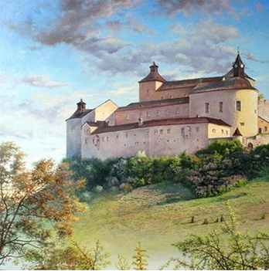
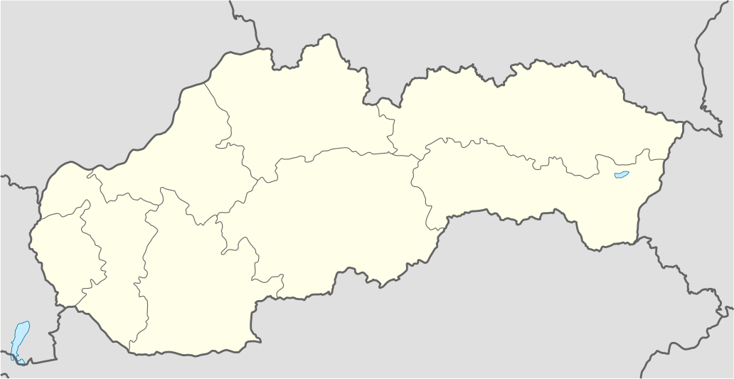
Informations
- Krásnohorské Podhradie
- Near Rožňava, Košice Region
- 1333
- 1961- National Cultural Monument
Notes:
The Krásna Hôrka Castle is a castle built on a hilltop overlooking the village of Krásnohorské Podhradie near Rožňava, in Košice Region. The first recorded mention of the castle was in 1333. From 1961 Krásna Hôrka is National Cultural Monument of the Slovak Republic. It was said to be one of the country's best-preserved castles.

Slide 3
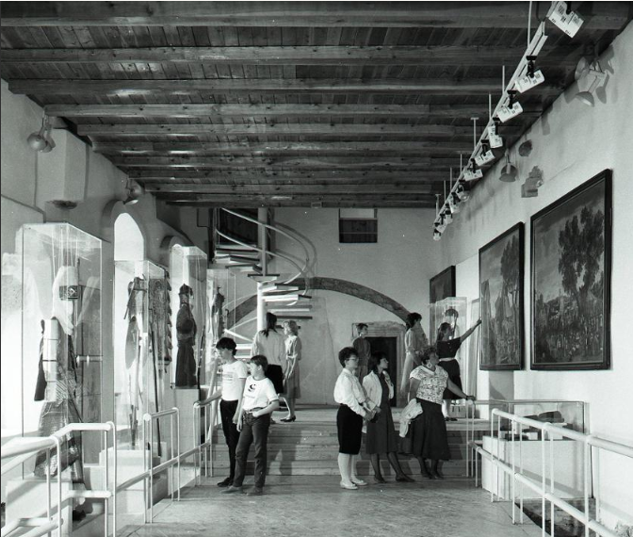
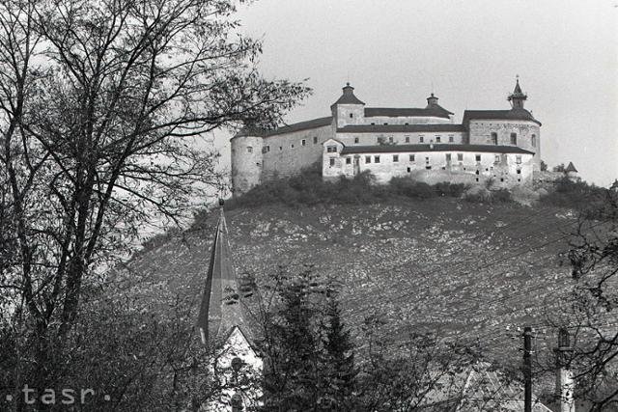
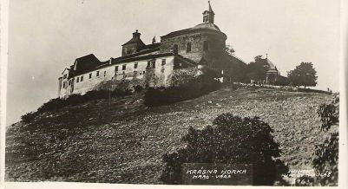
History
- Protection for mining areas
- Older castle, 1241- King Belo IV
- 13th century- prismatic tower, residental palace
- 1441 - Jinsko‘s army
- 1546 - new fortifaction- Franz Beck
Péter Andrássy- 16th century- reconstruction
- 1857 - museum
- 1945 – available to the public
Notes:
The castle was built to protect the medieval path that passed through the mining areas of the Slovak Ore Mountains. It is built probably on the place of the previos castle, which was rebuilt in 1241 by King Belo IV. It protected area from Tatars. The king gave the Bebek‘s family vast estates in Gemer, where they settled and ruled more than 300 years. The original castle, built in the 13th century, was made up of a prismatic tower and a residential palace. In 1441, Jiskro's army occupied Gemer, but the castle wasn‘t destroyed and when the army abandoned the castle, castle was again Bebek‘s property. Because of Tatars, Franz Beck in 1546 built a new fortification with Italian architect. When the castle was acquired by Péter Andrássy, he began at the end of the 16th century with the reconstruction of the castle, which eventually lasted 100 years. Krásná Hôrka became a museum in 1857. Since 1945, the castle has been the property of the state and after its restoration it is again available to the public.

Slide 4
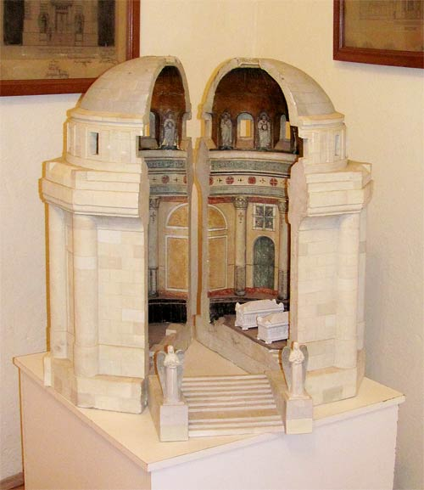
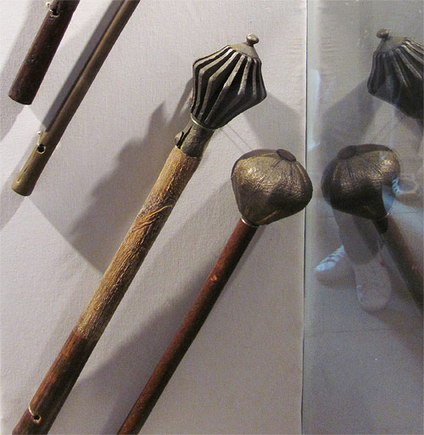
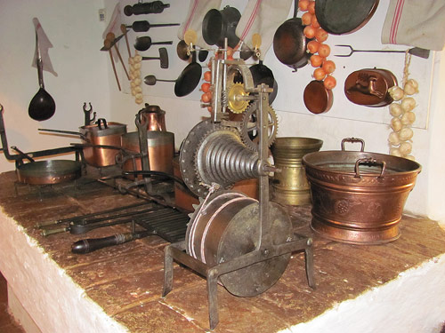
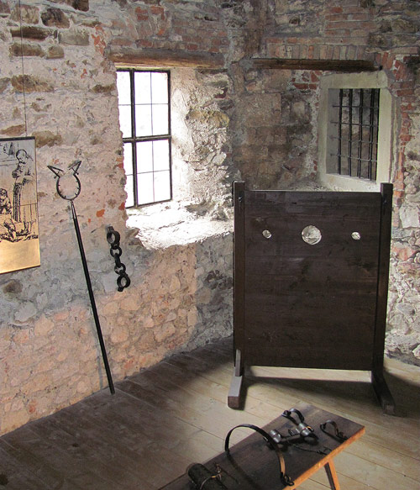
Exhibition
- Oldest part- Acient past, Romanesque and Githic period, craftmanship
- Torturehouse- unique tools
- In the lower castle- kitchen, music salon
Notes:
The exhibition is located in three parts of the castle, the oldest part of the exhibition is devoted to the ancient past - the eastern part of the Gemer, a rare exhibit of the Romanesque and Gothic period and the craftsmanship. The torturehouse documents demonstrations of unique tools. Rare is a collection of medieval weapons: punching, cutting and multipurpose. In the lower castle there is a castle kitchen with open fire and original equipment and a music salon with a rare collection of musical instruments. There is also the Castle Chapel - on the right side a glass sarcophagus into which the mummified body of Zofia Serédy was carried. It was originally buried in a church crypt near the castle, where limpid water and dry air naturally embalmed her body.

Slide 5
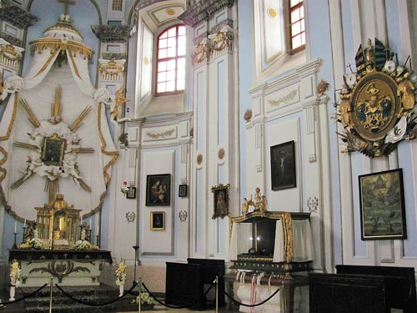
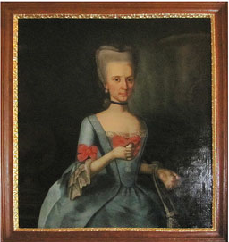
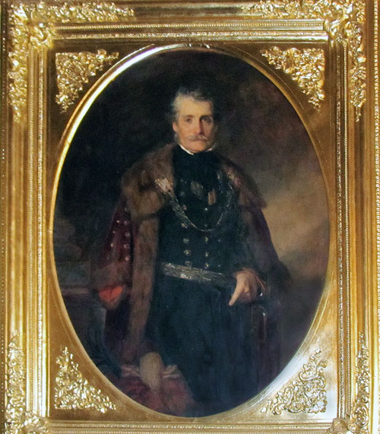
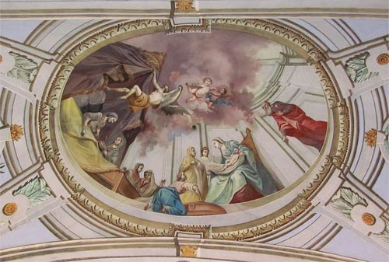
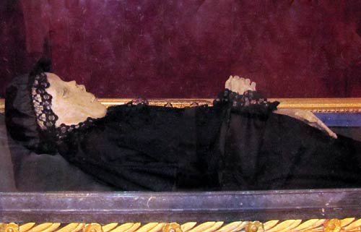

Slide 6
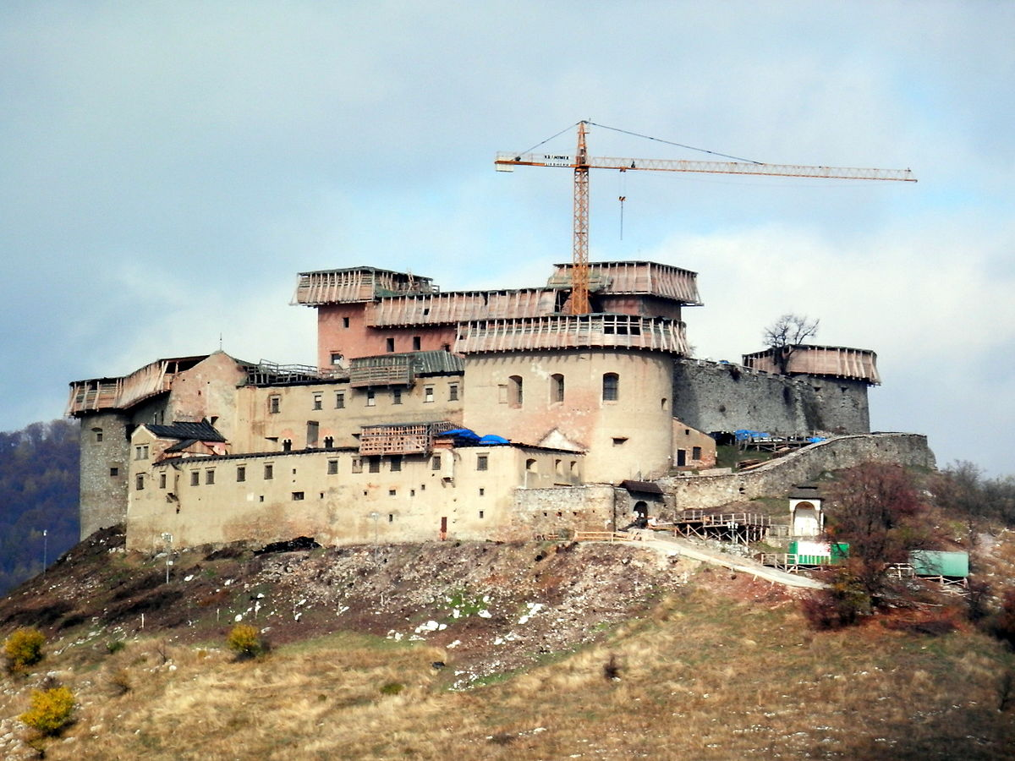
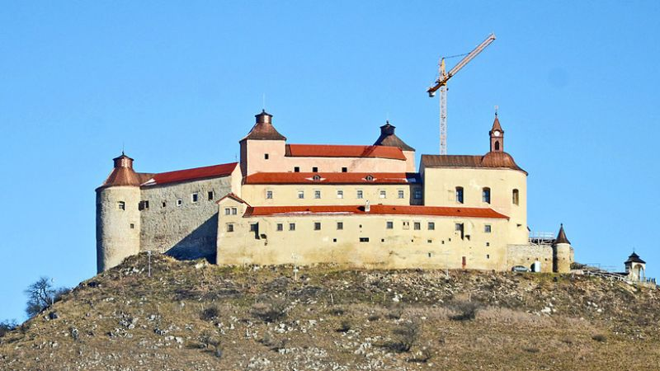
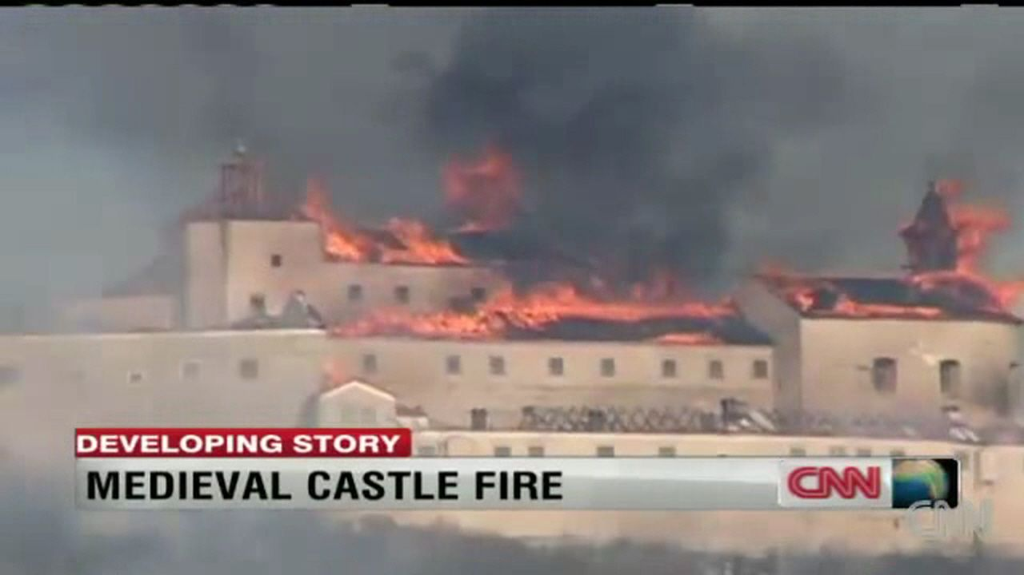
Fire
- 12 March 2012
- roof, exposition, bell tower (3 bells)
- 90% of the collections were undamaged
- castle is still closed
Notes:
On 10 March 2012, the castle was badly damaged by fire. The fire was caused by two young boys who attempted to light up a cigarette and accidentally lit a grass.
The castle suffered extensive damage. The roof, the exhibition area in the Gothic palace and the bell tower were completely destroyed. Three bells in the bell tower were melted by the heat. Castle is still closed

Slide 7
Resources
Krasna Horka Fire: Smoking Children Burn Down Slovakia Castle [online]. 13.5.2018 Dostupné na https://www.huffingtonpost.com/2012/03/11/krasna-horka-fire-smoking-children-slovakia-castle_n_1337606.html
Krásna Hôrka [online]. 13.5.2018 Dostupné na http://www.gemer.sk/ciele/khorka/en.html
The Krásna Hôrka Castle: A Medieval Residence of the House of Andrássy [online]. 13.5.2018 Dostupné na http://www.hradkrasnahorka.sk/index.php?page=hrad&lng=en
Krásna Hôrka vo fotografiách [online]. 13.5.2018 Dostupné na https://peraskova.blog.sme.sk/c/244358/Krasna-Horka-vo-fotografiach.html

Slide 8
Thanks for paying attention!

