Slide 1
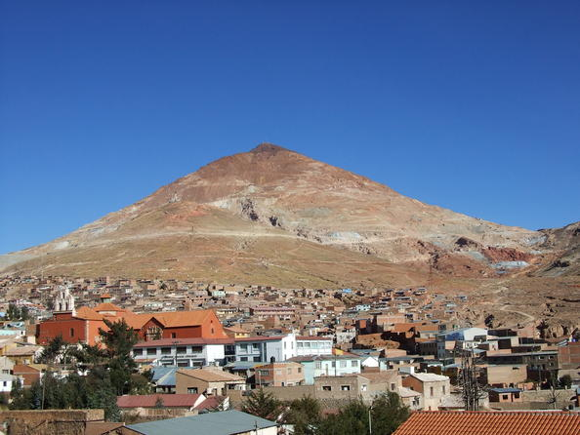
POTOSI

Slide 2
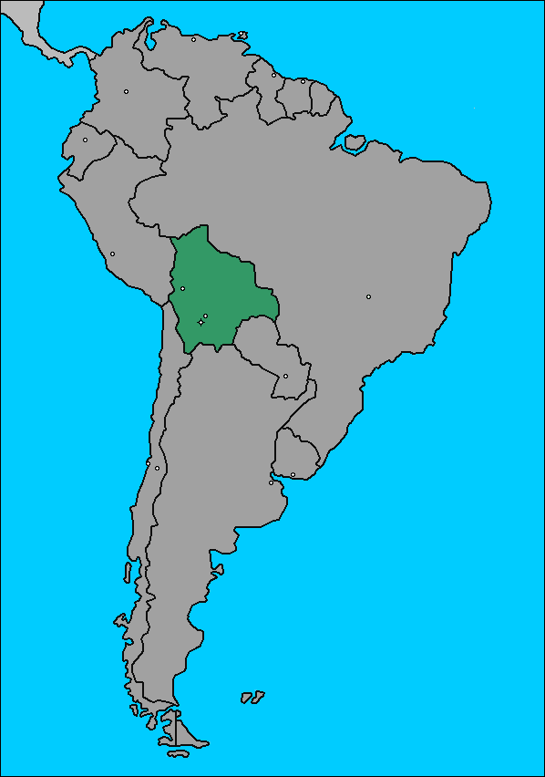
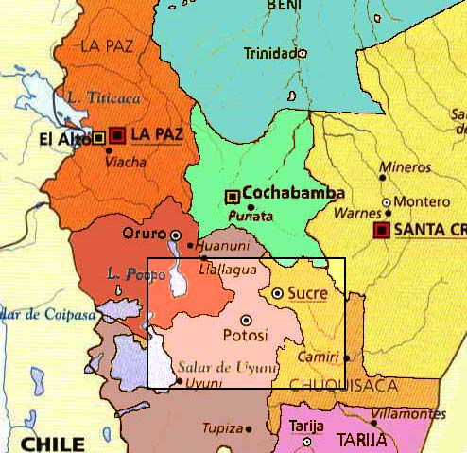

Slide 3
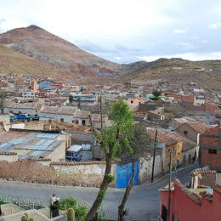
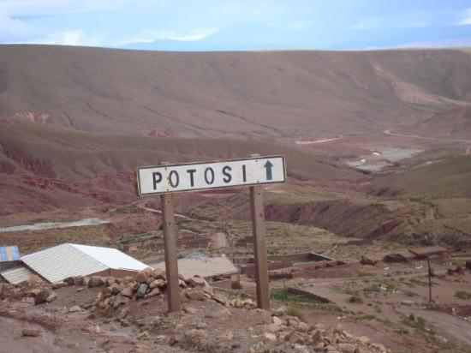
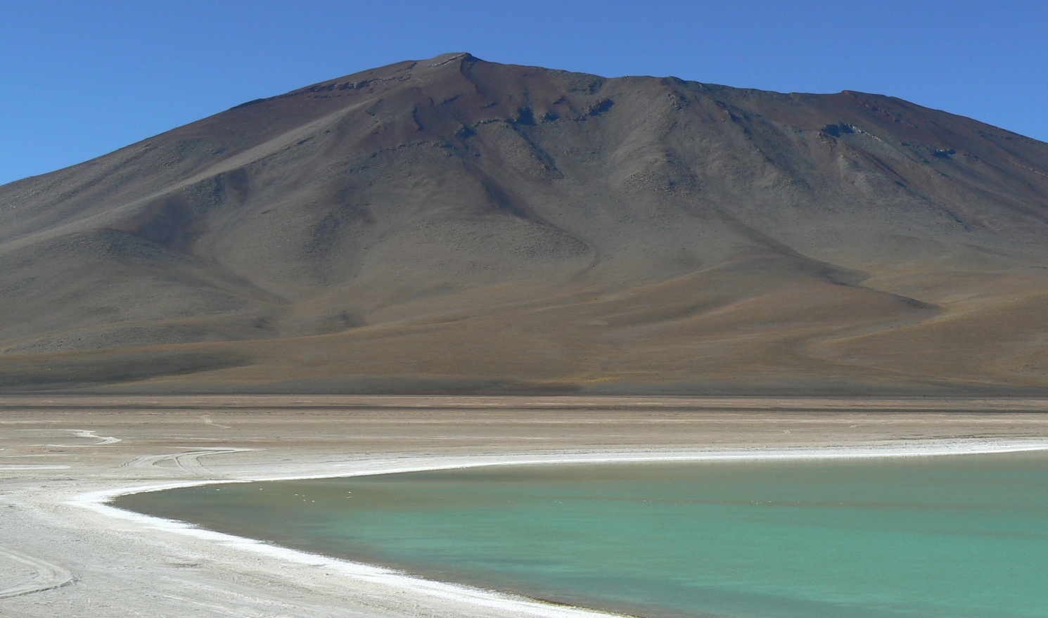

Slide 4
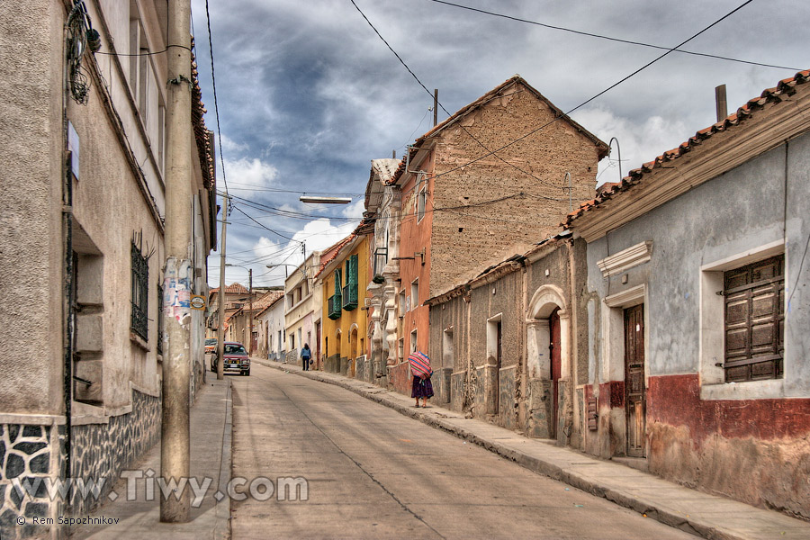
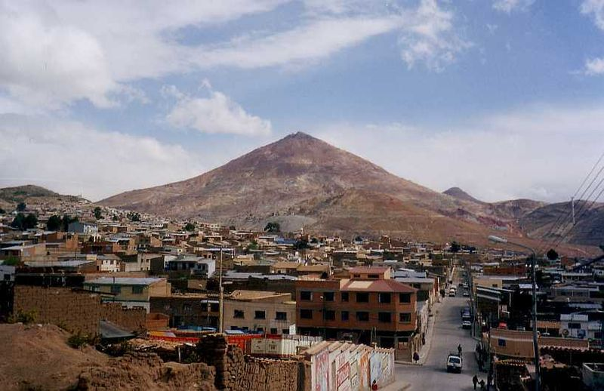

Slide 5
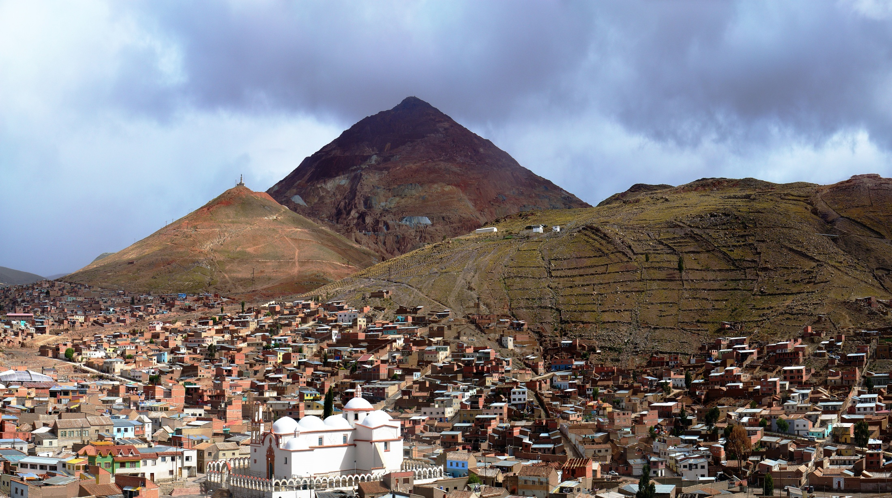

Slide 6
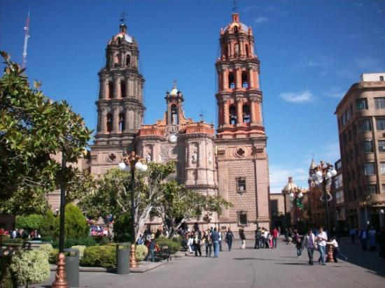
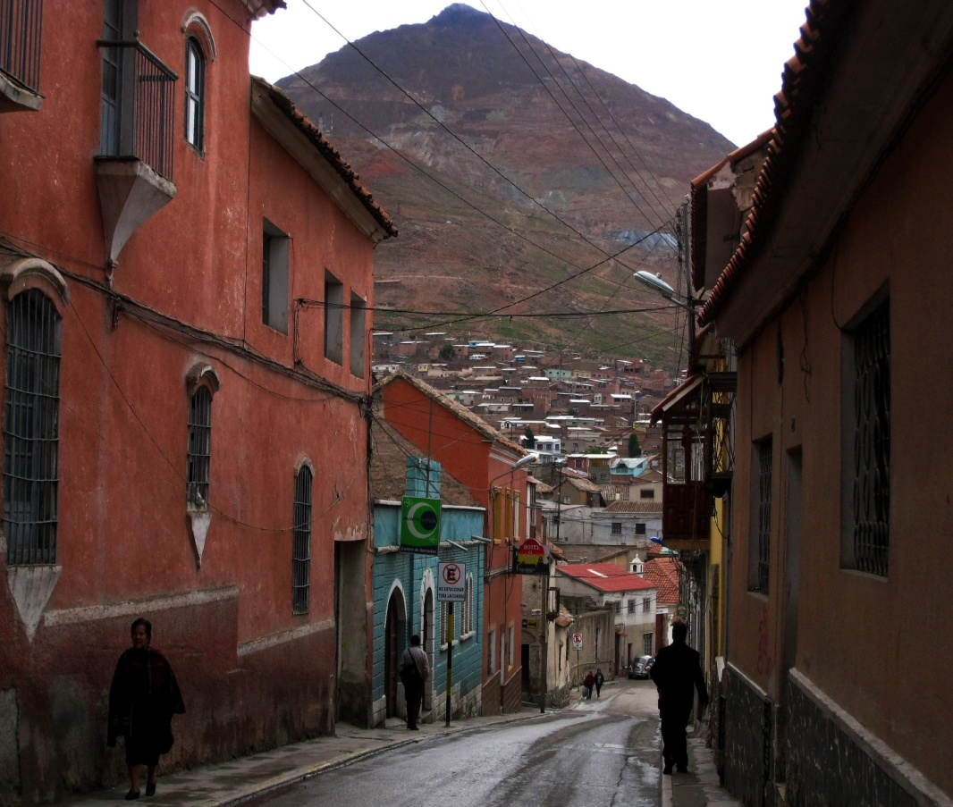

Slide 7
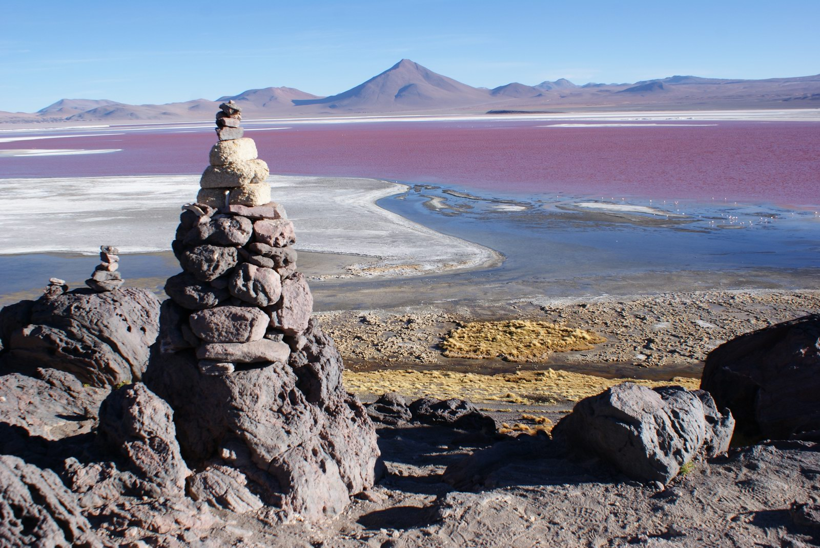

Slide 8
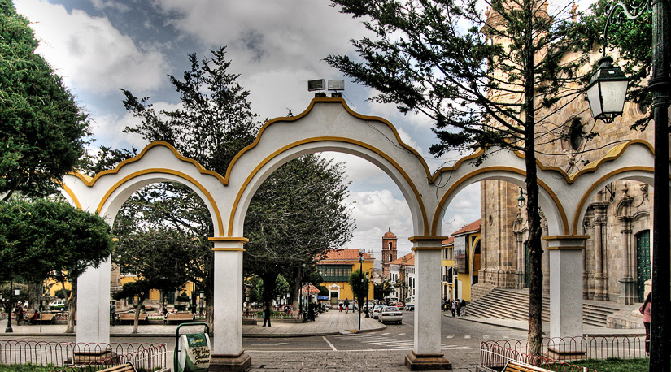
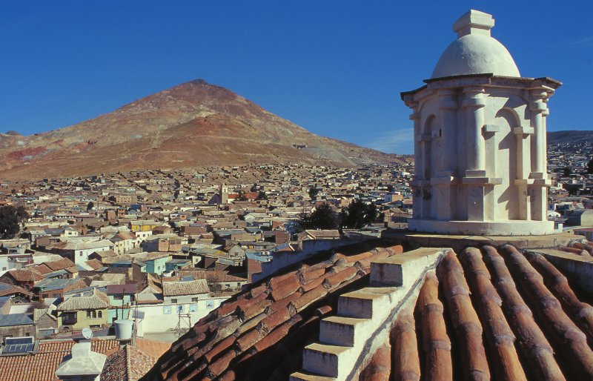
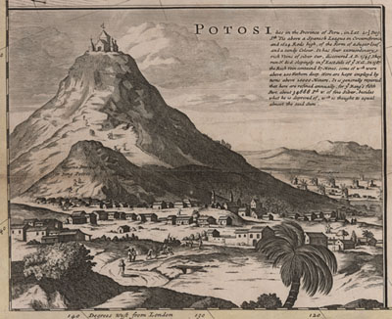

Slide 9
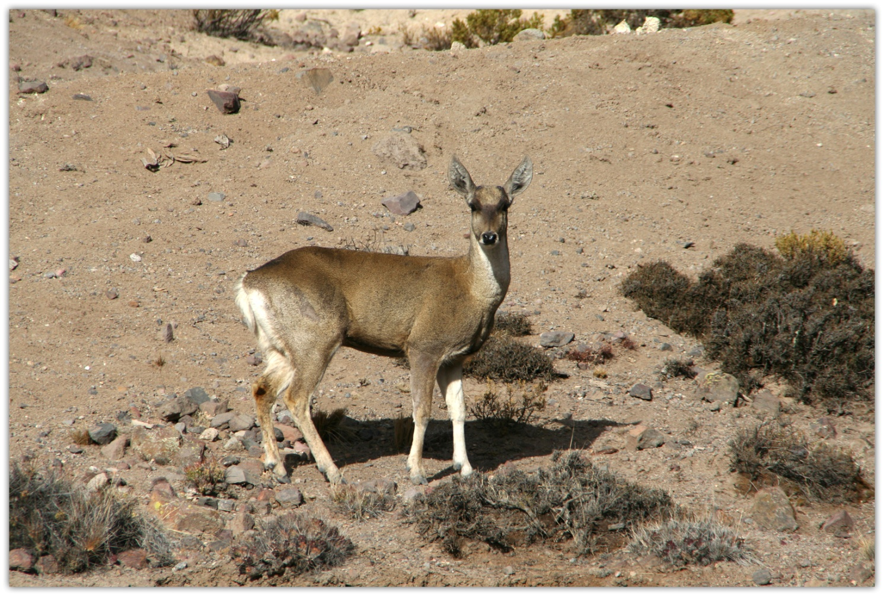
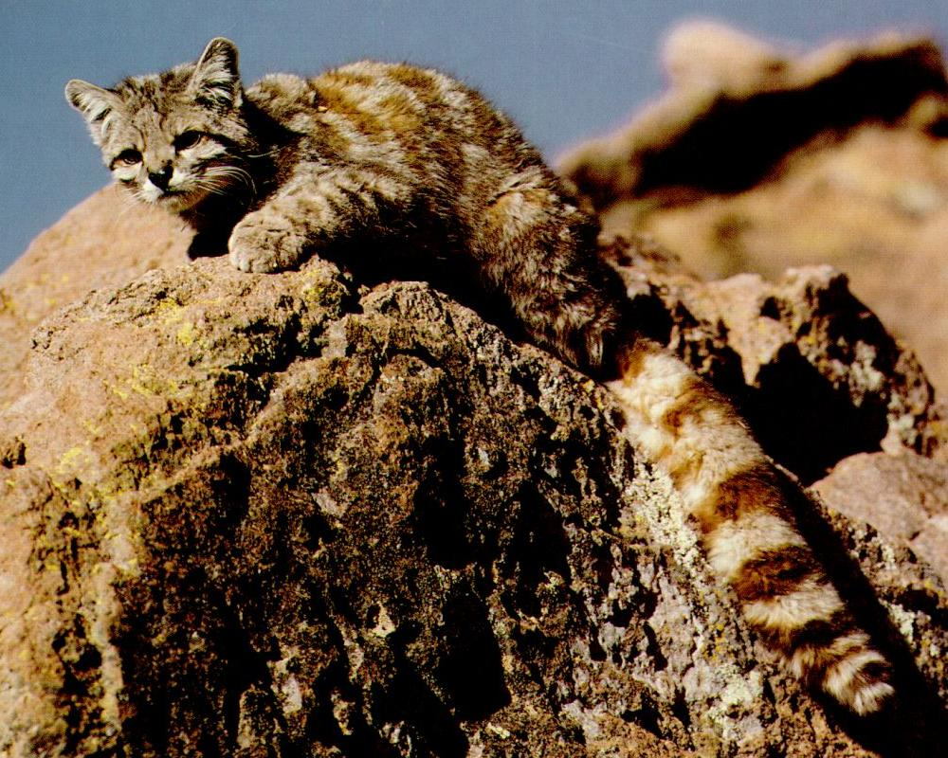

Slide 10
Zdroje
http://whc.unesco.org/en/list/420
http://www.8thingstodo.com/wp-content/uploads/2013/04/Laguna-Verde-Potosi.jpg http://www.common-place.org/vol-03/no-04/potosi/images/potosi.jpg
http://www.tiwy.com/pais/bolivia/potosi/calles/calle_chuquisaca.jpg
http://www.lideazeme.cz/files/imagecache/dust_filerenderer_big/files/upload/story_press/1851/083_001_jpg_48fc4ce5e1.jpg
http://media-cdn.tripadvisor.com/media/photo-s/01/7f/a6/64/potosi.jpg
http://www.globeimages.net/data/media/16/landscapes_of_potosi__bolivia.jpg
http://landofwinds.blogspot.sk/2011/12/quechua-area.html

Slide 11
Ďakujem za pozornosť ☺
Anna Pasternáková 2.C

