Slide 1
Slovakia castles
By anton uhrin & nikolas pomfy

Slide 2
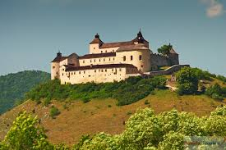
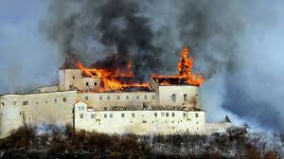
Krásna hôrka
8 km eastwards from Rožňava
above the Krásnohorské Podhradie village
since 1961 - Natural Cultural Monument
The first written mention - 1241

Slide 3
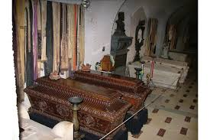
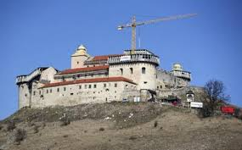
inhabited until 1812
last owner Andrássy
1902 – museum
Exhibitions of medieval and modern weapons, mausoleum, art museum
2012 – fire destroy half of castle

Slide 4
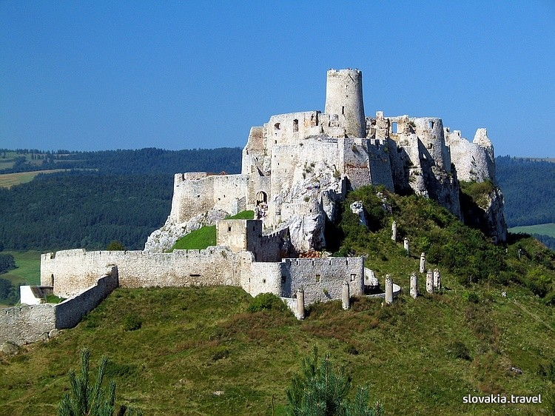
SpiŠ castle
The ruins of Castle are one of the largest in the central Europe
Area : 41 426 m²
above the town Spišské Podhradie and the village of Žehra
1993 – Unesco

Slide 5
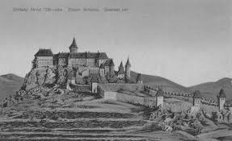
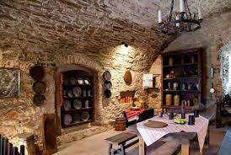
Built in 12th century
Last owners: csáky family
1780 – castle burned down – 3 theories
It was no longer occupied
Partly reconstructed in 20th century

Slide 6
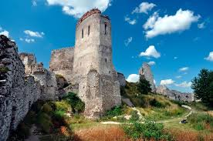
Čachtice castle
near village of Čachtice
declared a national nature reserve for rare plants
Residence and prison of the Countes Elisabeth Báthory
Bloody history

Slide 7
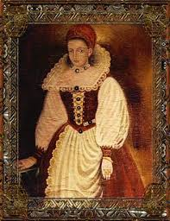
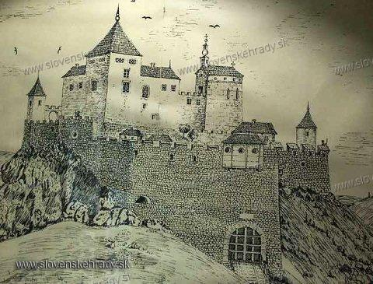
Built in late 12th century
by Kazimir from the Hont-Pázmány clan
last owner was elizabeth báthory
1772 – beginning of its end
Today there is just ruins providing wonderful view

Slide 8
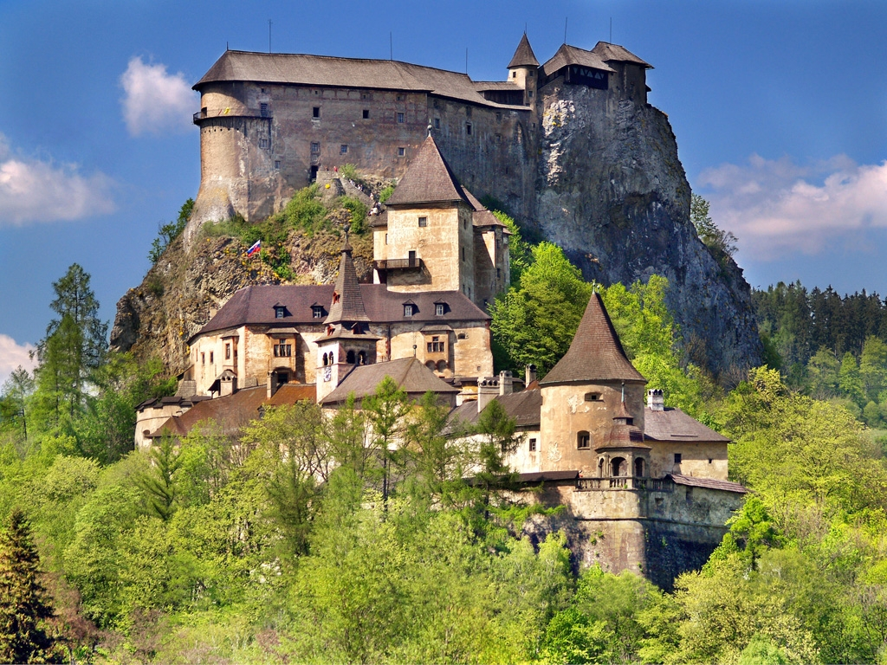
Orava castle
situated on a high rock above Orava river in the village of Oravský Podzámok
built in the Kingdom of Hungary in the 13th century
Scenes of film nosferatu (1922) was filmed here

Slide 9
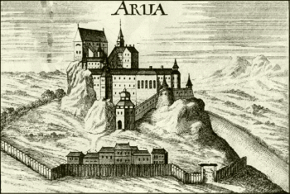
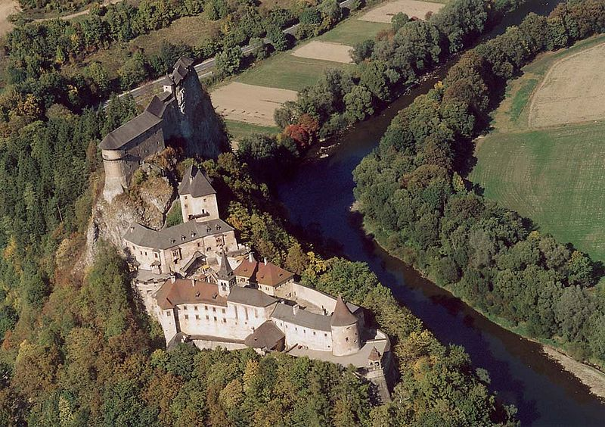
Thurzo family rebuilt it in 16th
In 1800 it burned down again
1861 reconstructed again
Nowadays it´s orava museum

Slide 10
sources
https://upload.wikimedia.org/wikipedia/commons/3/32/%C4%8Cachtice,_hrad,_Slovensko.jpg
http://image.slovenskehrady.sk/CachtickyHrad/CachtickyHrad_N_17.jpg
http://www.juhaszovak.estranky.sk/img/mid/7/bathory9.jpg
http://www.grandhotelspis.com/images/obr19.jpg
http://files.spissky-hrad.webnode.sk/200000026-bc0babd054/Spissky-hrad-z-lietadla.jpg
http://www.obcasnecas.ukf.sk/wp-content/2011/08/podobu-spisskeho-hradu-zachytil-v-roku-1720-neznamy-maliar-450x275.jpg
http://www.galeriaslovakia.sk/Upload/Image/Galeria/304/8181B.jpg
http://www.snm.sk/swift_data/source/muzeum_betliar/0/hrad_krasna_horka/interiery_hradu_kh/1/Rodinna%20hrobka.jpg
http://www.snm.sk/swift_data/source/muzeum_betliar/0/hrad_krasna_horka/interiery_hradu_kh/1/Rodinna%20hrobka.jpg
http://www.slovakia.com/photos/photographer/13/1342436751_foto_web_castle_orava_P5034336C.jpg
https://en.wikipedia.org/wiki/Orava_Castle
http://infovekacik.sk/2008-december/mesta/historia.gif
1

Slide 11
Thanks for attention

