Slide 1
CAVES IN PREŠOV REGION
By: Anton Uhrin II.C

Slide 2
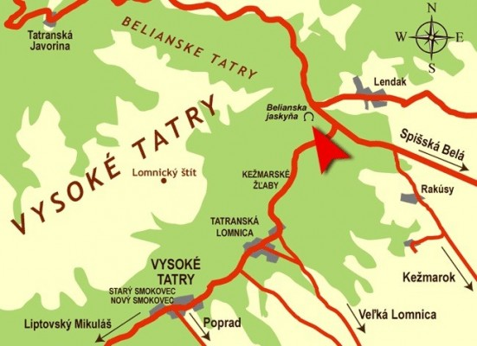
THE BELIANSKA CAVE
BASIC INFORMATION
District: Poprad
Average temperature: 5 – 7 °C
Lenght: 3 829 m
Depth: 168 m

Slide 3
The largest and the only one open to the public in the Tatras
Belongs among the most visited caves
It is located near the village of Tatranská Kotlina
The cave was discover in the 18th century
It was opened in 1884 and electrically lit in 1896

Slide 4
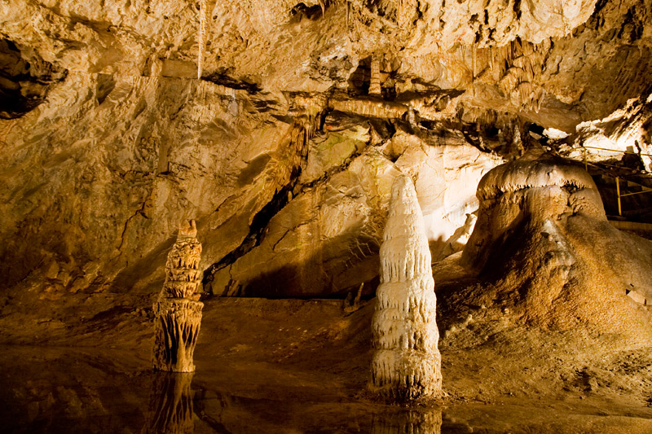
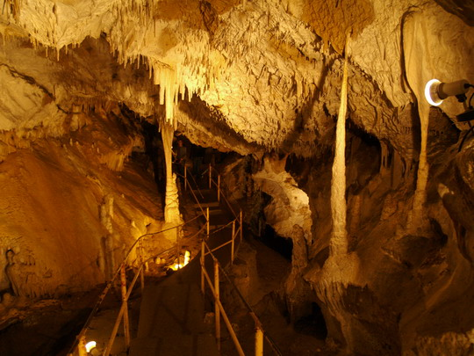

Slide 5
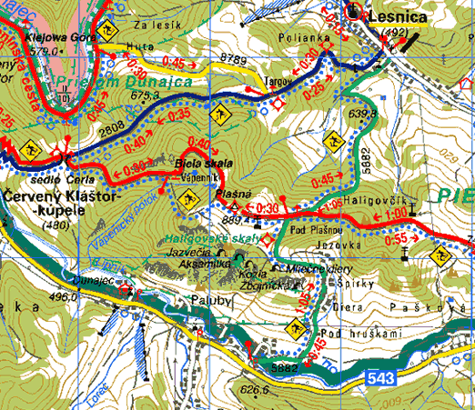
THE AKSAMITKA CAVE
Is national natural monument in Pieniny national park
Located near the village of Haligovce (district of Stará Ľubovňa)
Declared in 1979
Length is around 300 m
This cave is not available for tourists
There is an archeological site

Slide 6
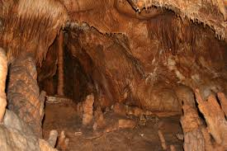

Slide 7
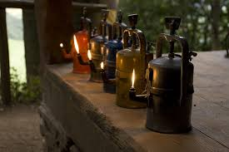
THE CAVE ZLA DIERA
Located near the village of Lipovce
Cave is unique for very sensitive way of acces into – visitors have to use helmets
There is not electricity in the cave – visitors use traditional carbid lamps or their own flashligts
Basic route is not physically strenuous so it´s suitable for children and older people (the youngest visitor had 6 weeks a the oldest 84)
You must wear trekking shoes and warmer clothes – average temperature is 5 °C

Slide 8
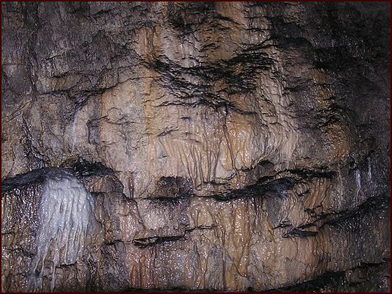
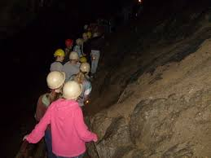
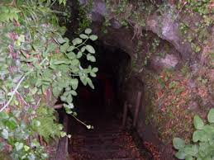

Slide 9
SOURCES
http://www.go2slovakia.eu/photos/medium/16c6881515371cf77e11ff8a5a3636f2.jpg
http://www.vysoketatry.com/chodniky/vt28/vt28m.jpg
http://fotobanky.kukucka.cz/wpimages/foto/mDSC_4868.jpg
http://www.mountain.sk/uploads/media/451/10.jpg
http://www.pieniny.sk/mapy/hskaly/hskaly.gif
http://hiking.sk/article/images/large_x/lesnicke_sedlo_16.jpg
http://img.topky.sk/cestovky/big/259605.jpg/jaskyna-aksamitka0.jpg
http://blog.sme.sk/blog/6420/102368/S6300089.JPG
http://3.bp.blogspot.com/-JTMkkkMygd4/Tlzz81gFheI/AAAAAAAAAJg/xDgq4owc76w/s1600/sueart_dov_2011_blog_3.jpg
http://blog.sme.sk/blog/6420/102368/S6300062.JPG
http://blog.sme.sk/blog/312/68690/0014.jpg

Slide 10
Thanks for Watching

