Slide 1
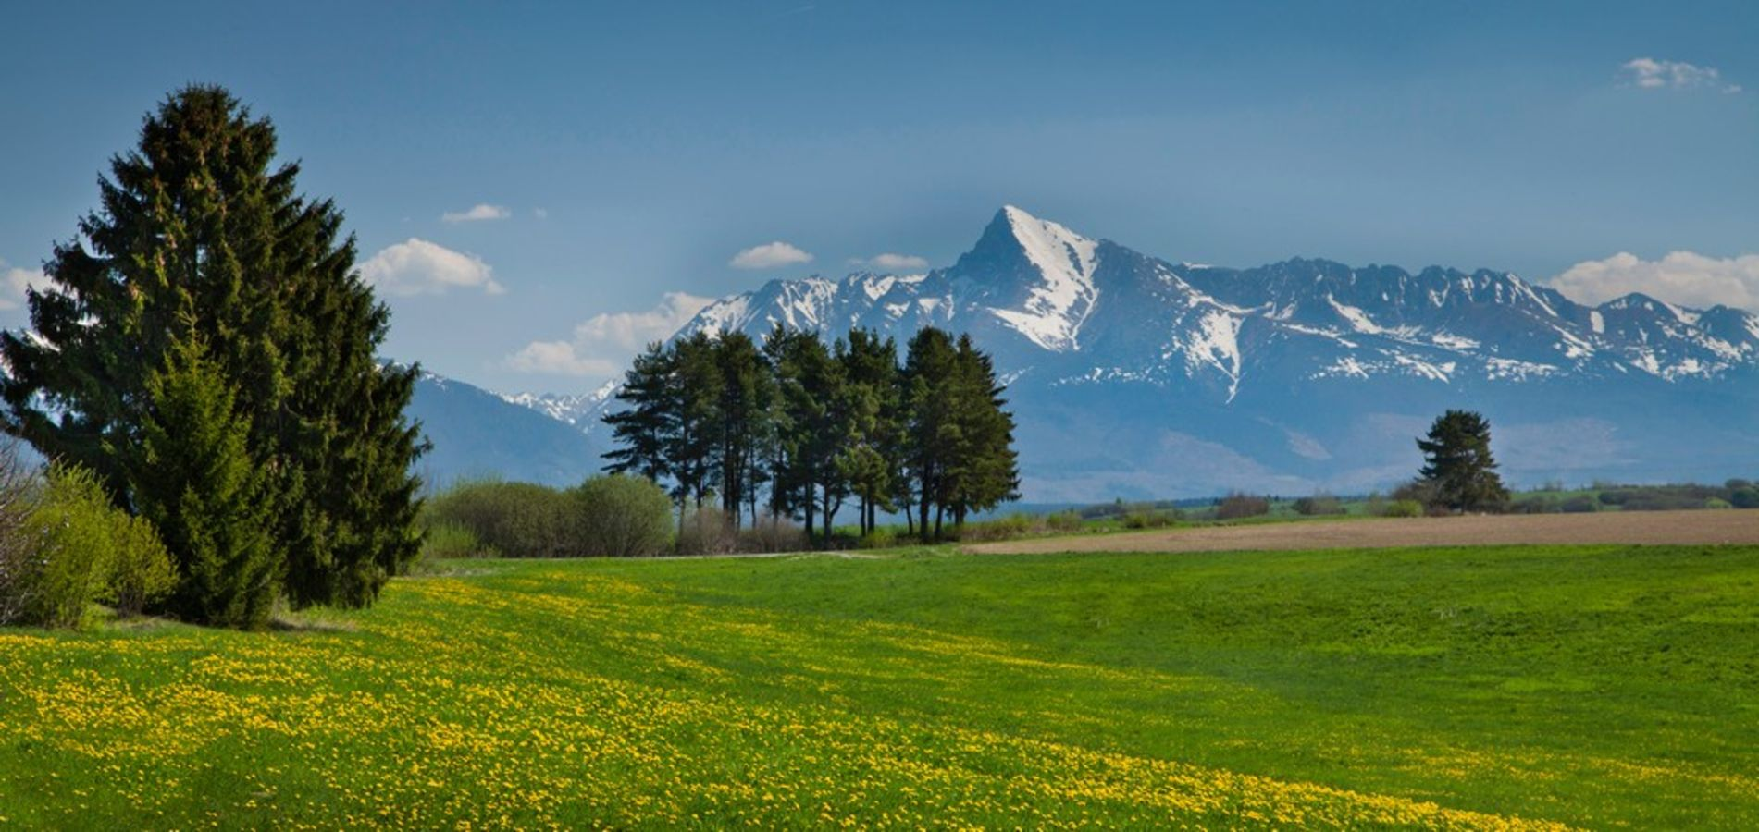
TATRAS

Slide 2
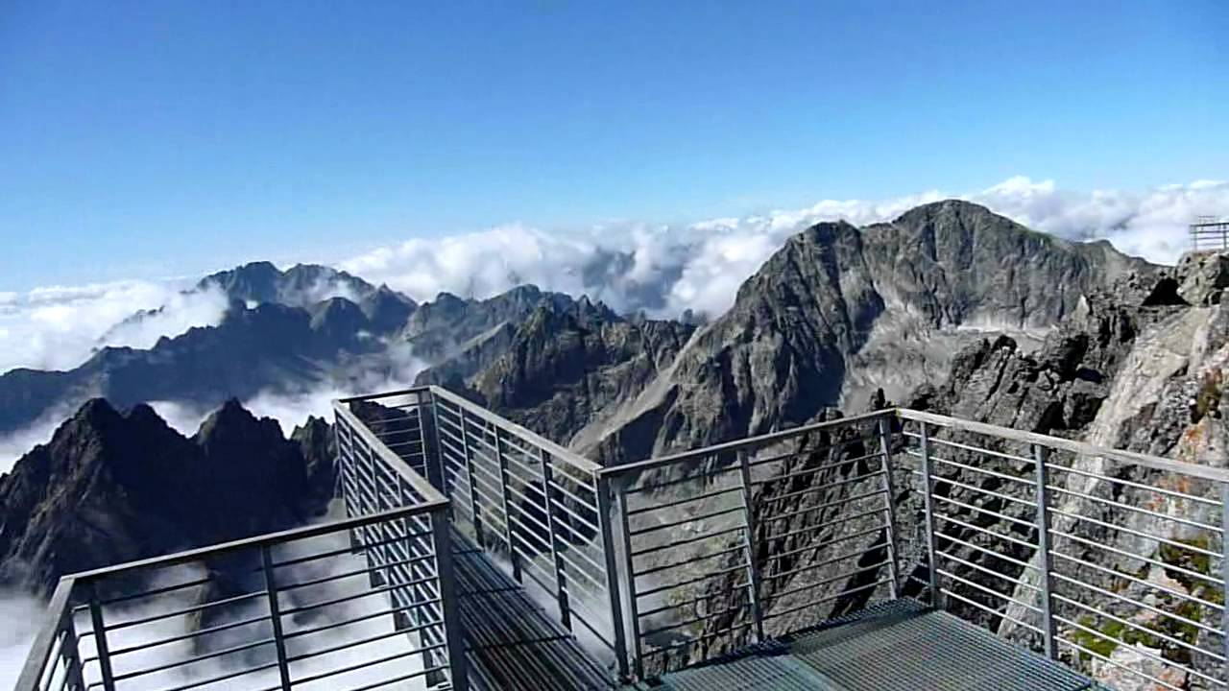
LOMNICKÝ ŠTÍT

Slide 3
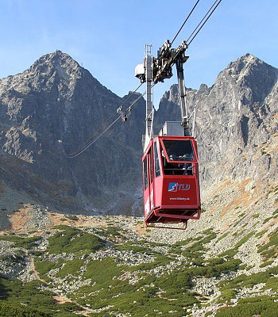
2633 meters above sea level
High Tatras
Second highiest pike
First ascent Jakub Fábry (1770)
First recorded ascent English traveler Robert Townson (1793)
Beautiful view at surrounding areas

Slide 4
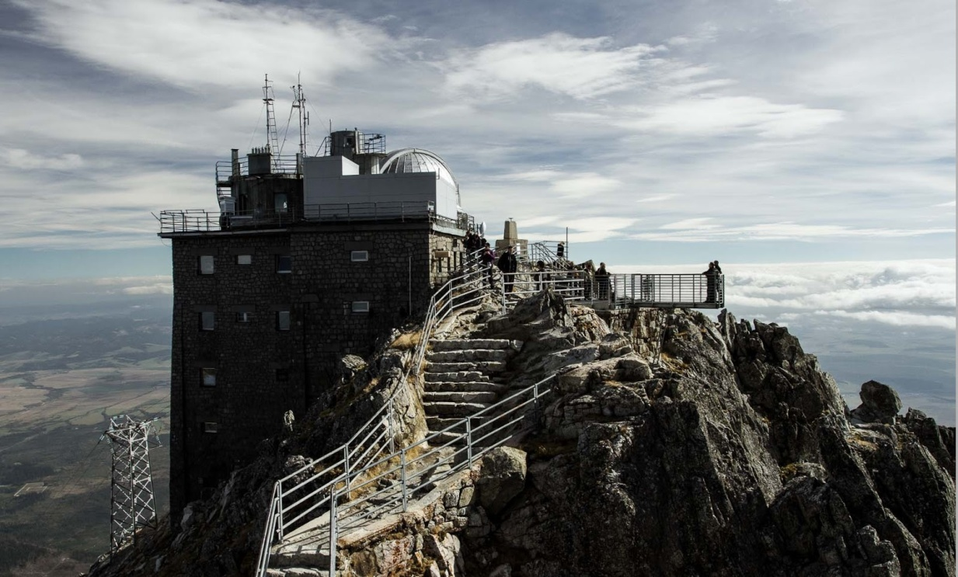
Observatory
Astronomical, meteorological station
Since 1940 cable car system
27 € from Skalnate pleso
50 minutes
Travel guide
4 hours

Slide 5
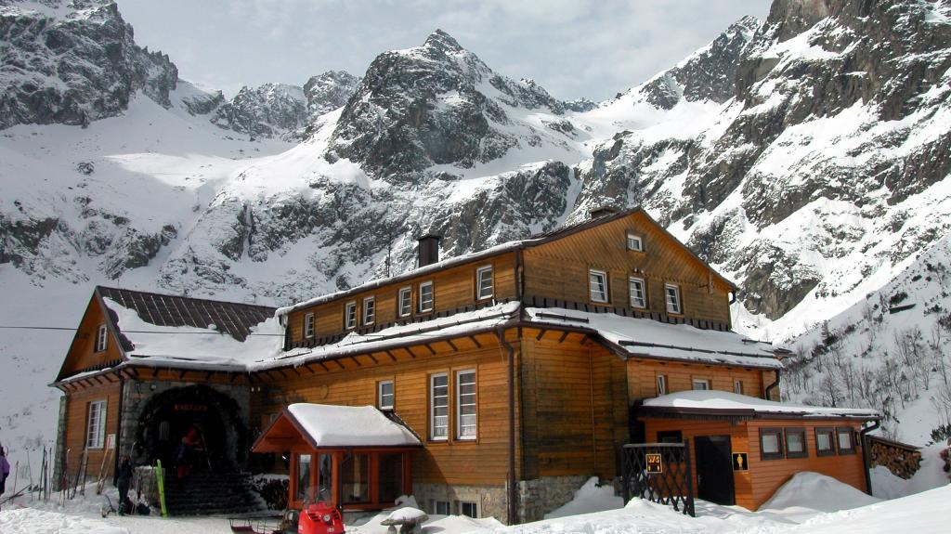
DOLINA ZELENÉ PLESO

Slide 6
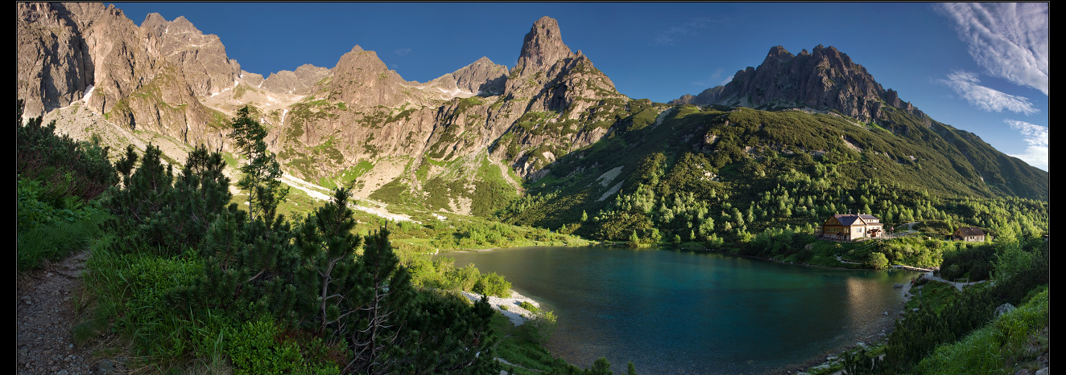
High Tatras
Zelené pleso
1545 meters above sea level
1,78 ha, 4,5m deep
Cottage near Zelené pleso (1551mnm)
15 € per night
Biela voda (autobusová zastávka) - rázcestie pri Šalviovom prameni (1 100 m n.m.) - Chata pri Zelenom Plese (1 551 m n.m.) - Jahňací štít (2 230 m n.m.)

Slide 7
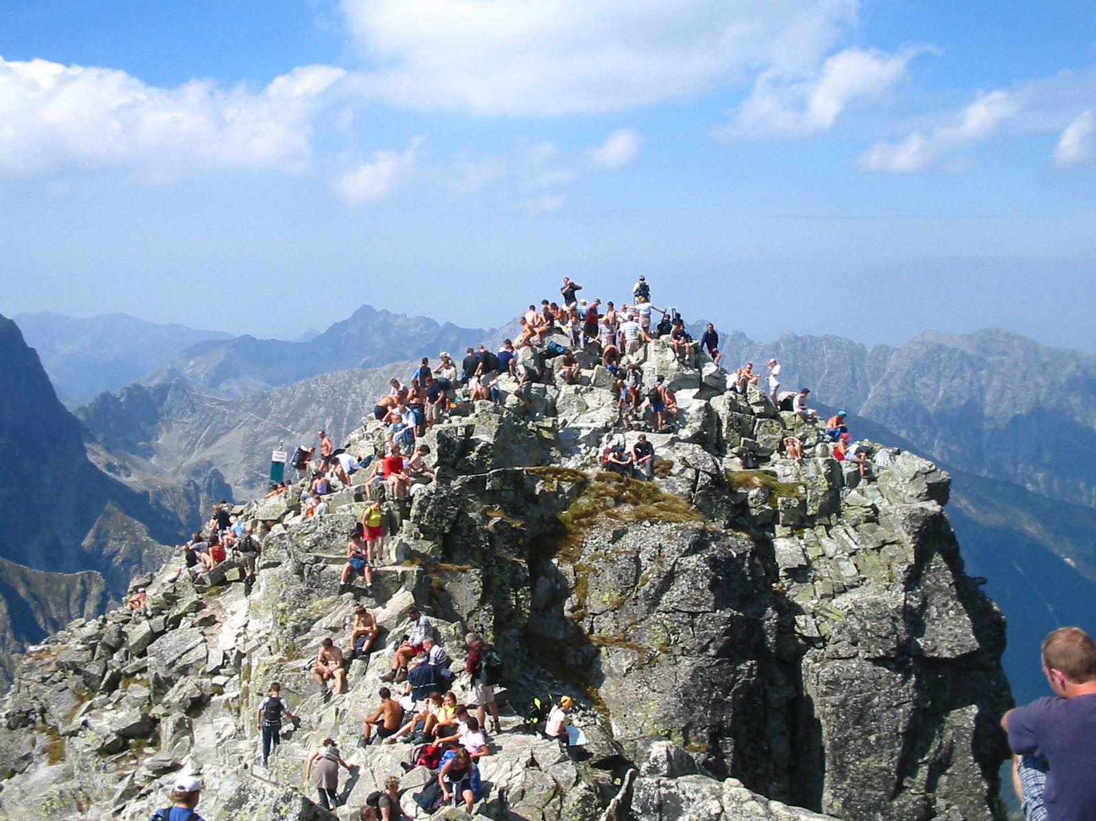
RYSY

Slide 8
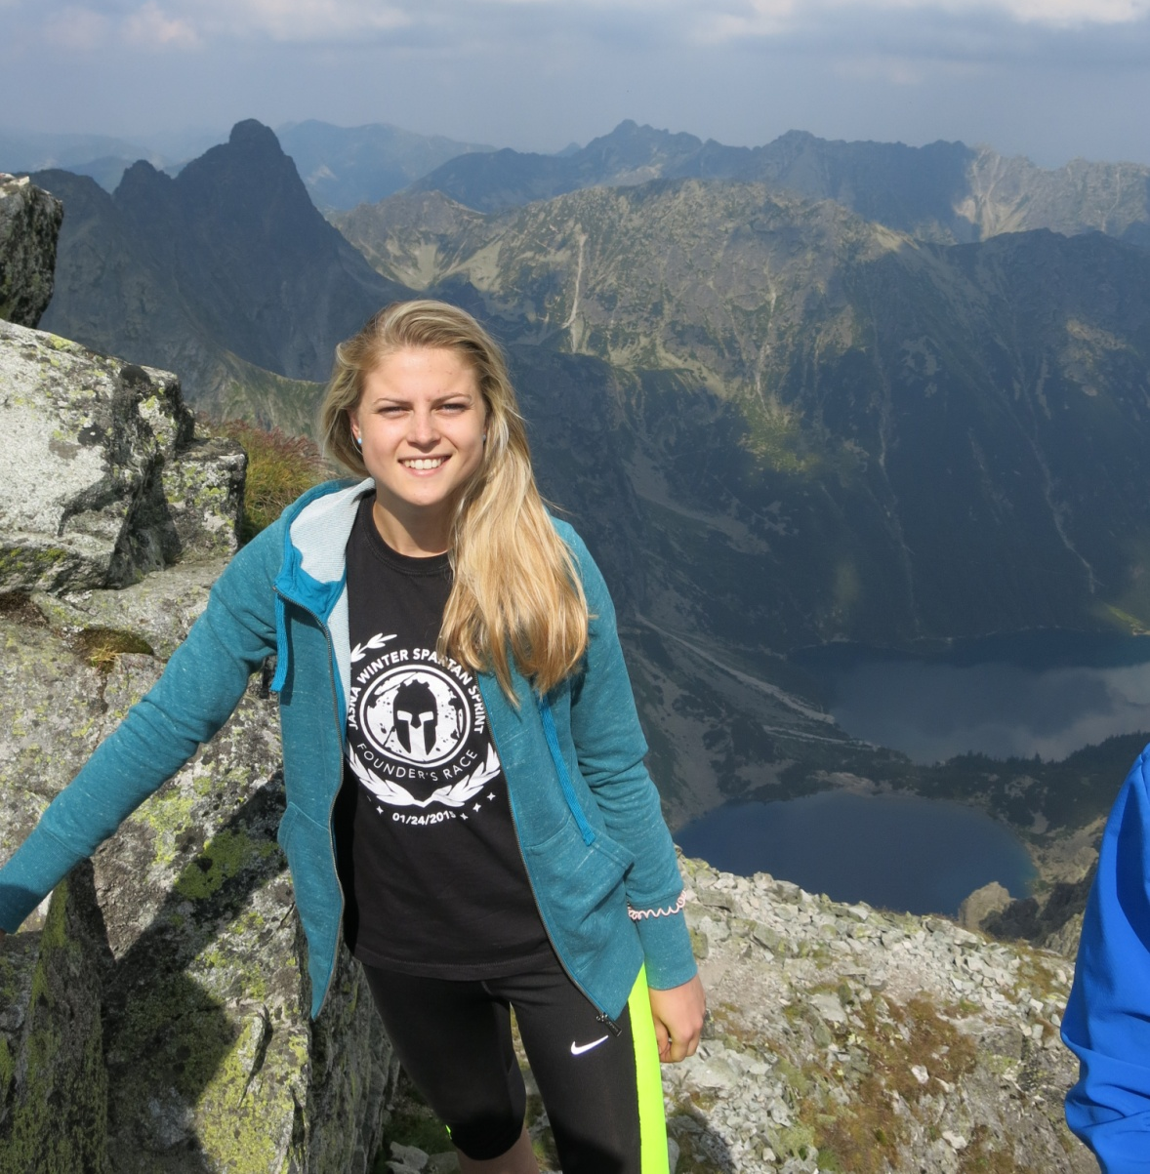
2499 meters above sea level
High Tatras
Slovak-poland border
The highiest situated cottage (2250 meters above sea level)
15 € per night with brekfast
Beautiful view
First ascent Eduard Blásy
4,40 hour
Chains, big stones
Physically demanding
Štrbské Pleso (1 350 m n.m.) - Popradské pleso (1 500 m n.m.) - rázcestie nad Žabím potokom - sedlo Váha (2 340 m n.m.) - Rysy (2 499 m n.m.)

Slide 9
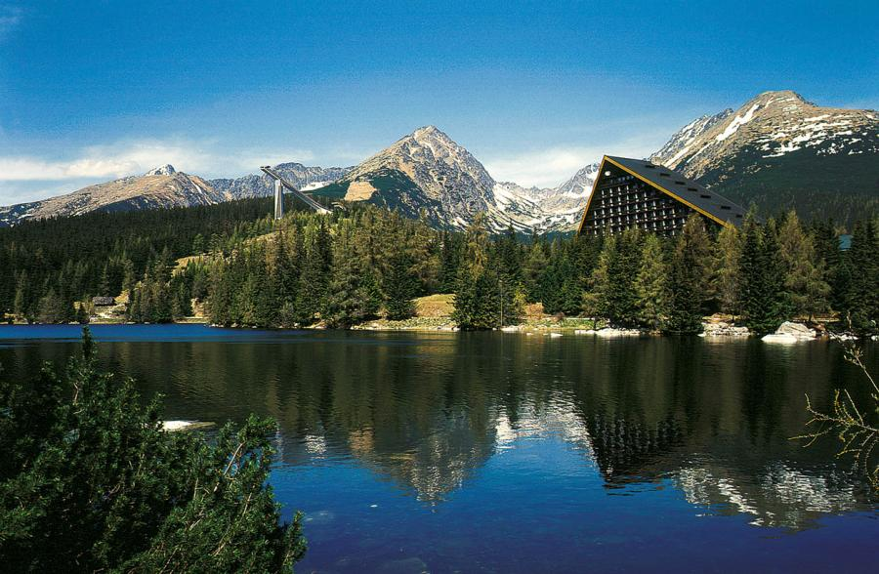
ŠTRBSKÉ PLESO

Slide 10
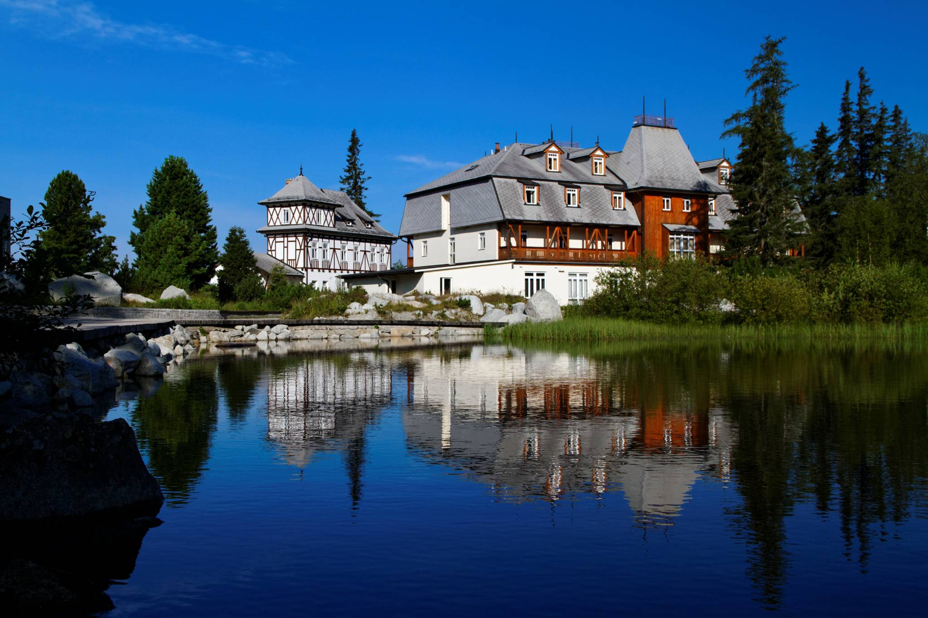
Popular ski and tourist center
High quality of acommodation, services
Skiing opportunities – ski slopes
Lovers of winter sports – cross-country trail
Hiking, walks in summer

Slide 11
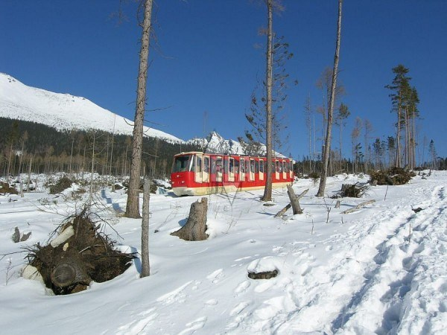
Funiclar railway
Trails: green, yellow, blue, red
Bilikova chata
Cold Creek Waterfalls
Zamkovskeho chata

Slide 12
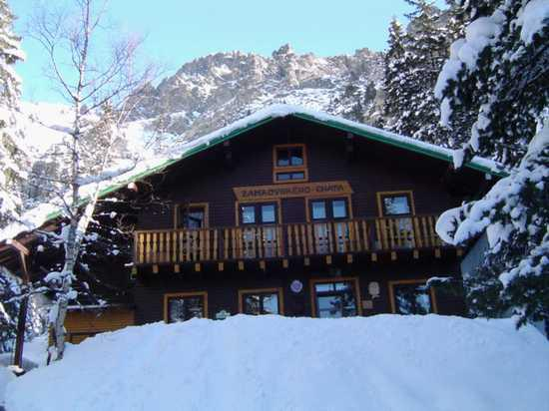
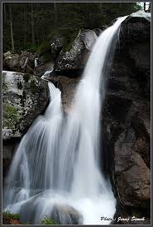

Slide 13
http://www.vt.sk/zazitky/vylety-lanovkami/hrebienok/ http://www.strbskepleso.eu/ http://www.vysoketatry.com/ciele/rysy/rysy.html http://www.enjoyzazitky.sk/vystup-na-lomnicky-stit/?gclid=COu8goermswCFQmNGwodayABCA Resources

Slide 14
THANK YOU FOR WATCHNG
Barbora Lučanová, Tatiana Kravcová

