Slide 1
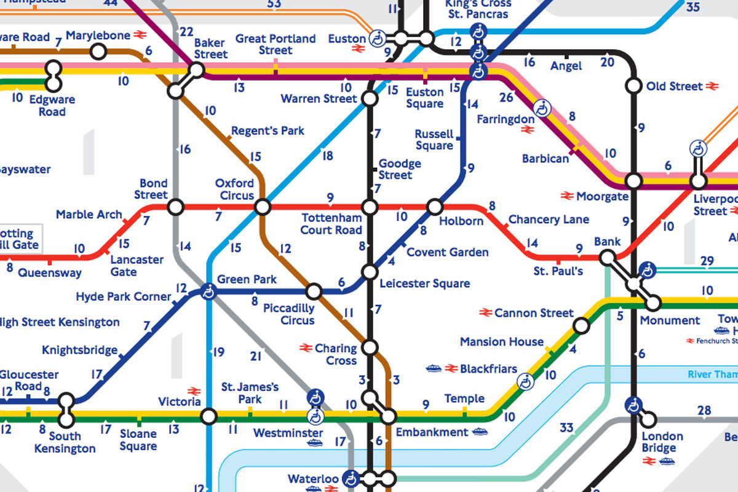
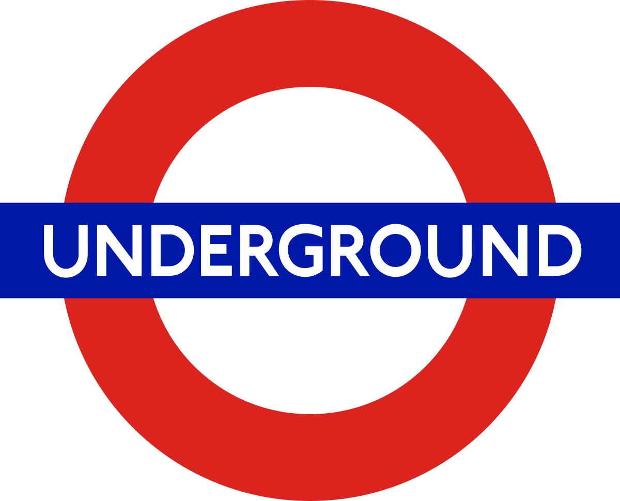

Slide 2
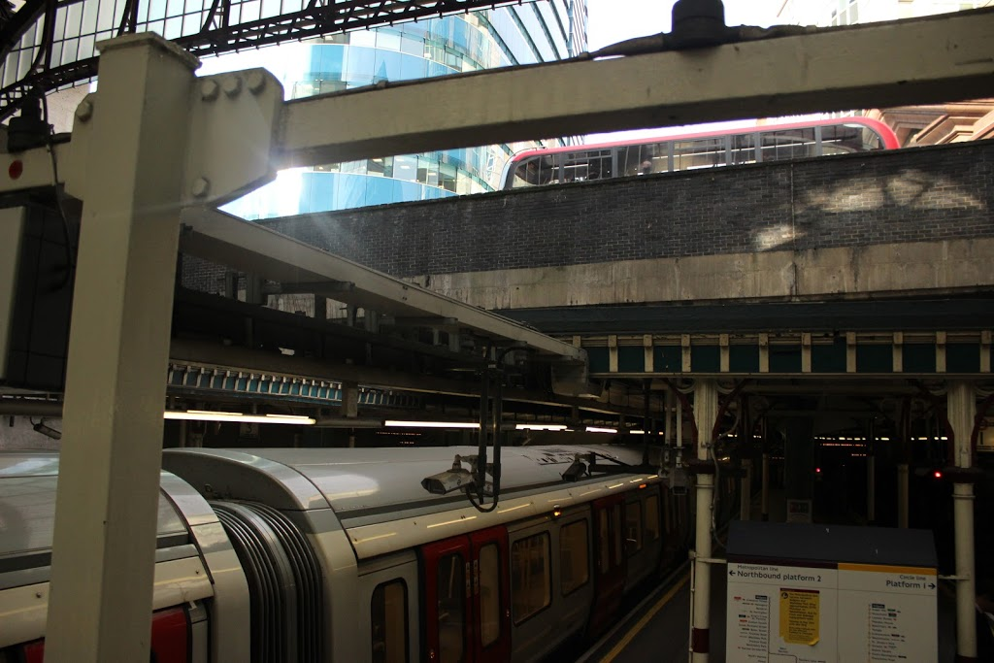
11 lines
270 stations
5 milion people daily
402 km
100 km/h
426 escalators and 184 lifts

Slide 3
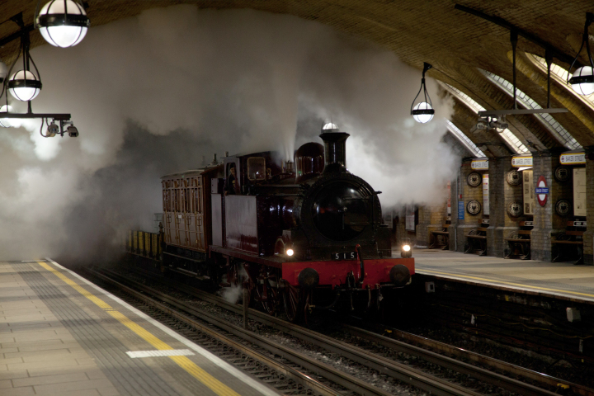
History of underground
1.Steam locomotives

Slide 4
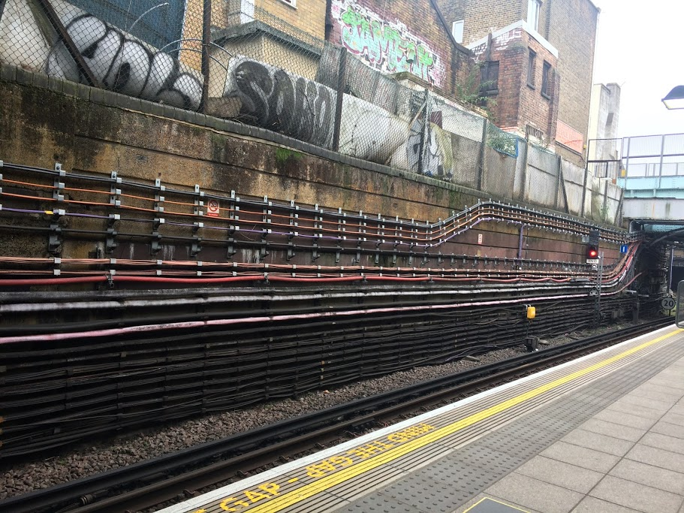
2.Railway electrification

Slide 5
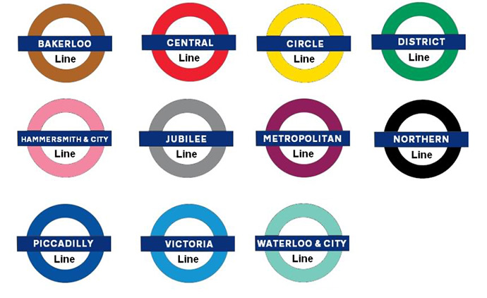
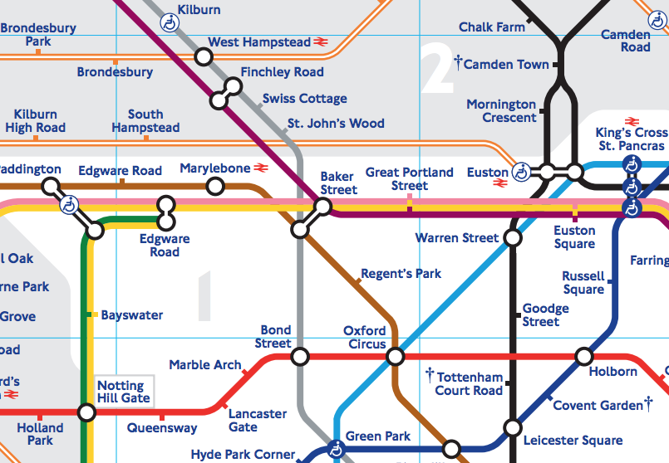
Lines
First line – Metropolitan - 1863
Lenght: 1. Central line – 74 km
2. Picadilly – 71 km
3. Metropolitan – 60 km

Slide 6
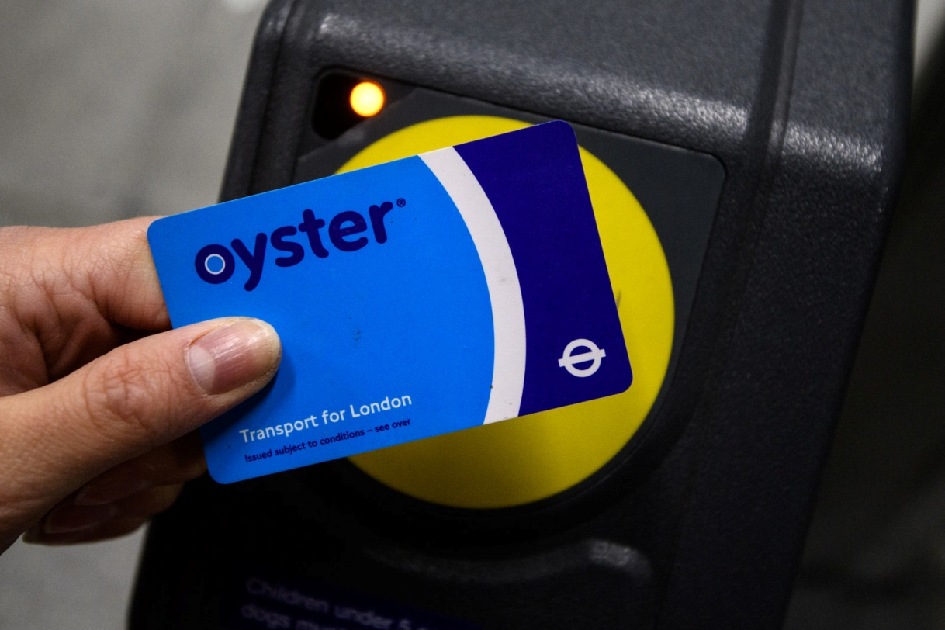
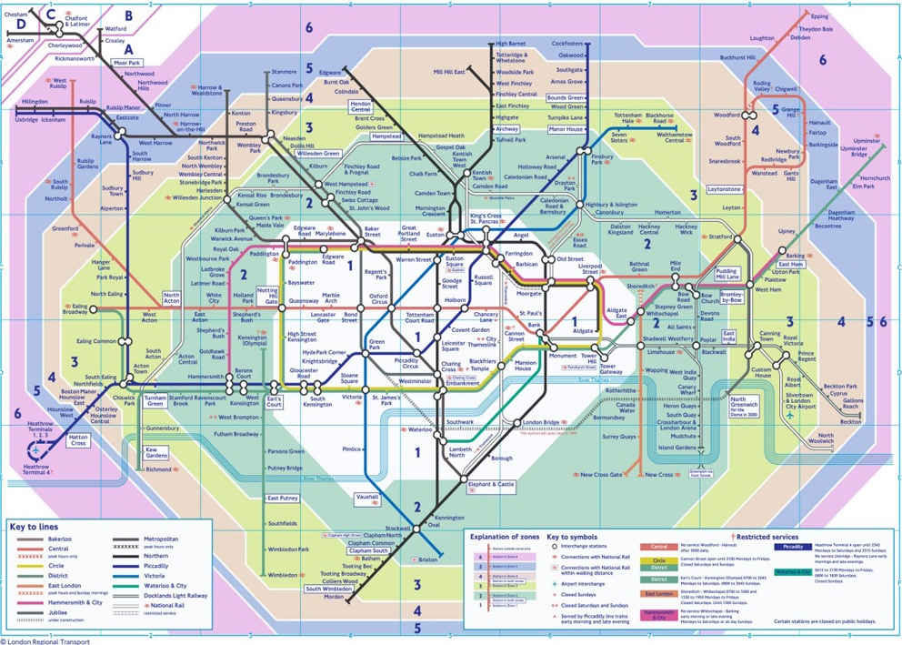
Fare
Zonal fare system: 6 main zones
Oystercard
Travelcard

Slide 7
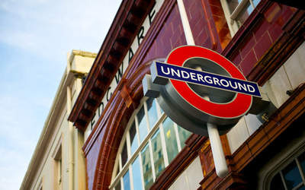
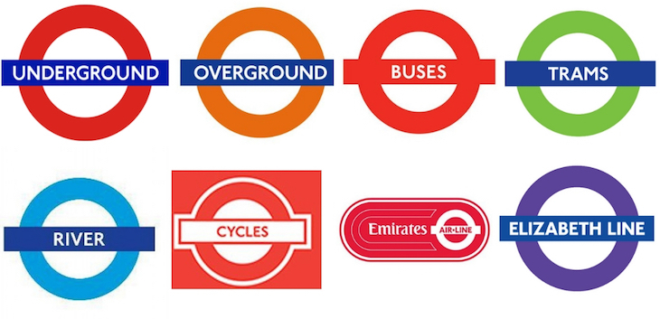
Roundel
one of the most recognised and imitated logos in the world

Slide 8
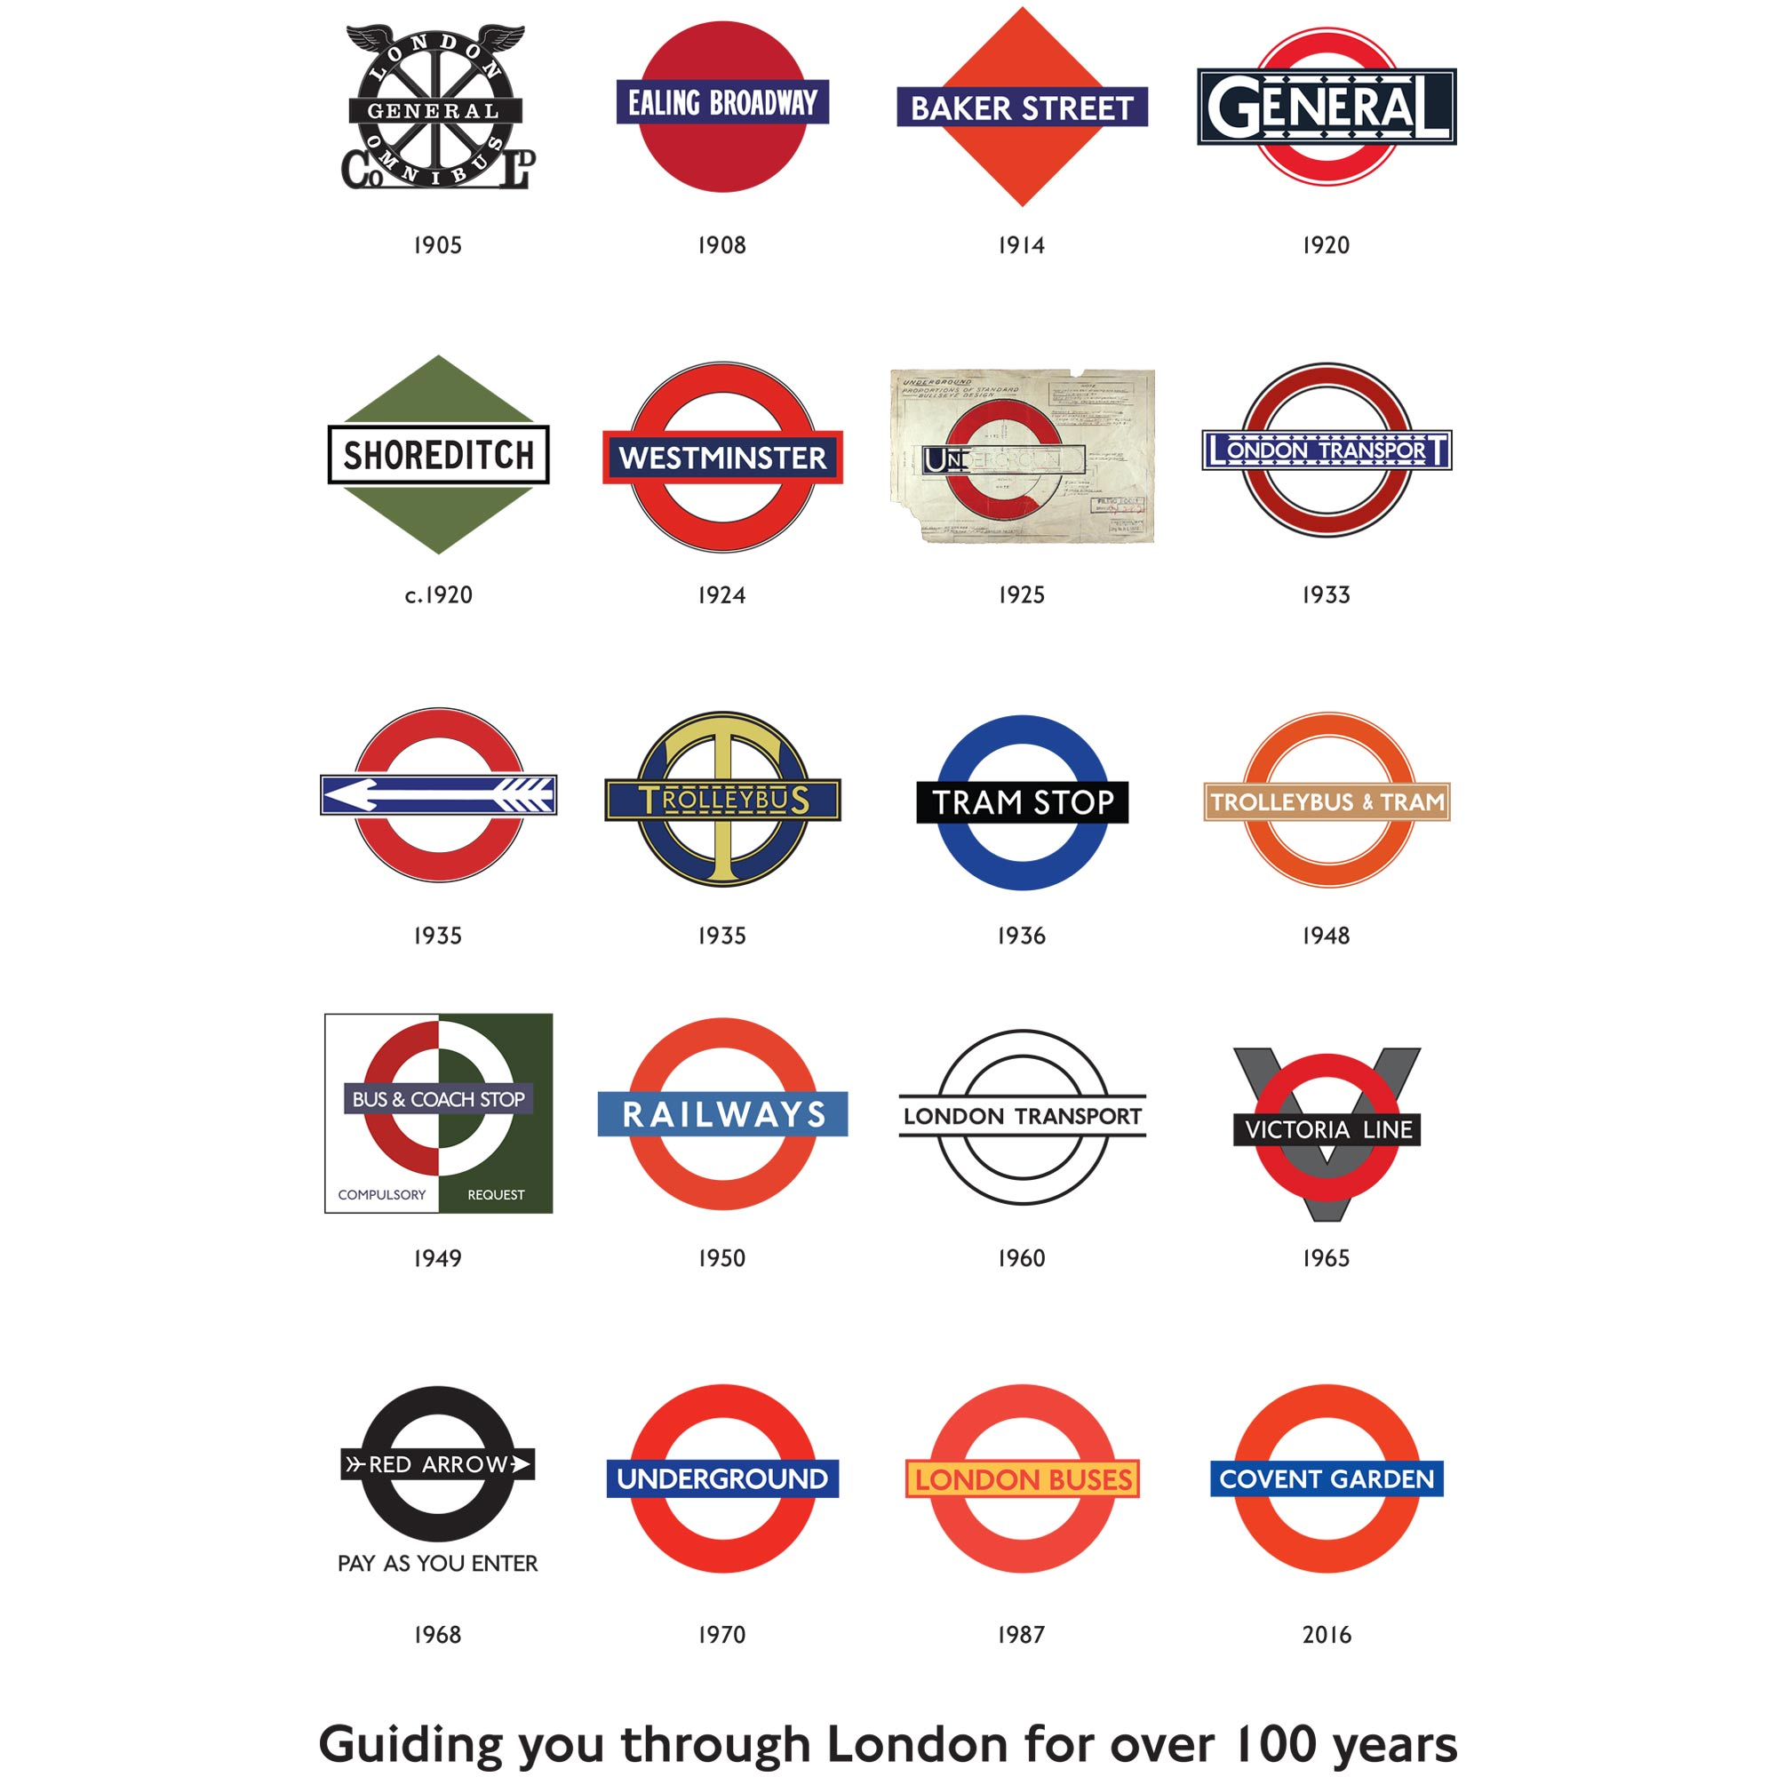

Slide 9
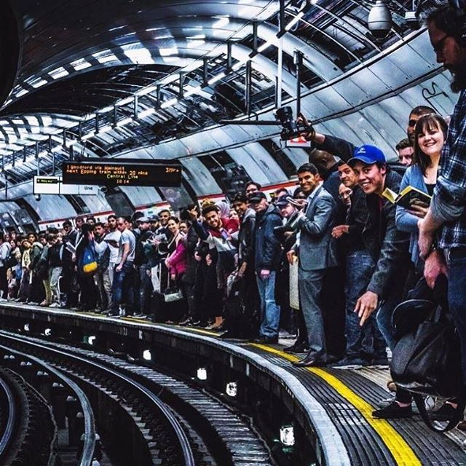
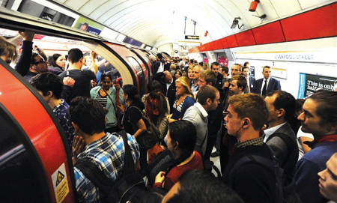
Delays and overcrowding

Slide 10
THANK YOU FOR YOUR ATTENTION!
Bianka Müllerová 3.B

