Slide 1
Prešov hockey and football
Jakub Bizub & Maroš Kačmár
II.E

Slide 2
1.FC Tatran Prešov
1. FC Tatran Prešov is a Slovak professional football club
25 May 1898
Notes:
Oldest football club in Slovakia

Slide 3
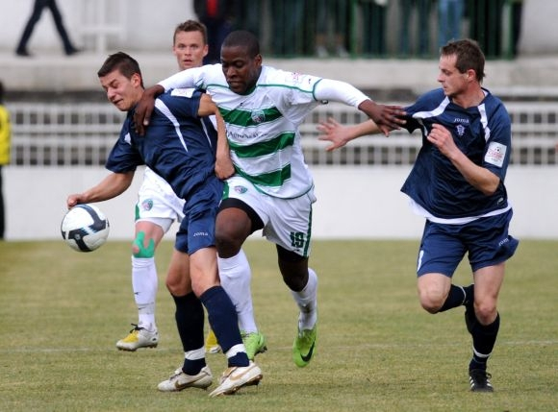
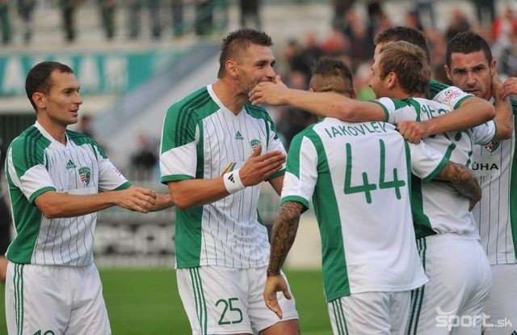
Never won anything
Biggest rivalities with MFK Košice
One of the richest clubs in Slovakia

Slide 4
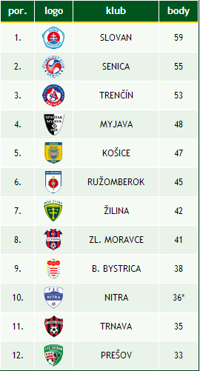

Slide 5
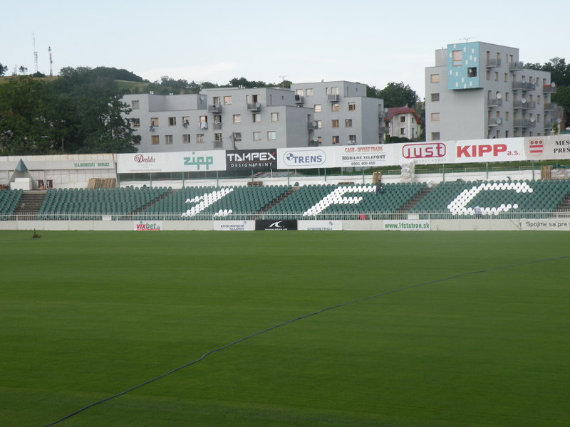
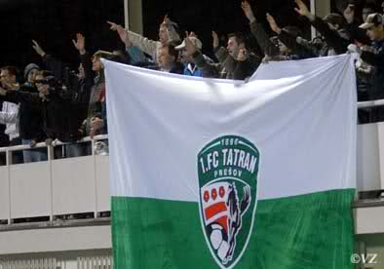
Stadium
5410 seats
Bombed in 1945

