Slide 1
Caves in Slovakia
Michal Čirip

Slide 2
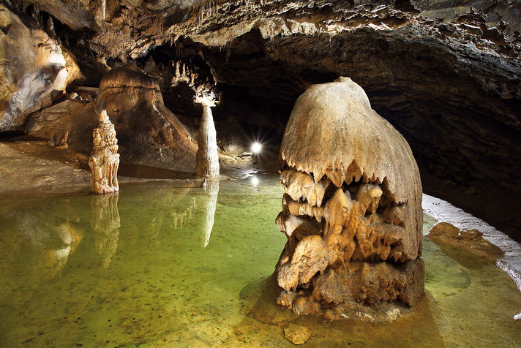
Belianska cave
only one accessible to public in the Tatras
the cave entrance is at an altitude of 890 metres above sea level
cave was lighted in 1896
sinter waterfalls, stalagmites, little lakes, Music Hall

Slide 3
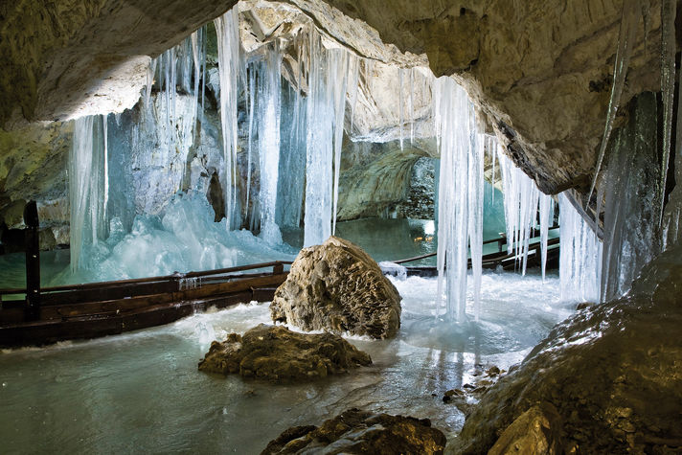
Demänovská ice cave
in the Demänovská valley
second largest ice cave in Slovakia
known since the Middle Ages, first reference to it is from 1299
four floors with a total length of 2.5 km
it was called the Dragon Cave

Slide 4
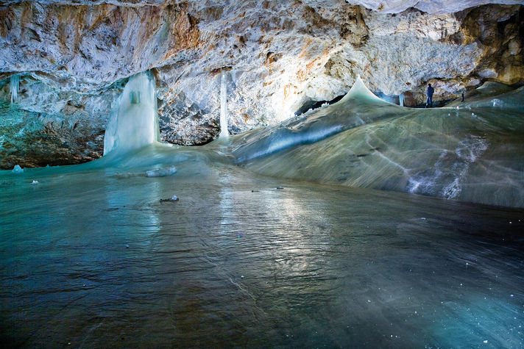
Dobšinská ice cave
in the Slovak Paradise, one of the largest ice caves in Europe
entrance is in 971m
1,232 m long, 112 m deep, 26m deep ice in the Grand Hall
bulgarian Tsar and the King of Serbia visited it in 1890

Slide 5
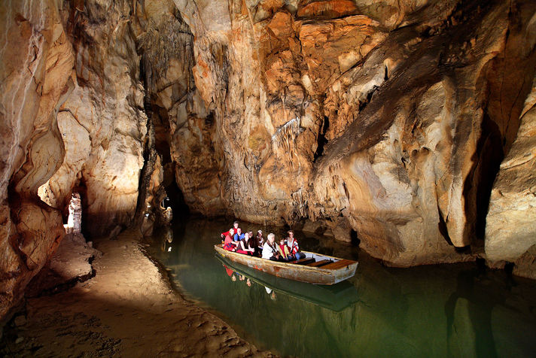
Domica cave
in the Slovak karst
cave offers boat trip on underground river Styx
cascaded lakes called the Roman Baths
Salt above Gold
the cave is part of the largest cave system in Hungary with total length of 25 km

Slide 6
Thanks for your attention

