Slide 1
Cities of Prešov Region

Slide 2
Content
Poprad
The High Tatras
Bardejov
Bardejov Spa

Slide 3
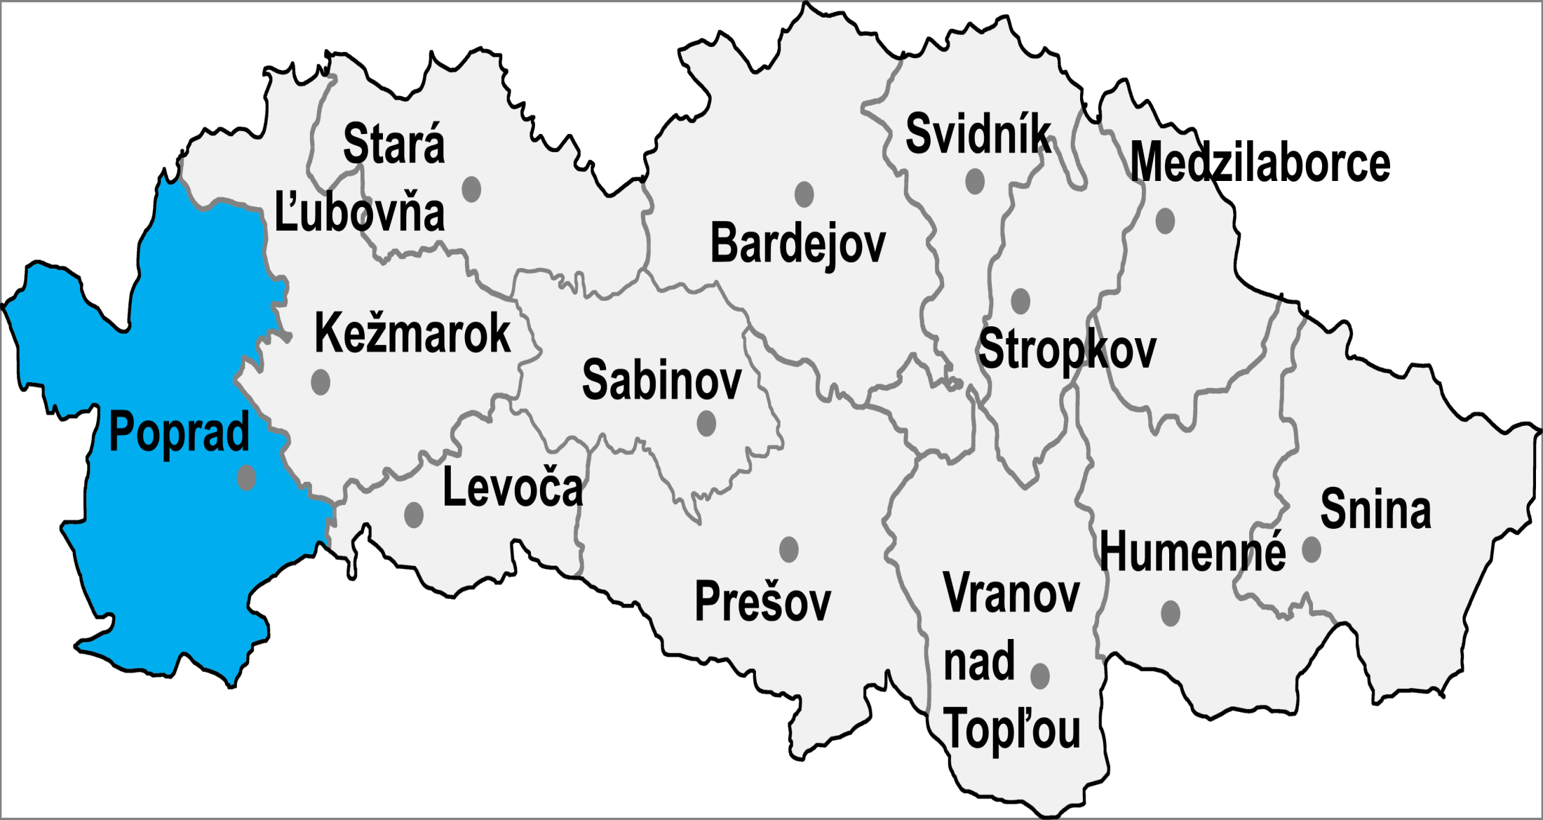
Districts

Slide 4
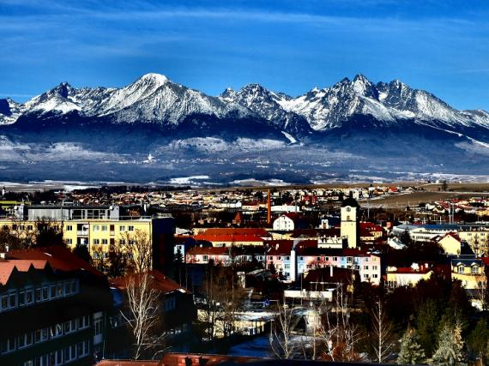
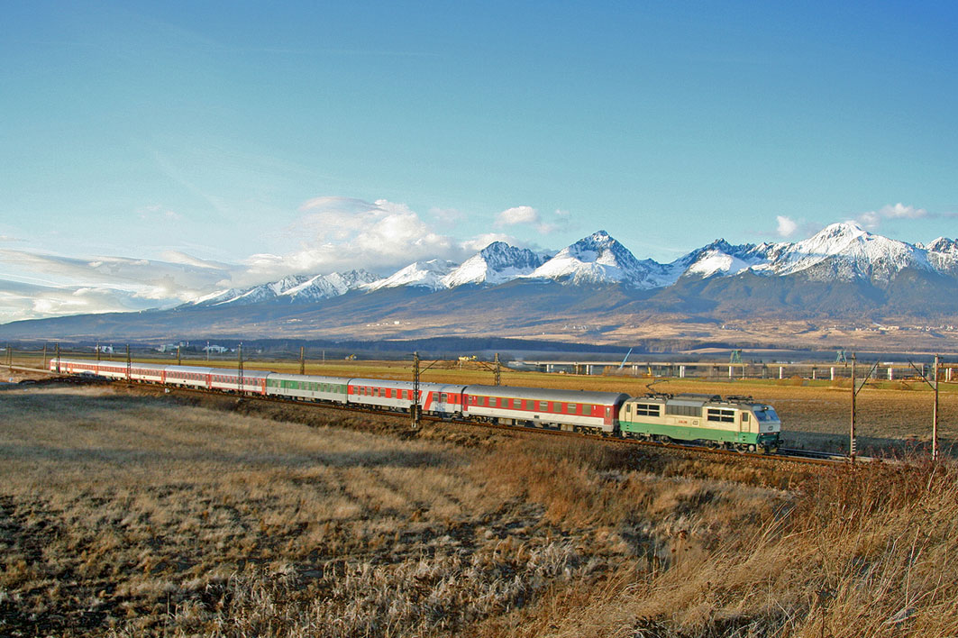
Poprad
10th biggest town in Slovakia
the third biggest town of East Slovakia
„gateway to High Tatras“
53 000 inhabitants
the first written mention ̶ from 1256
attractions

Slide 5
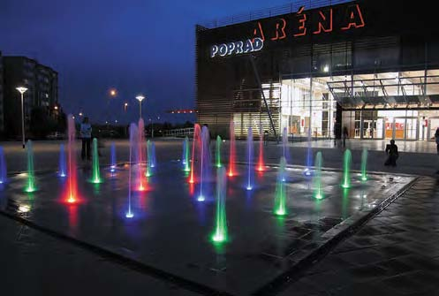
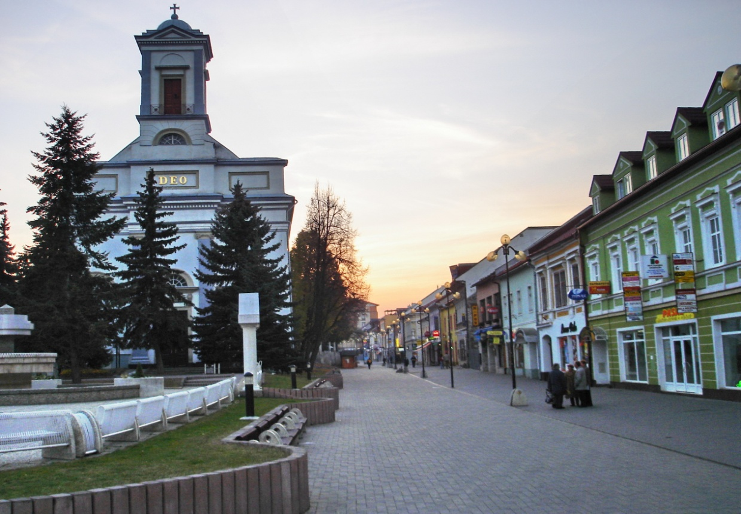
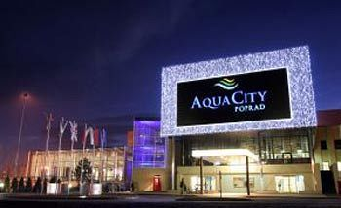
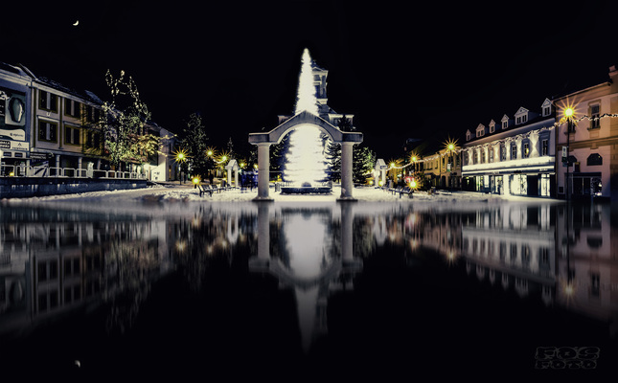
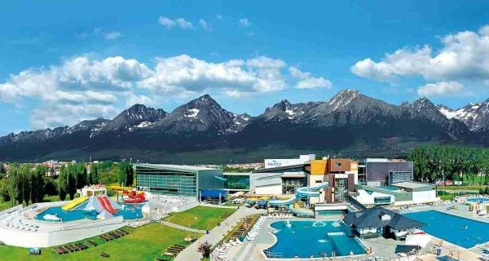

Slide 6
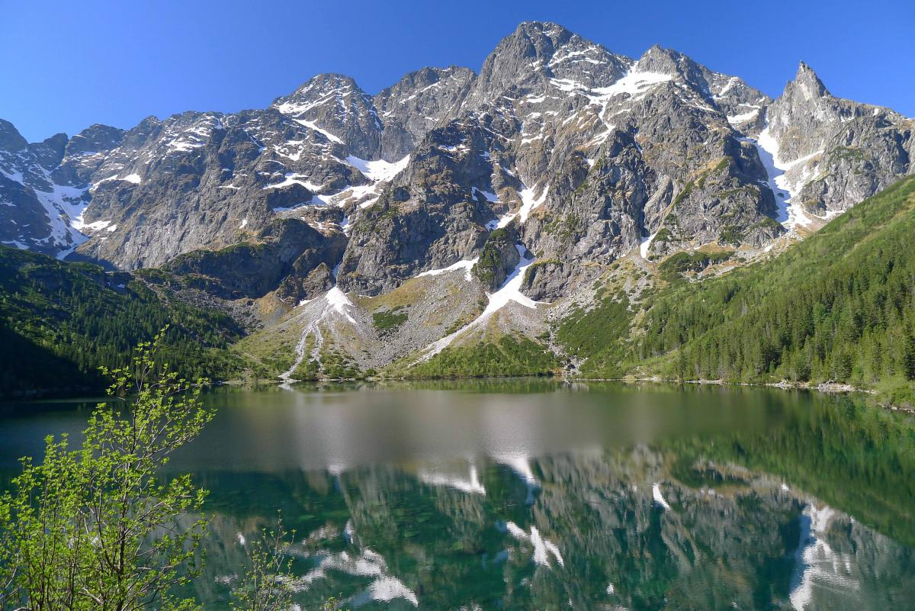
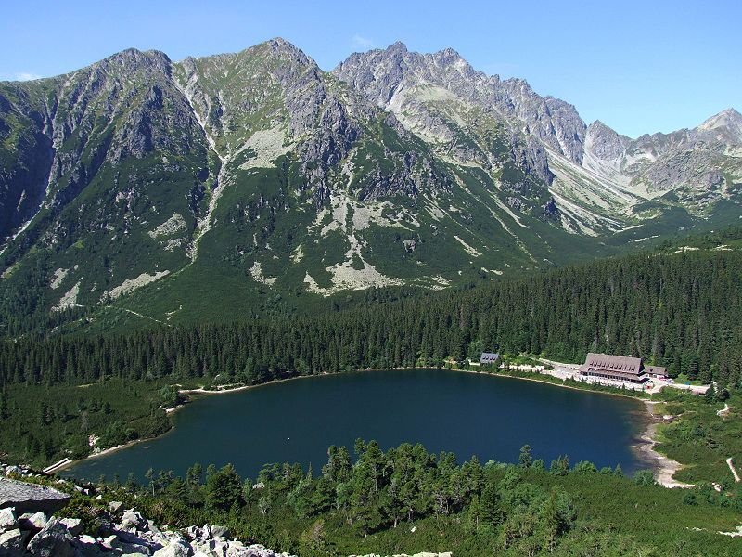
The High Tatras
small mountains in the northest part of Slovakia, on the Slovak-Polish frontiers
The highest Tatra peak is the Gerlach peak
unique plants and animals
Štrbské Pleso
Starý Smokovec

Slide 7
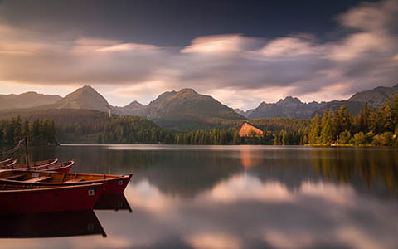
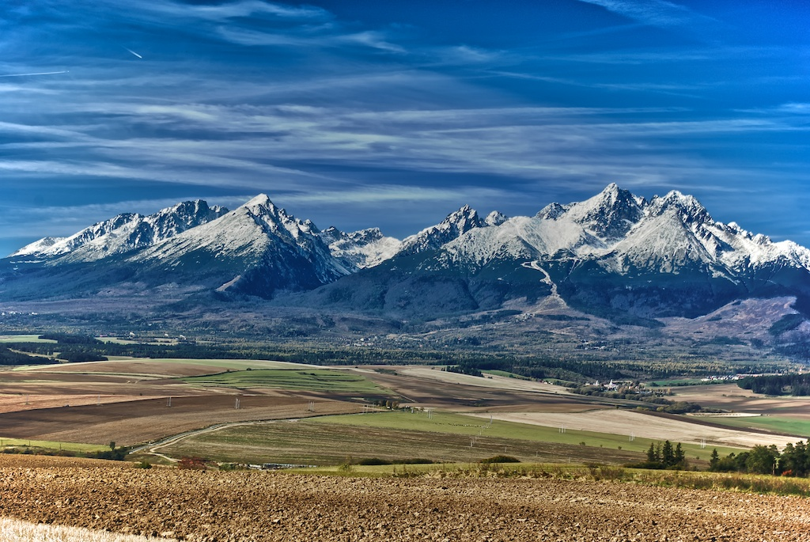
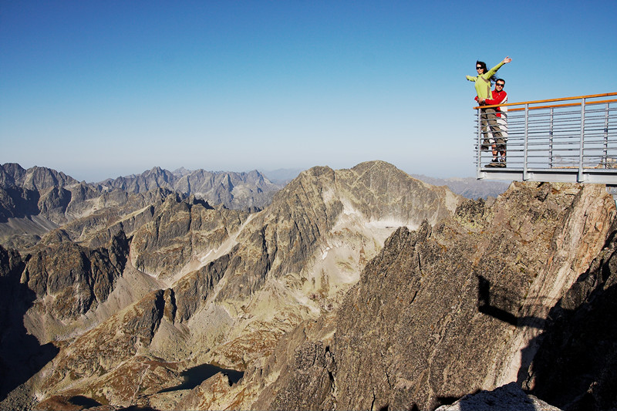
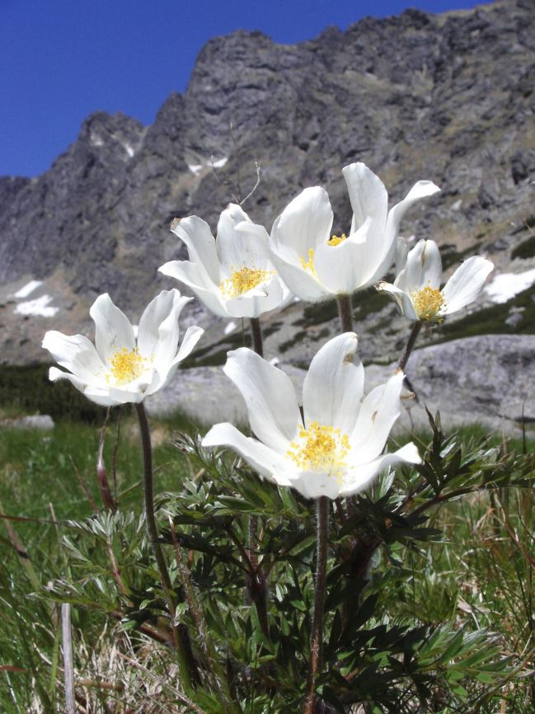

Slide 8
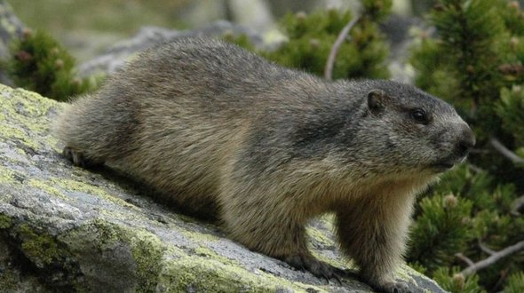
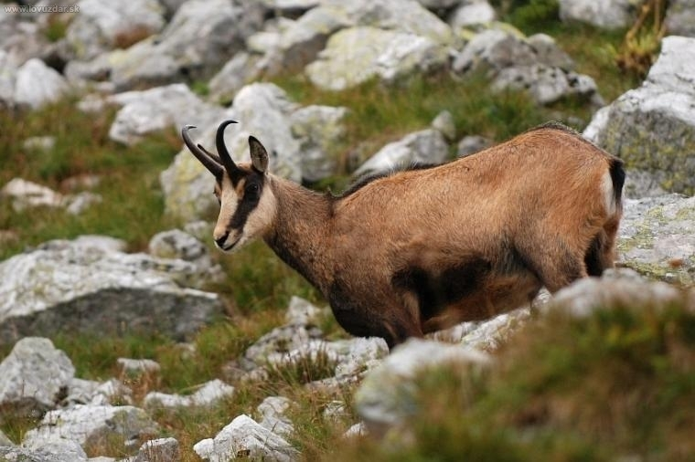
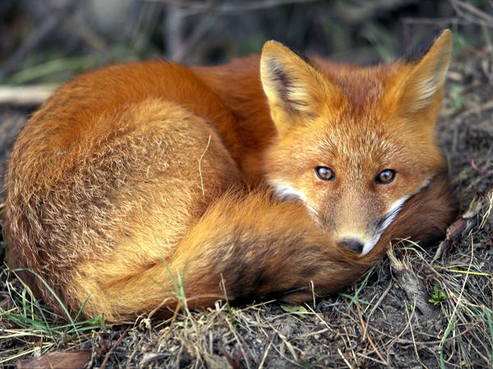
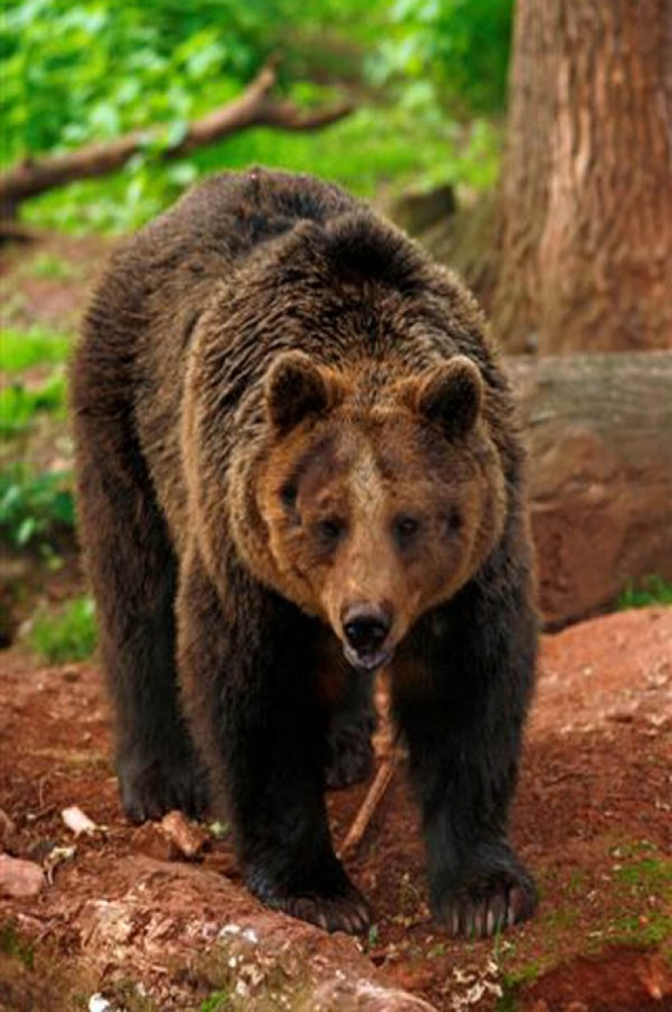
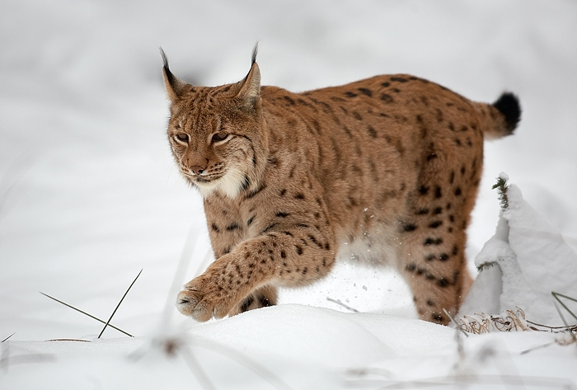
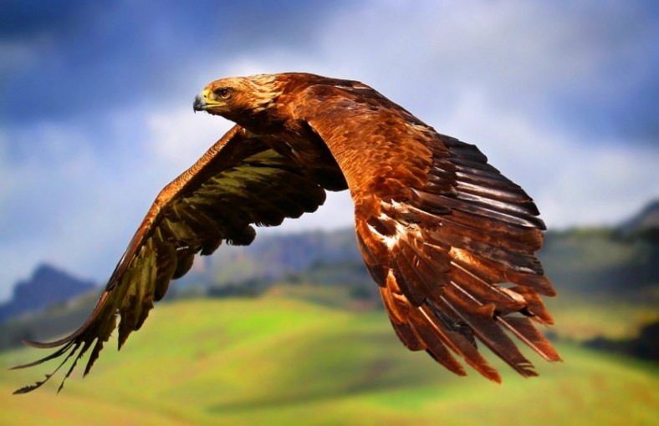

Slide 9
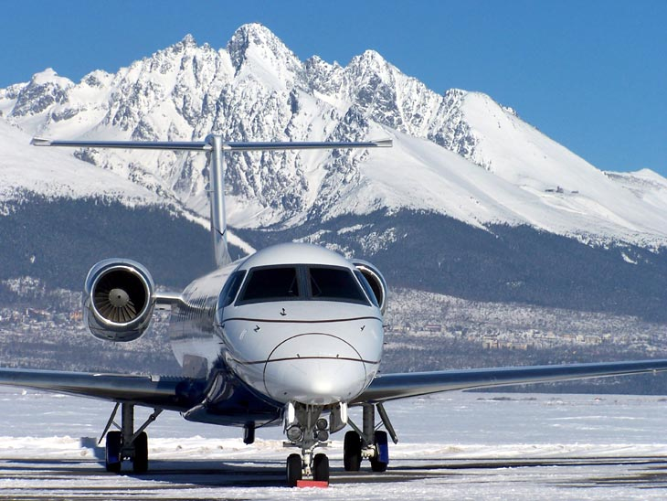
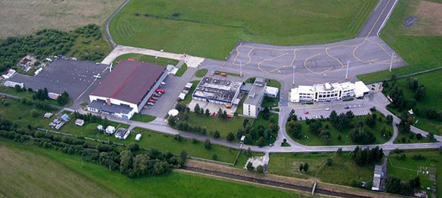
Airport Poprad ̶ Tatry

Slide 10
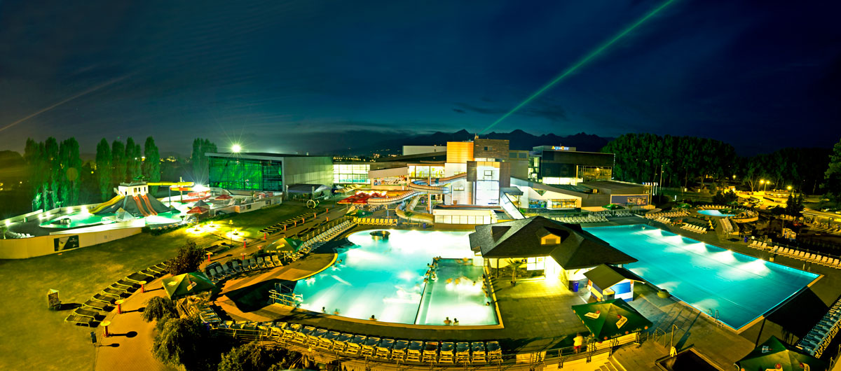
Aquacity

Slide 11
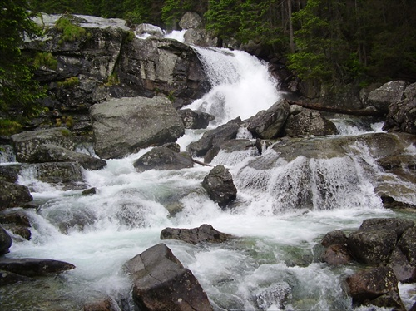
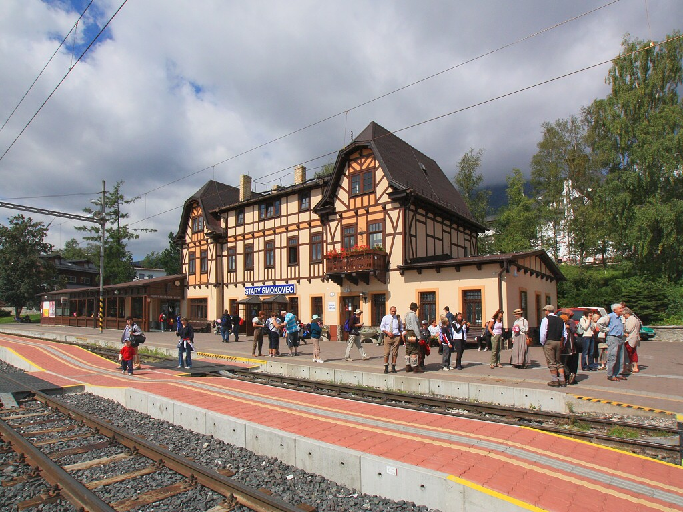
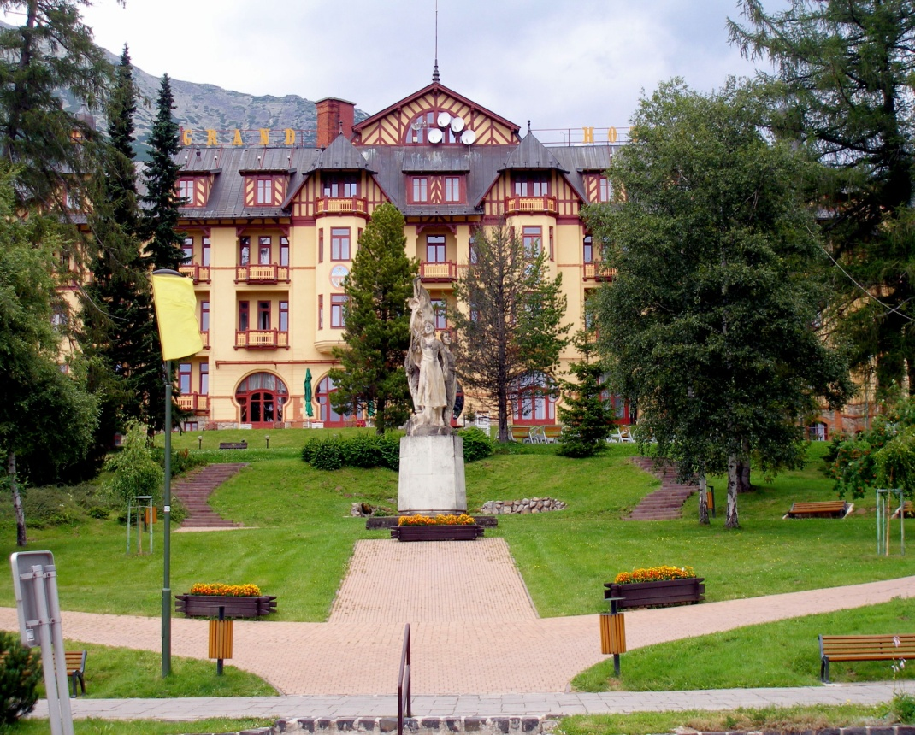
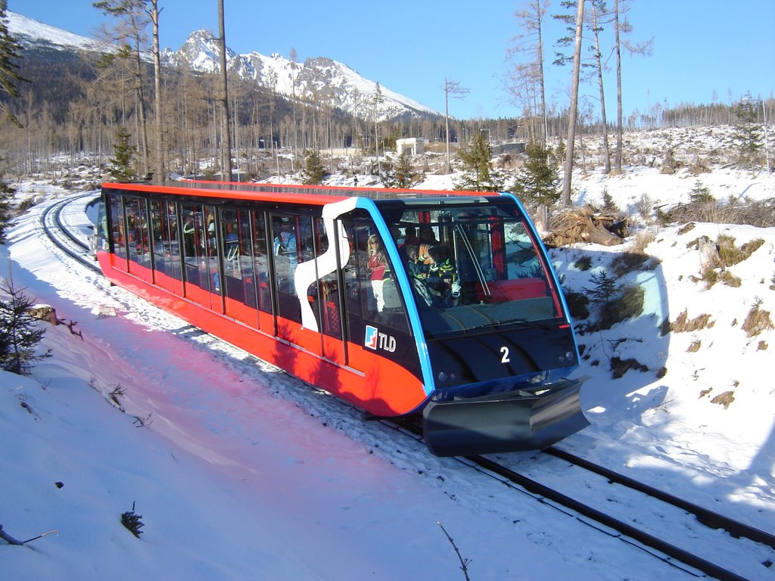
Starý Smokovec and Hrebienok

Slide 12
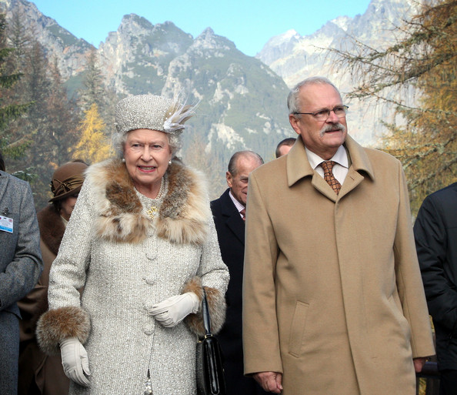
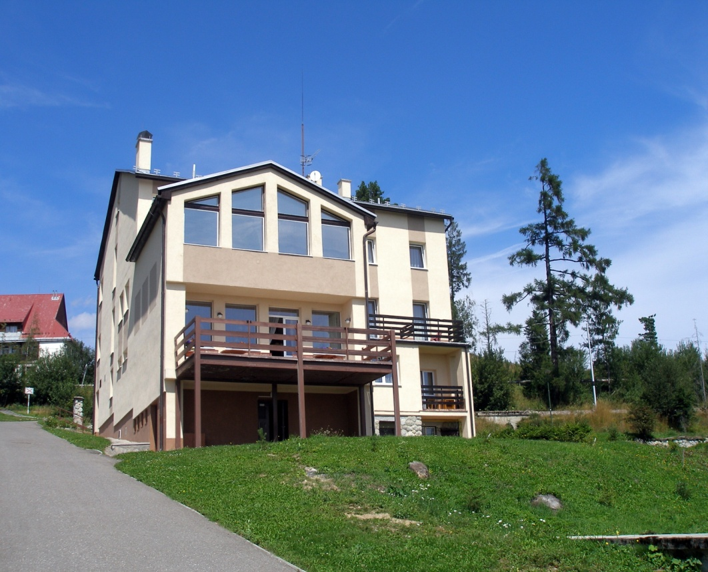
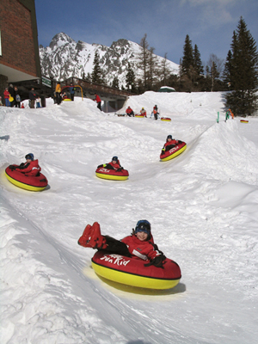
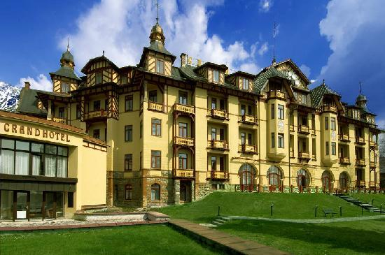

Slide 13
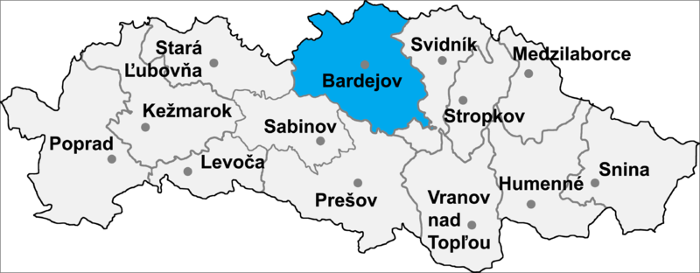
Districts

Slide 14
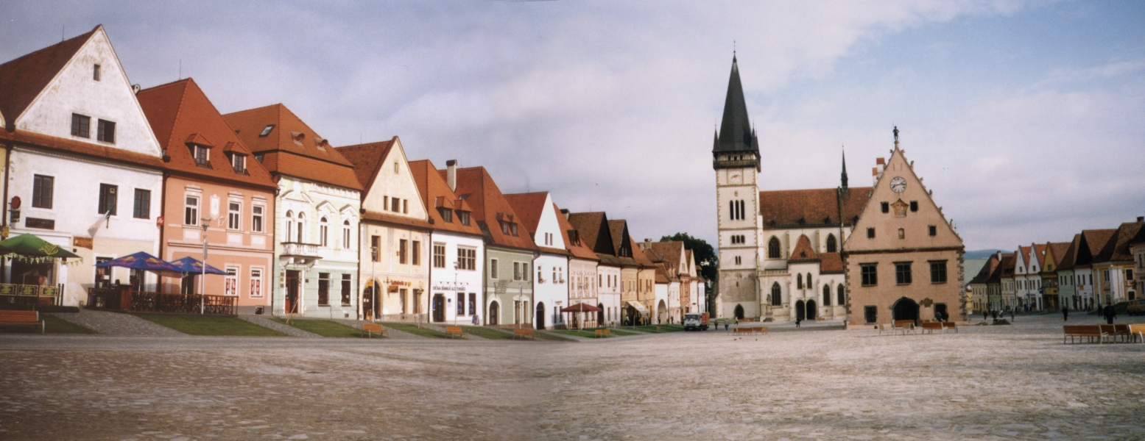
bardejov
Area: 72,39 km²
inhabitants: 33 296
the first written mention ̶ from 1241
Spa town
one of World Heritage Sites (UNESCO) coat of arms

Slide 15
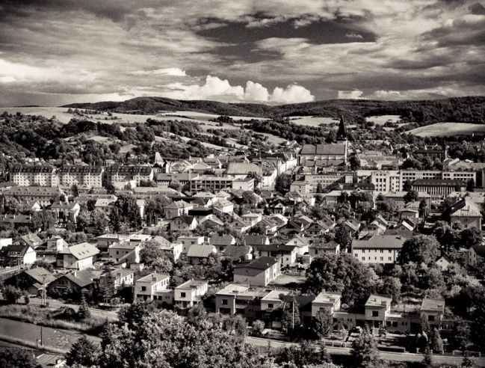
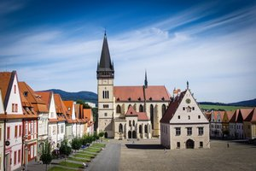
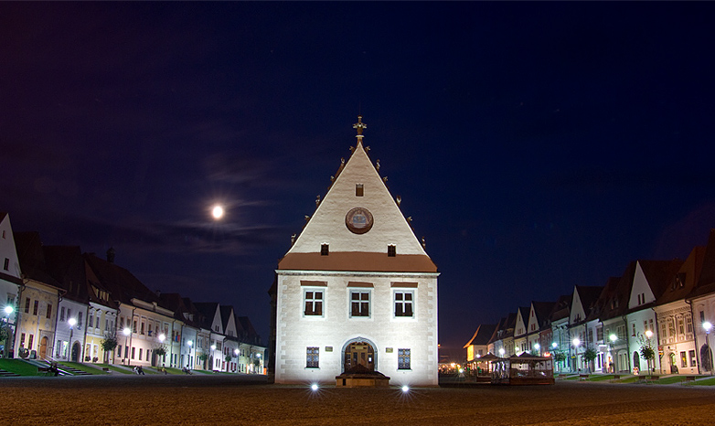
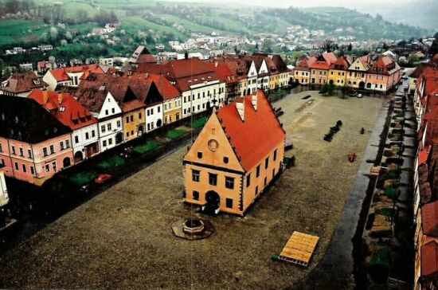

Slide 16
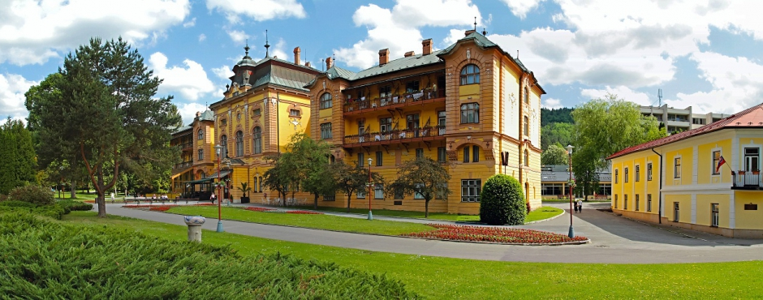
Bardejov spa
the first written mention ̶ from 1247
"oasis of health and relax„
natural mineral waters
Marie Louise, wife of French Emperor Napoleon I., Russian Tzar Alexander I., Empress Elisabeth (also known as Sissi), wife of Francis Joseph I., and other prominent European noblemen

Slide 17
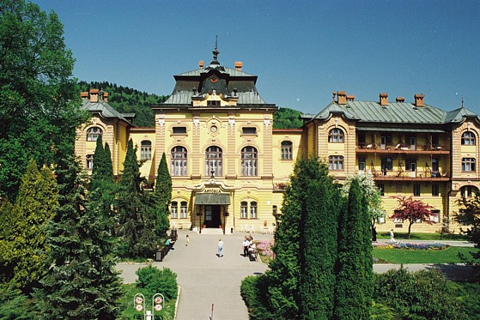
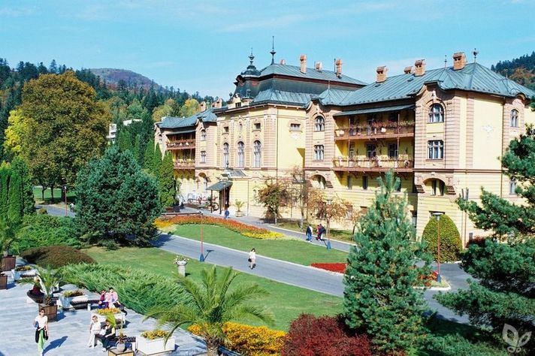
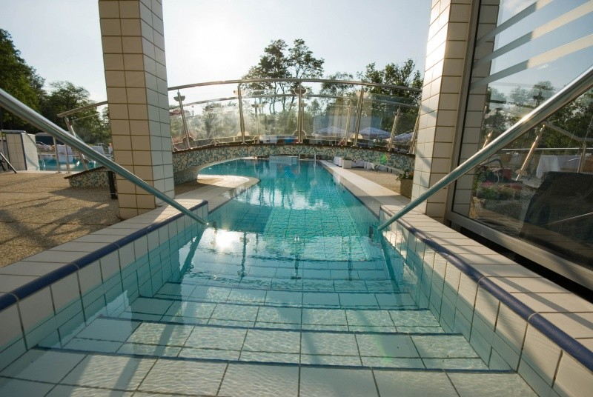
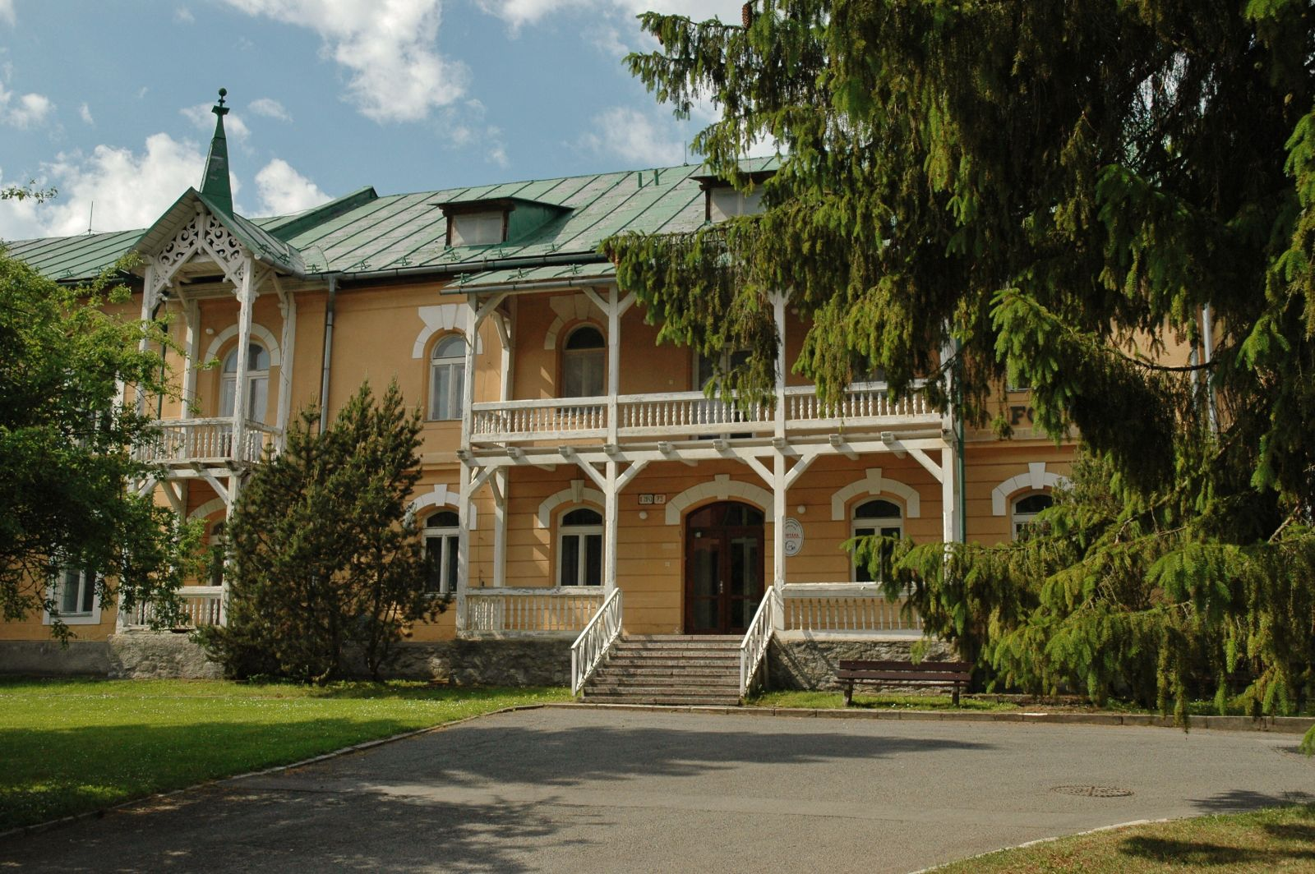

Slide 18
Recources
http://www.visitslovakia.com/data/usr_044_sv_hr_pp/293c.jpg
http://upload.wikimedia.org/wikipedia/commons/f/f7/Okres_poprad.png
http://www.vt.sk/en/mountains-holiday/skiing/strbske-pleso/
http://www.vt.sk/en/mountains-holiday/skiing/stary-smokovec/
http://www.slovakia.com/poprad/
http://www.vt.sk/en/mountains-holiday/region-of-the-high-tatras/resorts-interesting-facts-places-to-see/
http://www.dovolena-slovensko.com/images/upload/f/c/800px-okres-bardejov-p.png
http://www.arka-sro.eu/images/obce/bardejov/erbBardejov.gif
http://www.pamiatky.sk/content/data/obrazky/File/pamiatkovy_vyskum/Podujatia/Bardejov-RadnicneNam_Pincikova.jpg
http://en.wikipedia.org/wiki/Bardejov
http://fotky.sme.sk/foto/71947/bardejov?type=v&x=650&y=492
http://fotografovanie.info/fotogaleria/architektura/fimages/radnica-bardejov.jpg
http://i.sme.sk/cdata/3/66/6608593/BAKO_bjnajkrajsiemesto_1_DP-r885_s300.jpg
http://www.herkules.sk/userdata/imagelibrary/bardejov/namestie-bj.jpeg
http://www.intersportbenefit.sk/wp-content/uploads/2013/10/logo_bardejovske_kupele-293x254.png
http://www.vodnesvety.sk/images/stories/kupele/bardejovske/bardejov01.jpg
http://www.dobrodruh.sk/sites/default/files/images/Kam%20na%20Slovensku/Bardejov%20kupele%202009%20maj%20084.jpg
http://www.kupele.org/hotelyvysoketatry/userfiles/kupele/dudince/kupele-dudince-kupalisko-dudinka-4.jpg
http://slovakia.travel/en/spa-of-bardejov

Slide 19
Thank you for your attention
Have a nice day ☺
Anna Pasternáková
Dominika Vančíková

