Slide 1
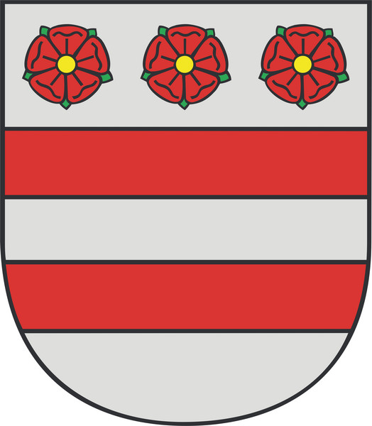
Prešov
Dominika Vančíková
I.C
Šk. r. 2012/2013

Slide 2
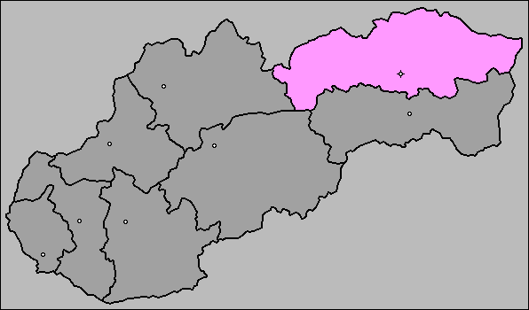
contect
In general about Prešov
History
Construction the city
Solivar and Calvary
Personalities of Prešov
Immigrants and John Paul II.
Population
Review
Notes:
Chapels and the church of the holy cross at calvary

Slide 3
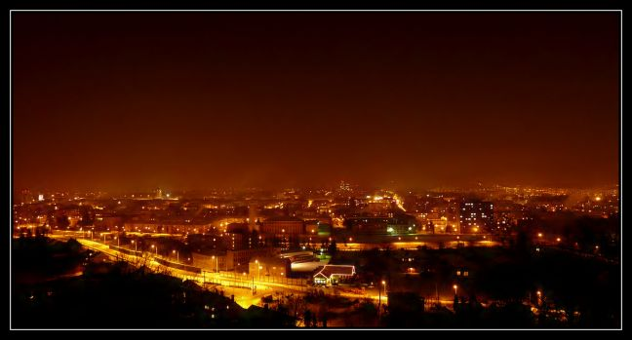
In general about Prešov:
Prešov is:
the centre of the Šariš Region
the third biggest city in Slovakia
the centre of the largest Slovak self-governing region (since 2002)
the centre of three bishoprics, and it is a treasury of cultural and historical landmarks.

Slide 4
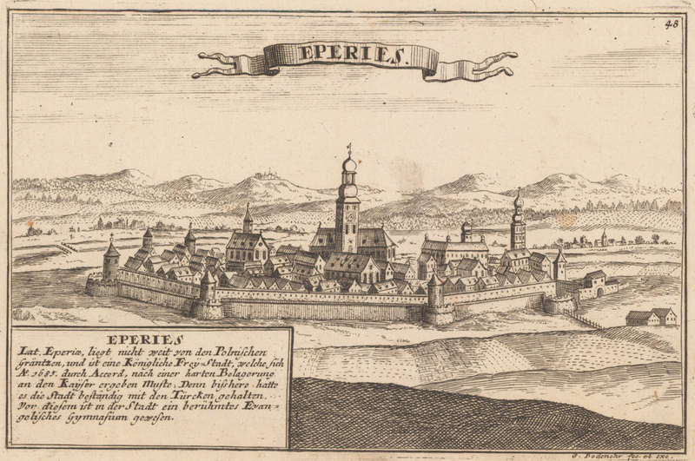
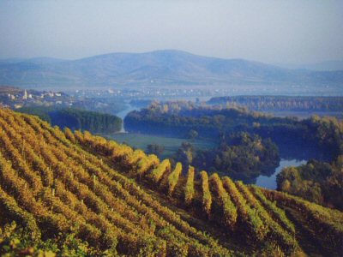
History
settlement called Epuries
3 ethnic groups: - the original Slav population
- Hungarian settlers
- German immigrants from Saxony
trade of Tokay wine
vineyards of Tokay
Epuries

Slide 5
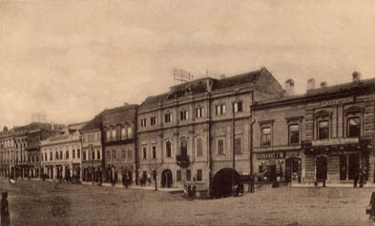
construction the city
walls - around the town
church - middle of main square
- surrounded by medieval houses
→one of them TOWN HALL
←town hall

Slide 6
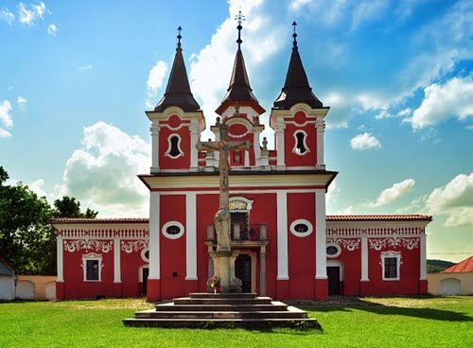
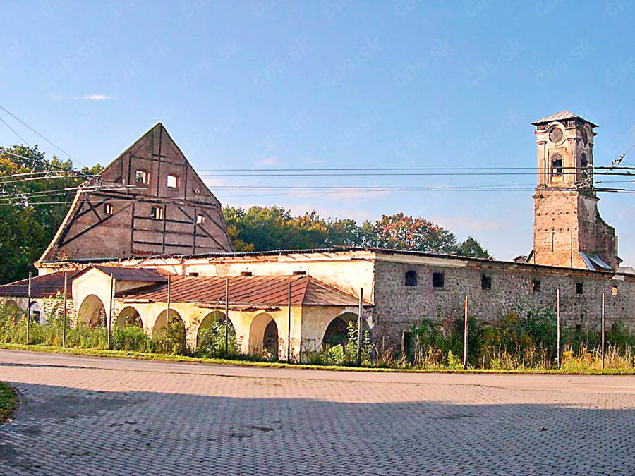
Solivar Calvary
Chapels and the church of the holy cross at Calvary
Located – on hill on the west side of the city
originally outside the city limits
1572 – started salt mining
National Historic Landmark
Salt storage

Slide 7
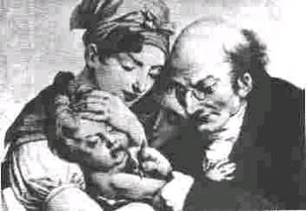
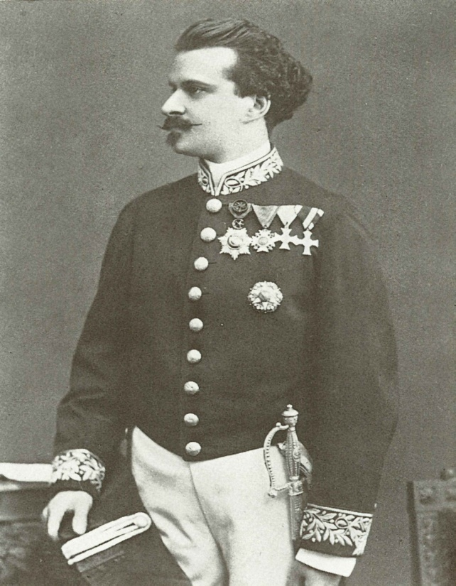
personalities of Prešov
17th century - decline as a result of wars, fires and plague epidemics
J. A. Reimanus - carried out vaccination the smallpox
K. Kern - discovered a drug against the cattle plague
J. Gertinger - made the first crystalline sugar in Hungary
J. Gertinger →
J. A. Reimanus

Slide 8
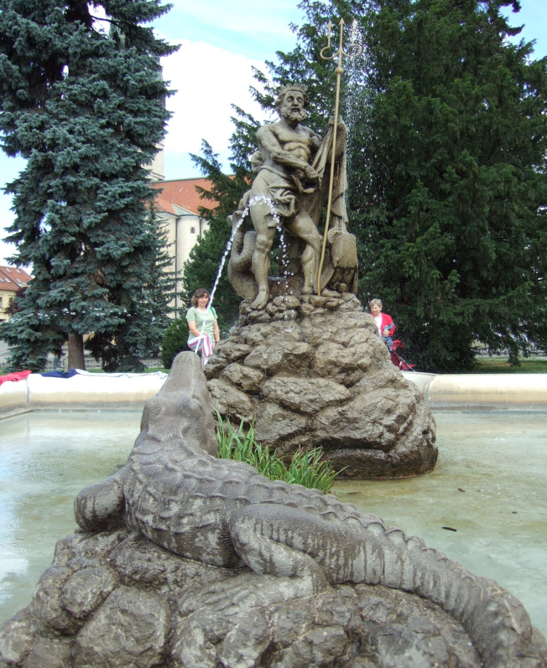
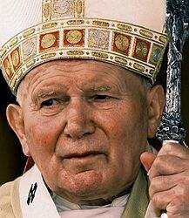
Immigrants and John Paul II.
16th century - coming Roma
1789 – 1. Jews settled there
1808 – Markus Holländer
- The Neptune Fountain
1995 – pope John Paul II.
← John Paul II. the Neptune Fountain

Slide 9
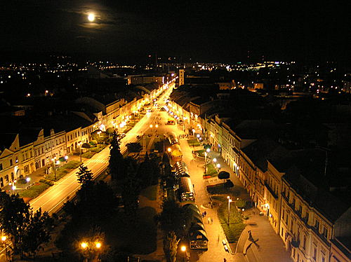
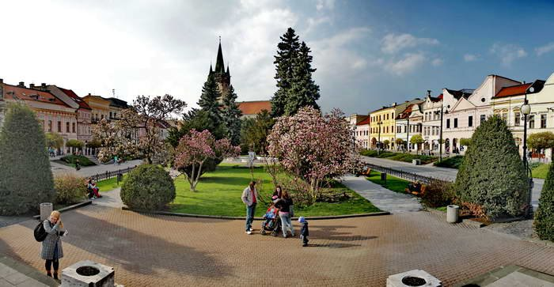
Population
1887 – big fire
World War II
today → more than 92, 000

Slide 10
review
 |  |  |  | S | E | T | T | L | E | R | S
 |  |  | N | E | P | T | U | N | E
 |  |  |  | S | U | G | A | R
C | A | L | V | A | R | Y
 |  |  |  | S | E | T | T | L | E | R | S
 |  |  | N | E | P | T | U | N | E
 |  |  |  | S | U | G | A | R
C | A | L | V | A | R | Y
 |  | S | O | L | I | V | A | R
 |  |  |  | S | E | T | T | L | E | R | S
 |  |  | N | E | P | T | U | N | E
 |  |  |  | S | U | G | A | R
C | A | L | V | A | R | Y
 |  | S | O | L | I | V | A | R
 |  | W | I | N | E
 |  |  |  | S | E | T | T | L | E | R | S
 |  |  | N | E | P | T | U | N | E
 |  |  |  | S | U | G | A | R
C | A | L | V | A | R | Y
 |  | S | O | L | I | V | A | R
 |  | W | I | N | E
 |  |  |  |  | S | A | L | T
 |  |  |  | S | E | T | T | L | E | R | S
 |  |  | N | E | P | T | U | N | E
 |  |  |  | S | U | G | A | R
 |  |  |  | S | E | T | T | L | E | R | S
 |  |  |  | S | E | T | T | L | E | R | S
 |  |  | N | E | P | T | U | N | E

Slide 11
Books: Prešov Region, A guide
http://www.presov.sk/image/7199/img_1346739436.jpg
http://fotky.sme.sk/foto/49041/presov-panorama?type=v&x=650&y=349
http://img.sk.prg.cmestatic.com/media/images/original/Nov2010/2193270.jpg
http://www.presov.sk/image/47/img_1210060585.jpg
http://www2.luventicus.org/mapas/eslovaquia/presov.gif
http://pincekulcs.hu/wp-content/uploads/tokaj.jpg
http://pis.sk/image/36469/presov-rytia.jpg
http://www.oocities.org/collecting_sk/pohladnice/Presov10.jpg
http://mw2.google.com/mw-panoramio/photos/medium/38433485.jpg
http://img.cas.sk/img/4/galleryBig/1495070_.jpg
http://www.hpl.sk/preview.php?id=7b0c04ad46d442016a5ff2705bfb2dab
http://upload.wikimedia.org/wikipedia/commons/2/23/Eduard_Strau%C3%9F_by_J._Gertinger_ca_1873.jpg
http://img.aktuality.sk/stories/2005/Ludia/Papez/papez_jan_pavol_1_ap.jpg
http://upload.wikimedia.org/wikipedia/commons/b/b4/Nept%C3%BAnova_font%C3%A1na.jpg

Slide 12
Thank you for attention

