Slide 1
The top 10 patries in the world

Slide 2
La Tomatina
What: Nobody is really sure how it began- practical joke? A harmless food fight between two merchants? A prank? No one knows but this messy fiesta has been a strong tradition since 1945. On the last Wednesday in August, about 30,000 people descend on this little town to participate in the world’s largest food fight. Never had that massive cafeteria food fight when you were younger? Well, here’s your chance.
When: The last Wednesday in August.
Where: The tiny town of Buñol in the Valencia region of Spain
Bring: Throw-away clothes and goggles! Tomato juice in the eye stings!

Slide 3
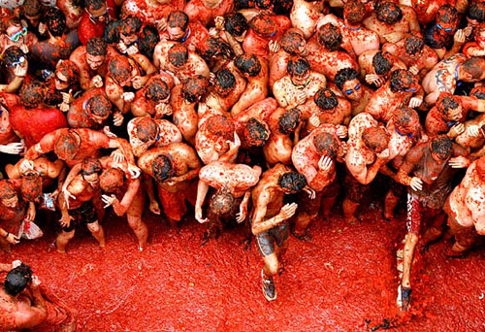
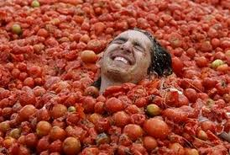
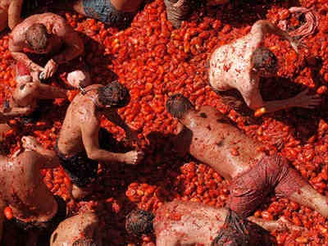

Slide 4
Full Moon Party
What: Legend has it that the Full Moon Party started as a birthday party in the 80s. The backpackers decided to come back again and again. Soon word spread and every month, backpackers would head to KPG to party.
Over the years, the hippy party morphed into a 20,000 person festival. Even in the low season, the party still sees about 10,000 visitors. Many people will tell you that it’s lost its charm over the years but for a serious dose of all night (and all day) partying in Thailand, this is place to get it.
When: During the full moon, every month
Where: Ko Pha Ngan, Thailand
Bring: Your drinking shoes, a red bull, facepaint, and clothes you don’t care about.

Slide 5
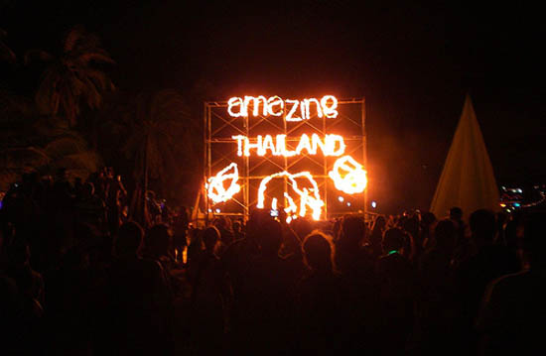

Slide 6
Burning Man
What: Looking for the ultimate arts extravaganza? Burning Man is for you! An 8 day festival that culminates in the burning of a 72ft wooden man, this festival is where you can cut loose. Each year has a theme (this year, it’s “American Dream”) and last year 47,000 people decided to join the fun.
When: Starts 8 days before the American Labor Day, September
Where: Blackrock Desert, Nevada USA
Bring: Everything BUT money! Burning Man runs on a full barter system and the only things you can buy are water and ice. Aside from the obvious supplies you’d take camping, other essentials include sunblock, a Camel Back and goggles. MOST importantly, bring something that allows you to participate–that’s what Burning Man is all about.

Slide 7
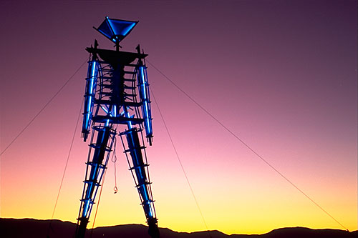
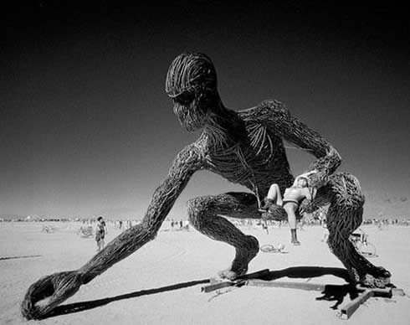
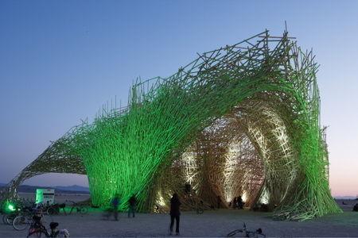

Slide 8
Songkran
What: Songkran is the Thai New Year. It’s a spiritual festival designed to cool you down and wash away the sins of the previous year. What better way of doing that than by committing a few new ones, right away? Songkran takes place all over the country with everyone embarking on possibly the world’s largest water fight.
When: Mid-April
Where: Anywhere in the land of Smiles (Bangkok and Chang Mai have the biggest parties)
Bring: Anything you don’t mind wearing only once, a water gun, extra water, and a good attitude.

Slide 9
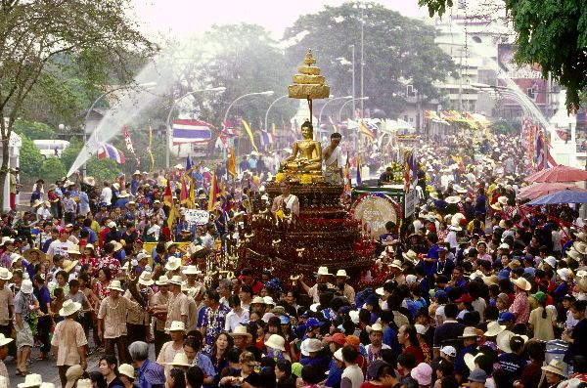

Slide 10
Glastonbury Music Festival
What: A 3 day music festival designed to celebrate the earth, music, and the arts, this festival brings in people from all over the world. Last year’s event had over 177,000 people and 700 musical acts.
When: The last weekend in June
Where: Pilton, England
Bring: Tickets, a tent, sleeping bag, food, and whatever else you “need” to have fun.

Slide 11
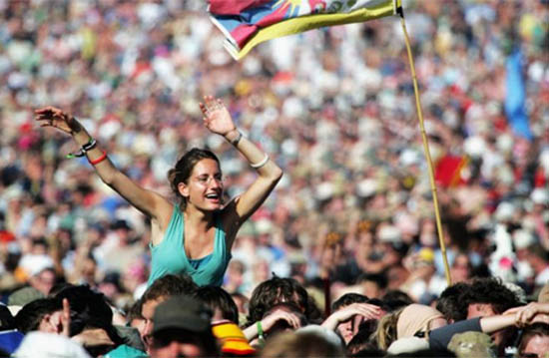
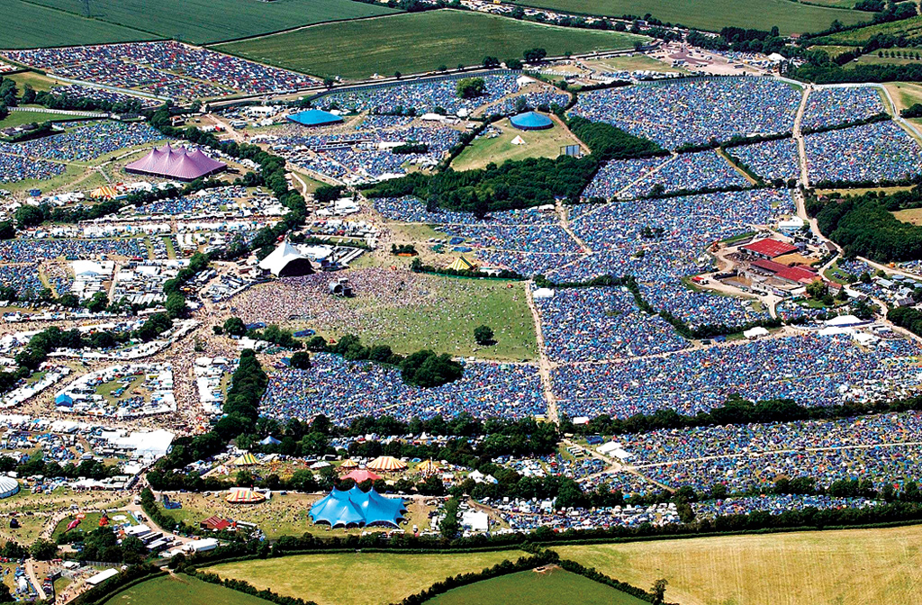

Slide 12
Holi
What: Similar to the Thai holiday of Songrkan, Holi is a two day Hindu spring festival that occurs in northern India. The first night is marked by bonfires, and the second day is spent pleasuring your inner 2nd grader by splashing colored flour and water over everybody. It’s a celebration about renewal.
When: The full moon in March.
Where: India
Bring: Red, orange, and green flour, lots of water, clothes you don’t need!

Slide 13
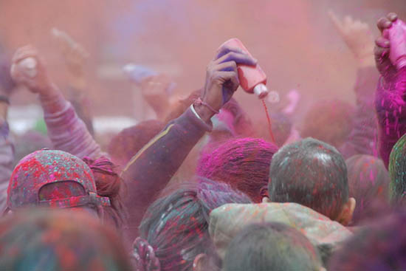

Slide 14
Bay to Breakers
What: It’s supposed to be a 7 mile foot race but instead it’s a 7 mile costume party and keg race that goes through downtown San Francisco. It began in 1906 to keep people’s sprits up after the earthquake and locals are still keeping that alive, in force! Over 70,000 people, congregate downtown in costumes (or nothing at all) and shopping carts filled with kegs. A little Mardi Gras + a little Halloween college party = a lot of fun.
When: The third Sunday in May.
Where: San Francisco, California
Bring: A crazy costume and lots of beer!

Slide 15
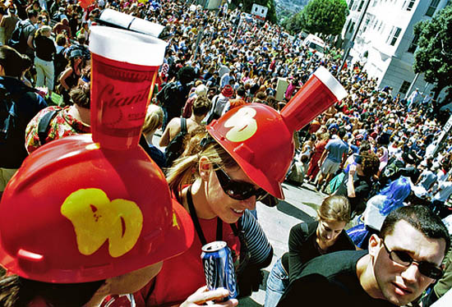

Slide 16
Australia Day
What: Australians love two things: beer and bbqs. No day brings out the best in these two than Australia Day, when Aussies celebrate the first European settlement on the continent of Australia. Aussies, a normally festive bunch, kick it up a notch all over the country with bbqs, music, and beer. From the cities to the towns, Aussies are out in full force. If you don’t already have an Aussie friend to take you under his/her wing, head to a beach with beer and make some new friends! Most Australians would love nothing more to break in a newbie!
When: January 26
Where: Anywhere in Oz!
Bring: Your Australian pride, a case of Carlton draught or Coopers, and something for the grill.

Slide 17
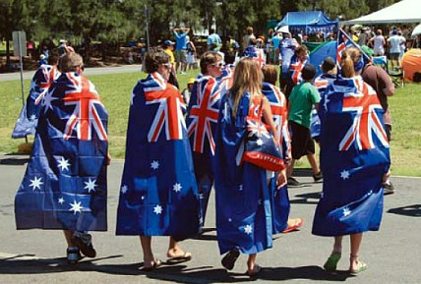

Slide 18
Queen’s Day
What: The normally reserved Dutch cut lose to celebrate the birth of their Queen. Originally to celebrate the birth of Juliana, the day now celebrates the birth of Beatrix, whose January birthday makes it cold to party. All over the country, the Dutch head outside with their beer and music, flood the streets in orange, and cruise up and down the canals in revelry.
When: April 30th
Where: The Netherlands (Amsterdam has the biggest party)
Bring: Anything orange!

Slide 19
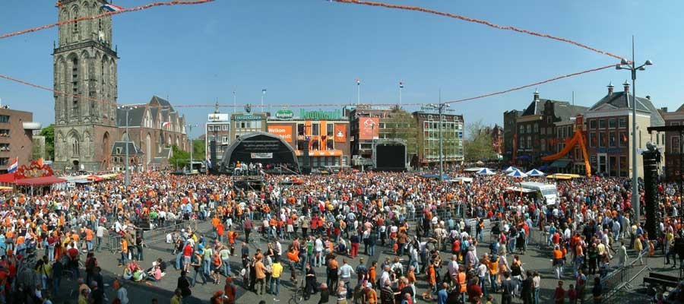

Slide 20
Calgary Stampede
What: A 10 day rodeo that attracts over a million visitors during its course. The festival features a parade and is the largest event in Canada. But don’t come to watch the rodeo, come for the party! The throngs of people who flock to Calgary are there for the revelry, the beer, and the girls (or boys).
When: Second week in July
Where: Calgary, Alberta
Bring: Your best cowboy outfit and a tolerance for country music.

Slide 21
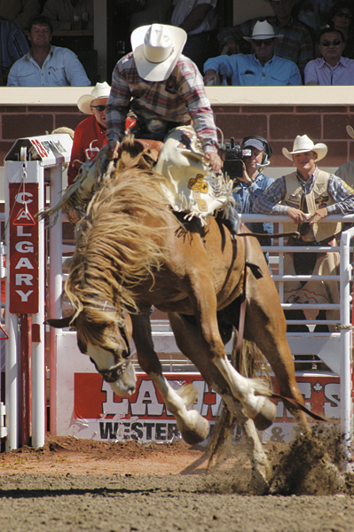
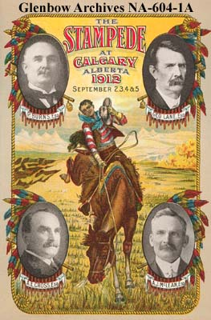

Slide 22
The end
Jaro Fedor
Aďa Šimková
;)

