Slide 1
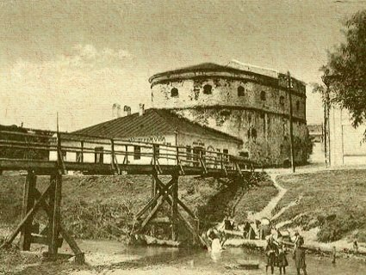
Bardejov

Slide 2
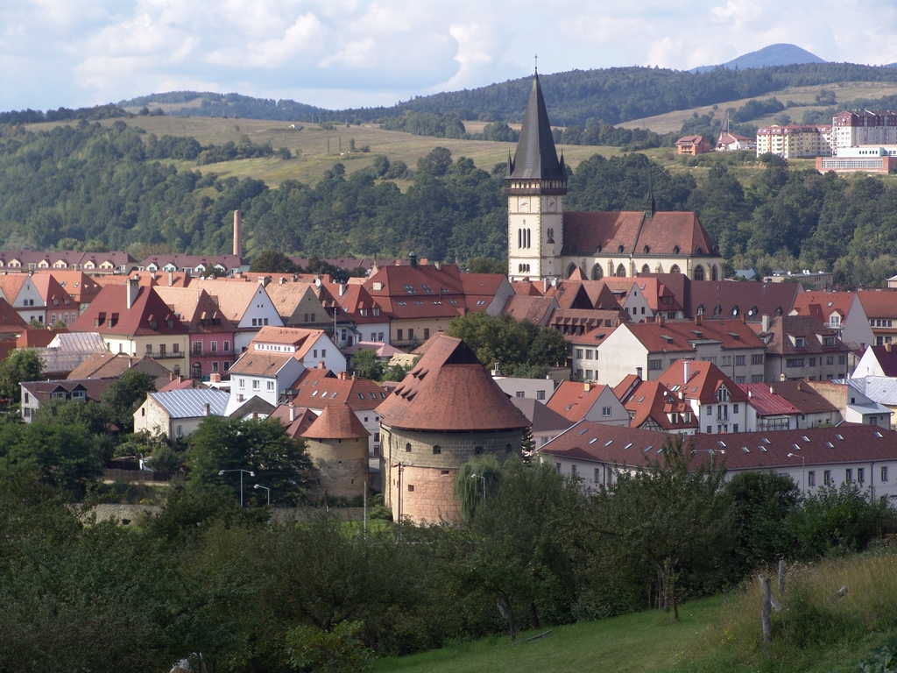
Content
History
Symbols
Unesco & cultural monuments
Bardejov Spa
Resources

Slide 3
History
1241 & 1247
1352 & Ľudovít I.
1. September
1453 & own coat of arms
16 century as century of culture and education
Leges scholae Bartphensis

Slide 4
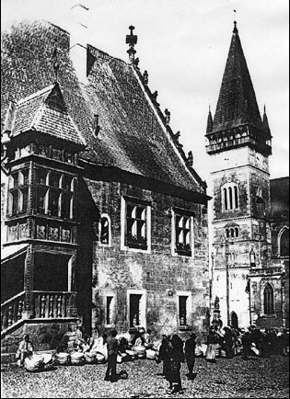
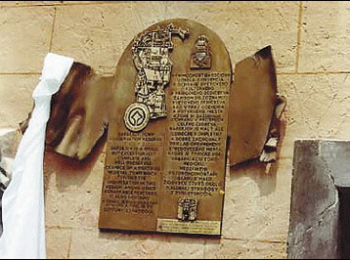
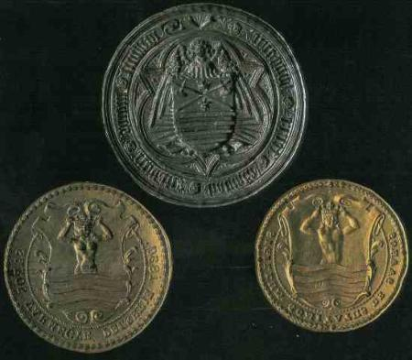
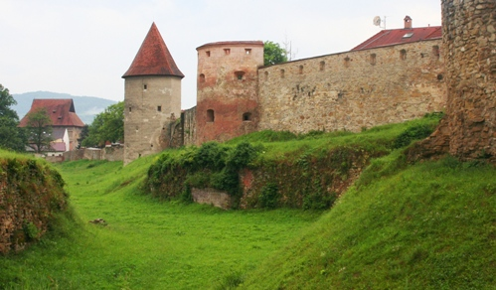
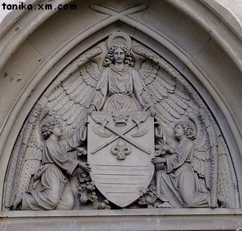

Slide 5
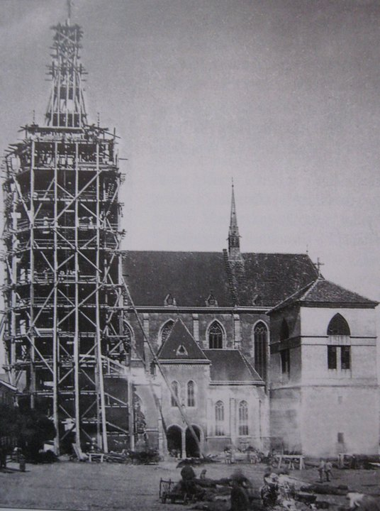
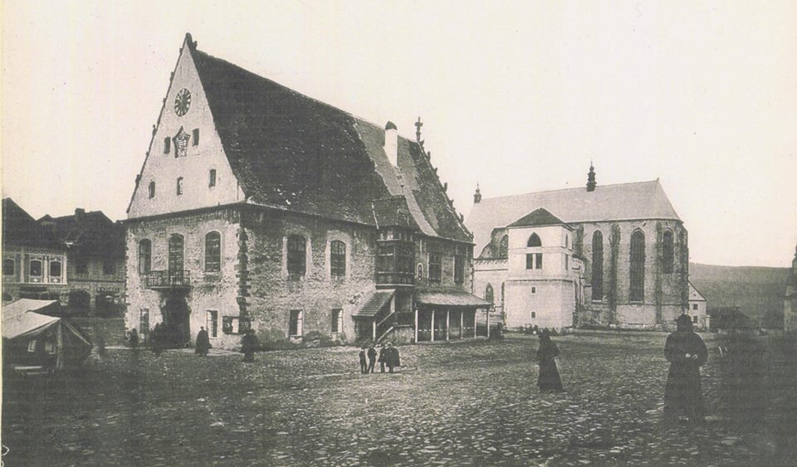
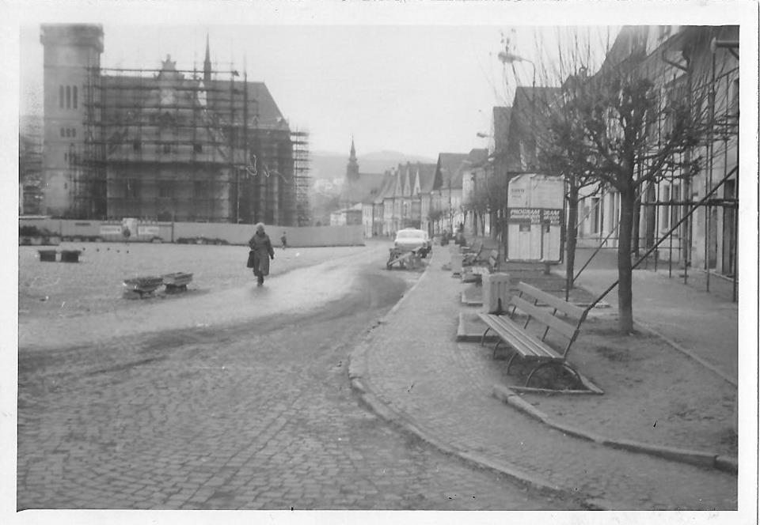
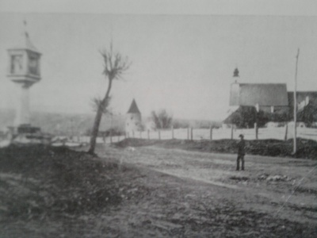

Slide 6
Symbols
Coat of arms
Flag of the city
The seal of the city

Slide 7
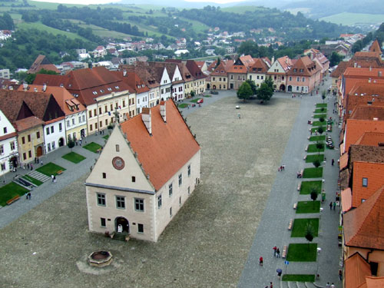
Unesco and some other monuments
2000
Town square
Bsilica Minor of St. Egídius
Town hall
The statue of St. Florián

Slide 8
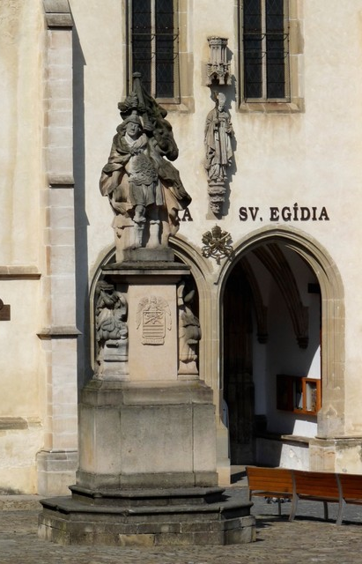
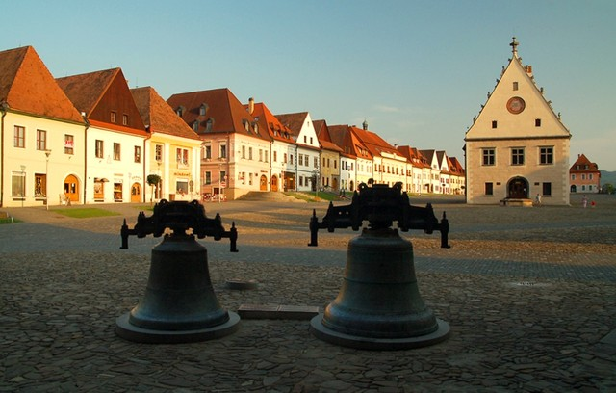
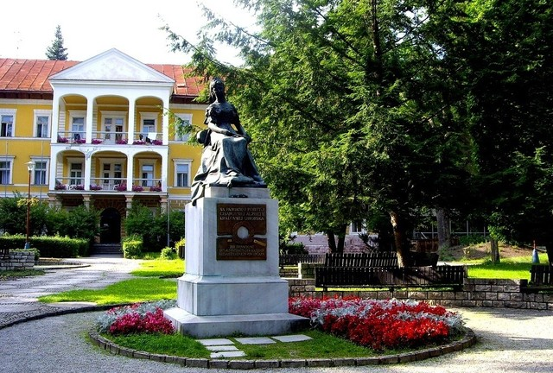
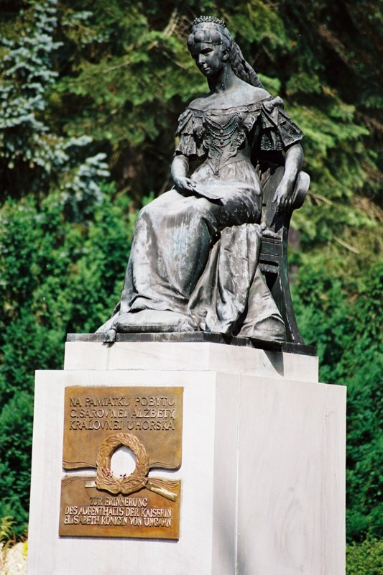

Slide 9
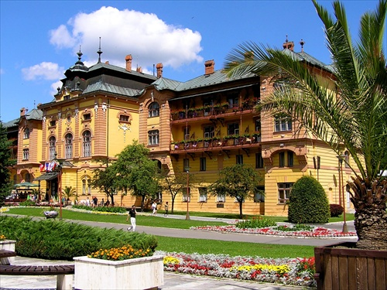
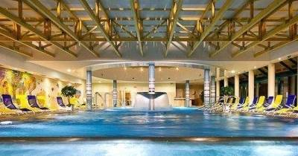
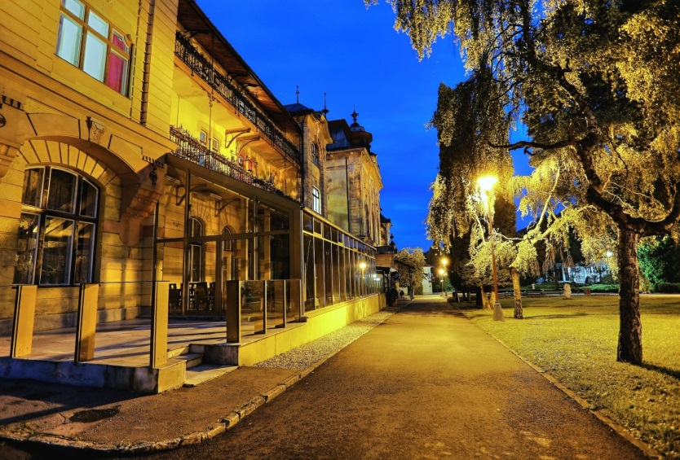
Bardejov Spa

Slide 10
Resources
http://www.bardejov.sk/mesto/bardejov
http://www.tanika.sk/web/bardejov/erb.htm
http://www.j-henischa.szm.com/bardejov/bardfa01.html

Slide 11
Thank you for your (in)attention!!! ☺
Ivana Vavreková 2.C Gjar

