Slide 1
The High Tatras
Lucia Burdová & Iveta Greifová

Slide 2
The contents
Basic information
TANAP
Fauna
Flora
People in the High Tatras
Hiking
Skiing
Mountain climbing
Spa
Sources

Slide 3
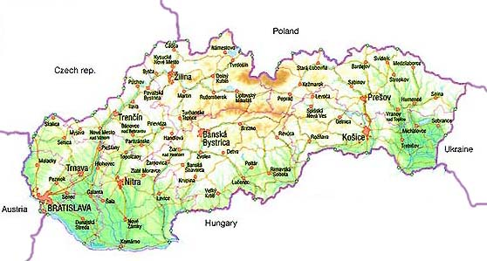
Basic information
Location - Slovakia & Poland
Area - 341 km²
Lenght – 55 km
Peak – Gerlachovský štít

Slide 4
TANAP
Tatra Nation Park - the oldest in Slovakia
Area: 738 km²
1993 – UNESCO
5 milion visitors per year
600 km of hiking trails and 16 bike trails

Slide 5
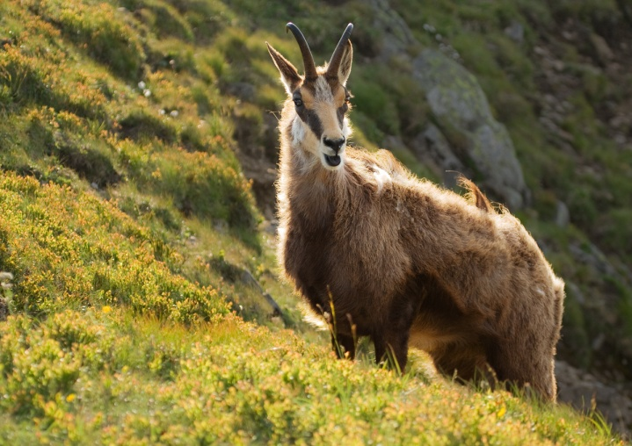
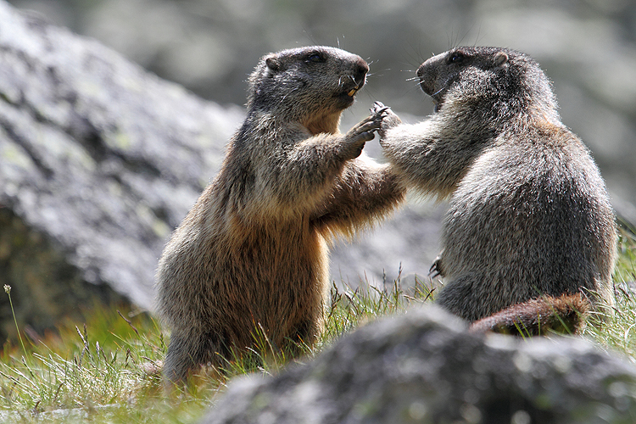
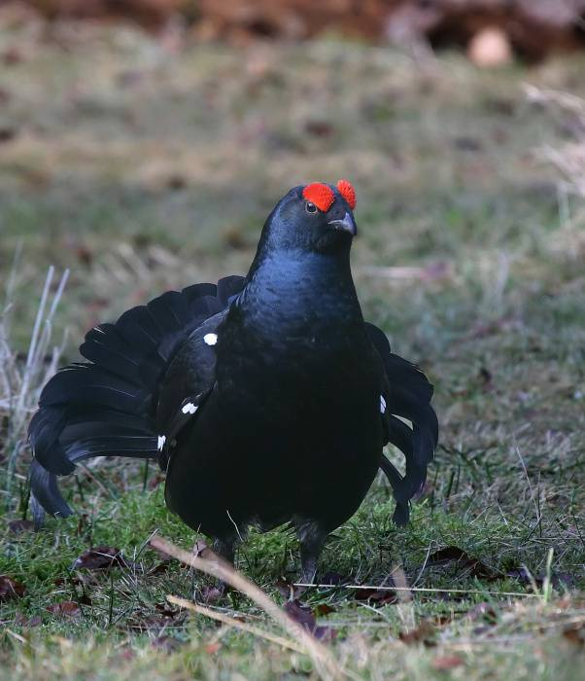
Fauna
Tatra chamois
115 species of birds
42 species mammals
5 species reptiles
6 species amphibians
16 species of fish
Alpine marmot
Black grouse

Slide 6
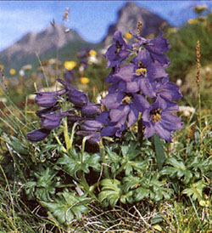
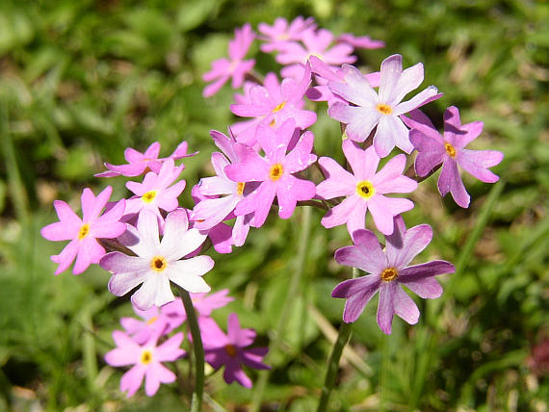
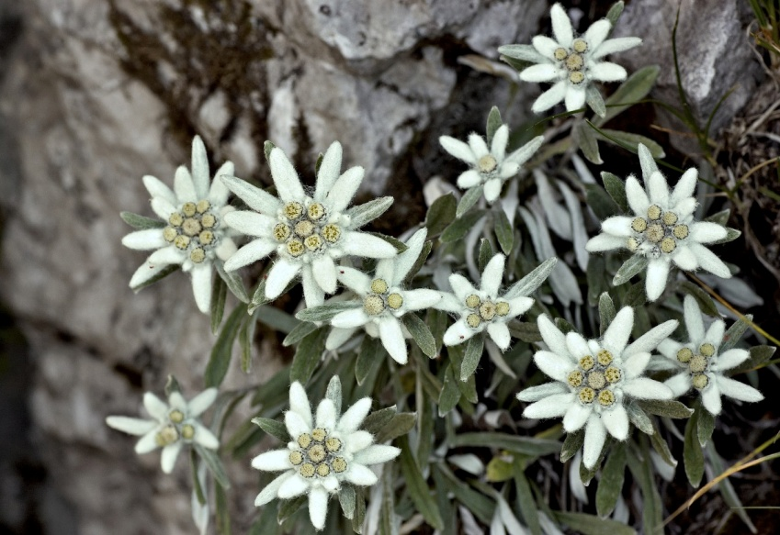
Flora
1 400 different species of plants
5 vegetation zones
some species bloom in 5 °C
1650 species of algae
1200 species of moss
Stračonôžka tatranská
Plesnivec alpínsky
Prvosienka pomúčená

Slide 7
People in the High Tatras
Hiking
Skiing
Mountain climbing
Spa

Slide 8
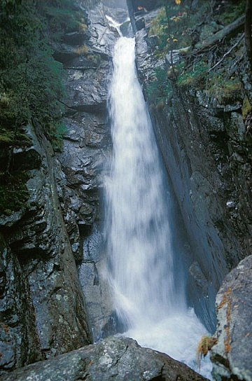
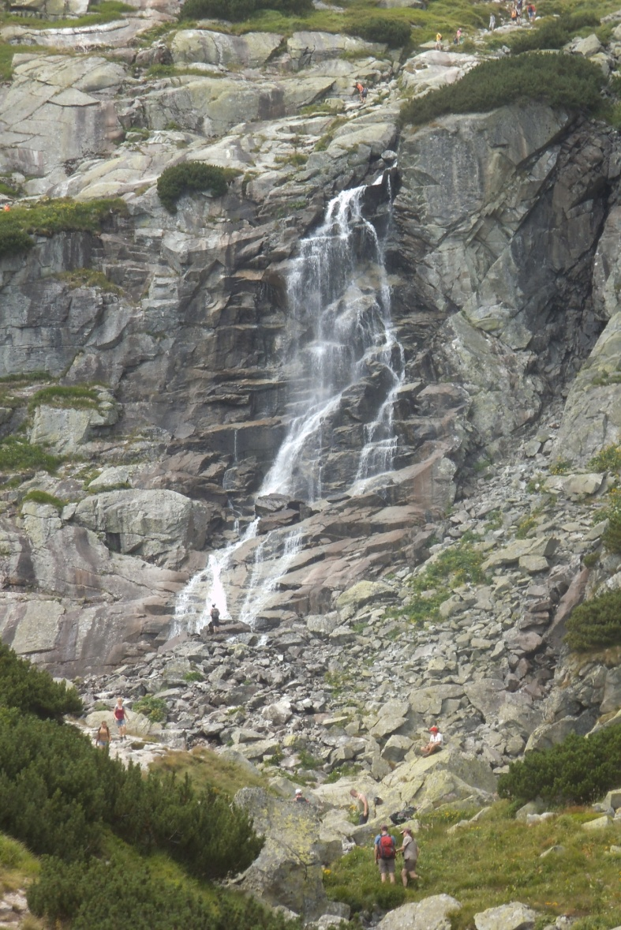
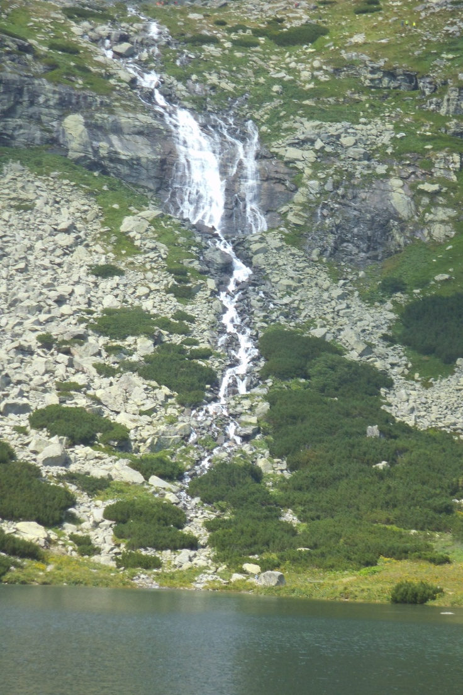
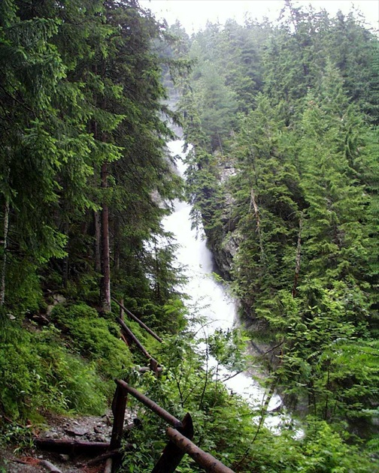
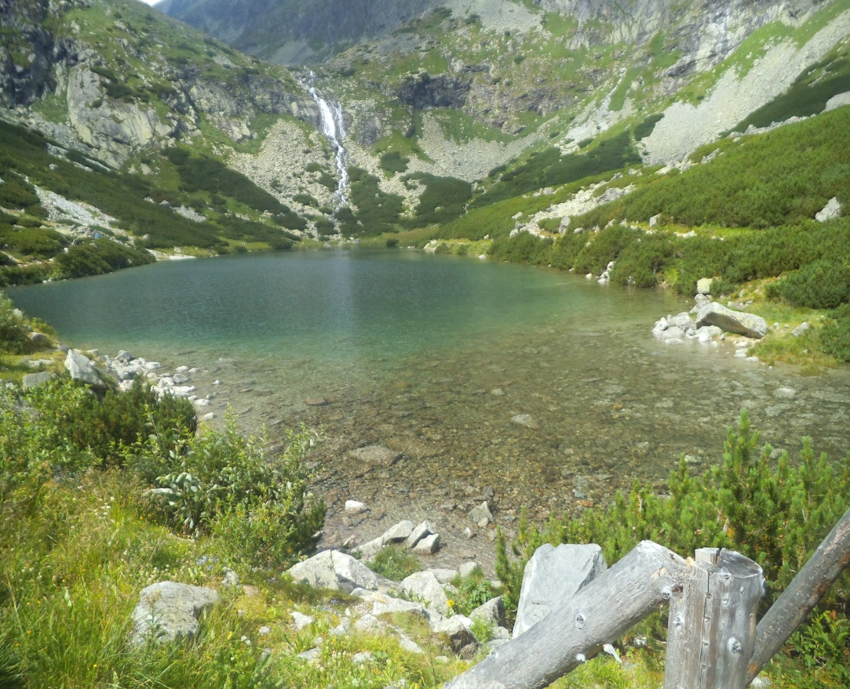
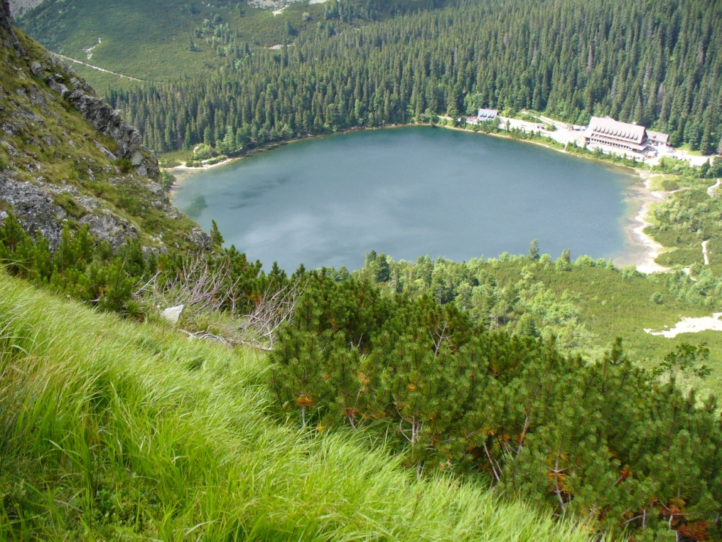
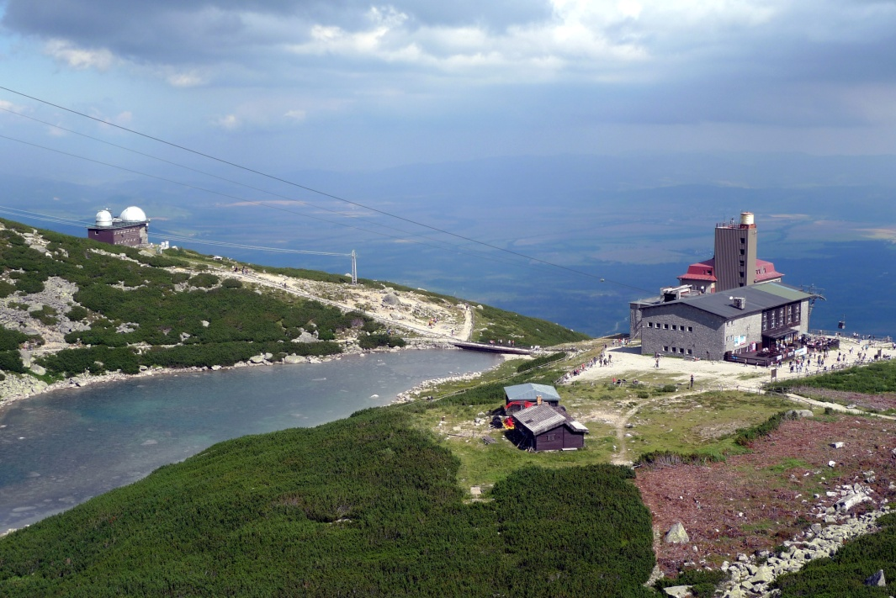
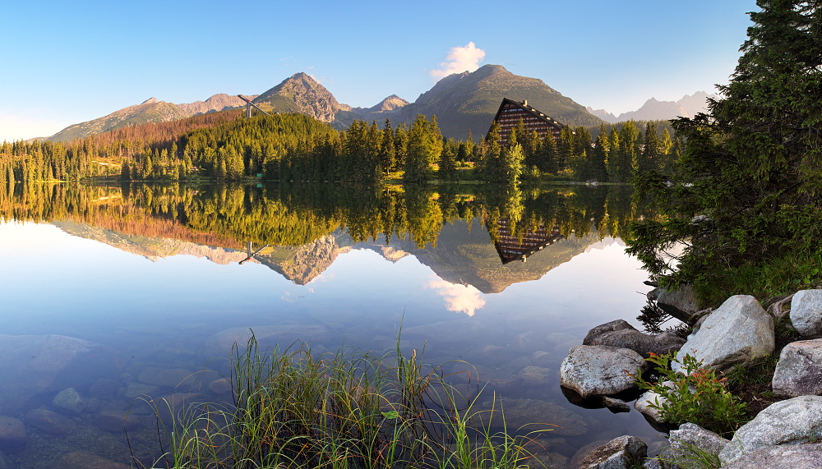
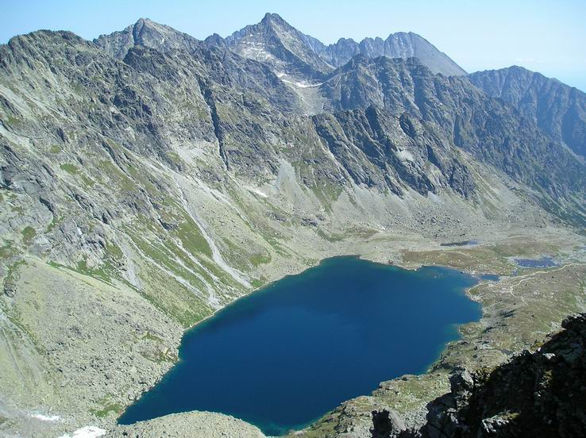
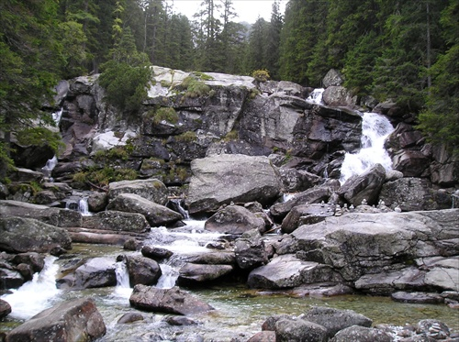
Hiking
Mountain lake:
Veľké Hincovo pleso
Štrbské pleso
Popradské pleso
Skalnaté pleso
Velické pleso
Waterfall:
Velický vodopád
Kmeťov vodopád
Vodopád Skok
Studenovodské vodopády (Waterfall of the Cold Springs)

Slide 9
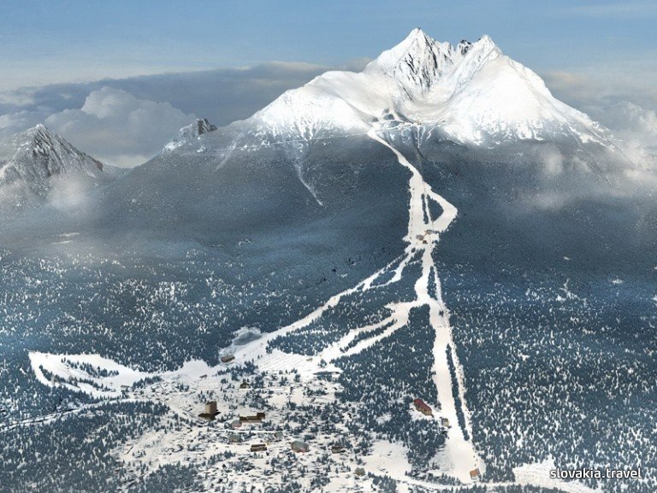
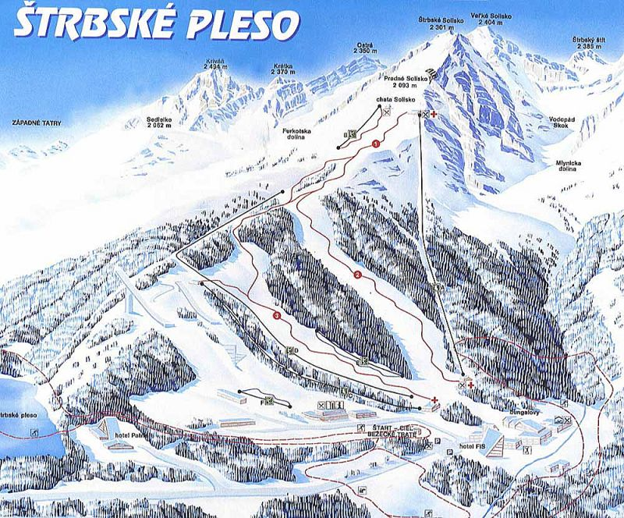
Skiing
Tatranská Lomnica (Lomnické sedlo - Skalnaté pleso)
Štrbské Pleso
Starý Smokovec
Jezerisko - Bachledova

Slide 10
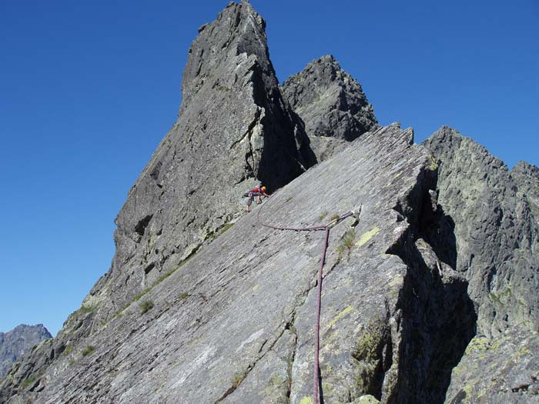
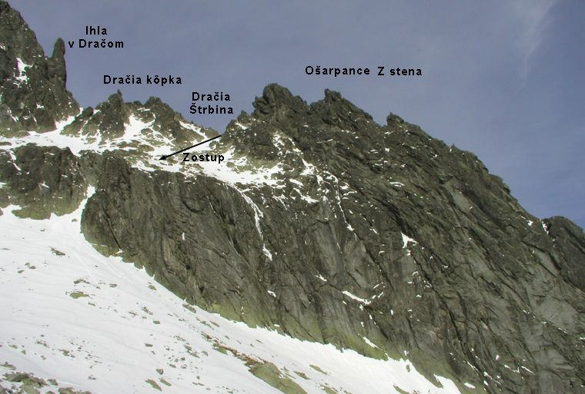
Mountain climbing
Volia veža
Žabí kôň
Galéria Ganku
Ostrý štít
Žltá stena
Jastrabia veža
Dračie pazúry
Ošarpance
Ihla v Ostrve

Slide 11
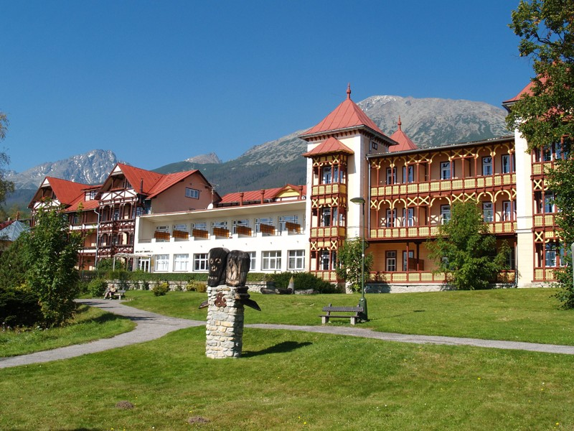
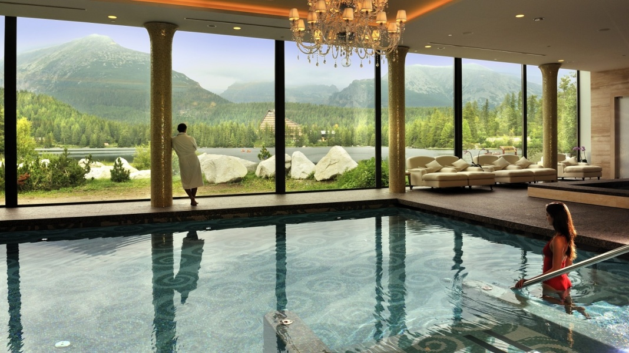
Spa
Spa Nový Smokovec
Spa Štrbské pleso
allergy
Asthma
Respiratory disease

Slide 12
Sources :
https://en.wikipedia.org/wiki/Tatra_National_Park,_Slovakia
http://www.vysoketatry.com/en.html
http://www.beliansketatry.sk/wp-content/uploads/2014/01/03-zasnezene-tatry-pitonak_20140127.jpg
http://plazyunas.com/wp-content/gallery/vipera-berus/vipera-berus-5.jpg
http://www.kampolovat.sk/files/animals/34/images/source/4033v.jpg
http://sk.wikipedia.org/wiki/Ve%C4%BEk%C3%A9_Hincovo_pleso
http://sk.wikipedia.org/wiki/%C5%A0trbsk%C3%A9_pleso
http://sk.wikipedia.org/wiki/Popradsk%C3%A9_pleso
http://sk.wikipedia.org/wiki/Skalnat%C3%A9_pleso
http://sk.wikipedia.org/wiki/Velick%C3%A9_pleso
http://zena.sme.sk/c/5124024/plesa-klenoty-nasich-tatier.html
http://www.slovenske.cz/lanovky-ski-arealy/vysoke-tatry.html
http://www.tatry.cz/cs/horolezecke-cesty
http://www.slovak-republic.org/high-tatras/

Slide 13
Thank you for your attention!

