Slide 1
Prešov
Prepared by Jakub Jambrich

Slide 2
Basic facts
Third biggest city in Slovakia
Hagyari is a citymayor
Approximately 88 659,5 people
Most of them are women

Slide 3
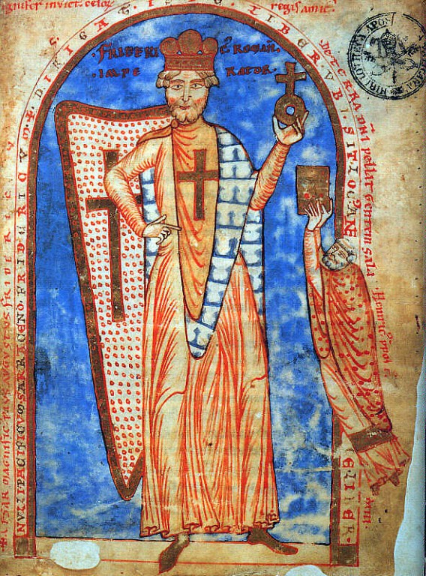
Legend of the founding of the city
King Belo II. Was hunting here
He get lost – he was blind
Strawberries save his life
Prešov is named after them

Slide 4
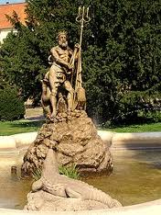
Something about Neptun’s fountain
Jewish merchant want to live here
He can’t because of law
Than he build a fountain with statue of Neptune
Neptune was “alone”, so he conjure “friends” up

Slide 5
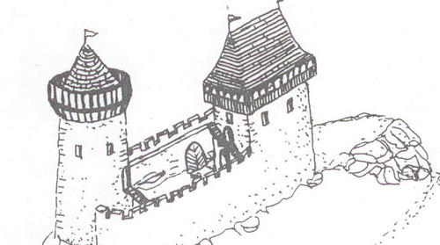
Prešov vs. Šebešovci
Šebeš castle in Podhradík
13. - 14. stor. – they were attacking to Prešov
After 1526 Prešov wanted to destroy them
Prešov decept them and execute them

Slide 6
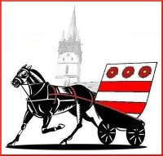
Koňare
In 1859 was built haras in Prešov
In 1899 there was huge football field
Probably angry fans was shouting „Koňare!”
So we are „Koňare“ just because of football

Slide 7
Thank you for attention!

