Slide 1
Skyscrapers in Slovakia
Jakub Jambrich

Slide 2
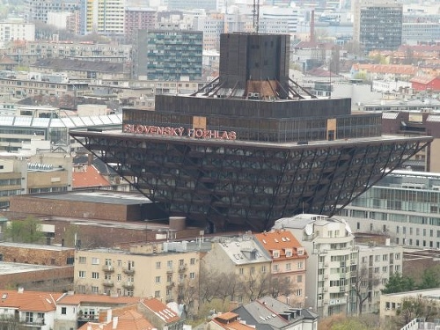
Wilson city(Bratislava)
The ugliest city
The sixth ugliest
building in the world

Slide 3
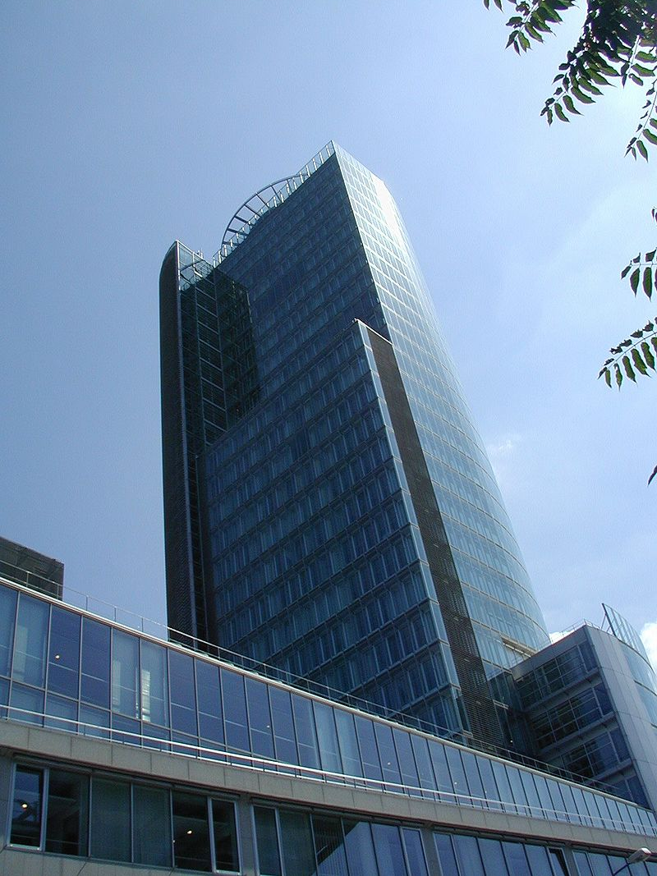
Skyscrapers in BA
Bigger than 100m (150)
National Bank of Slovakia(108)

Slide 4
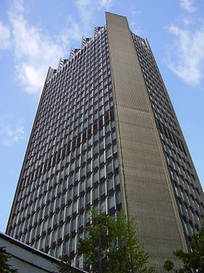
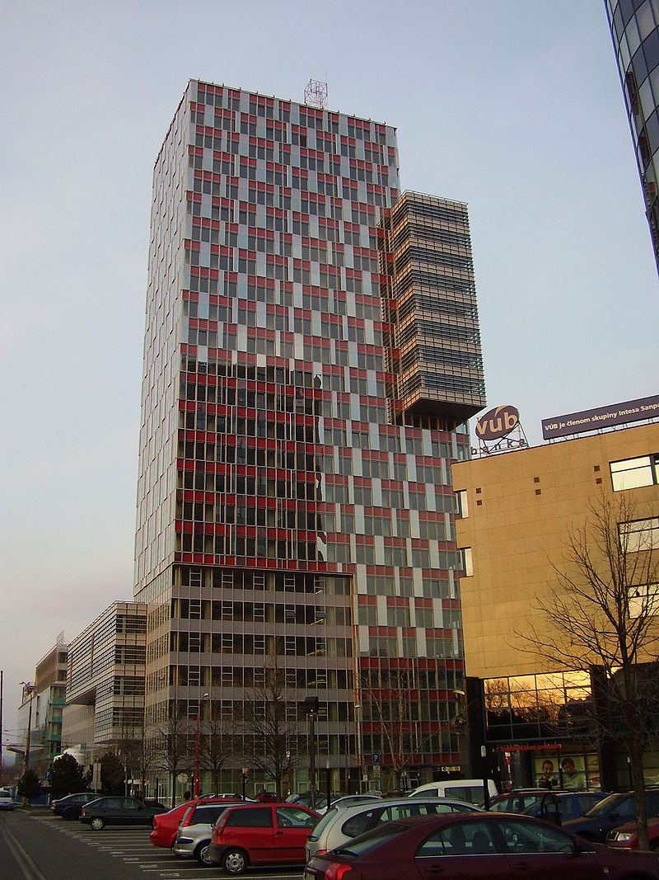
Skyscrapers in BA II.
Slovak Television Building(108)
City Bussiness Centre

Slide 5
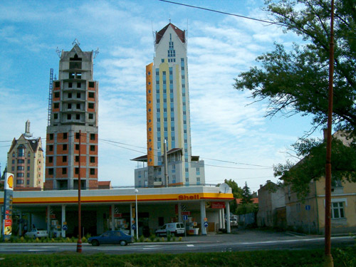
Skyscrapers in Lučenec
ESO 1
ESO 2
ESO 3
22 floors

Slide 6
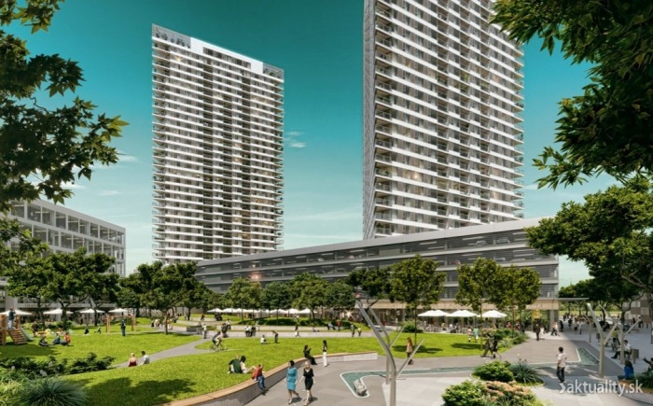
Panorama city
J&T and Penta
BA city of skyscrapers

Slide 7
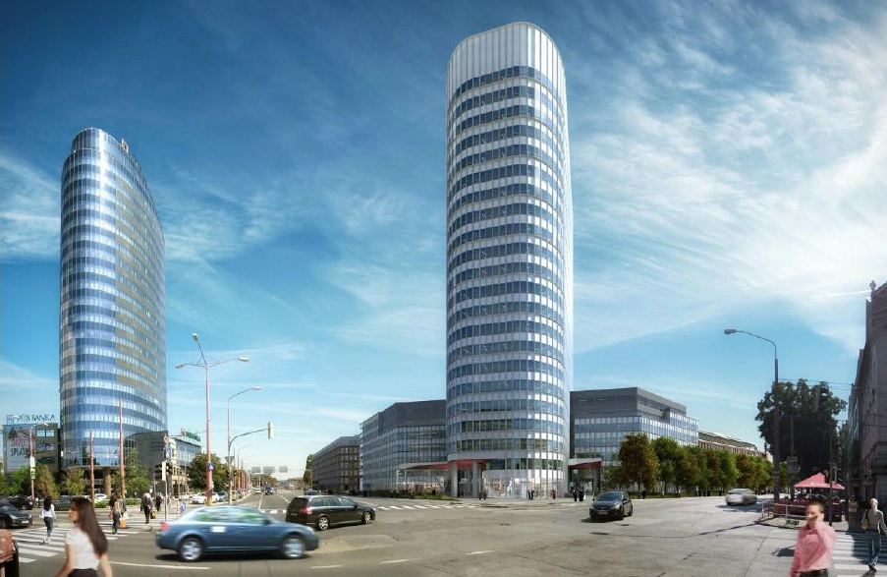
Twin city
The biggest project
17BN$
Multifunctional complex

Slide 8
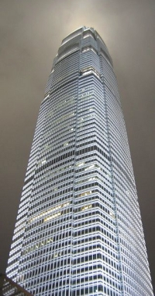
Skyscrapers in CA$HICE
Kechnec Education Center (KEC)
286m
Biggest in Europe

Slide 9
Thank you for your attention !!!

