Slide 1
Vatikán
Gymnázium Jána Adama Raymana Mudroňova 20 Prešov
Jozef Štefančin 3.C

Slide 2
Štátne znaky
vlajka
štátna vlajka
štátny erb
pápežský znak
znak svätej stolice

Slide 3
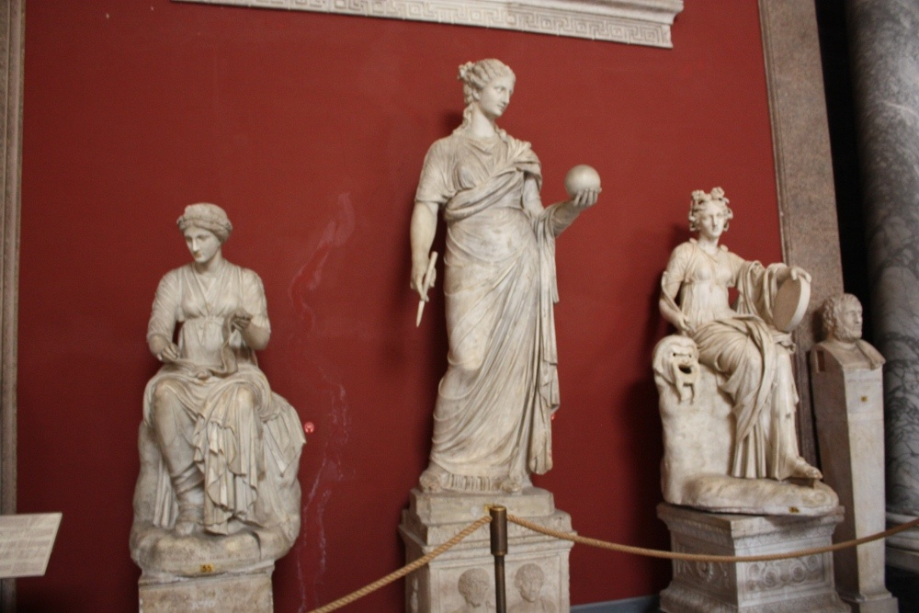
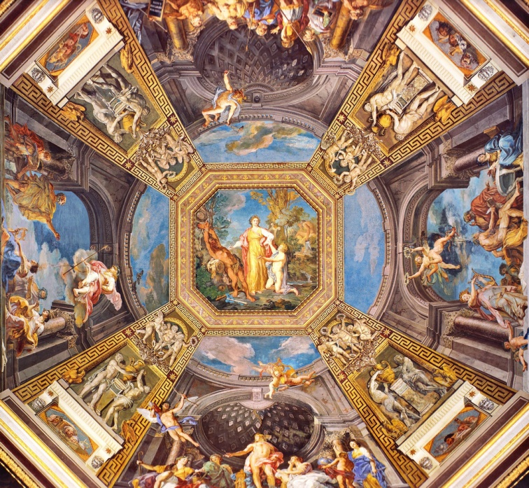
Sala delle Muse

Slide 4
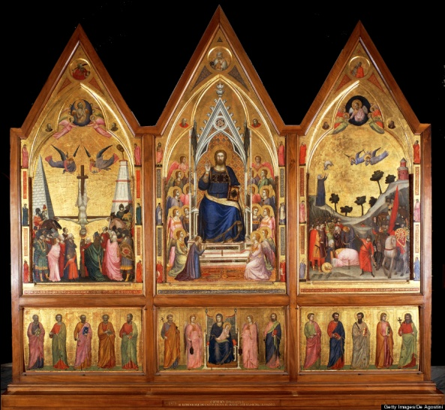
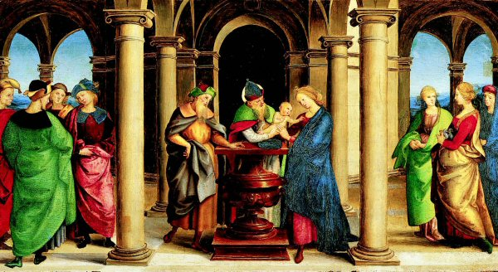
Pinacoteca Vaticana

Slide 5
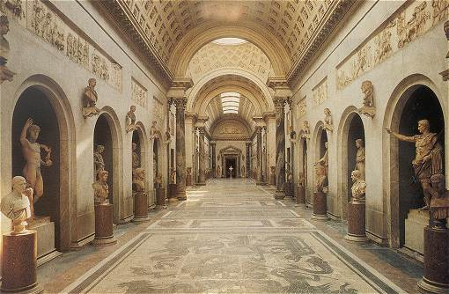
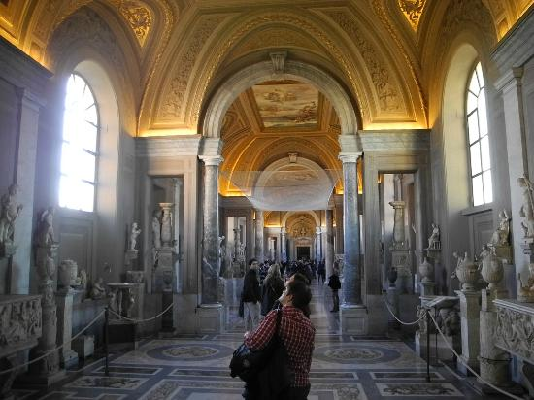
Galleria dei Gandelabri

Slide 6
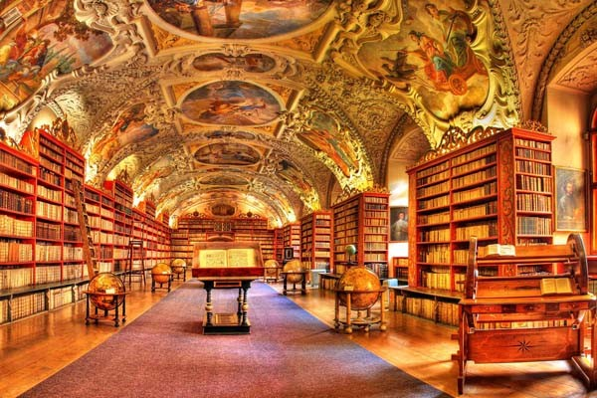
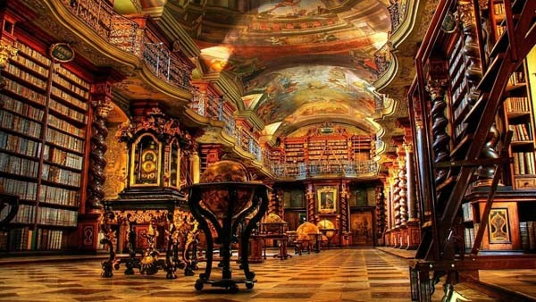
Bibliotheca Apostolica Vaticana

Slide 7
zdroje
http://server.sk/zaujimavosti/cestopisy/vatikan-stat-v-state-s-mnozstvom-kultury-a-histori/
http://www.rim.maweb.eu/vatikan/vatikanska-muzea/
http://www.rim.maweb.eu/vatikan/sixtinska-kaple/
https://www.youtube.com/watch?v=mDV48bsquew
http://www.radiovaticana.va/slovak/posizione%20geografica.html
http://www.radiovaticana.va/slovak/stemma_vaticano.html
http://www.atlantedellarteitaliana.it/immagine/00008/4354OP1317AU7460.jpg
https://c2.staticflickr.com/6/5299/5561754721_7fcdf8db6a_b.jpg
http://www.rim.maweb.eu/vatikan/vatikanska-apostolska-knihovna/
http://www.visit-vaticancity.com/img/raphael-circumcision.jpg
http://allart.biz/temp/Club/images/logotype.jpg
http://radiovaticana.cz/images/stemma.jpg
http://media-cdn.tripadvisor.com/media/photo-s/02/56/f4/d6/filename-dscn1860-jpg.jpg
http://www.romeguide.it/VATICANO/musei_images/braccio_nuovo.jpg
http://www.doba.sk/wp-content/uploads/2014/07/08-BNNWpHB-620x.jpg
http://www.doba.sk/wp-content/uploads/2014/07/19-1k4Gg3g-620x.jpg

