Slide 1
Protected Areas of Prešov region
Jozef Štefančin 3.C

Slide 2
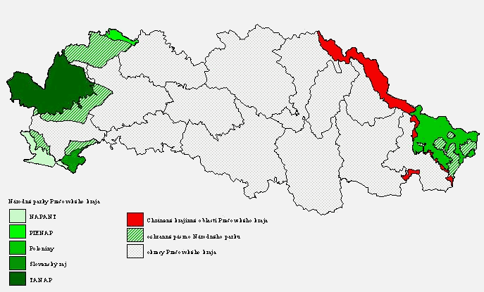

Slide 3
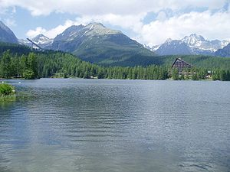
TANAP
Establishment – 1st January 1949
Area – 738 km²
Hiking trail 600 km
16 marked and maintained bike trails

Slide 4
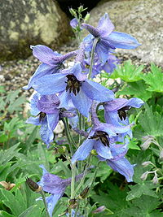
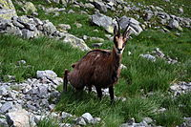
Flora and fauna

Slide 5
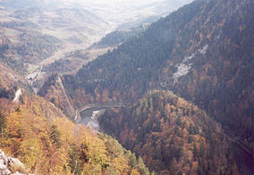
PIENAP
Establishment – 16th january 1967
Area – 37,5 km² ; the smallest one
Known for the Dunajec River and the natural beauty

Slide 6
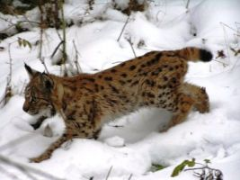
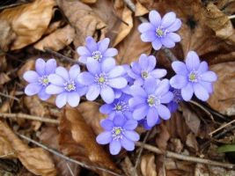
Flora and fauna

Slide 7
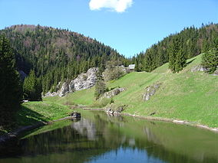
Slovak Paradise National park
Establishmen 18th January 1988
Area 130,11 km²

Slide 8
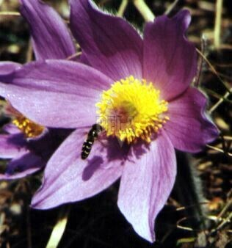
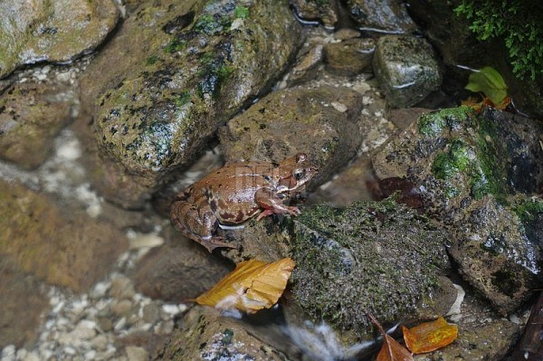
Flora and fauna

Slide 9
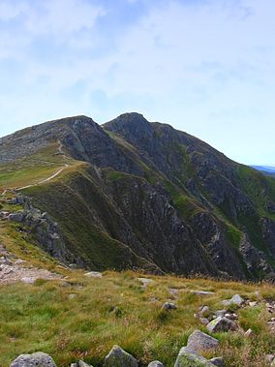
Low Tatras National park
Establishment – 1978
Area – 728 km²
The largets one on Slovakia

Slide 10
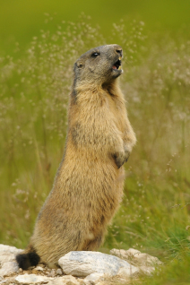
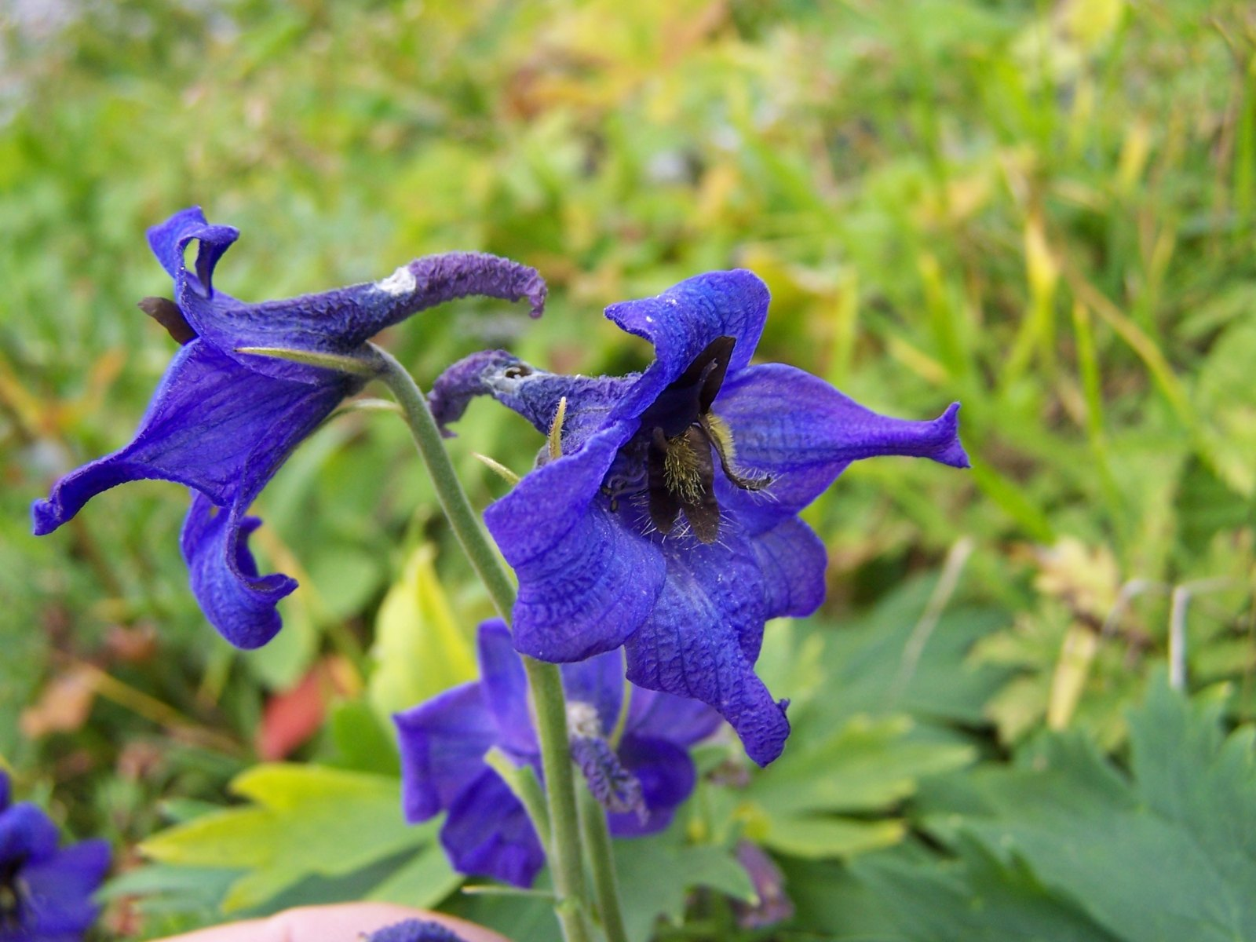
Flora and fauna

Slide 11
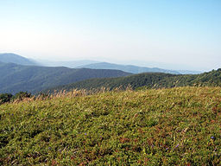
National Park Poloniny
Establishment – 1st October 1997
Area – 298,05 km²

Slide 12
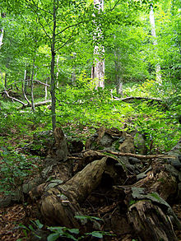
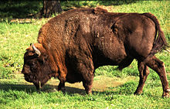
Flora and fauna

Slide 13
sources
http://www.sazp.sk/slovak/periodika/sprava/kraje/presov/images/mapa6a.gif
http://en.wikipedia.org/wiki/Tatra_National_Park,_Slovakia
http://upload.wikimedia.org/wikipedia/commons/thumb/d/d2/Strbske_pleso_lake.jpg/300px-Strbske_pleso_lake.jpg
http://upload.wikimedia.org/wikipedia/commons/thumb/4/49/Delphinium_oxysepallum.jpg/200px-Delphinium_oxysepallum.jpg
http://upload.wikimedia.org/wikipedia/commons/thumb/c/c4/Rupicapra_rupicapra_-_Jah%C5%88aci_%C5%A1t%C3%ADt.jpg/200px-Rupicapra_rupicapra_-_Jah%C5%88aci_%C5%A1t%C3%ADt.jpg
http://en.wikipedia.org/wiki/Pieniny_National_Park_(Slovakia)
http://upload.wikimedia.org/wikipedia/commons/thumb/5/56/Dunajec_and_Lesnica.jpg/284px-Dunajec_and_Lesnica.jpg
http://www.pienap.sk/mambots/content/multithumb/thumbs/b.300.200.16777215.0..stories.Fauna.rys.jpg
http://www.pienap.sk/mambots/content/multithumb/thumbs/b.300.200.16777215.0..stories.flora.Pecenovnik.jpg
http://en.wikipedia.org/wiki/Slovak_Paradise_National_Park
http://upload.wikimedia.org/wikipedia/en/thumb/2/29/Slovensky_raj_logo.gif/150px-Slovensky_raj_logo.gif
http://upload.wikimedia.org/wikipedia/commons/thumb/4/45/Slovensky_raj-Stratenska_pila.jpg/284px-Slovensky_raj-Stratenska_pila.jpg
http://www.slovenskyraj.sk/popis/flora/floram.jpg
http://www.slovenskyraj.sk/popis/fauna/faunac04m.jpg
http://upload.wikimedia.org/wikipedia/commons/thumb/8/85/Derese2.jpg/284px-Derese2.jpg
http://upload.wikimedia.org/wikipedia/commons/6/65/Delphinium_oxysepalum_a6.jpg
http://www.napant.sk/flora/znak_uprss.gif
https://pamiatkyslovenska.files.wordpress.com/2013/07/svist-vrchovsky.jpg?w=212&h=318&crop=1
http://upload.wikimedia.org/wikipedia/en/thumb/1/1b/Poloniny_2008a.JPG/256px-Poloniny_2008a.JPG
http://en.wikipedia.org/wiki/Poloniny_National_Park
http://upload.wikimedia.org/wikipedia/en/thumb/3/32/Poloniny.png/90px-Poloniny.png
http://upload.wikimedia.org/wikipedia/commons/thumb/9/98/Wisent.jpg/220px-Wisent.jpg
http://upload.wikimedia.org/wikipedia/commons/thumb/1/1b/Stu%C5%BEica.JPG/220px-Stu%C5%BEica.JPG

Slide 14
Thanks for your attention

