Slide 1
Adrenaline
By Lenka Karahutova and Tomas Bilak

Slide 2
What’s adrenaline
Adrenaline/epinephrine is hormone
Dilates air passages, increase heart-rate
From adrenal glands
Helps survive in extreme conditions
Notes:
Dilate air passages – rozsirit priedusnice
Heart-rate – puls
Glands – zlazy

Slide 3
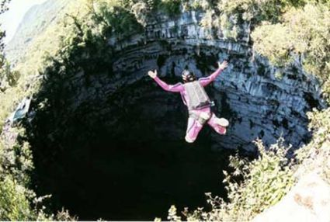
Cause of its secretion
Dangerous activities such as skidiving, base jumping, bungee jumping or making a woman angry
Fast paced team sports like basketball, football, etc.
Riding a roller coaster, driving fast automobiles, studying martial arts

Slide 4
Elevator surfing
An illegal “sport” popular with students
High buildings (skyscrapers)
Several people died doing this
Similar to train surfing

Slide 5
Idioms
Play with fire/Skate on thin ice
On dangerous ground/icy grond
Sail close to the wind
Watch one’s step
Pull your socks up
Keep your head down

Slide 6
Videos
Wingsuit proximity flying
Avalanche launching
Driving Ariel Atom (3:06)
Bear fighting
Bear Grylls
Proper way of phoning
Adrenaline

