Slide 1
6 Wonders of Slovakia

Slide 2
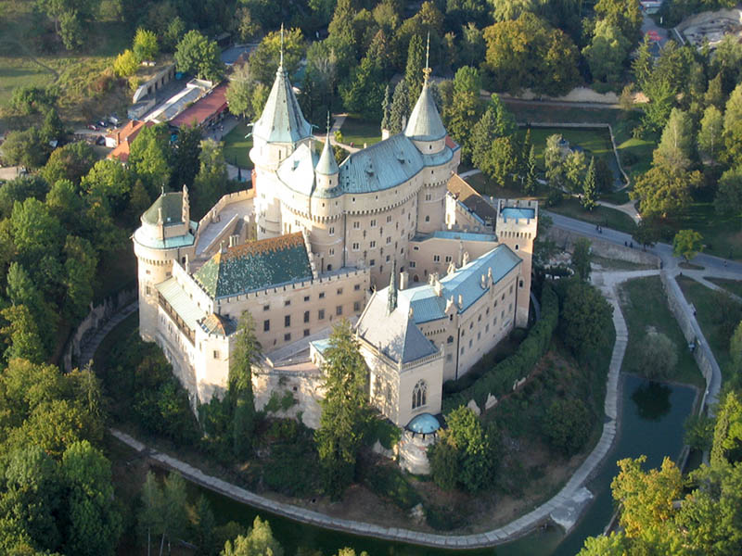
1. Bojnice Castle
The first written mention of the castle came from 1113,
originally built as a wooden fort
its first owner was Máté Csák
On 9 May 1950, a huge fire broke out in the castle
In 1970 it was declared a
national cultural monument

Slide 3
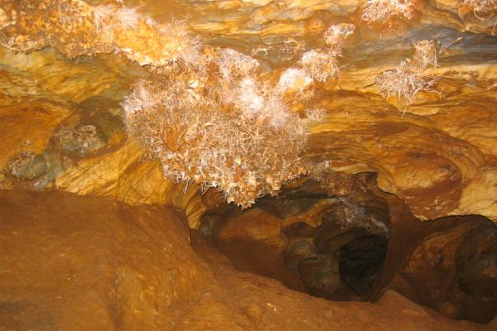
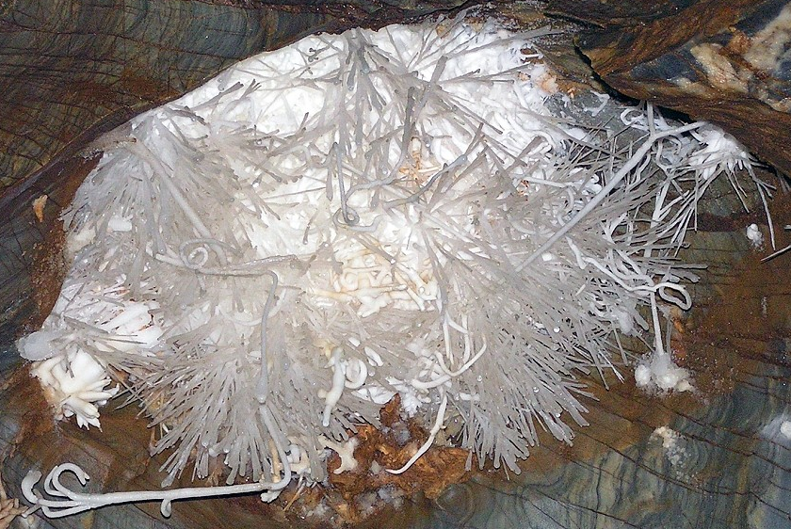
3. Ochtinská Aragonite Cave
located under the Revúca highlands.
One of the world's 3 available aragonite caves
the cave was discovered by Martin Cangár and Jiri Prosek in 1954
the mineral aragonite covers the walls of the cave
UNESCO

Slide 4
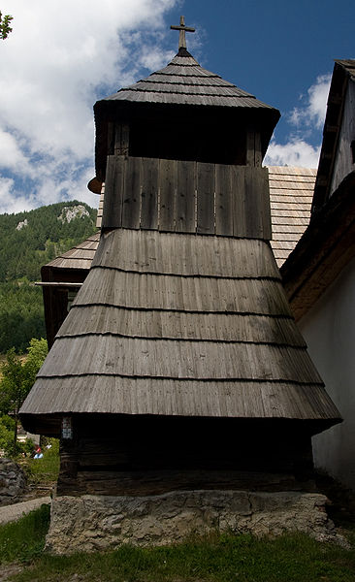
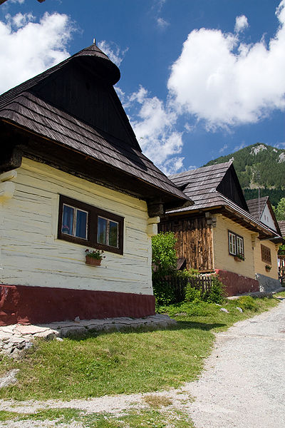
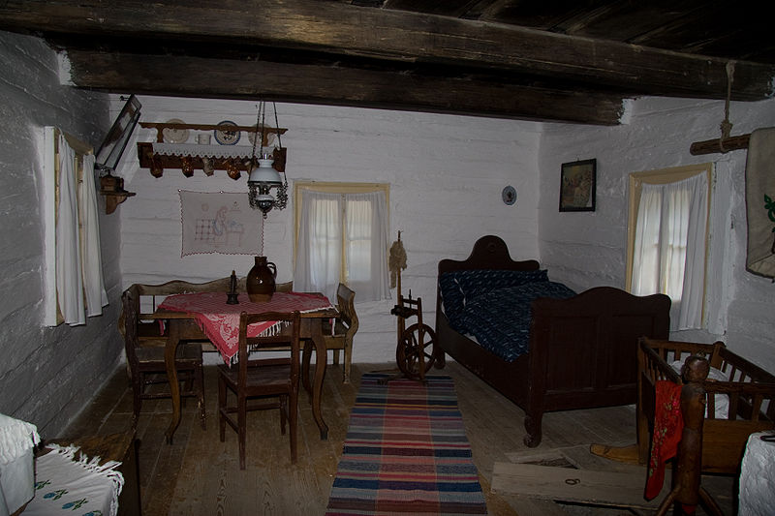
5.Vlkolínec
the first written mention of the village came from 1376
after 1882 it became part of Ružomberok
pure wooden village
1944, part of the village burned.
UNESCO

