Slide 1
PARAGLIDING
Lucia Holodňaková II.D

Slide 2
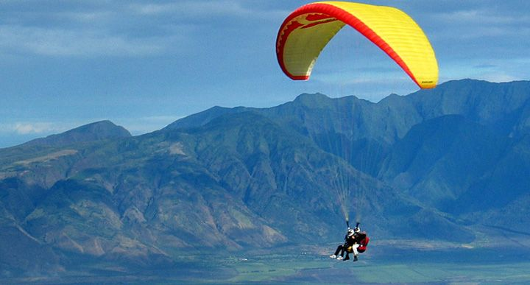
What is it?
It is the recreational and competitive adventure sport of flying paragliders.
It is type of lightweight and free-flying.

Slide 3
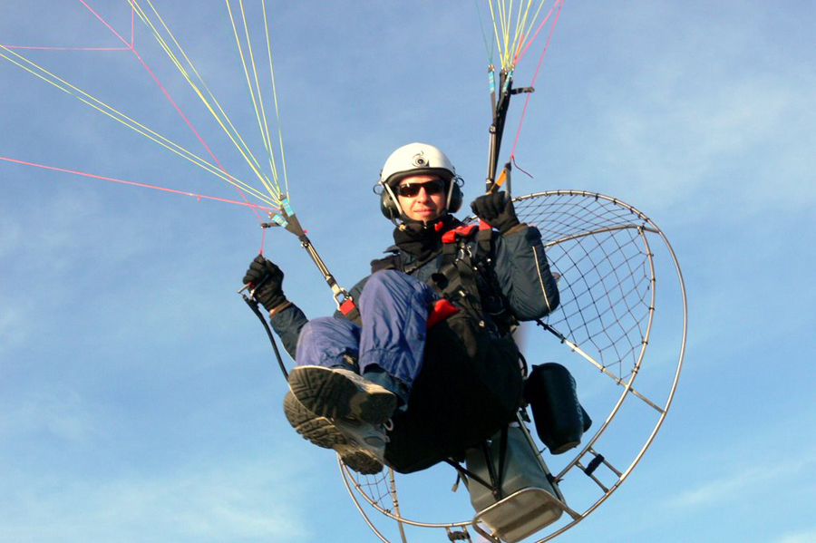
Pilot is sitting on seat made from cloth and he is holding a rope in his hands. It starts by running from hill or switch on some type of motor.

Slide 4
history
The 1st time it was jump from building with some type of umbrella.
The 1st jump was historically documented from tower in Venice by Fausta Veranzia.
Real jump with parachute was in 1797 from
hot air balloon.

Slide 5
Nowadays
More and more people want to try it.
They can check in course of paragliding.
The flying is philosophy for someone , for others it is relax or escape from worries, for many it is a lifestyle.
VIDEO

Slide 6
Thank you for your attention ☺

