Slide 1
Special events, festivals
Laura Mária Sabolová
Lucia Holodňaková
III.D 2015/2016

Slide 2
Contents
Festival of costumed dolls
Festival of flavors in Nitra
FIVA World Rally 2016
Across Slovakia on bike for 5 days
Art film festival

Slide 3
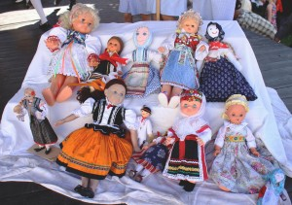
festival of costumed dolls 2.-7.6.2016
It is a international children 's festival.
It takes few days.
Folk ensembles are changing costumed dolls.

Slide 4
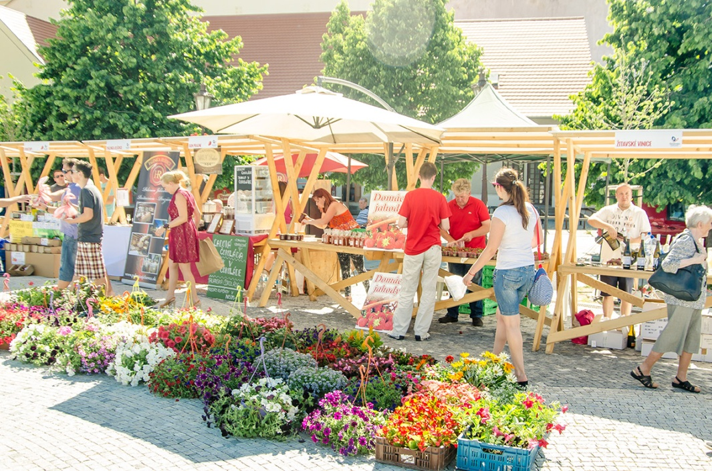
festival of flavors in Nitra 4.6.2016
There are more than 150 different meals.
It includes strawberry specialties.
There are coffee roasters, chocolate, small breweries, distillers and vintners awards at international competitions.

Slide 5
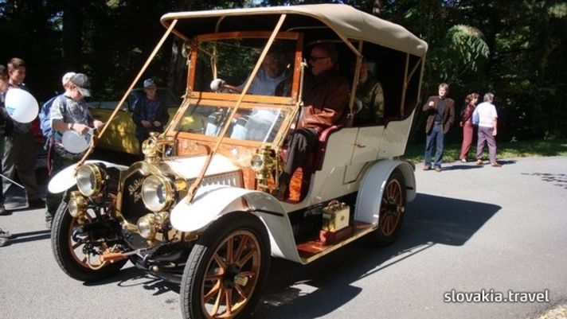
FIVA World Rally 2016 7.- 12.6.2016
FIVA - Organisation which supports historical vehicles throughout the world. (1966)
In Slovakia it will be for the first time.
Piešťany-Bojnice-Volkswagen-Nitra

Slide 6
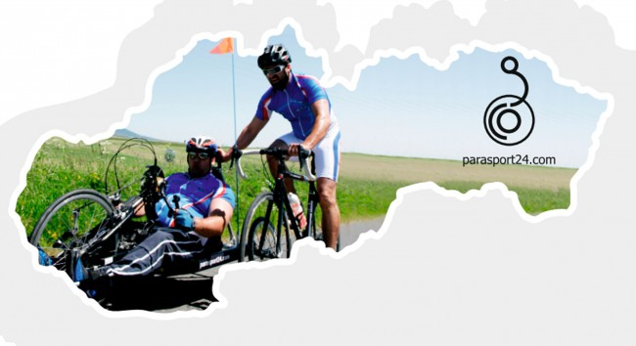
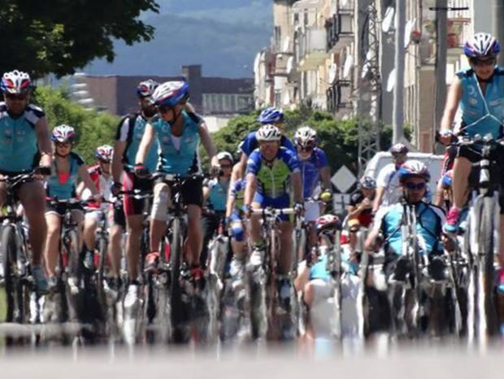
Across Slovakia on bike for 5 days
The largest sports charity event in Slovakia.
There are handicapped people.
Start: Trenčianske Teplice
Finish: Spišská Nová Ves
420 kilometres
24 towns

Slide 7
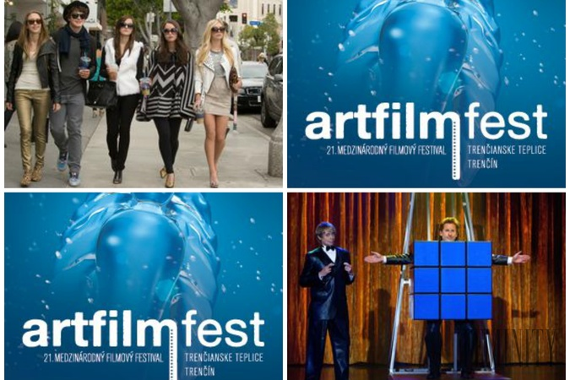
Art film festival 17.- 25.6.2016
The largest film festival in the Slovakia.
There are great actors and news from the world of movie.
Awards: Actor's mission and Golden camera

Slide 8
Thank You for your Attention ☺

Slide 9
sources
http://slovakia.travel/medzinarodny-festival-krojovanych-babik#prettyPhoto
http://slovakia.travel/festival-chuti-nitrianskeho-kraja-a-jahodova-nitra-opaet-oziju
http://slovakia.travel/fiva-world-rally-v-piestanoch
http://spravy.pravda.sk/domace/clanok/355110-cez-slovensko-na-bicykli-za-5-dni-vyrazi-pre-charitu-opat-mnozstvo-celebrit/
http://artfilmfest.sk/festival/

