Slide 1
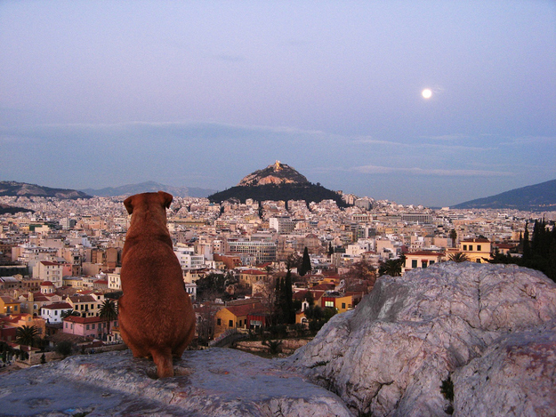
Grécko
Martin Ištoňa 3.C

Slide 2
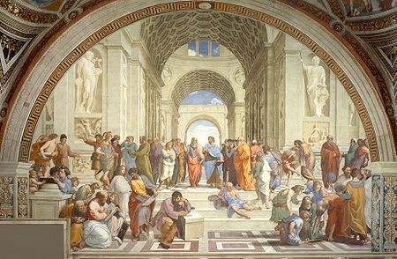

Slide 3
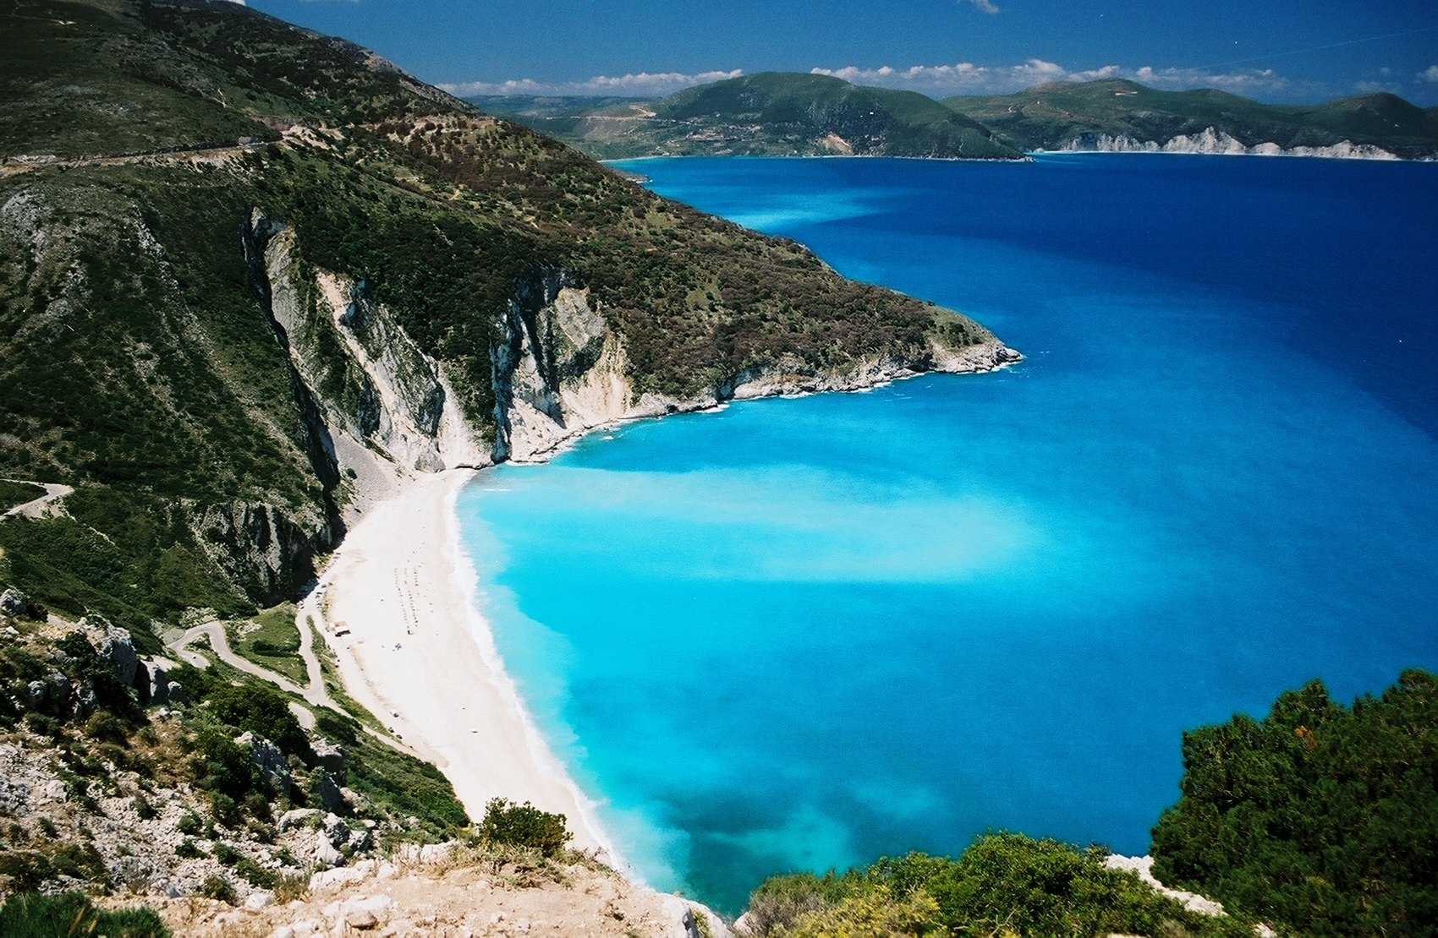
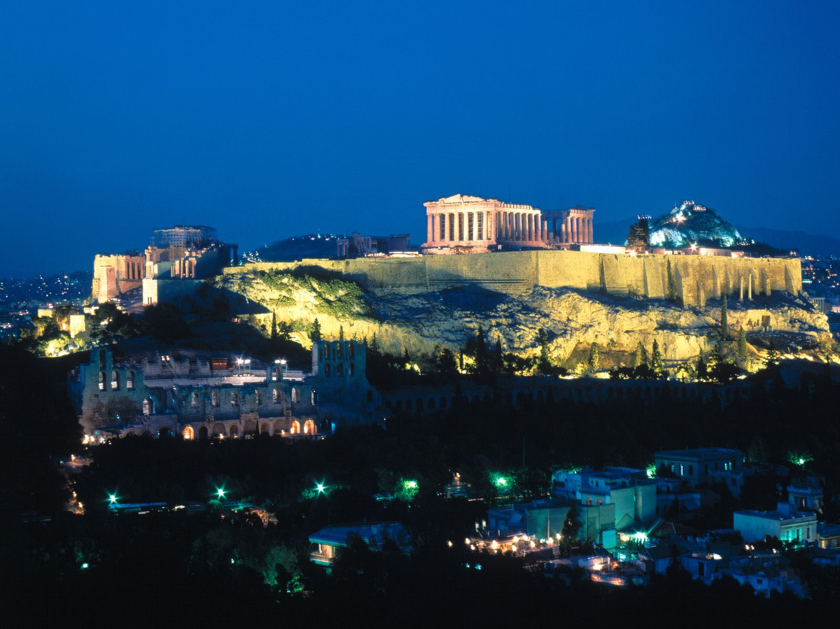
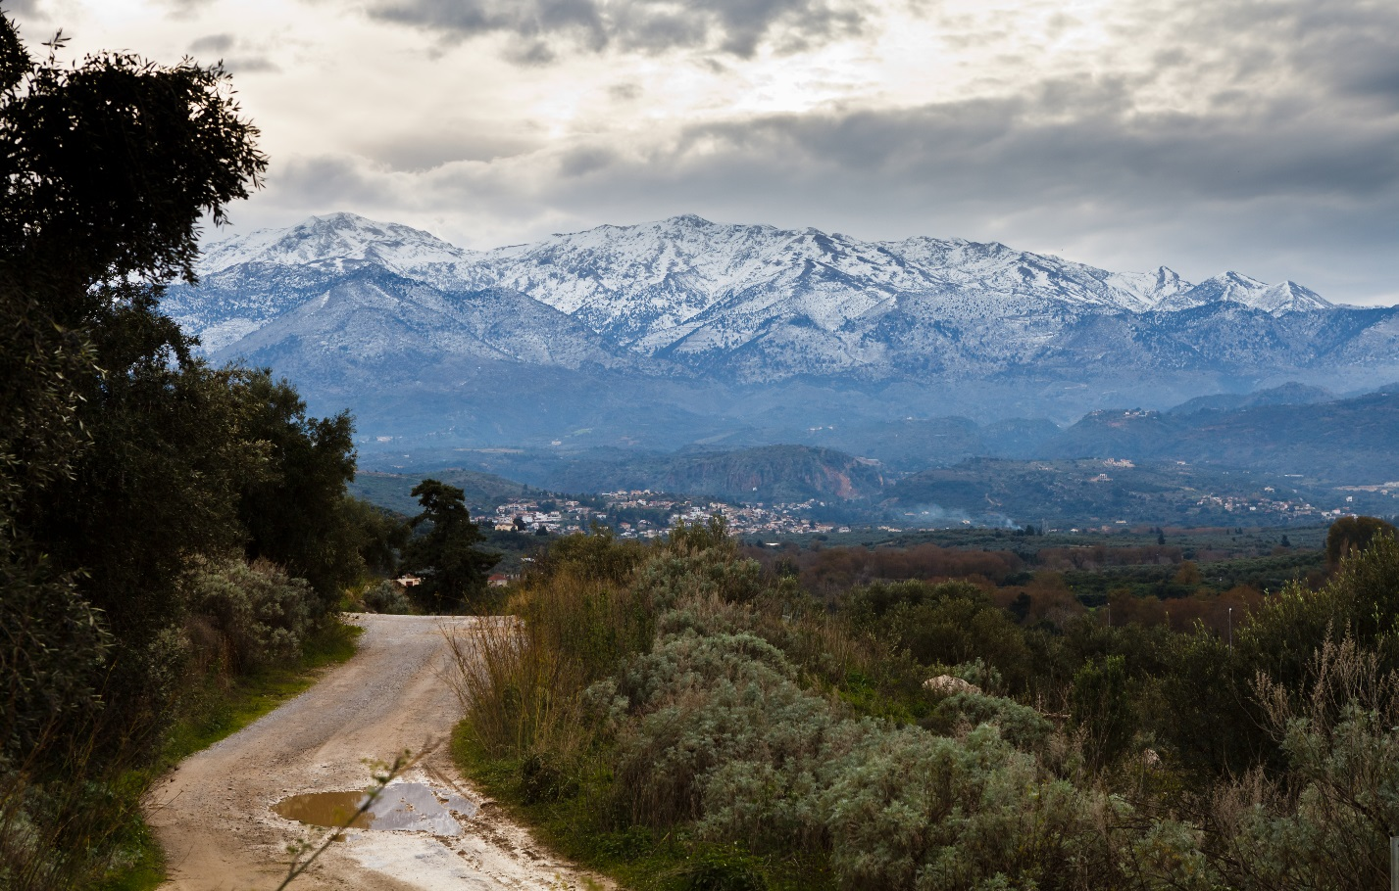

Slide 6
Štátne symboly
https://www.youtube.com/watch?v=5VkPRU6C-JQ

Slide 7
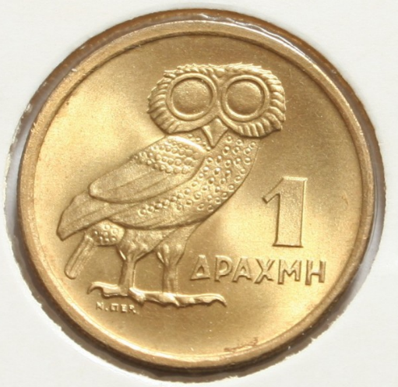
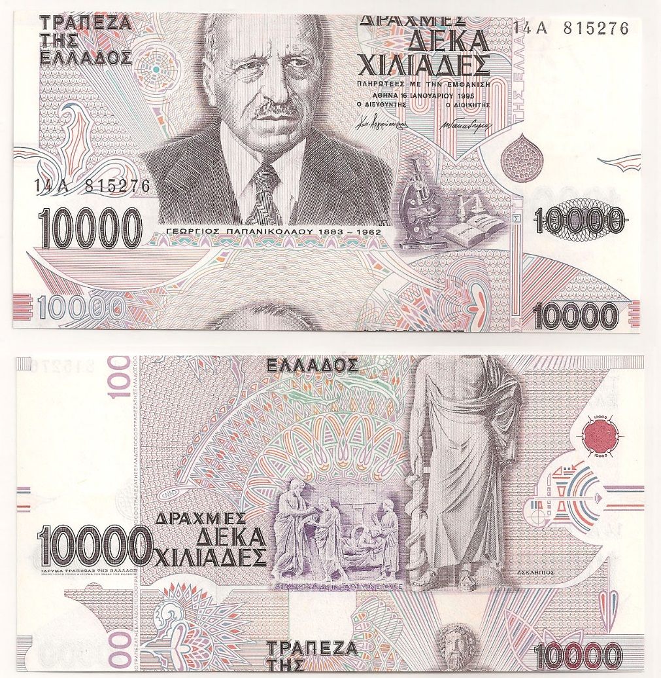
Základné informácie

Slide 8
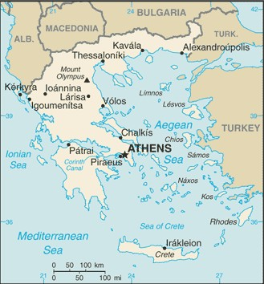
Poloha

Slide 9
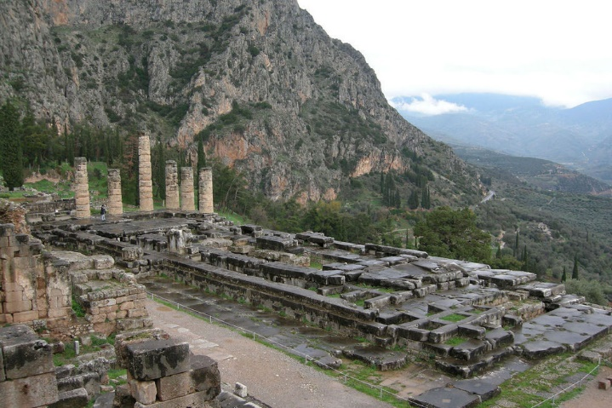
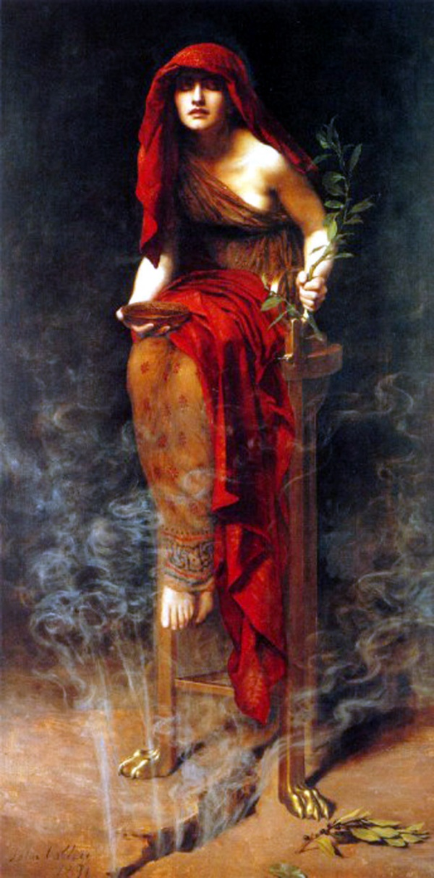
Delfská veštiareň

Slide 10
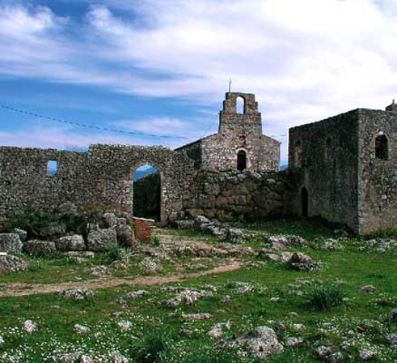
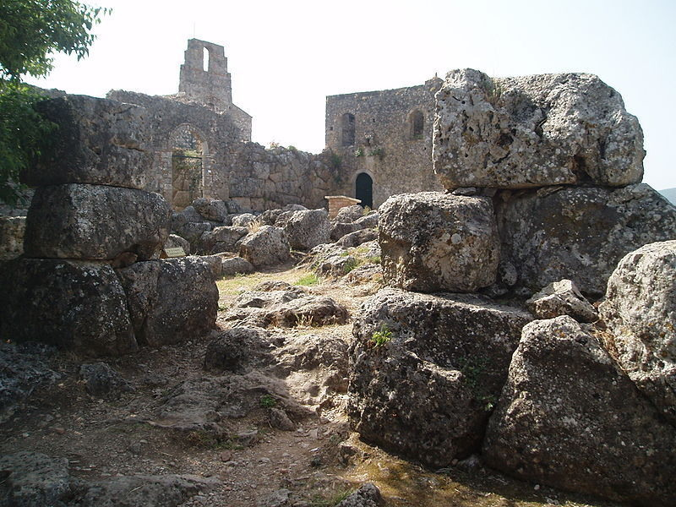
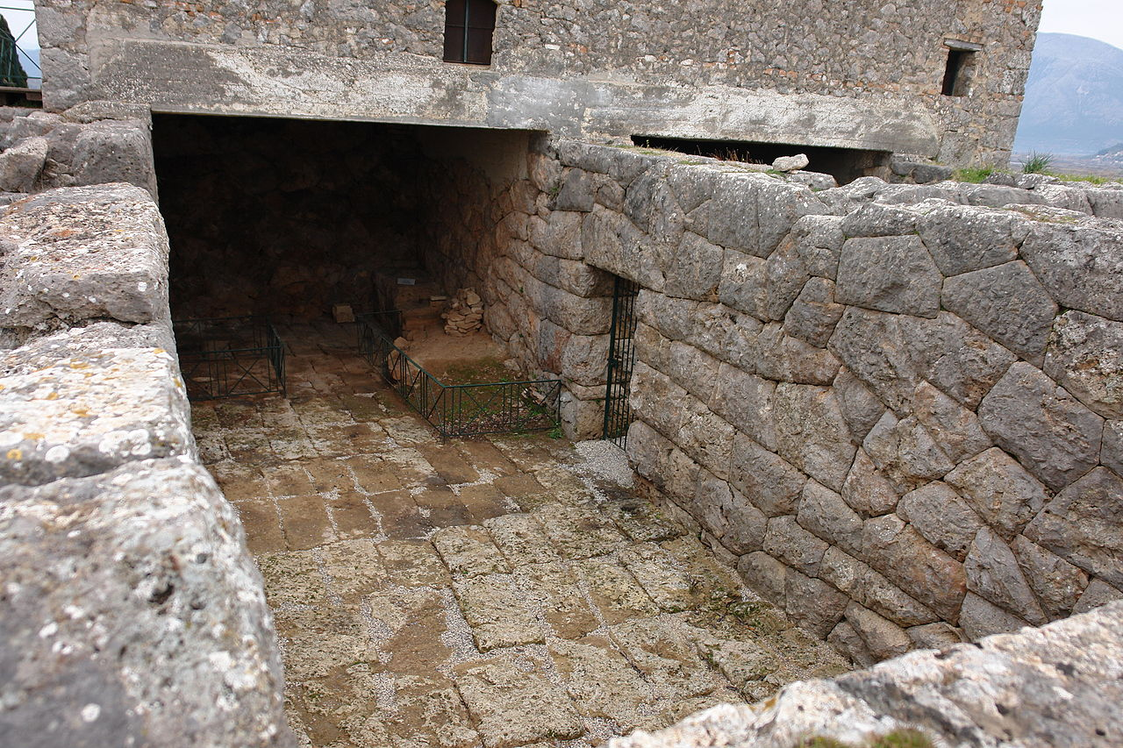
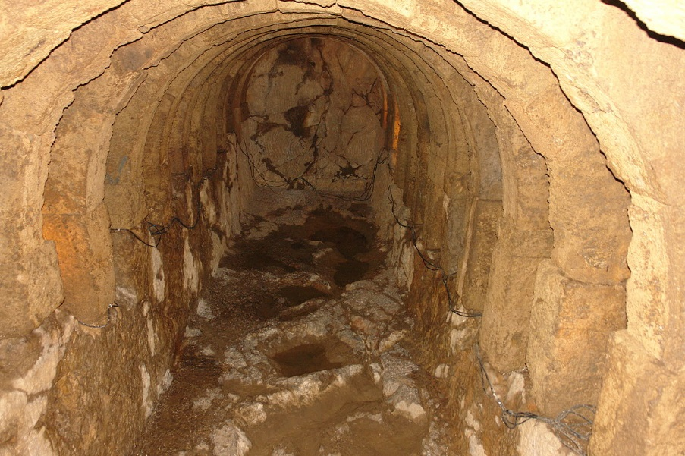
Necromanteion „veštiareň mŕtvych“

Slide 11
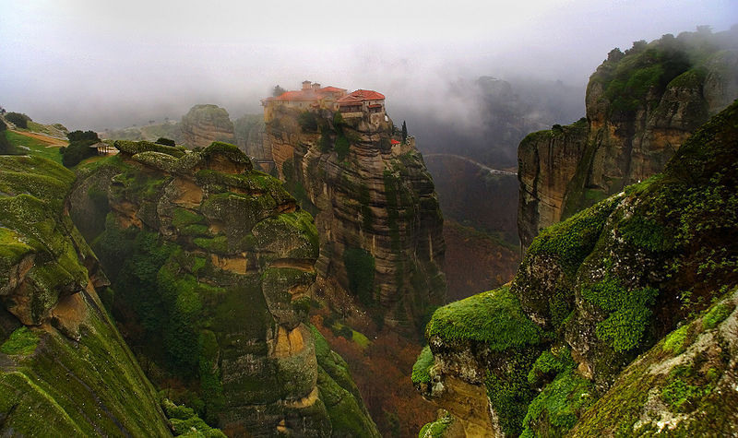
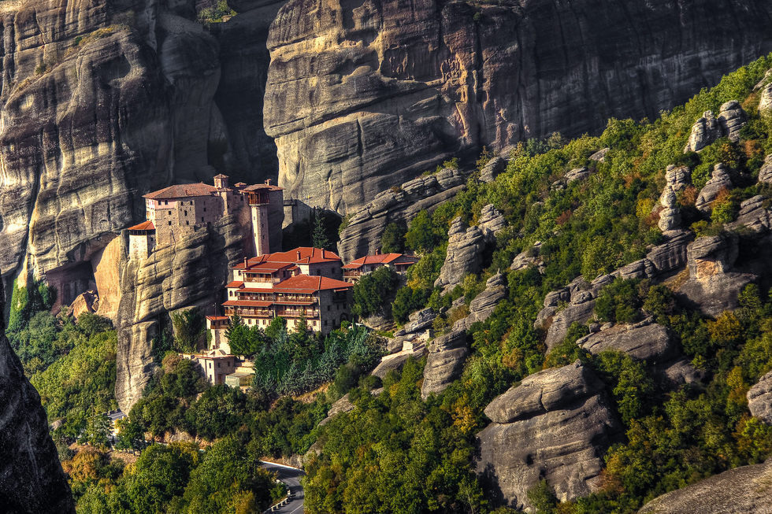
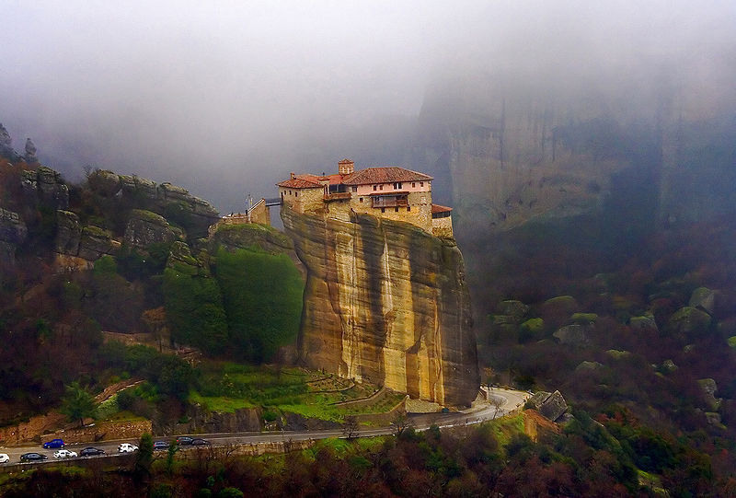
Meteora

Slide 12
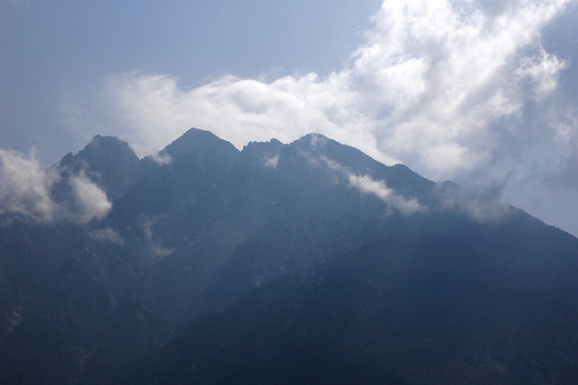
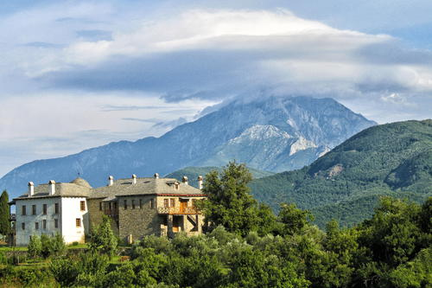
Athos

Slide 13
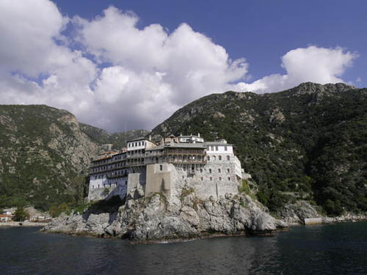
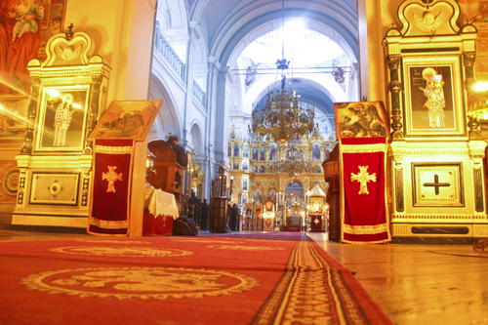
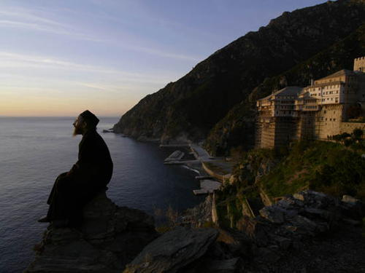
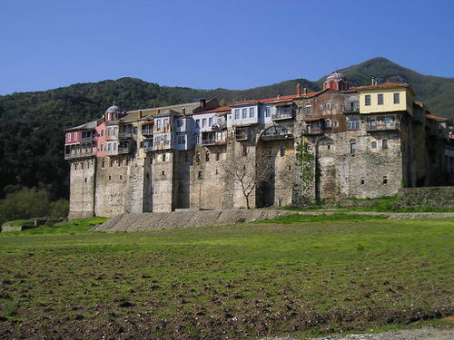

Slide 14
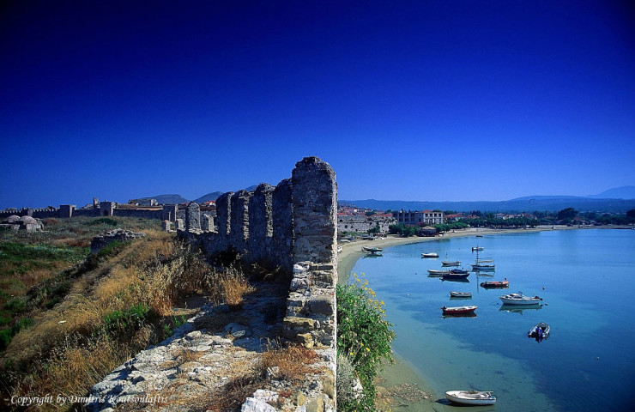
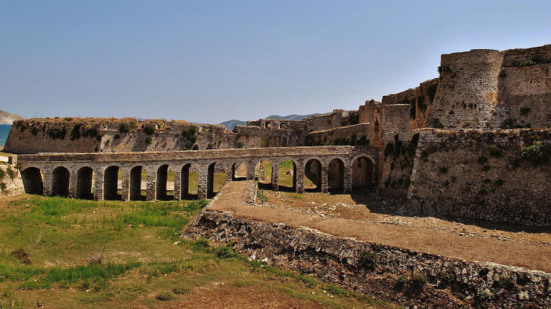
Methoni

Slide 15
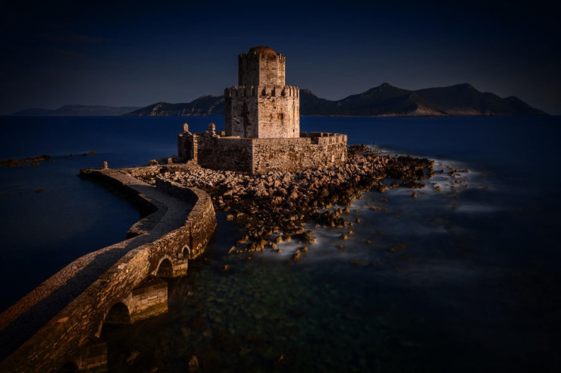
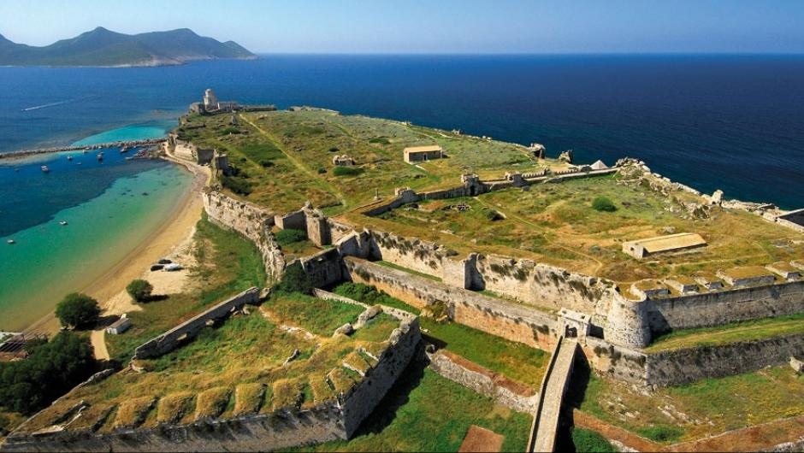

Slide 16
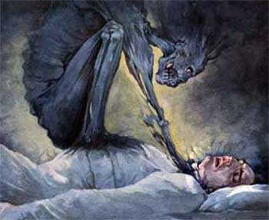
Mykénsky vampír

Slide 17
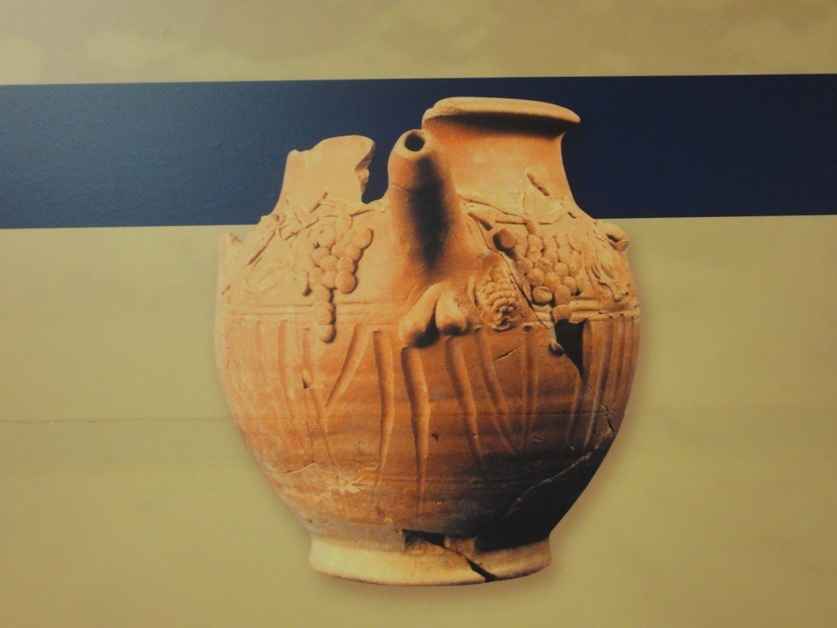
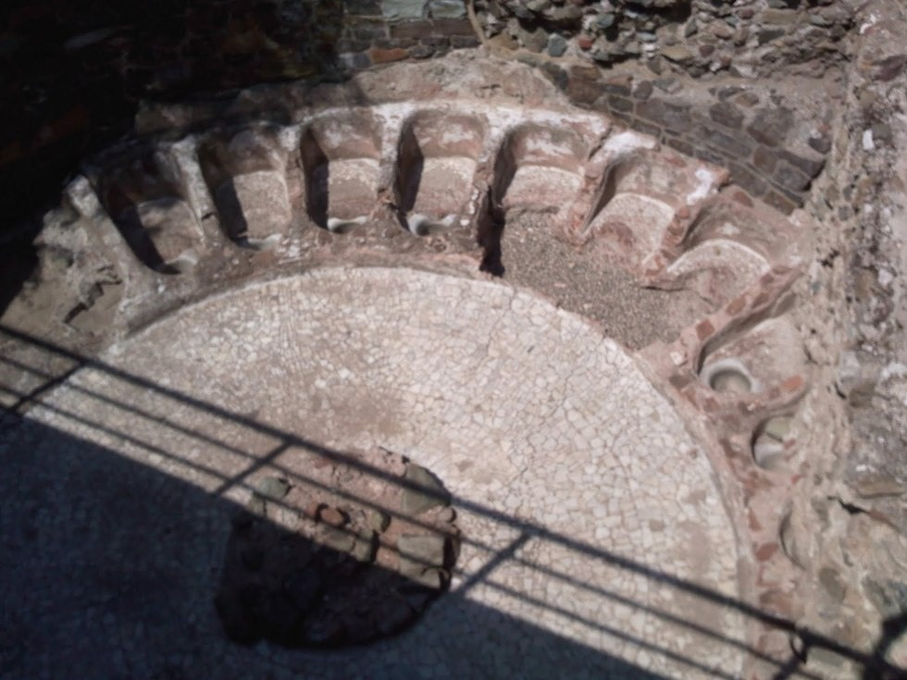
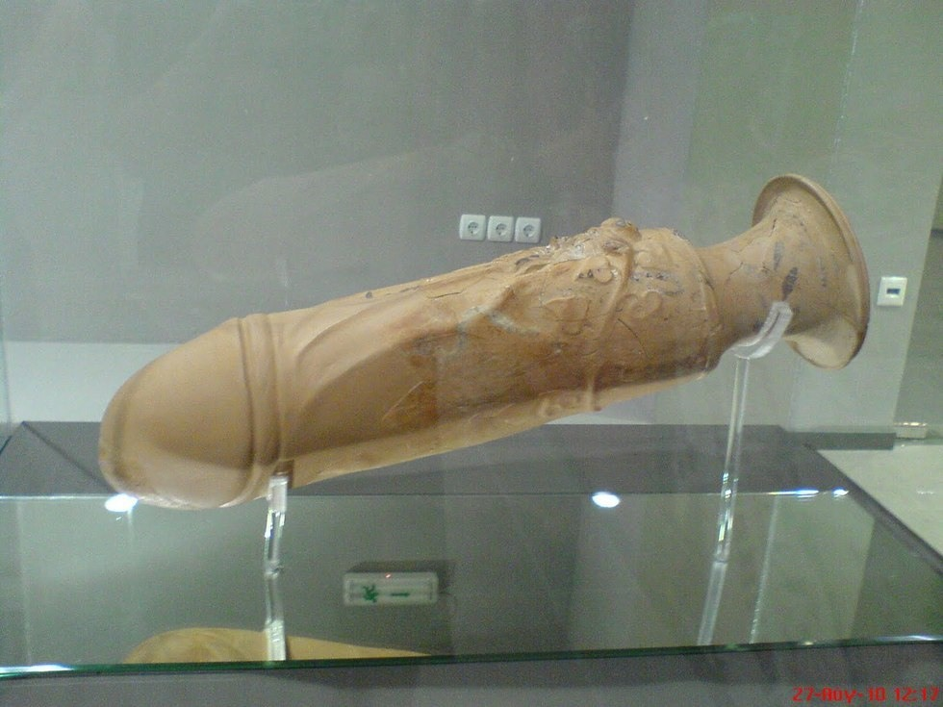
Nevestinec Thessaloniki

Slide 18
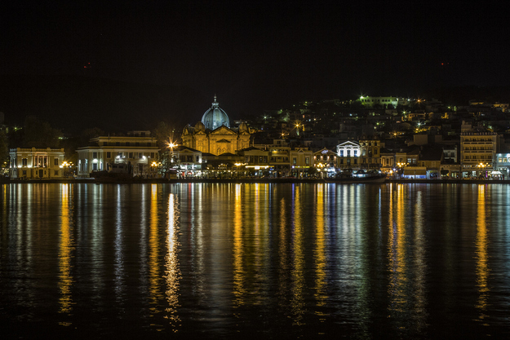
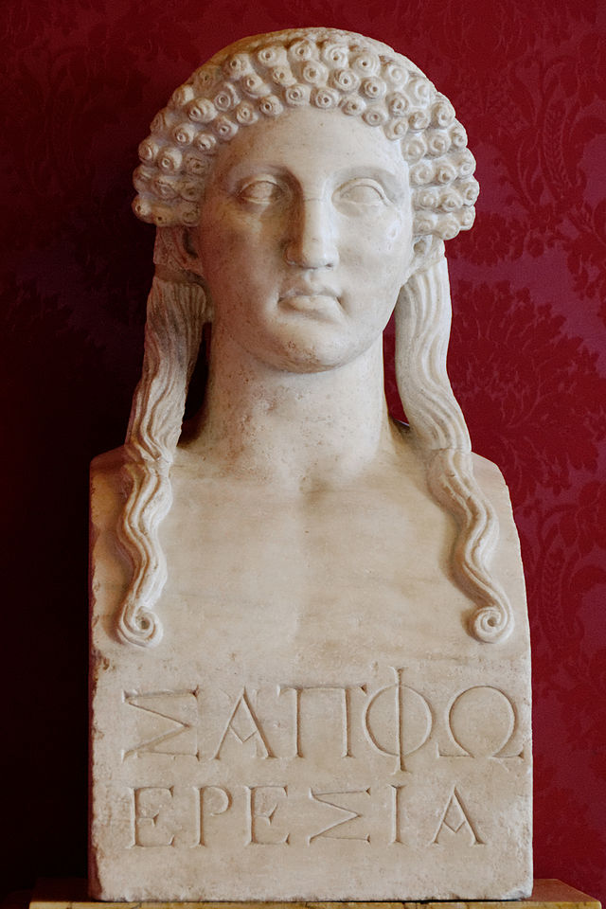
Ostrov Lesbos

Slide 19
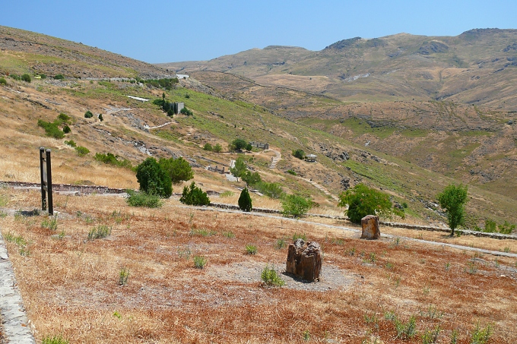
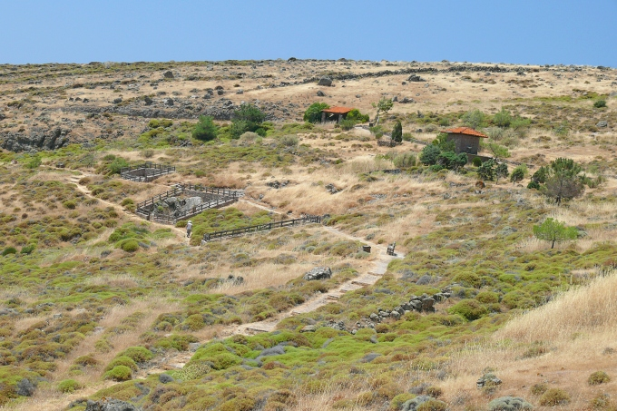

Slide 20
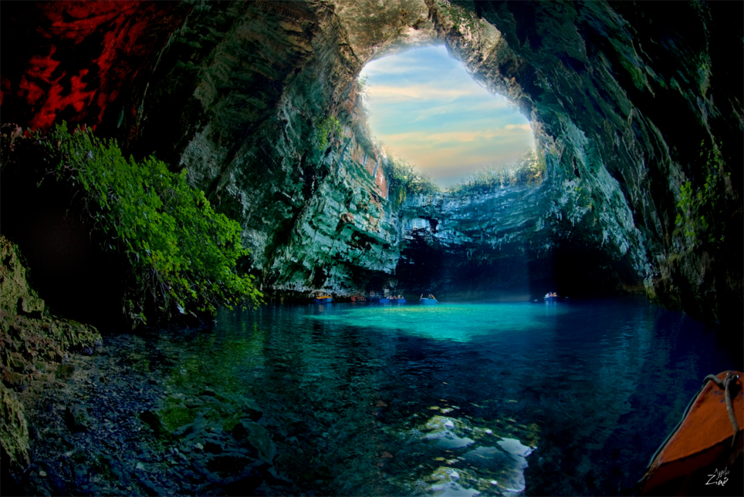
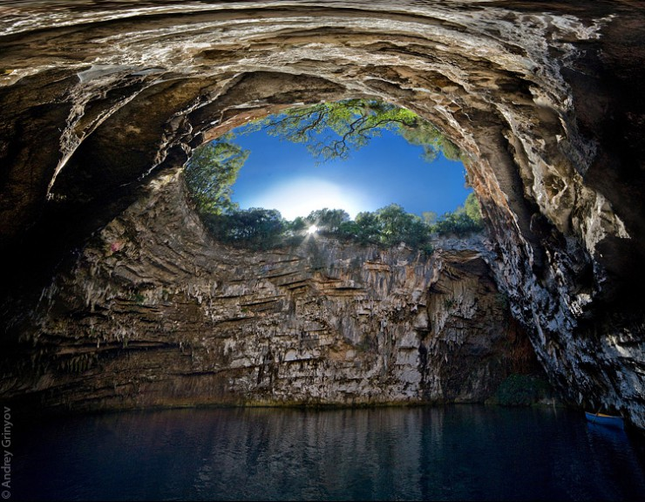
Jazero Melissani Sami, Kefalonia

Slide 21
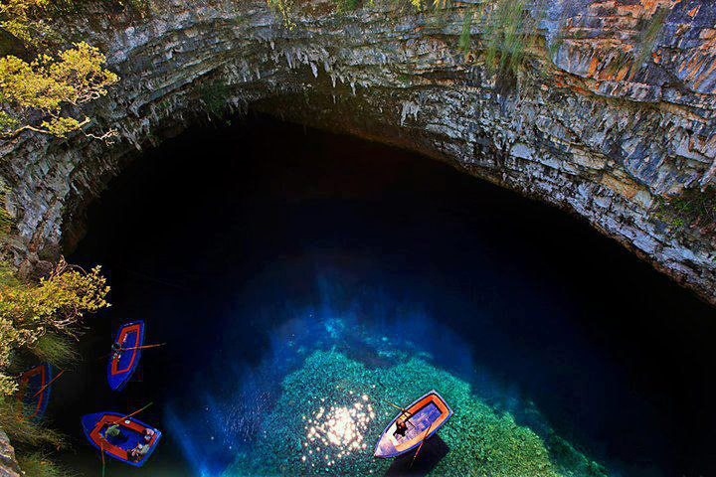
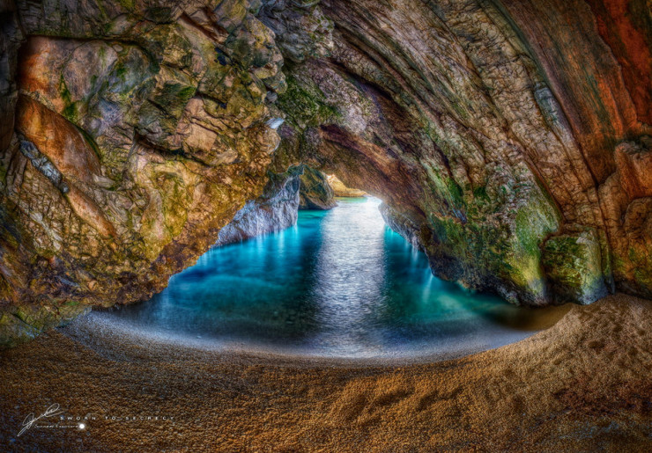
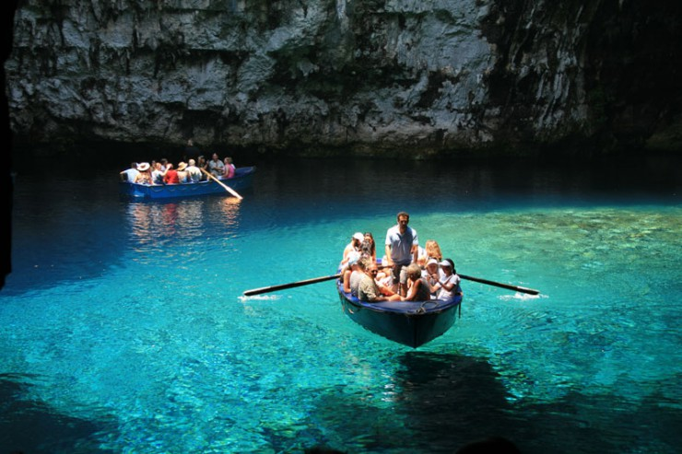

Slide 22
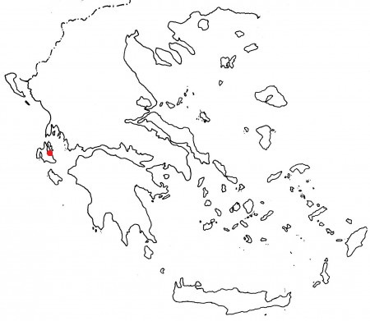
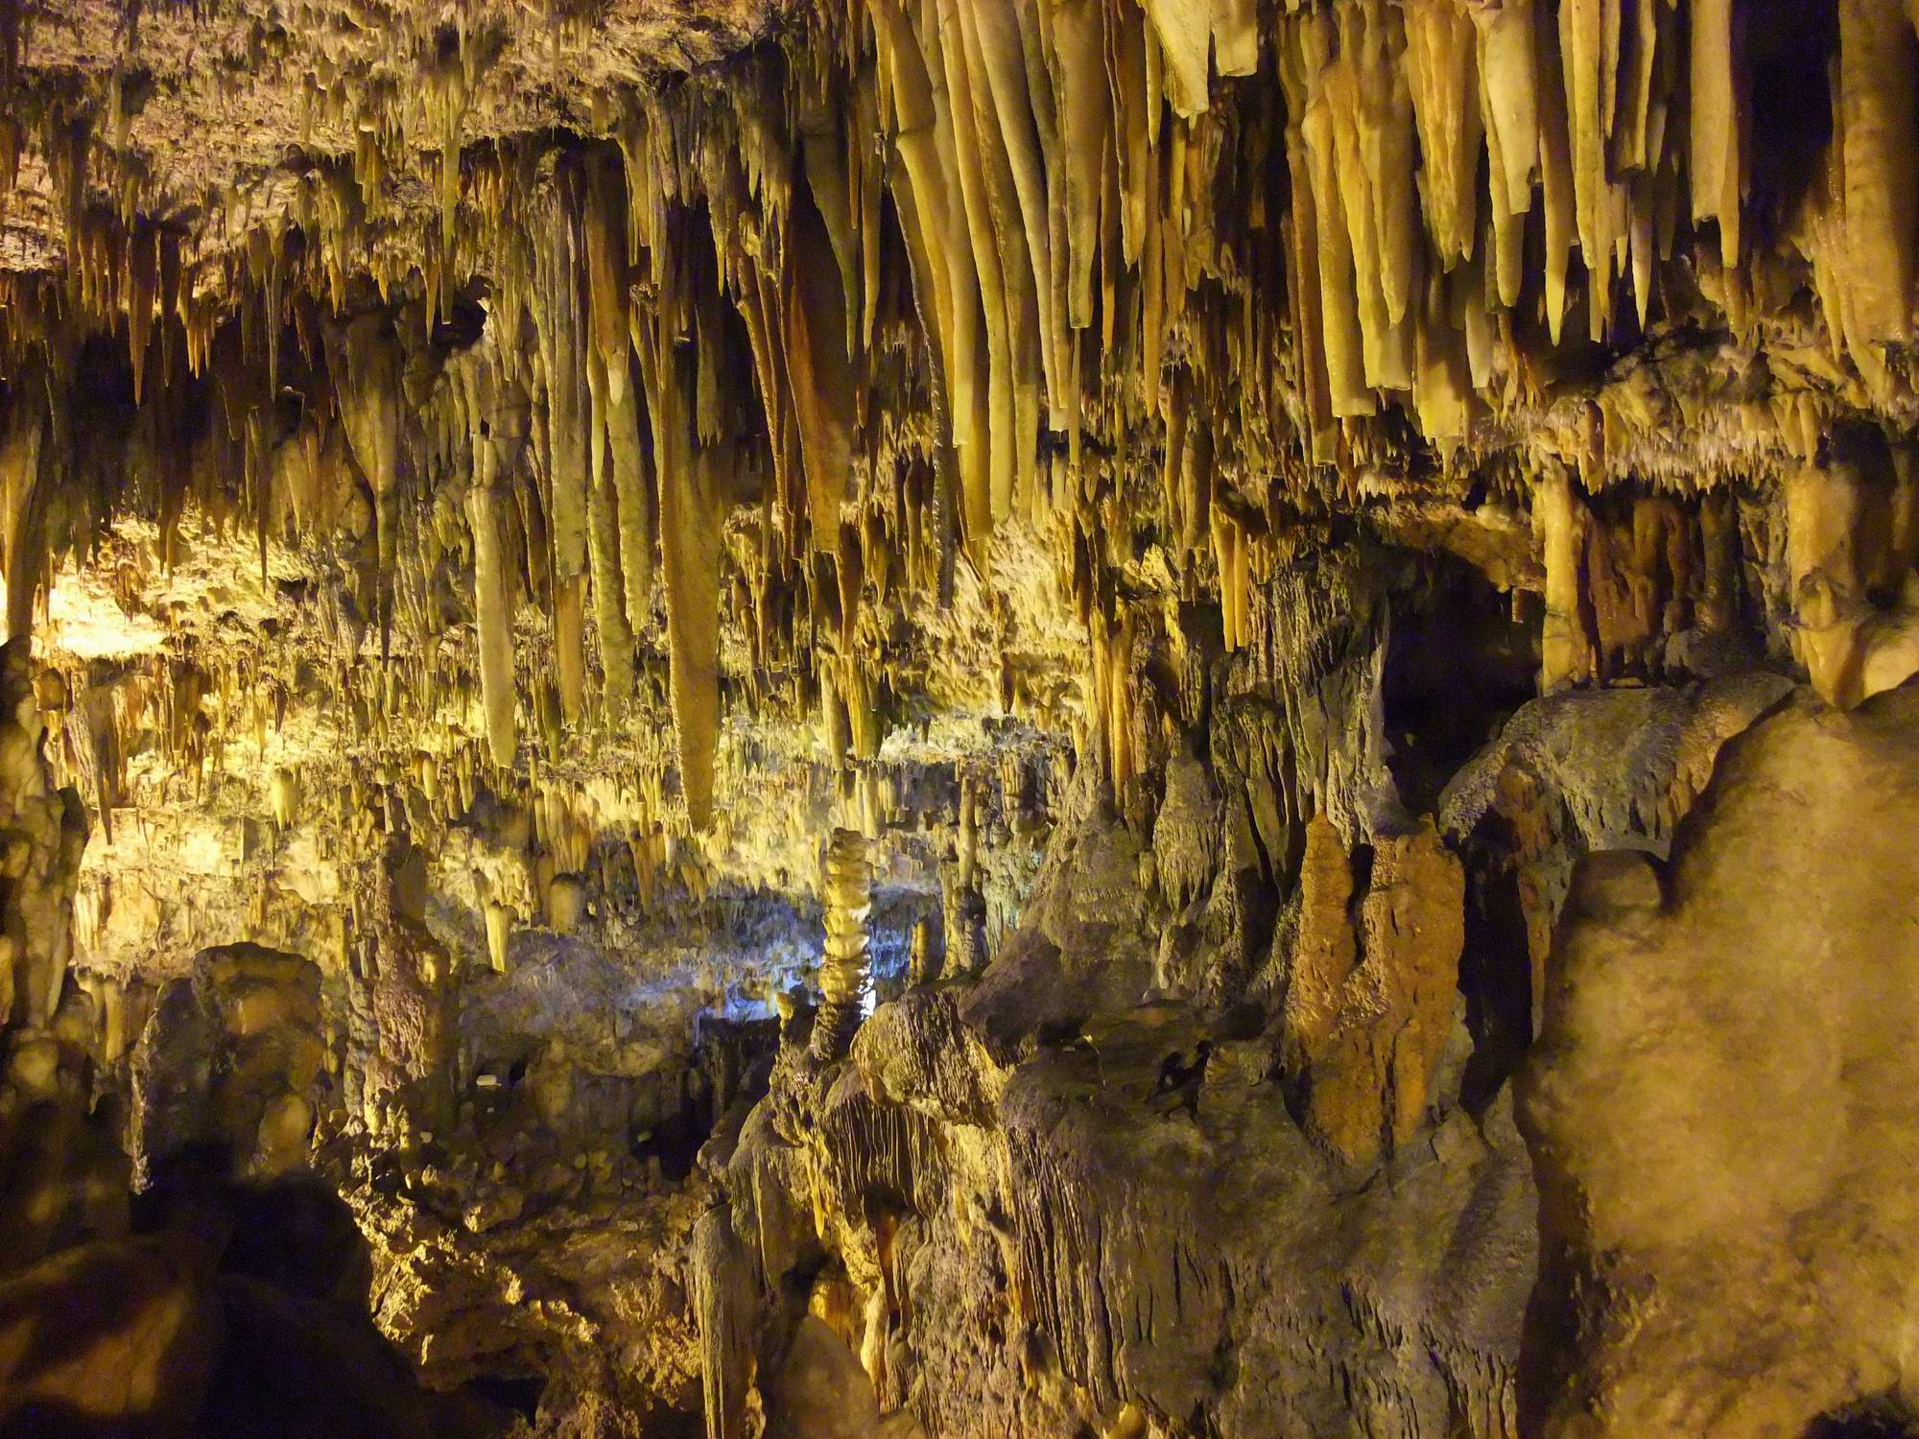
Jaskyňa Drogaratti Sami, Kefalonia

Slide 23
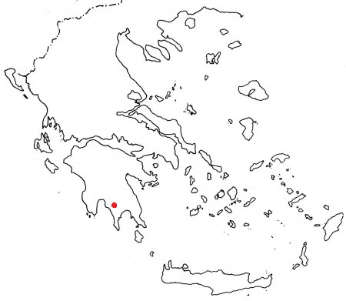
Jaskyňa Kastania

Slide 24
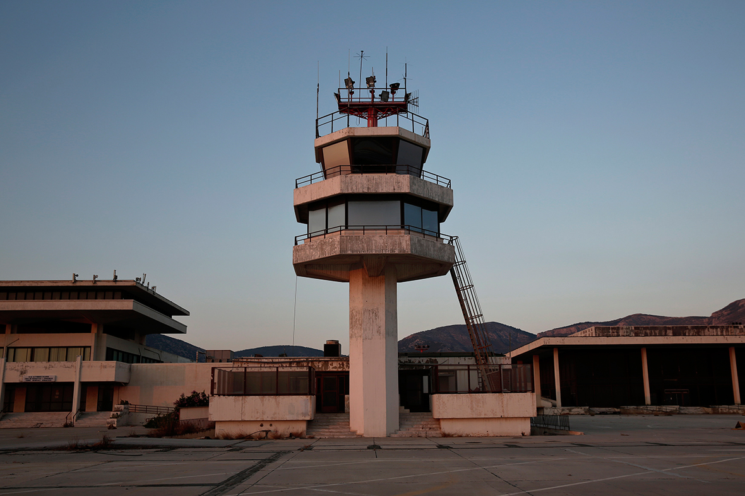
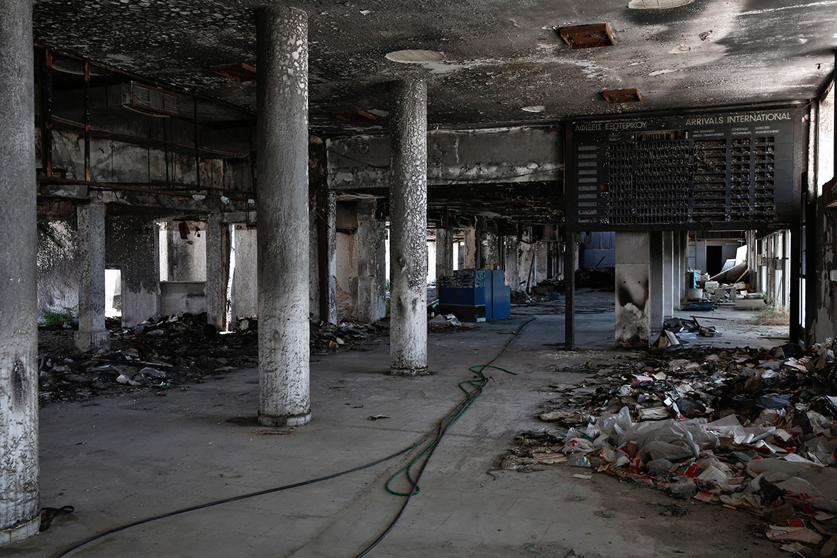
Letisko Hellenikon

Slide 25
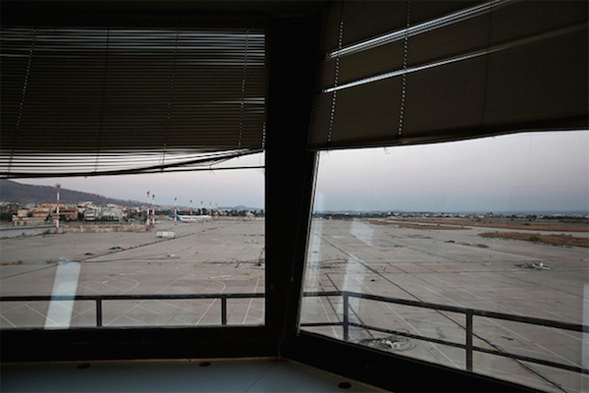
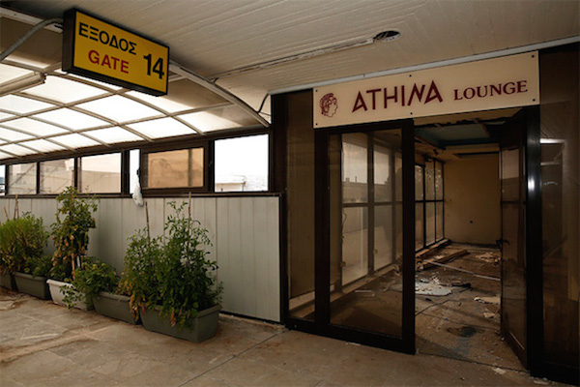
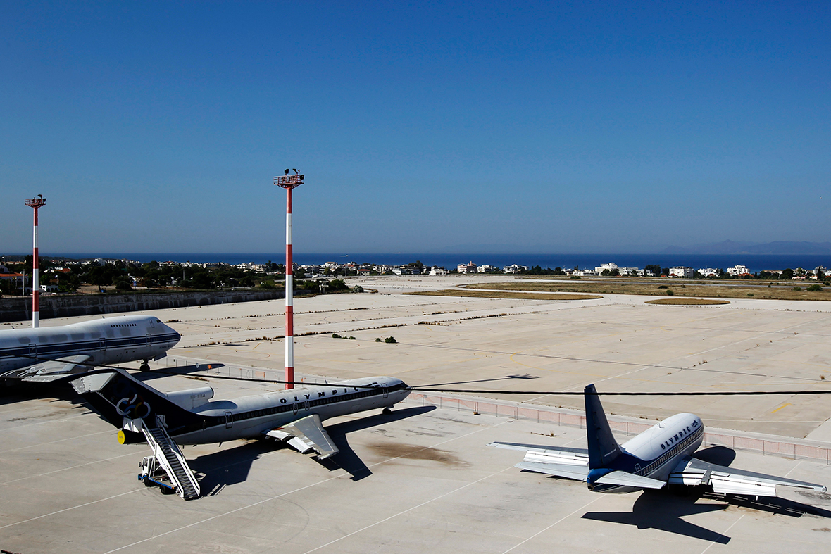

Slide 26
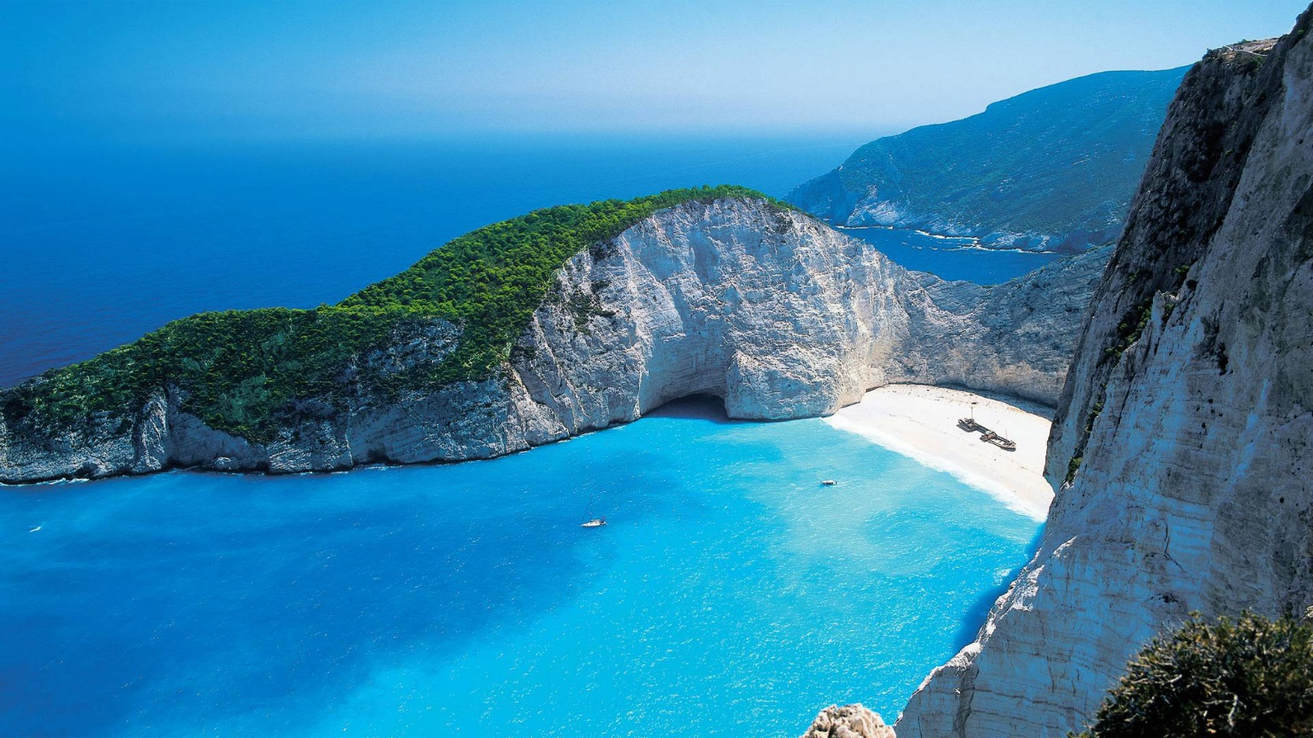
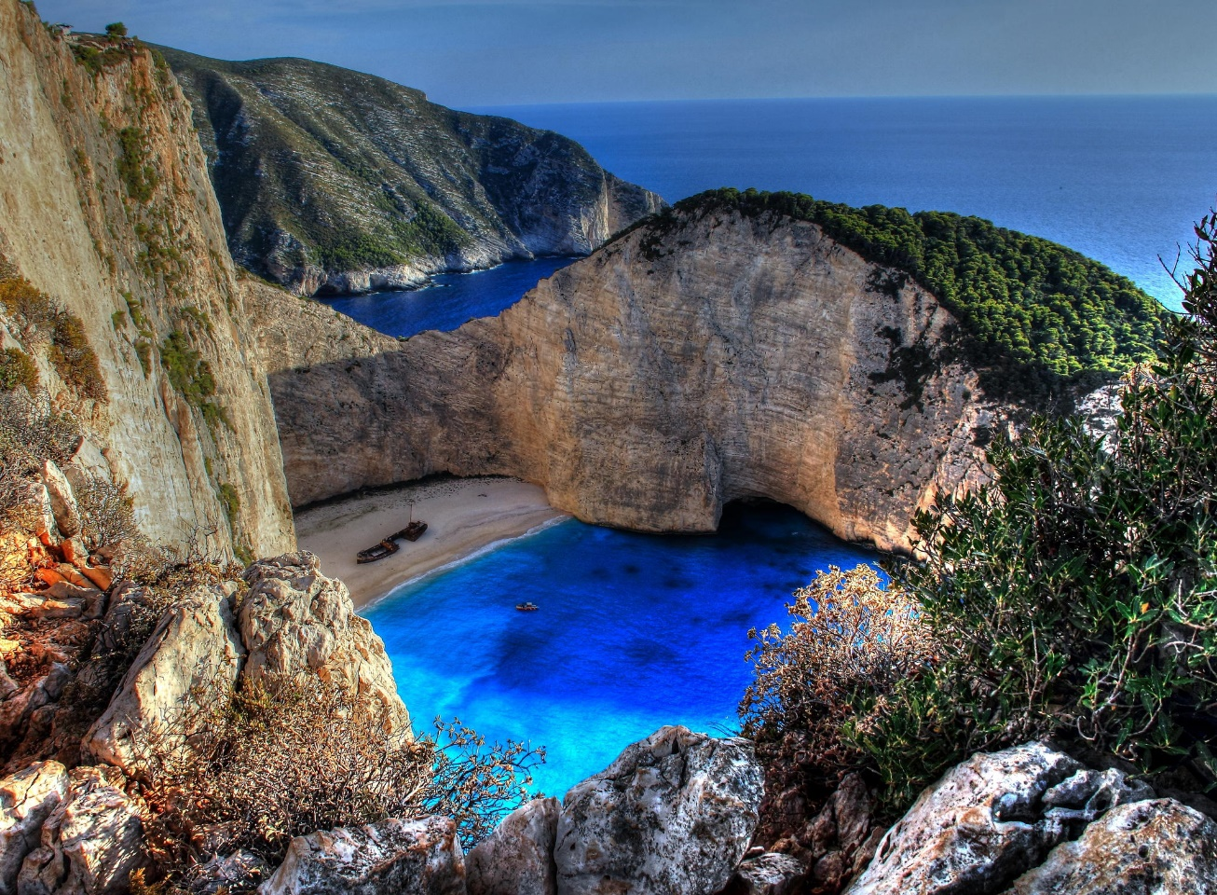
Navagio Beach

Slide 28
Giola – prírodné kúpalisko

Slide 29
Mirage House

Slide 30
Graffiti

Slide 32
Santorini

Slide 36
Amirandes Grecotel Exclusive Resort

Slide 37
Hotel Senia

Slide 38
Jedlá

Slide 39
Nápoje

Slide 40
Kolomboi

Slide 41
Bouzoki

Slide 42
Zaujímavosti

Slide 43
Zdroje
http://www.europskaunia.sk/grecko
http://www.fphil.uniba.sk/index.php?id=5411
http://www.euroinfo.gov.sk/452/grecko/
http://www.milujemcestovanie.sk/grecko-zaujimavosti/
http://www.atlasobscura.com/places/the-oracle-of-delphi
http://www.atlasobscura.com/places/necromanteion-of-ephyra
http://www.atlasobscura.com/places/meteora
http://zaujimavosti.sk/archives/1911
http://www.lifehack.org/articles/technology/30-spectacular-aerial-photos-unesco-world-cultural-heritage-sites-that-will-take-your-breath-away.html
http://www.atlasobscura.com/places/thessaloniki-two-thousand-years-old-brothel
http://www.wikisexguide.com/wiki/Thessaloniki
http://www.theguardian.com/world/2008/may/08/gayrights.greece
http://www.atlasobscura.com/places/sami
http://www.placestoseeinyourlifetime.com/the-magnificent-lake-in-melissani-cave-greece-3966/
http://zaujimavosti.sk/archives/10790
http://www.theguardian.com/science/2014/jul/06/worlds-earliest-erotic-graffiti-astypalaia-classical-greece
http://content.time.com/time/photogallery/0,29307,2099542,00.html

Slide 44
http://www.dezeen.com/2014/06/01/mirage-house-kois-associated-architects-rooftop-pool/
http://zaujimavosti.sk/archives/1759
http://www.placestoseeinyourlifetime.com/amazing-natural-pool-in-thassos-greece-911/
http://www.shroudeater.com/cmykonos.htm
http://www.discovergreece.com/
http://www.placestoseeinyourlifetime.com/santorini-island-in-greece-453/
http://ctrl-alt-travel.com/europe/greece/santorini/doors-of-santorini/
http://www.placestoseeinyourlifetime.com/top-10-marvelous-pools-in-the-world-4181/
http://greek-bouzouki.com/main/
http://www.greecefoods.com/ouzo/
http://www.mediterraneanwines.com/beer.html
http://www.buzzfeed.com/alexbesant/49-reasons-to-love-greece-jugk?sub=3032162_2633879
http://realcorfu.com/greek-superstitions-customs-and-traditions/
http://www.hotel-senia.com/
http://vimeo.com/45012683
http://media-cache-ec0.pinimg.com/736x/f8/03/43/f803435f8c9858107105ed33b8ee591d.jpg
http://media-cache-ec0.pinimg.com/736x/f8/2f/88/f82f88038c5c6231d69c068538598675.jpg

Slide 45
Ďakujem za pozornosť ☺

