Slide 1
Most influential toys
Martin Šarišský 3. C

Slide 2
Rubik´s cube
More than 350 million sold worldwide
invented in 1974 in Budapest by architecture professor Erno Rubik
the best-selling puzzles of all time
there are a maddening 43,252,003,274,489,856,000 different ways to twist and turn it
today, there are annual tournaments held to reward the fastest solvers
Feliks Zemdegs achieves fastest time to solve a Rubik's Cube in 4.22 seconds | Guinness World Records

Slide 3
Rubik´s cube

Slide 4
Barbie
Mattel still claims a Barbie doll is sold every three seconds
most popular doll for girls
more than 150 careers—including doctor, scientist and lawyer—since her debut in 1959
Barbie was the first incarnation of the adult version of a doll that would allow girls to envision, 'What do I want to be when I grow up?' besides a mom

Slide 5
Barbie

Slide 6
LEGO
world's biggest toy company
it has spawned action-figures, TV shows, a fan conference and more
allowing kids to build permanent structures from scratch, in all kinds of shapes and sizes, and "take them anywhere they want,„
Minecraft
Future job

Slide 7
LEGO

Slide 8
Cabbage Patch dolls
These dolls were the first toys not tied to a popular TV, movie, or comic
parents knocking over display tables, grabbing, and shoving each other just to get one for their kids
each doll came with adoption papers and a birth certificate

Slide 9
Cabbage Patch dolls

Slide 10
Doc McStuffins
The toy line based on the Disney Junior animated TV star
first black figure to become popular among kids
This is a big statement about how the world is finally changing, because it means kids are buying the doll not because of the color of its skin, but because of the character of the person."

Slide 11
Doc McStuffins

Slide 12
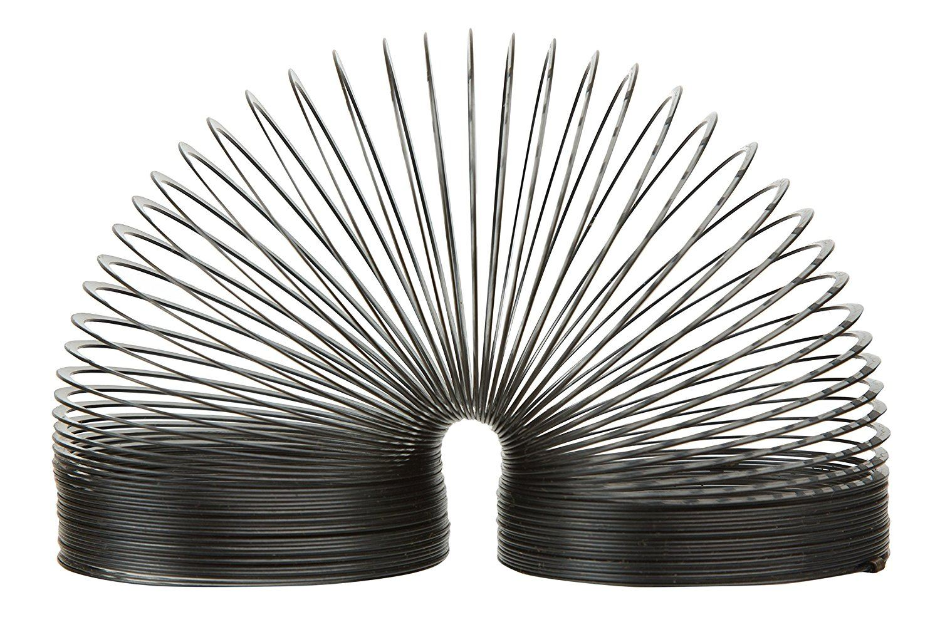
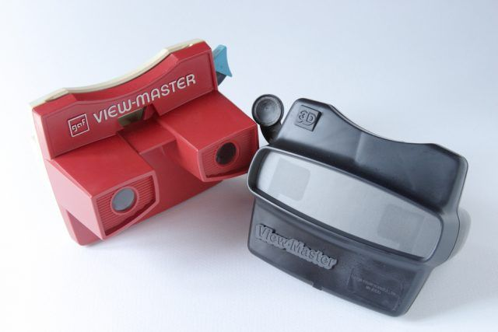
Others
Play-Doh
Slinky
Yo-Yo
Radio Flyer Wagon
Easy Bake Oven
The View Master

Slide 13
Thank you for your attention

