Slide 1
Famous people in Prešov

Slide 2
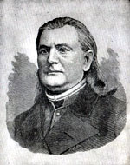
Alexander Duchnovič
Alexander Duchnovič (* 24 April 1803, Topoľ - † March 30 1865 in Prešov) was Ruthenian national revivalist, a writer and Greek Catholic priest in Beloveža. Since year 1990 is named after him Rusyn Theatre in Prešov.

Slide 3
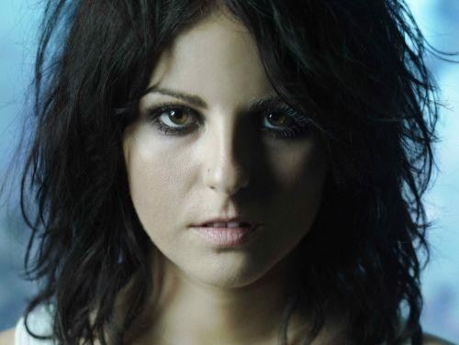
Katarína Knechtová
Katarína Knechtová (* March 14, 1981, Prešov) is a Slovak singer, pianist, guitarist, composer and songwriter. She is known from working in Prešov group Peha. Until the year 1997 she worked as a vocalist in the Prešov group IMT Smile.

Slide 4
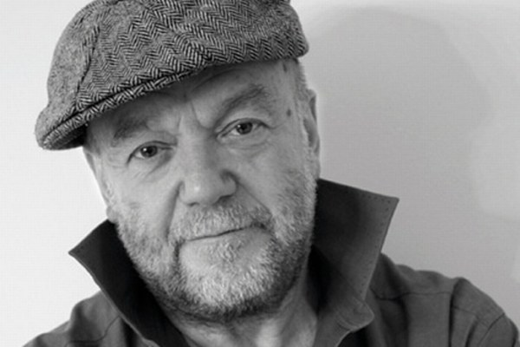
Peter Lipa
Peter Lipa (* May 30, 1943, Prešov) is a Slovak singer, songwriter, businessman, organizer of musical events, moderator, manager of jazz events, adviser and promoter of European festival of Jazz Days. For many years he was only known jazz singer in Slovakia.

Slide 5
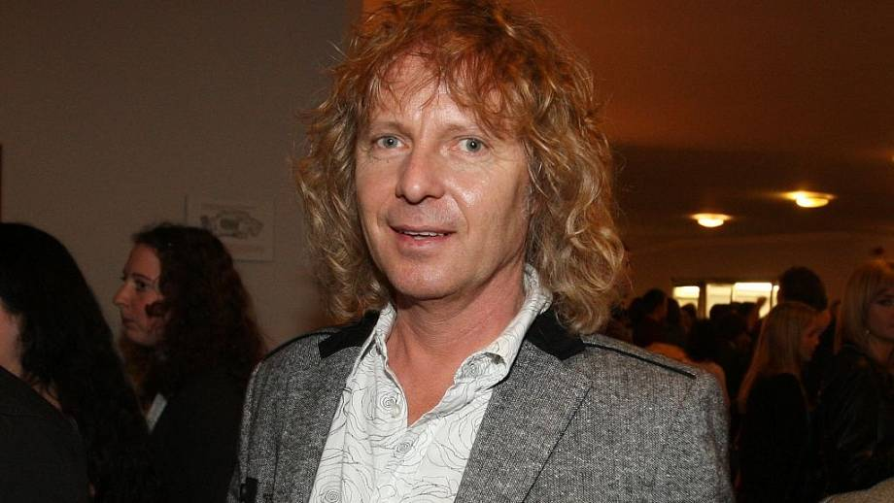
Peter Nagy
Peter Nagy (* April 9, 1959, Prešov) is a Slovak singer, songwriter, musician, record producer, and photographer. Along with Richard Muller, Robo Grigorov, Miroslav Žbirka, Marika Gombitová and groups such as Elán, Metalinda was Peter Nagy one of the most successful singers of popular music in Slovakia of the 20th century.

Slide 6
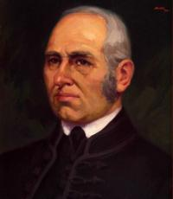
Jonáš Záborský
Jonáš Záborský (* February 3, 1812, Záborie - † 23 January 1876, Župčany) was a Slovak poet, novelist, dramatist, historian, journalist, and priest. In 1834 he studied at the Protestant Theological College in Prešov.

Slide 7
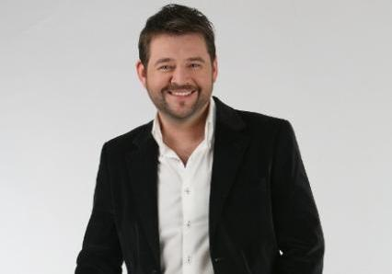
Michal Hudák
Michal Hudák (* June 27, 1969, Prešov) is a Slovak moderator and theatrical actor. He is Rusyn nationality. Primary school and secondary school he graduated in Ukrainian language.

Slide 8
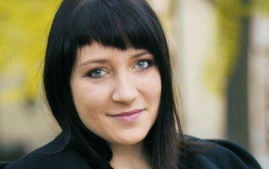
Katka Koščová
Katka Koščová (* February 11, 1982, Prešov) is a Slovak singer, winner of Slovakia Superstar in 2005. Her sister Veronika is actress and singer.

Slide 9
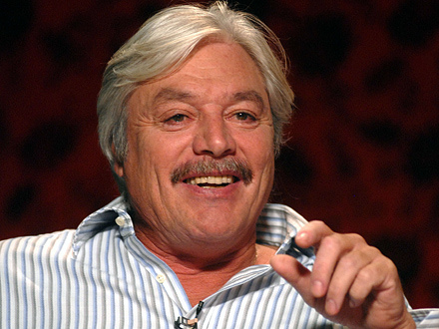
Juraj Kukura
Juraj Kukura (* March 15, 1947, Prešov) is a Slovak actor. He completed his secondary technical school in Bratislava and he started study acting at the Academy of Arts.

Slide 10
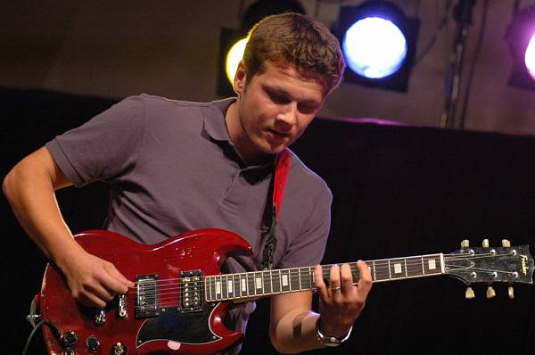
Dávid Kollár
Dávid Kollár (* October 25, 1983, Prešov) is a Slovak guitarist, film composer, producer and screenwriter. He was born in a musical family. He started with music, when he was 8 years old. From year 2005 to year 2009 he was a student of Andrej Šeban.

Slide 11
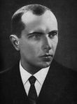
Ján Adam Rayman
Ján Adam Rayman (* April 23, 1690, Prešov - † April 23, 1770, Prešov) was a doctor, immunologist, pharmacist, polymath, town doctor of Presov and county doctor of Saris County.

Slide 12
Music
Peter Lipa-Balada o 4 koňoch http://www.youtube.com/watch?v=q2xRqqUcKU4
Peter Nagy-Aj tak sme stále frajeri http://www.youtube.com/watch?v=vMKZquwU1ag
Katarína Knechtová-Spomaľ máš privysokú rýchlosť http://www.youtube.com/watch?v=DzMf9BZYuZo

Slide 13
Resources
http://sk.wikipedia.org/wiki/Alexander_Duchnovi%C4%8D
http://sk.wikipedia.org/wiki/Katar%C3%ADna_Knechtov%C3%A1
http://cs.wikipedia.org/wiki/Peter_Lipa
http://cs.wikipedia.org/wiki/Peter_Nagy
http://sk.wikipedia.org/wiki/Jon%C3%A1%C5%A1_Z%C3%A1borsk%C3%BD
http://sk.wikipedia.org/wiki/Michal_Hud%C3%A1k
http://sk.wikipedia.org/wiki/Katar%C3%ADna_Ko%C5%A1%C4%8Dov%C3%A1
http://sk.wikipedia.org/wiki/Juraj_Kukura
http://sk.wikipedia.org/wiki/D%C3%A1vid_Koll%C3%A1r
http://cs.wikipedia.org/wiki/J%C3%A1n_Adam_Rayman

Slide 14
Thanks for watching
Authors: Štefan Straka, Michal Tomaško

