Slide 1
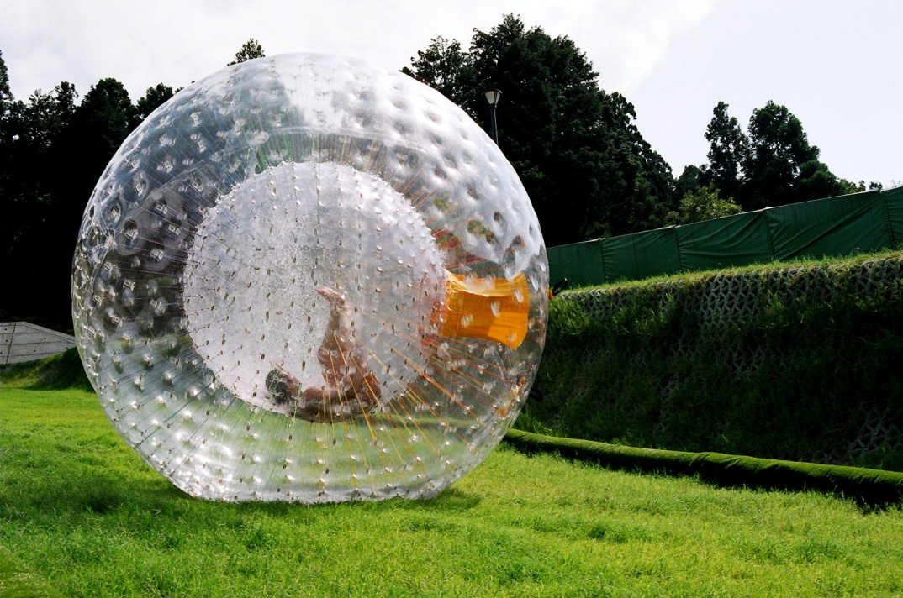
Zorbing
Michal Tomaško

Slide 2
Zorbing
- recreation activity or sport of rolling downhill inside an orb, made of transparent plastic
- performed on a gentle slope
- 2 types of orbs: harnessed and non-harnessed
- first zorbing site was established in Rotorua, New Zealand, by David and Andrew Akers

Slide 3
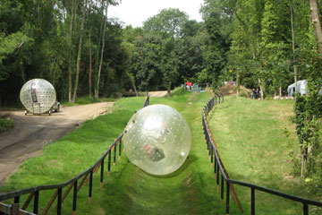
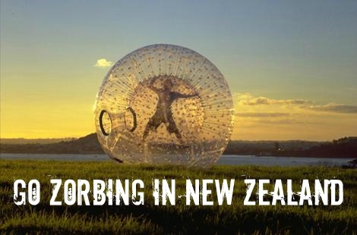
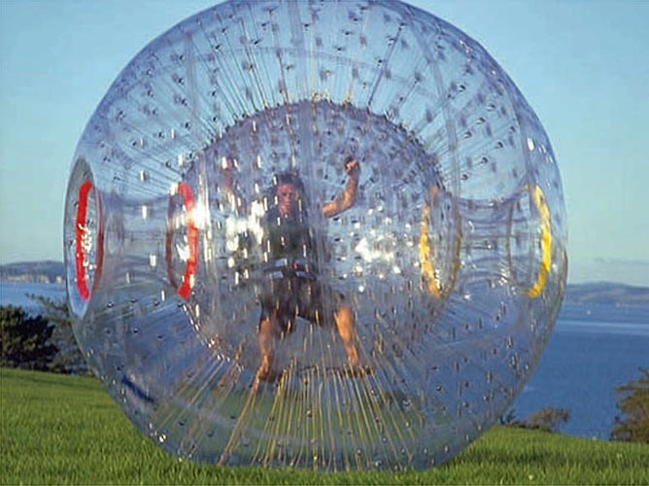

Slide 4
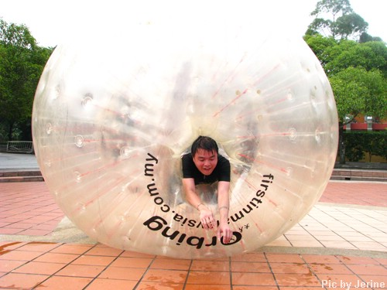
Construction
- the orb is double-sectioned, with one ball inside the other with an air layer between them
- orbs are lightweight and made of flexible plastic
- orbs have one or two tunnel-like entrances

Slide 5
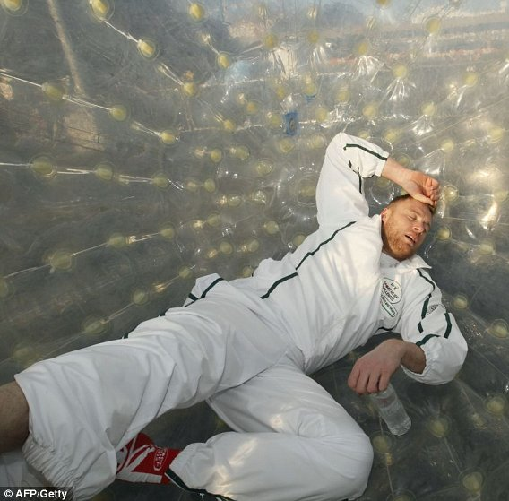
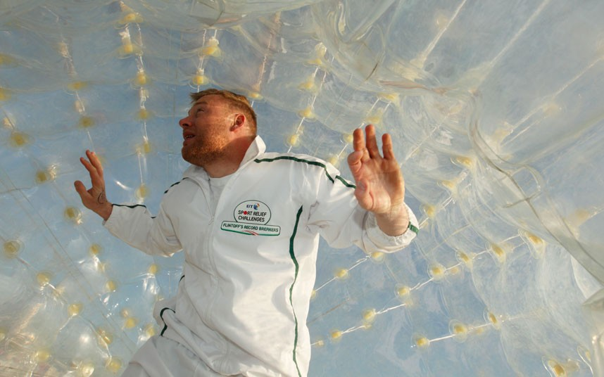
Records
The Guinness Book of World Records recognises 3 zorbing records:
Longest ride- Steve Camp- 570 metres
Fastest ride- Keith Kolver- 52 kilometres per hour
Fastest 100 metres- 26.59 seconds- Andrew Flintoff

Slide 6
Sources
www.zorb.com
www.zorbing.com
www.wikipedia.org
www.newzealand.com
https://www.youtube.com/watch?v=TQWwJwxT3oE

Slide 7
Thank you for watching

