Slide 1
PREŠOV
Natália Petričová
1.D

Slide 2
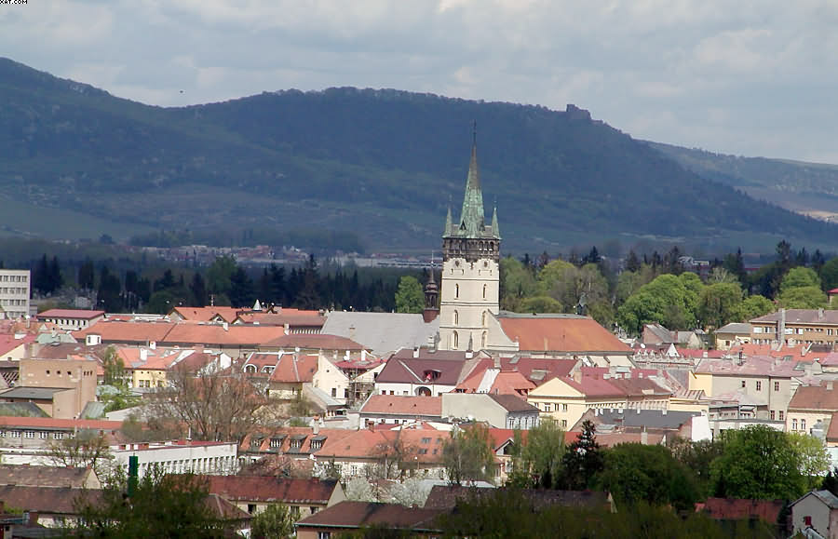

Slide 3
REGISTER
Characteristics
Geography
History
Monuments
The biggest attractions

Slide 4
Characteristics
Baroque, Rococo and Gothic architecture
European Capital of Culture 2013
population:approximately 91,000
third-largest city in the country
Notes:
The city is a showcase of Baroque, Rococo and Gothic architecture. In the historical center, the main street is lined with churches and other buildings built in these styles. The Soviet influence is clearly evident through the massive concrete panel buildings of the housing estates and the Sekčov district. More Soviet-style architecture is seen in the government buildings near the city center. Many concerts, operas, operettas and stage plays are performed at the new building of the Jonáš Záborský Theatre, as well as at the older theatre premises. The city and the region were contenders for European Capital of Culture 2013. Prešov is city with a population of approximately 91,000 it is the third-largest city of Slovakia.

Slide 5
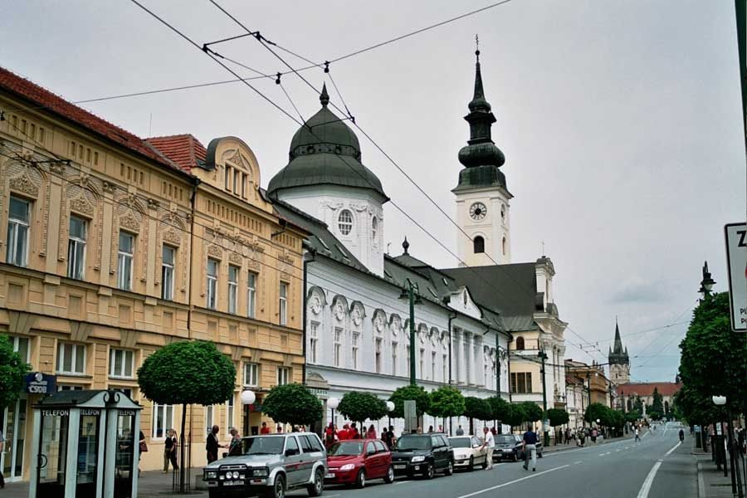

Slide 6
Geography
locality: north-eastern Slovakia
the Torysa river valley
historical Šariš region
mountain ranges nearby: Slanské vrchy, Šarišká vrchovina, Bachureň, Čergov
located: 33 km north of Košice, 410 km northeats of Bratislava, 50 km south of Polish border, 60 km north of the Hungarian border
Notes:
Prešov is located in the north-eastern Slovakia. It lies in the Torysa river valley, in the historical Šariš region. Mountain ranges nearby include Slanské vrchy (south-east), Šarišská vrchovina (south-west), Bachureň (west) and Čergov (north). Prešov is located 33 km north of Košice. It is about 50 kilometres south of the Polish border, 60 kilometres north of the Hungarian border and is some 410 kilometres northeast of Bratislava.

Slide 7
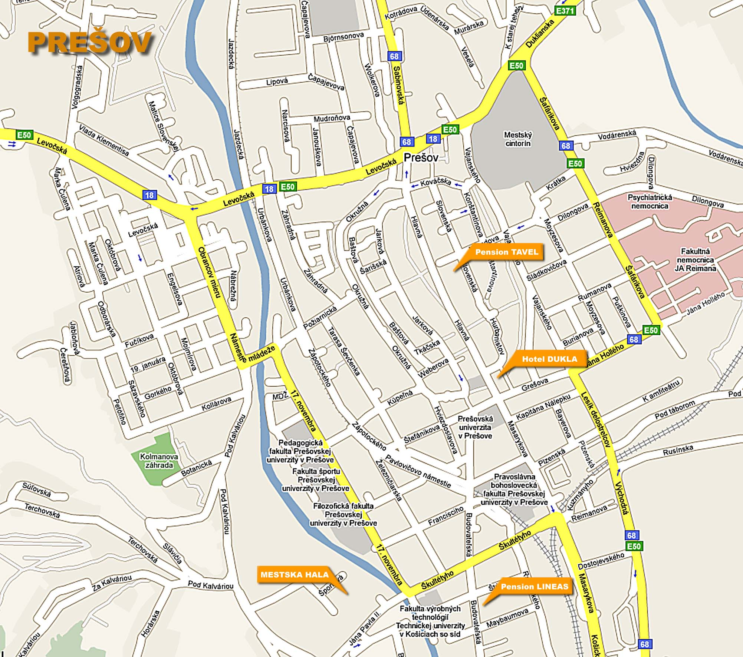

Slide 8
History
since the Paleolithic period
1247-first mentioned
1374-free royal town
16th century-salt mining
1752-the salt mine was flooded
1870-the first railway was built
19th century-the town introduced electricity, telephone..
1887-fire
Notes:
People have lived in the area since the Paleolithic period. Prešov is first mentioned in 1247. It became a free royal town in 1374. Salt mining started here in the 16th century, in the nearby town of Solivar (which is now part of Prešov). In 1752 the salt mine in Solivar was flooded. Since then salt has been extracted from salt brine through boiling. In 1870 the first railway was built. This was a line connecting the town to Košice. At the end of the 19th century, the town introduced electricity, telephone, telegraph and a sewage systems. In 1887 fire destroyed a large part of the town.

Slide 9
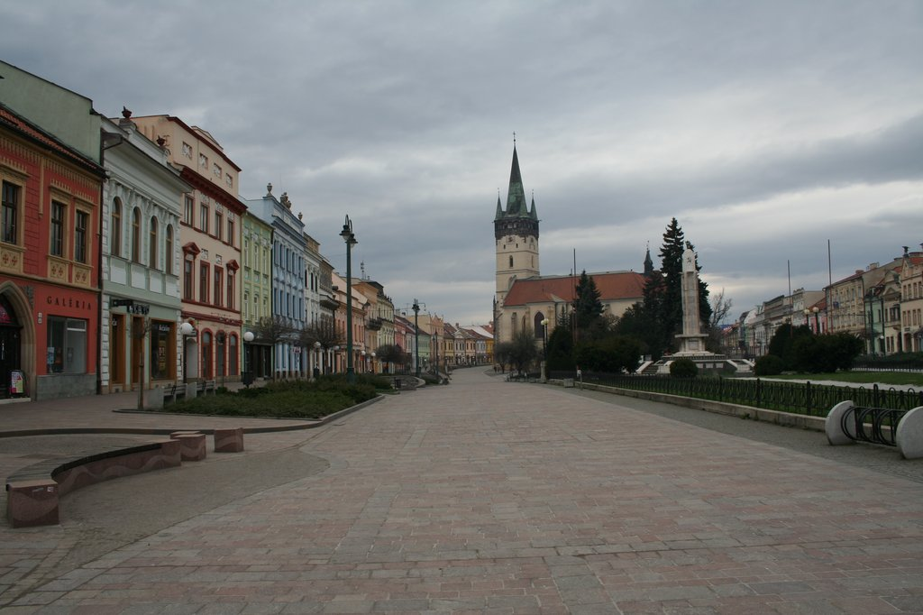

Slide 10
The biggest attractions
In the centre
Museums in Presov

Slide 11
In the center
The biggest attractions

Slide 12
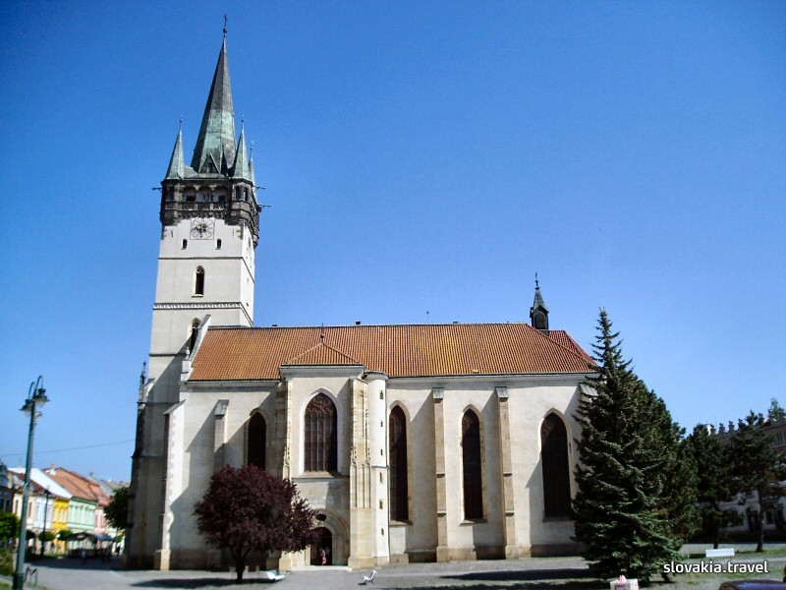
Rome Catholic church of St. Nicholas

Slide 13
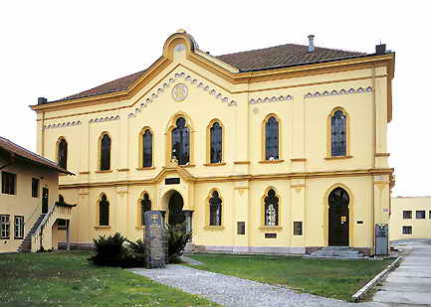
Jewish synagogue

Slide 14
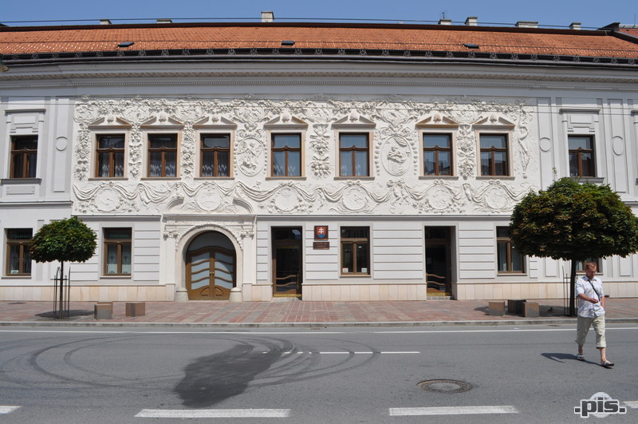
Klobusicky palace

Slide 15
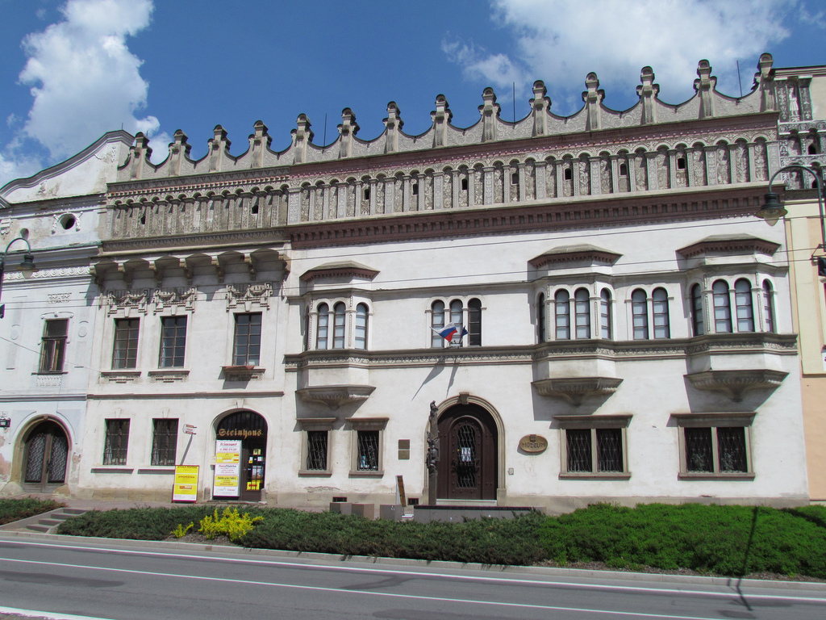
Rakoczi palace

Slide 16
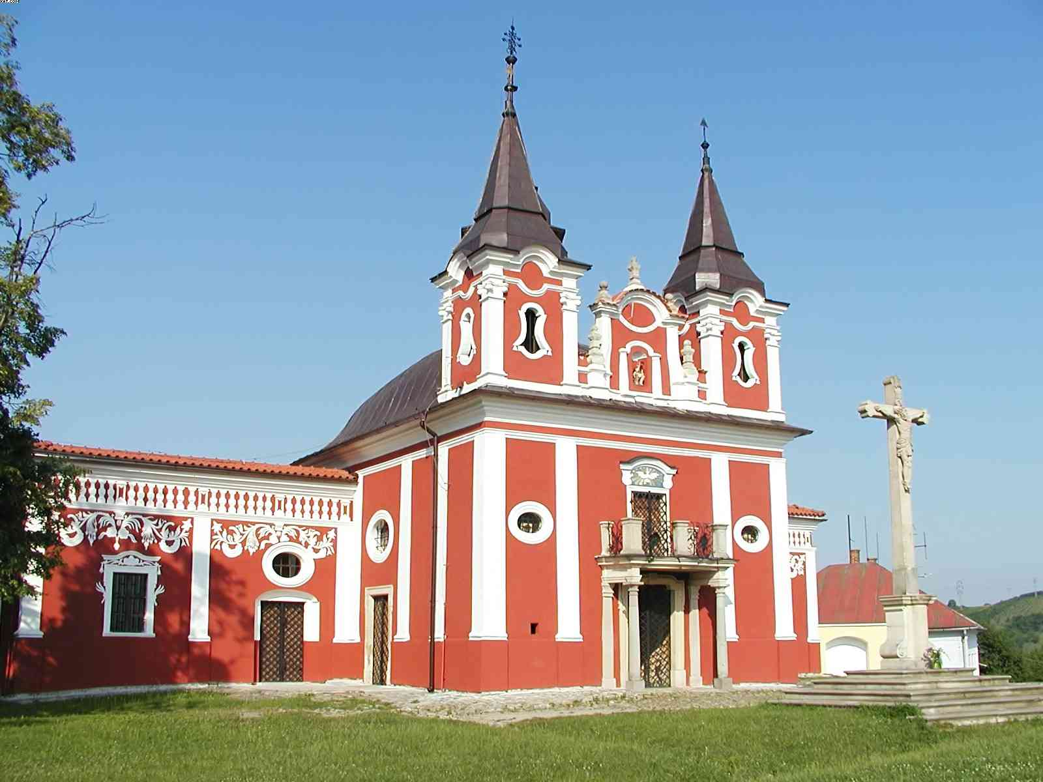
Calvary

Slide 17
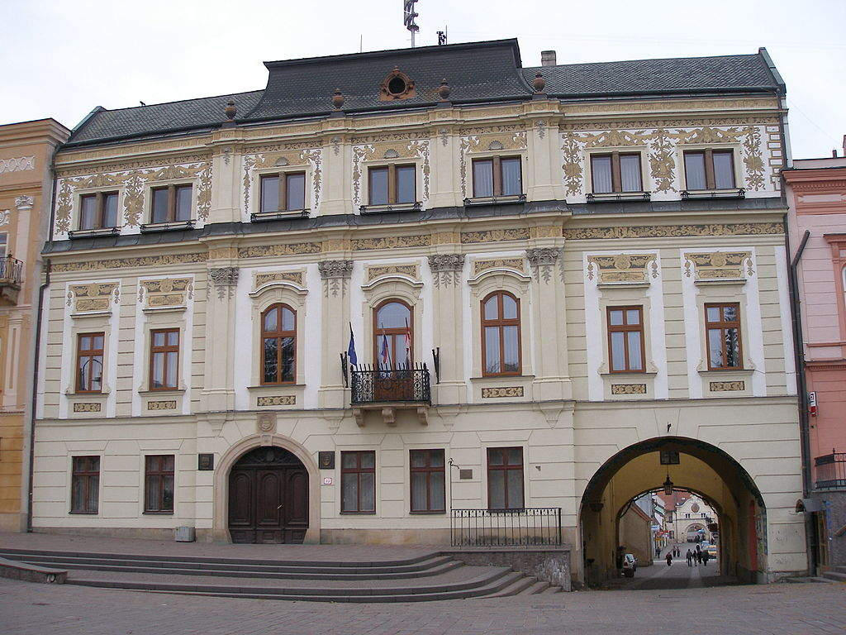
Town Hall

Slide 18
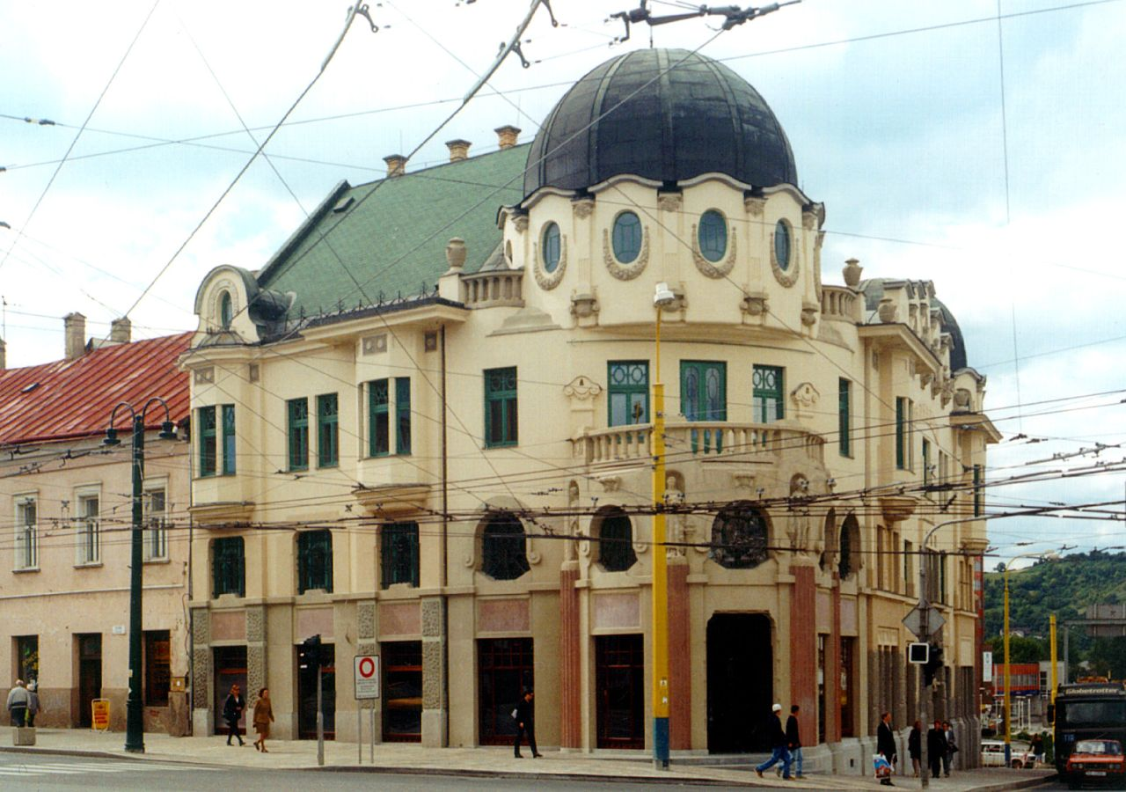
Bosak Bank

Slide 19
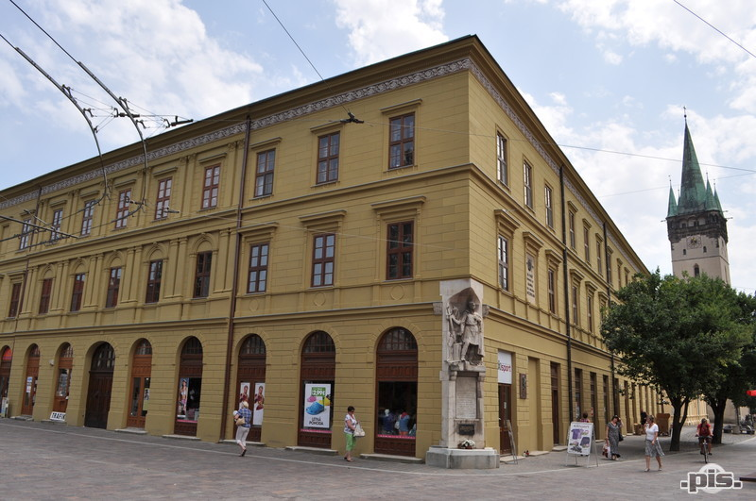
Evanjelic College

Slide 20
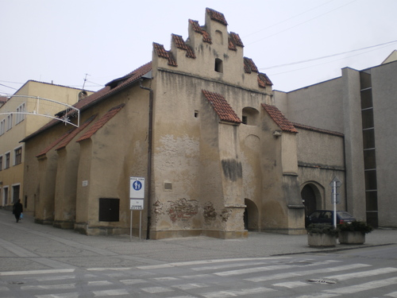
Caraffa's prison

Slide 21
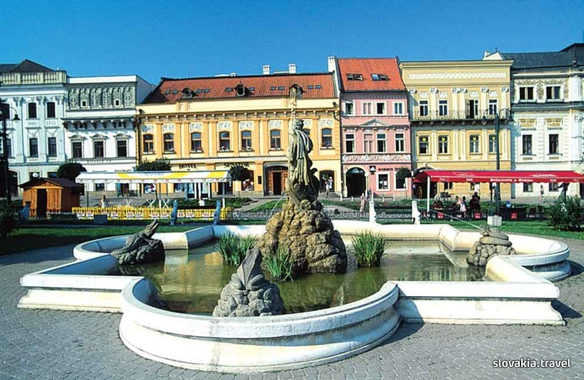
Neptune fountain

Slide 22
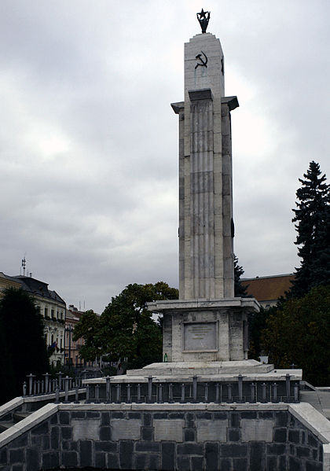
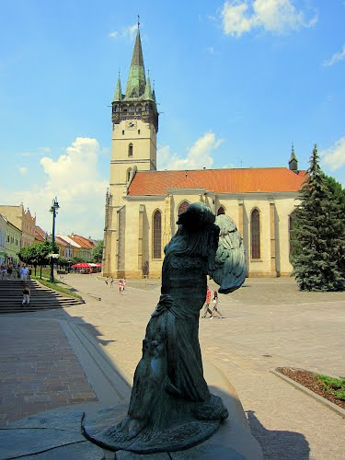
Guardian angel
Monument of the Red army

Slide 23
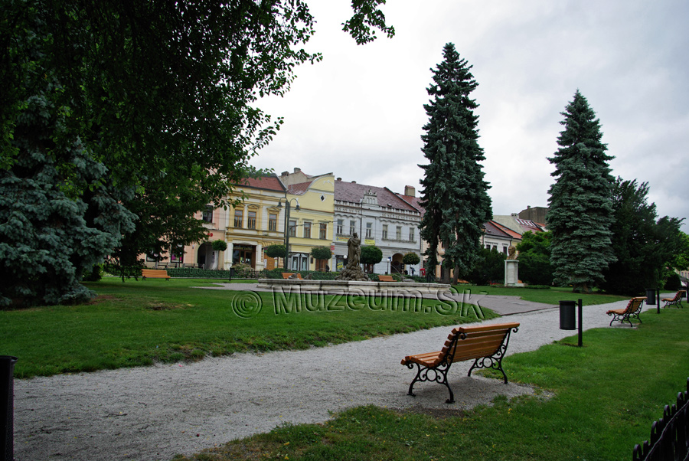
Park

Slide 24
Museums
The biggest attractions

Slide 25
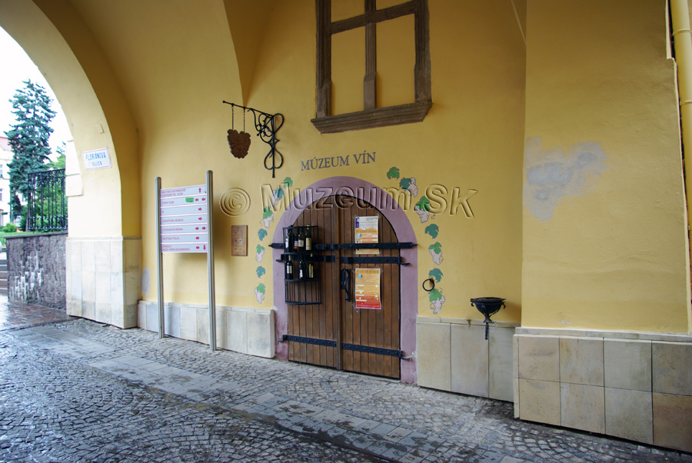
Wine museum

Slide 26
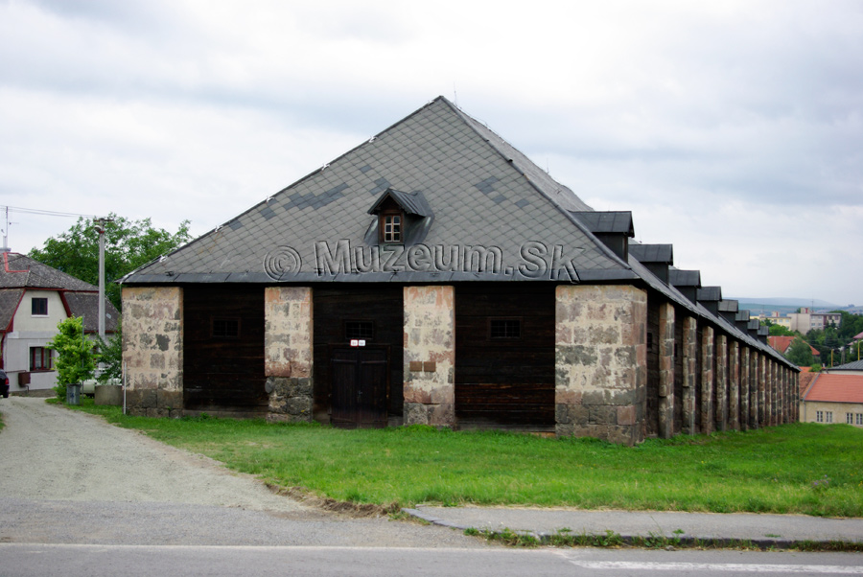
Solivary

Slide 27
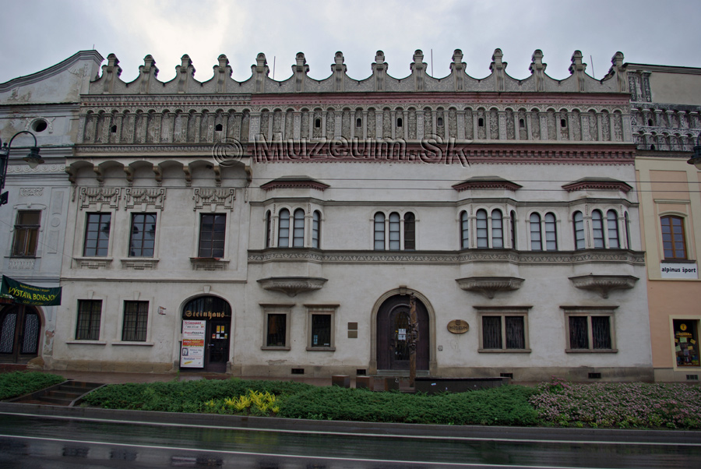
Regional museum

Slide 28
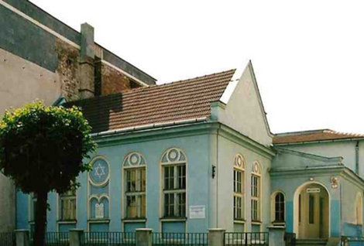
Museum of Jewish culture

Slide 29
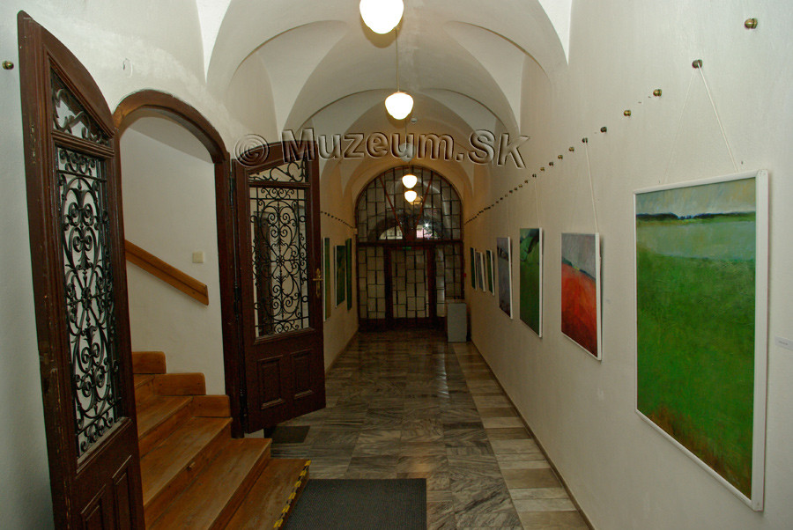
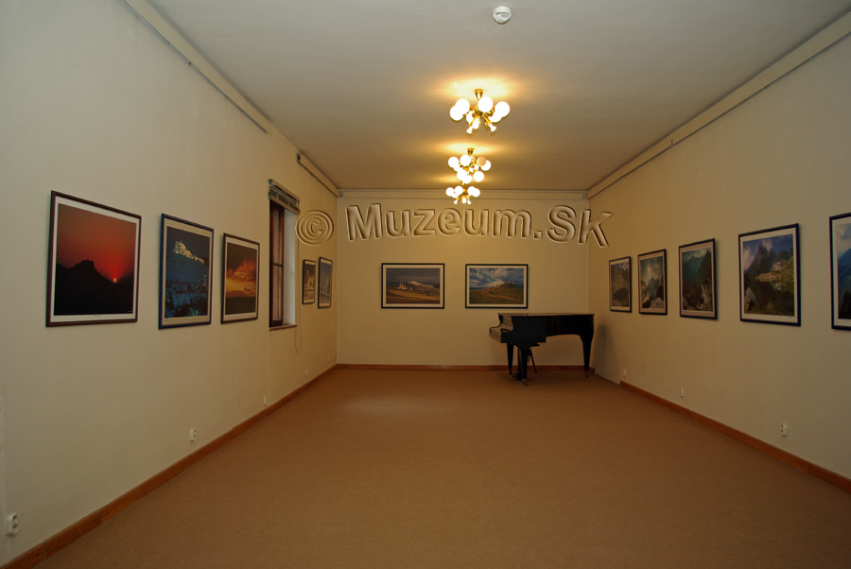
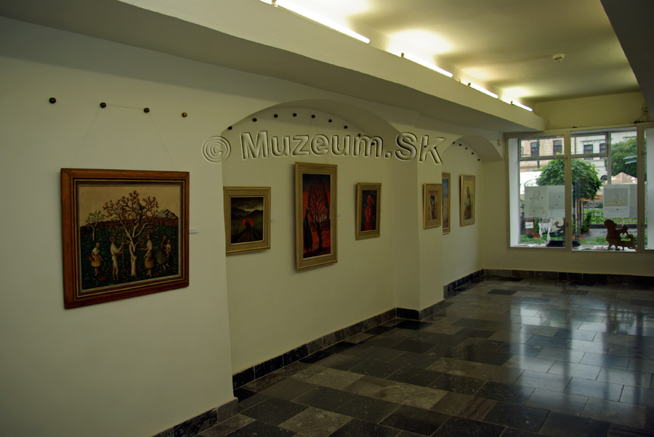
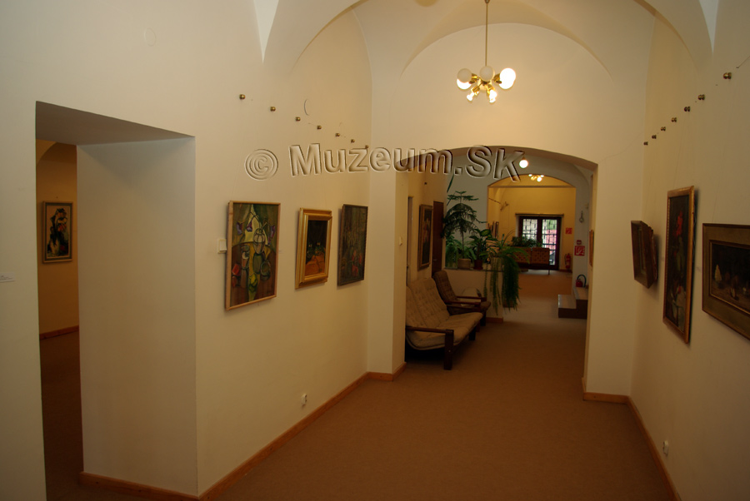
Saris gallery

Slide 30
resources
http://en.wikipedia.org/wiki/Pre%C5%A1ov
http://simple.wikipedia.org/wiki/Pre%C5%A1ov
http://www.presov.info/
http://www.muzeum.sk/?obj=mesto&ix=po

Slide 31
Thank you for your attention!

