Slide 1
Traditions
Patrícia Hatalová, 3.c

Slide 2
content
Lucia
Putting up of the maypoles
Midsummer Night‘s Bonfires
Burning of Morena

Slide 3
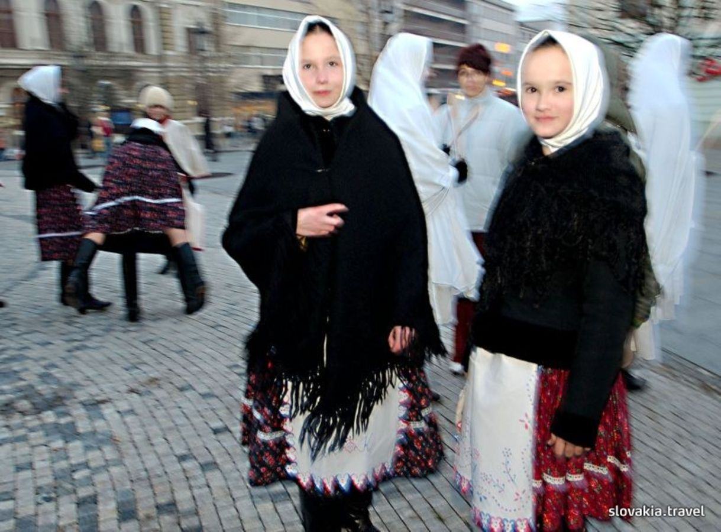
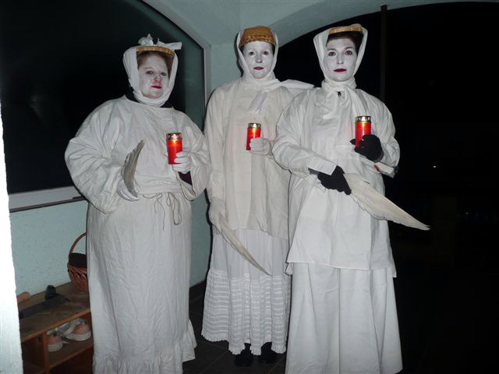
Lucia
13th December
Witches
Papers

Slide 4
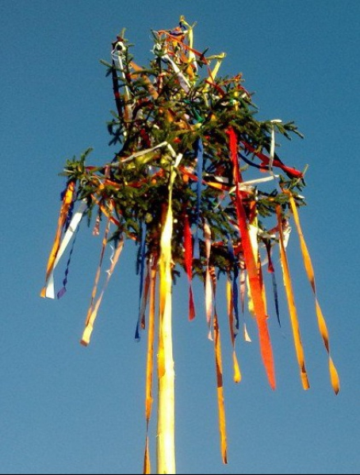
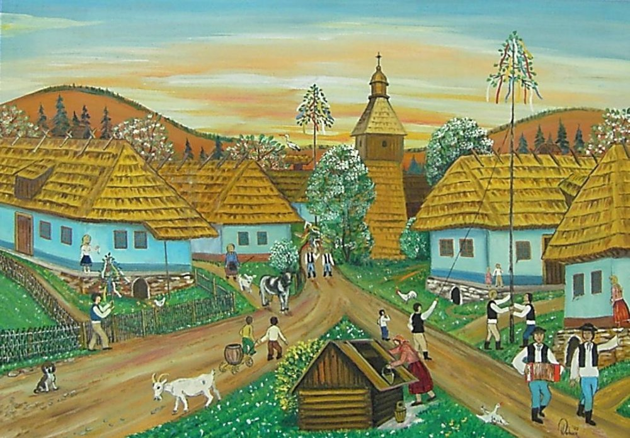
Putting up of the maypoles
1st May
Maypoles

Slide 5
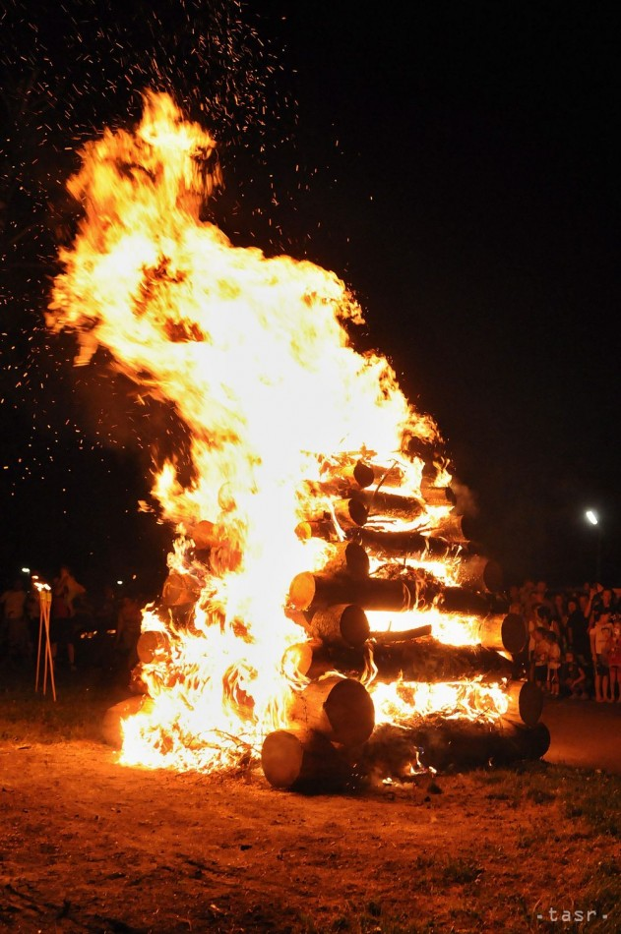
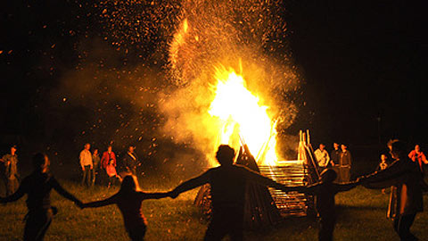
Midsummer Night‘s bonfires
23rd – 24th June night
Bonfires

Slide 6
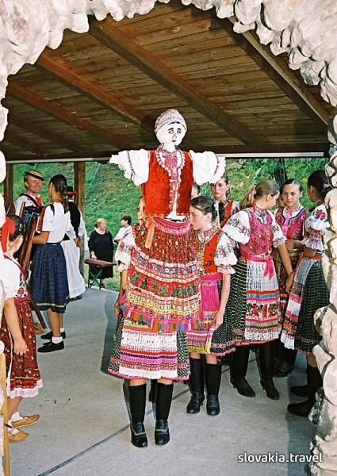
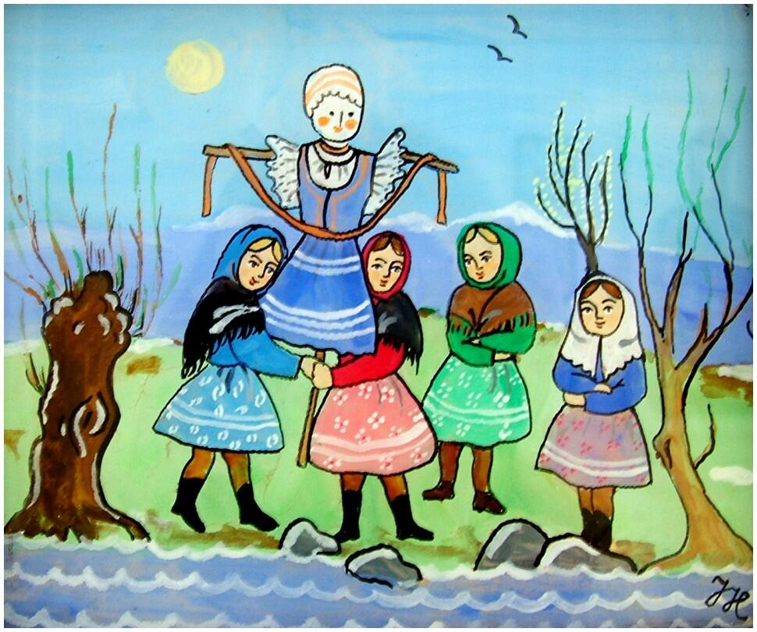
Burning of morena
Two weeks before Easter
Spring
Stream

Slide 7
sources
www.slovakia.travel
www.google.sk

Slide 8
Thanks for your attention

