Slide 1
HIGH TATRAS
Jakub Stašák
Ondrej Pribula

Slide 2
1.Basic information 2. Gerlach peak 3.Lomnica peak 4.Štrba Lake 5.Rainer´s chalet 6.Sliezsky house 7.ski Tatry 8.traffic 9.Poprad 10.activities

Slide 3
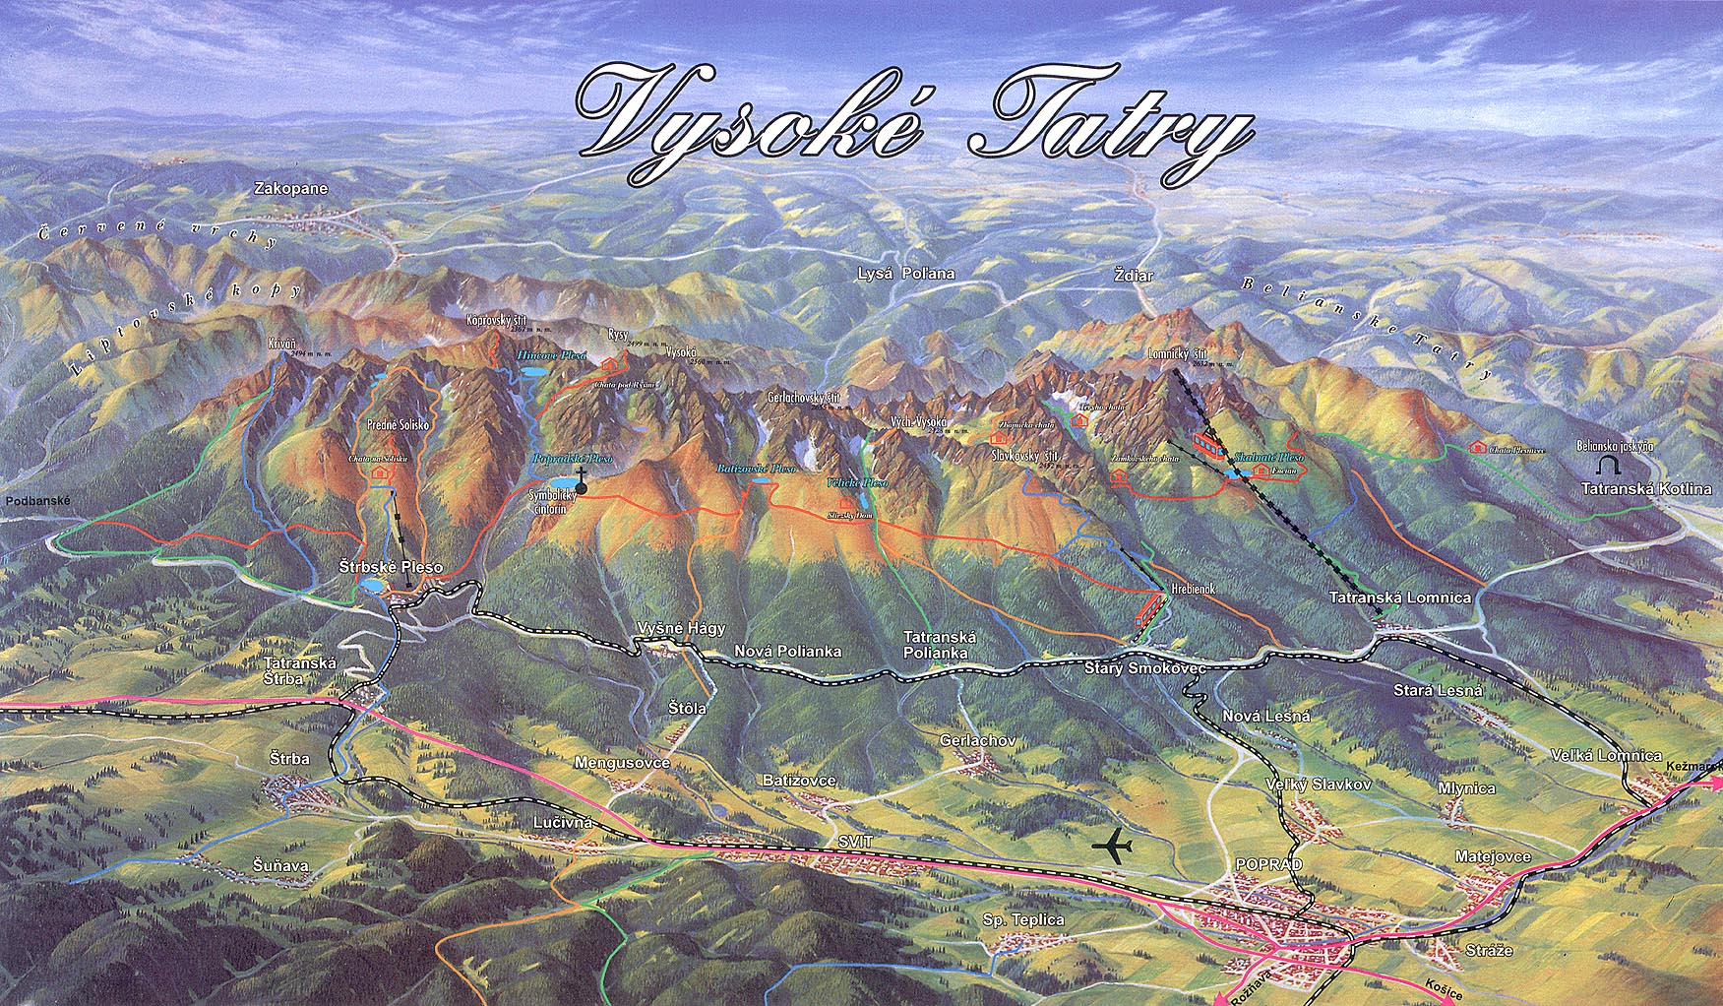
BASIC INFORMARTION
Located in west of Prešov region
Biggest town in Slovakia
Highest mountain of Karpaty
Notes:
High tatras are located in west of prešov region. Its biggest town in slovakia and its also biggest mountain of Karpaty. They have 341 km2. 75% are located in Slovakia. On Kriváň begins half of river Vah. Snow is there 200 or 250 days per year. The weather is very changeable. It could change 4 times per day. Thats why is better to come there in autumn. Also winters are good for skiing.

Slide 4
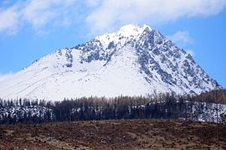
GERLACH PEAK
Notes:
Gerlach peak is the highest mountain of slovakia. Its two thousand six hundreed fifty four meters high. Gerlach peak is made of 3 peaks and it looks like crown.In middle is big crater. These 3 peaks are the first 3 highest peaks in Slovakia. First man who climbed on Gerlach peak was Jan Still. He climbed there in 1834. If you wanna go there, mountain guide(gajd). Price is cca 240€.

Slide 5
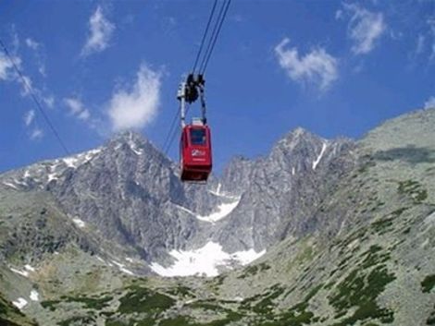
LOMNICA PEAK
Notes:
Lomnica peak is one of the highest and most visited mountain peaks in the High Tatras. One reason why it is so famous is because its connected with cable car to Tatranská Lomnica. Tourists are allowed to stay on the top of the peak 50 minutes. It has 2634 meters. First recorded ascent was made by the English traveler Robert Townson and his guide.It was in 1793.On the top of this peak is solar observatory which is the highest observatory in slovakia.

Slide 6
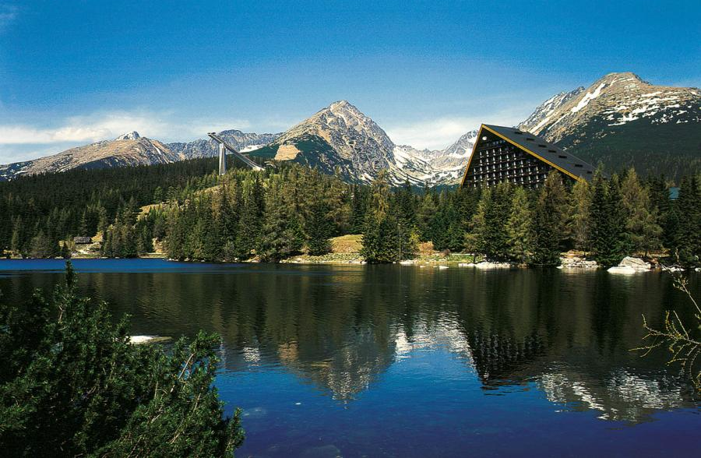
ŠTRBA PLESO
Notes:
Strba lake is a mountain lake of glacial origin and it is a top tourist destination in the High Tatras. There is the most luxury hotel in slovakia called Hotel Kempinski.You can ski there on a biggest ski resort which is the best ski centre in Slovakia. Olympic games in skiing took place there in 1970 and because of them there was built ski jumping areal and also Cross-country skiing.

Slide 7
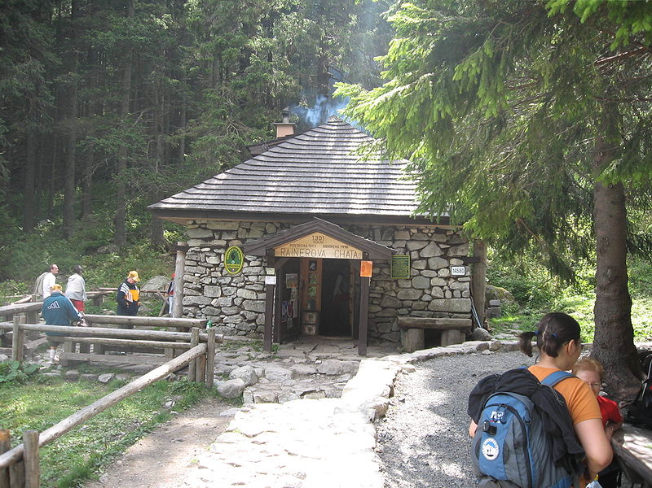
RAINER´S CHALET
Notes:
Its oldest chalet in high tatras. Every year there is exposition of ice statues. And sometimes its used as a resthouse. Its know because families go there with their children.Its part of Tatranska magistrala.

Slide 8
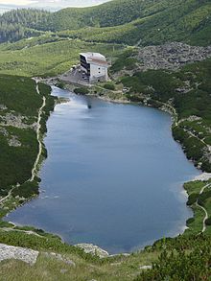
SLIEZSKY HOUSE
Notes:
Its the highest Hotel in Slovakia. Its also the biggest chalet in high tatras. Sliezsky house is place where rest people who goes to the Gerlach peak. The most famous man who rest there was John Paul 2. during his second visit of Slovakia. The easiest way to get there is asphalt road from Tatranska polianka. Hotel was under reconstruction and now, its luxury 4star hotel and in restaurant works famous chef Ľubomír Herko. Near hotel is beautiful lake called Velicke pleso. Also you can get there from Popradske pleso over Ostrva or from hrebienok.

Slide 9
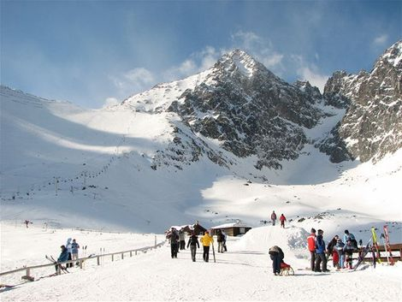
SKIING
Notes:
Ski tatry is the most modern ski resort in Slovakia. Ski resort contains 24 kilometers of slopes. Snow in Tatras is 5 months per year. Lots of tourists are russians or ukraines. Thats why the most of tourists come there between 6-8 january. You can go up by cable car, 2 chairlifts and lot of ski tows. On Lomnica saddleback you can ski on the hardest ski slope in Slovakia. There are particularly long bread lines so in middle of line is bar made from ice, where you can buy whisky or rum tea or traditional slovak drink „šľivovica“ .

Slide 10
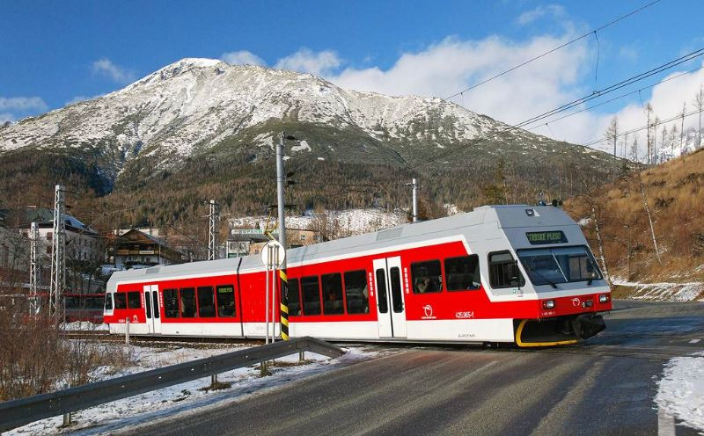
TRAFFIC
Notes:
In high tatras is modern railway net. This railway net connects tatranska lomnica, stary smokovec, štrbské pleso with Poprad. This railway net also goes to the symbolic cementery near poprad lake. One possibility to get there is by plane which lands on Poprad. From tatranská štrba to štrba lake goes „zubačka“.From stary smokovec to hrebienok goes modern train. This modern was repaired in 2007. There are also 2 cable cars and 2 chair lifts.

Slide 11
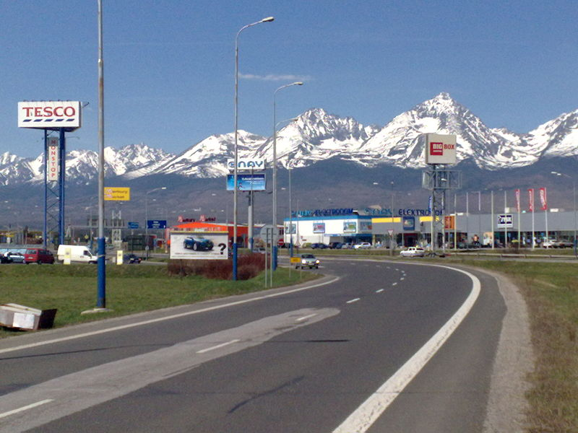
POPRAD
Notes:
Poprad is metropole of Spiš region and its also 3. biggest town in prešov region. Its popular because its called as enter gate to High tatras. Lot of tourists go there when they wanna escape from mountain town and go shopping or eat something in nice town. First mention was in 1256. In 2011 poprad played KHL as team HC Lev Poprad, but next year, this team moved to Prague. In poprad is aquacity, which is 3 biggest aquapark in slovakia.

Slide 12
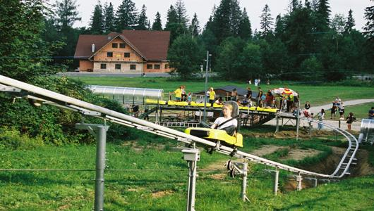
ACTIVITIES
Notes:
High Tatras offer great experiences. One of them is rollercoaster called Tatrabob. It is in service since 2004 and its construction offers safety rides whole year.Next experince is archery in nature. You can hunt with bow or crossbow.However you won´t shoot animales but you will shoot targets. There is also a museum of TANAP which shows you life in Tatras.

Slide 13
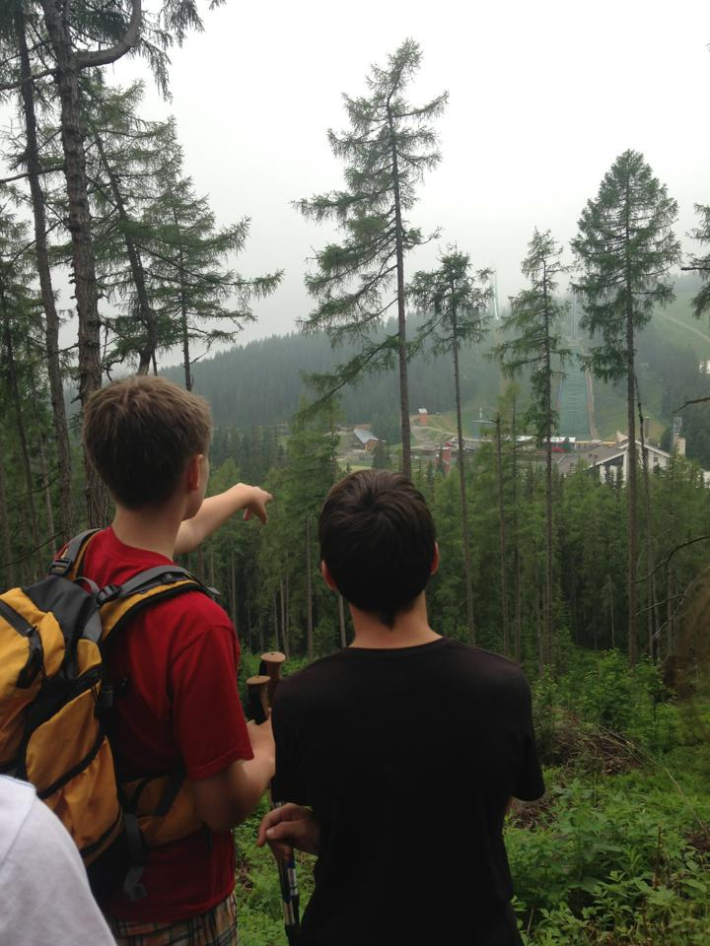
THANKS FOR YOUR ATTENTION
AHA!
SKRATKA!

