Slide 1
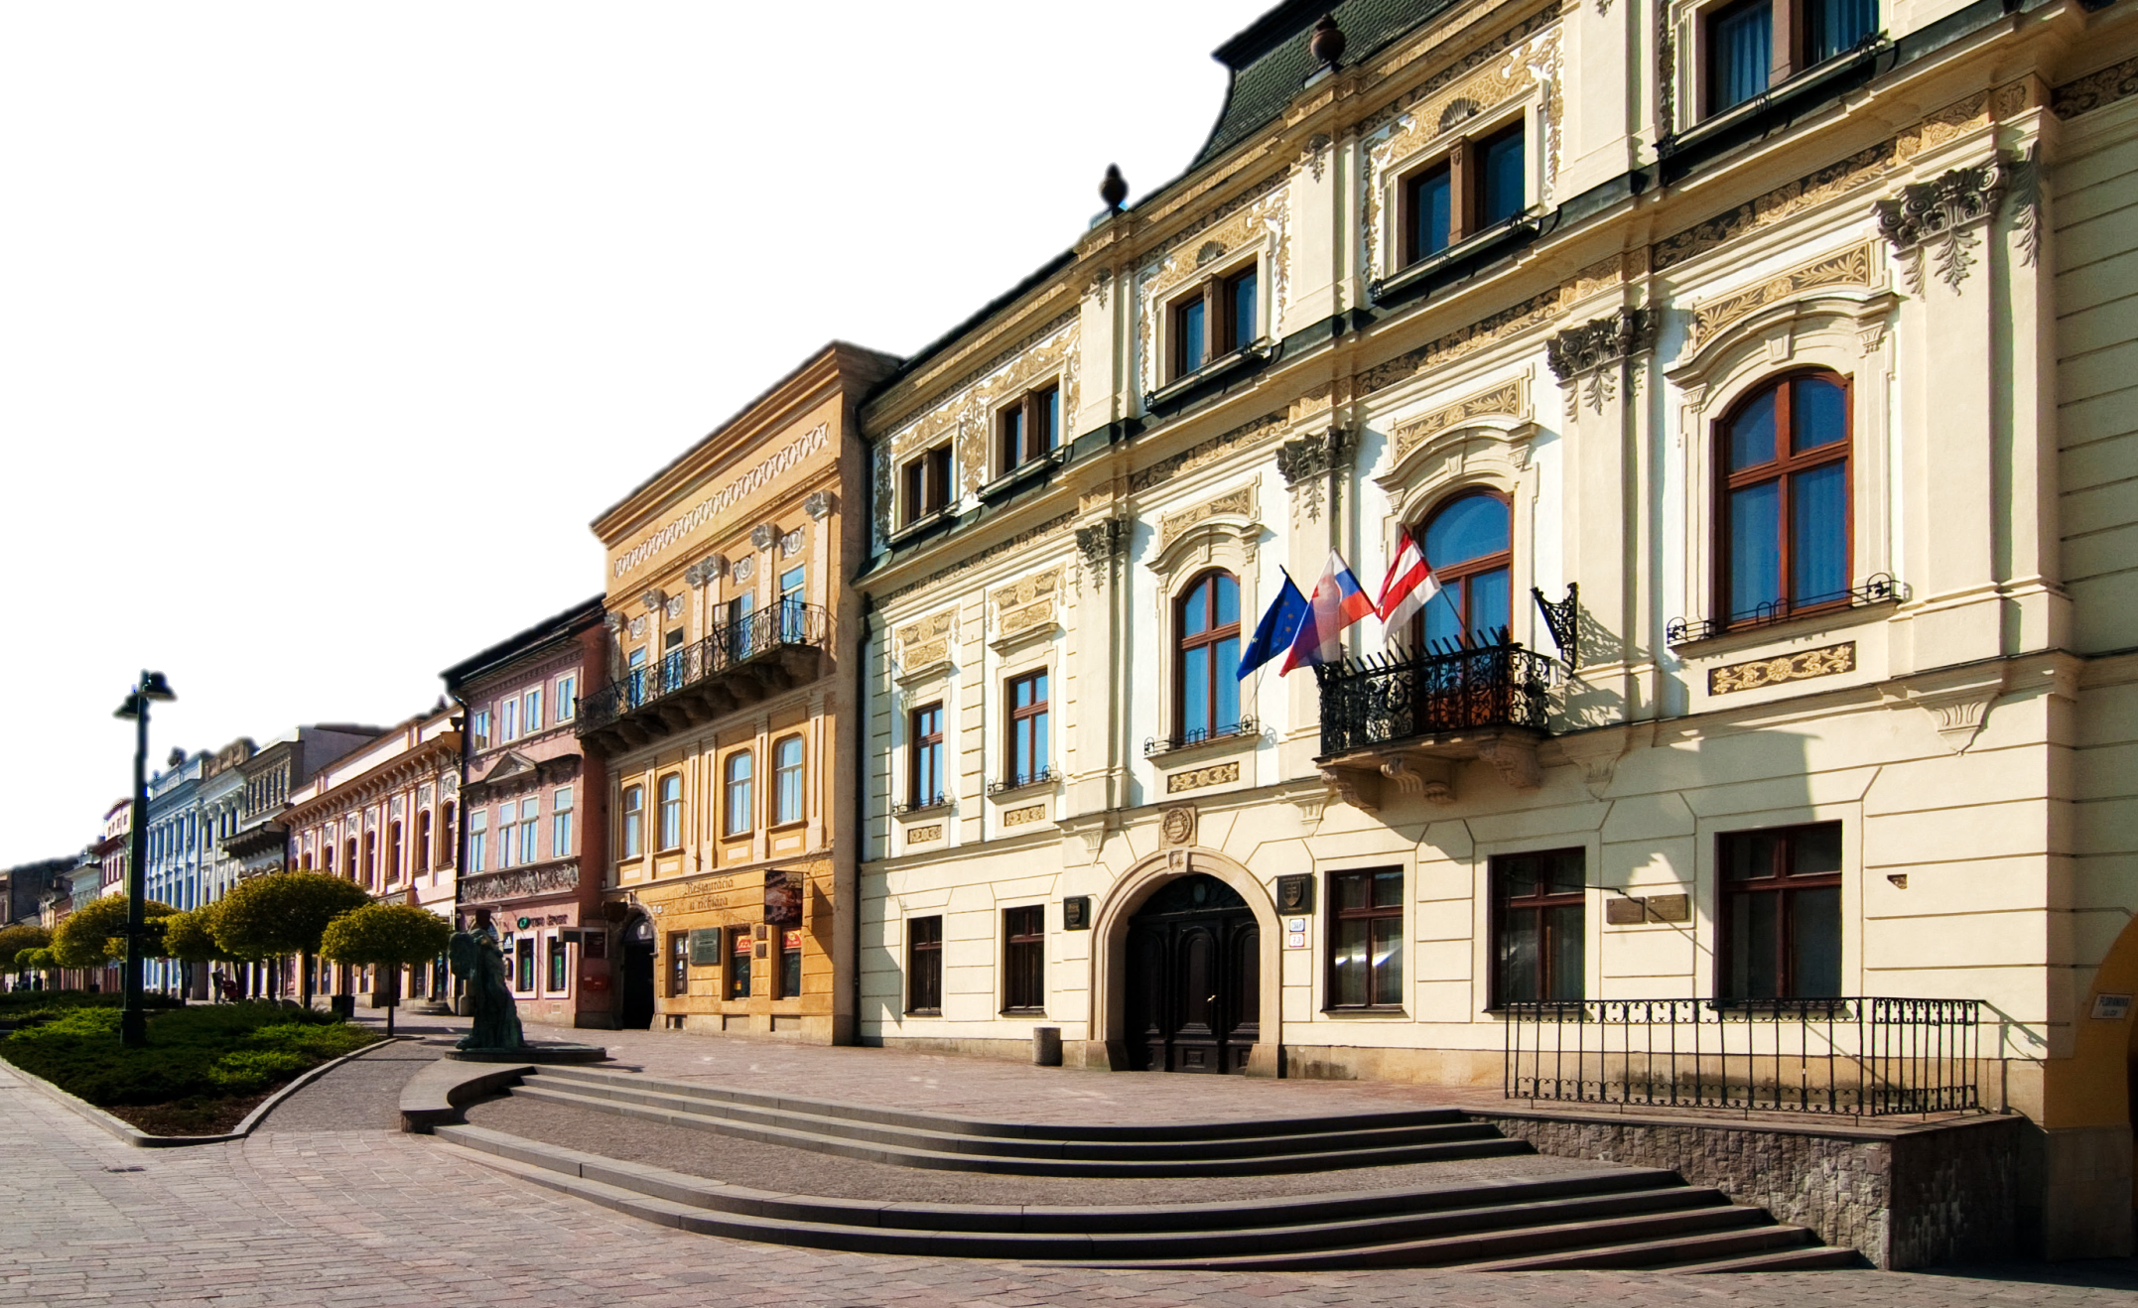
Prešov
Róbert Klučár, I.D
2012/2013

Slide 2
Location
north-eastern Slovakia
elevation - 250 m
rivers - Torysa, Sekčov
northern reaches of the Košice Basin

Slide 3
Information
population - 91,650
area - 70, 406 km²
region - Šariš
mayor - Pavel Hagyari

Slide 4
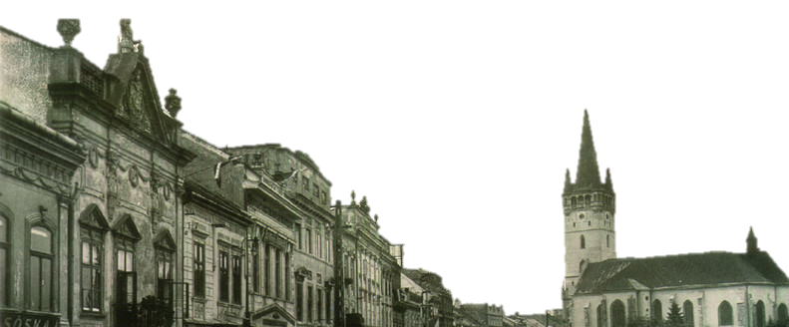
History
settled in the older stone age (40 000 – 100 000 b.c.)
6. cent. - Slavs settled in the Torysa valley
1299 - Ondrej III. - town rights
1374 - right to build the fortresses
1480 - member of Pentapolitana

Slide 5
History
1687 – Caraffa’s slaughter
1887 - fire damaged the town
16 June 1919 - the establishment of the The Slovak Republic of Councils in Prešov
Second World War - position of Prešov improved
19.1.1945 - Prešov´s freeing

Slide 6
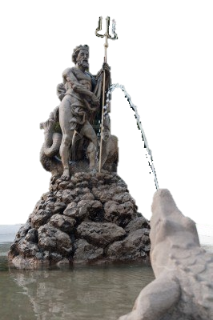
Neptunious Fountain
made by a Jewish merchant Mark Holländer
1826 – V. Staviarsky finished the sculptural group with the statue
1990 – the fountain was reconscructed

Slide 7
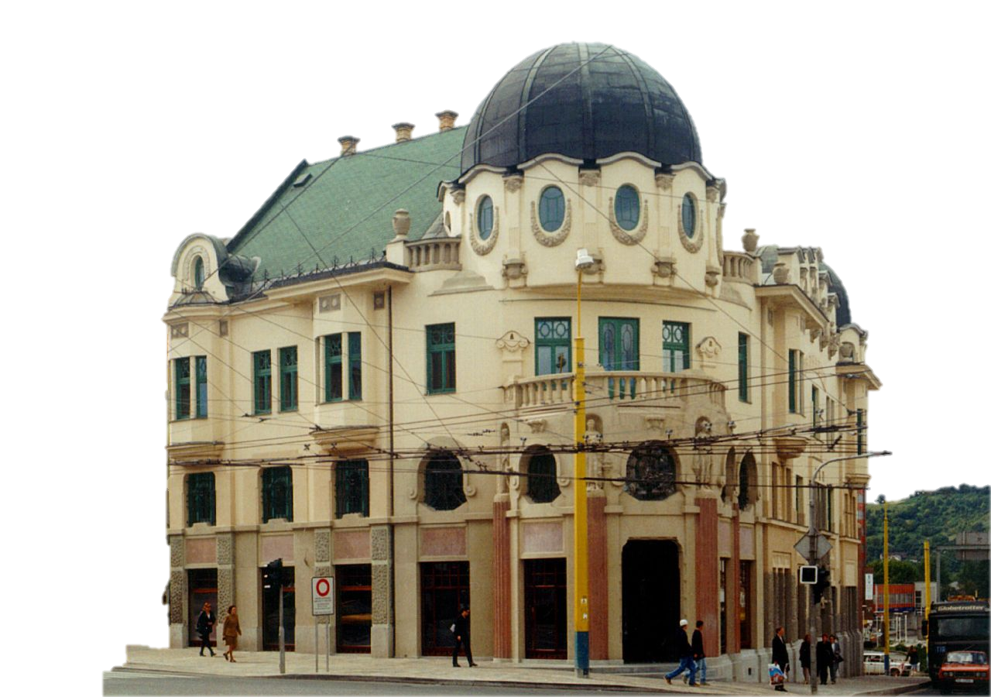
Bosak’s Bank
Vienna Sezession style
on a corner of Main and Levočská Streets
was built between 1923-1924
named after Michal Bosák

Slide 8
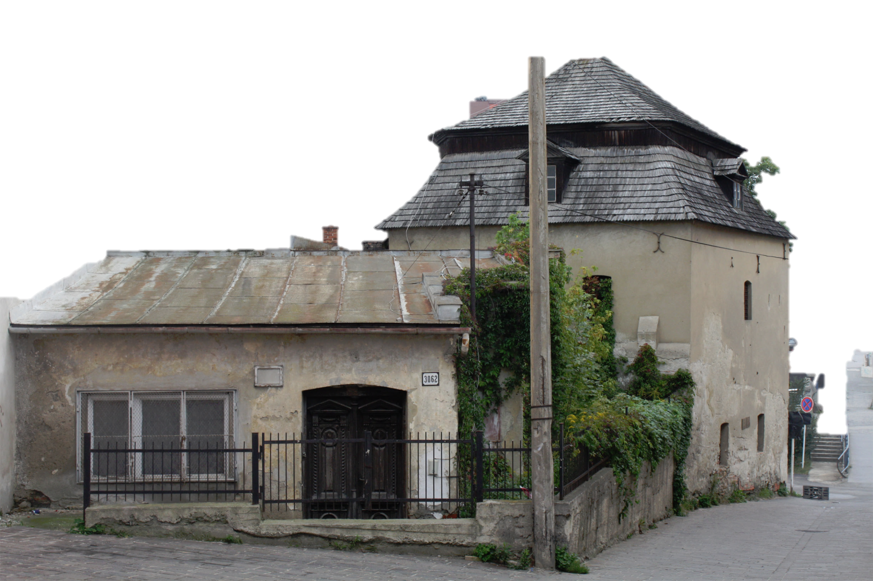
Kumšt
the forties of the 15th century
one of the original wall bastions
was operating continuously until the early 20th century
“machina hyd-raulica “

Slide 9
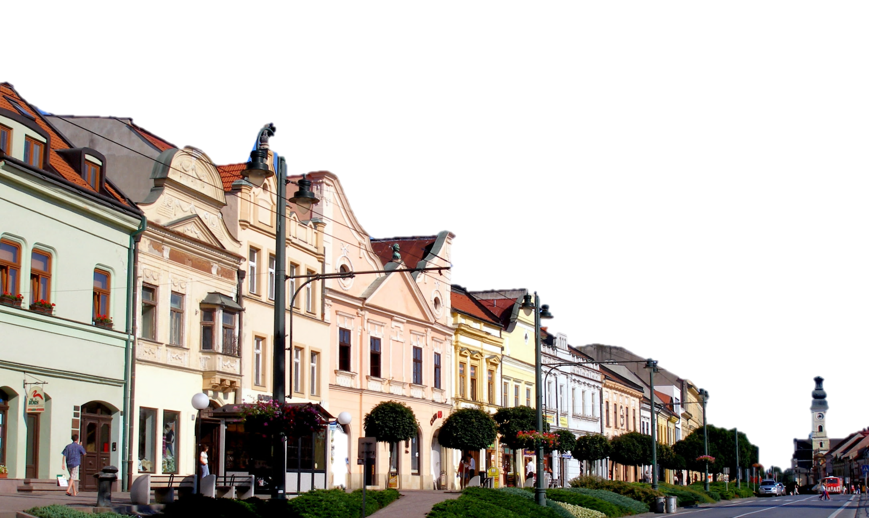
Sources
http://v1.cache2.c.bigcache.googleapis.com/static.panoramio.com/photos/original/34723832.jpg?redirect_counter=2
http://upload.wikimedia.org/wikipedia/commons/thumb/9/90/Town_Presov_Slovakia_Pano.jpg/1032px-Town_Presov_Slovakia_Pano.jpg
http://www.slovakia.travel/entitaview.aspx?l=2&idp=3502
http://en.wikipedia.org/wiki/Pre%C5%A1ov#Geography
http://www.presov.sk/portal/?c=12&id=3349
http://www.presov.sk/portal/?c=12&id=9061
http://ds-lands.com/presov.html

