Slide 1
Prešov Region
Prešov

Slide 2
Haniska, Memorial to the Peasants’ Uprising
National Historic Landmark
South of the county town of Presov
The monument was erected in 1938
In commemoration of the East peasant uprising that broke out in 1831

Slide 3
Stará Ľubovňa, Castle
built in 14. century
the oldest part is a circular tower
castle in the north of Slovakia
reconstructed castle on the limestone hill

Slide 4
Sabinov Church of the Martyrdom of St. John, the Baptist
burned down in 1461
original main altar made by Master Pavol
national Museum in Budapest.

Slide 5
Plaveč, Castle
adorn the top of the hill towering above the wide valley of the Poprad river
it name derives of the tribe of Plavci
burnt in 1856 and is in ruins since then

Slide 6
Veľký Šariš, Castle
situated north-westwards of the town Veľký Šariš
was inhabited in Palaeolithic era
situated on Torysa trade road
last yeoman owner - the family Rakoci
now - a property of the city

Slide 7
Kamenica, Castle
castle ruins above the village of Kamenica
was the center of social and historical events

Slide 8
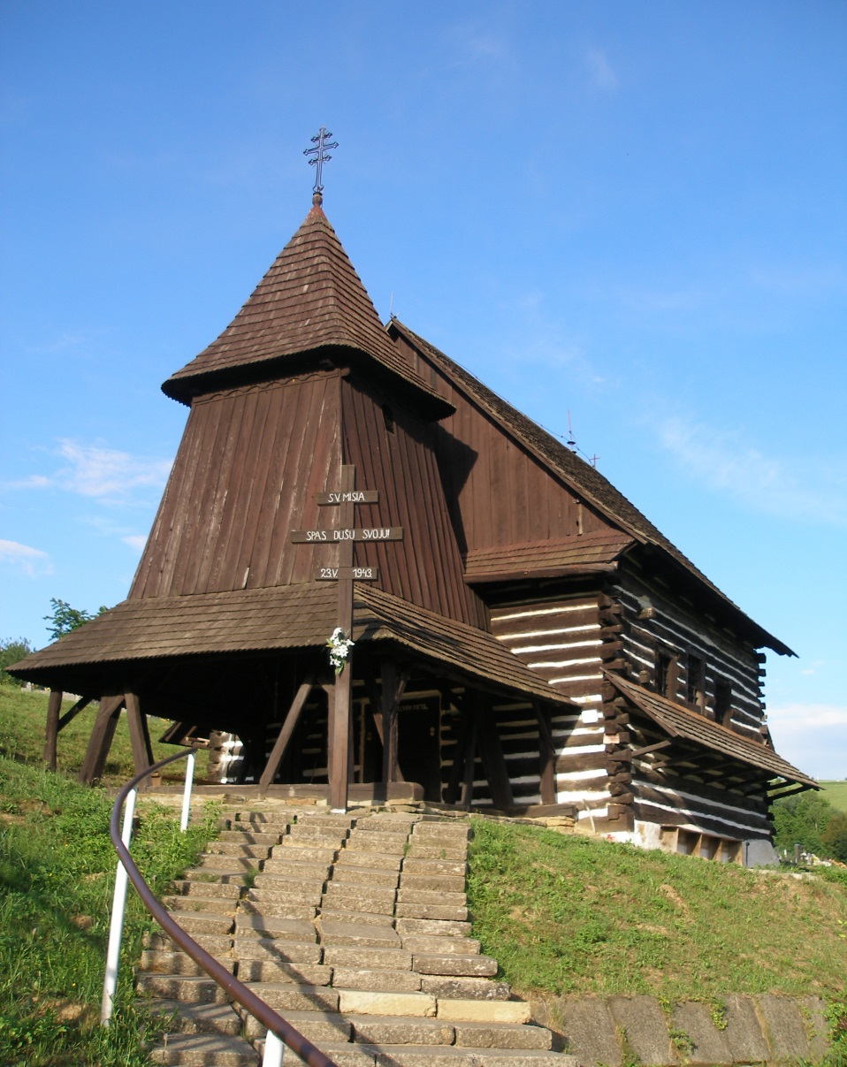
Brežany, Wooden Church
the Greek Catholic wooden church
built in 1727
located in the historic cemetery
one of the oldest wooden churches
the main altar from 1782 is in the Baroque style

Slide 9
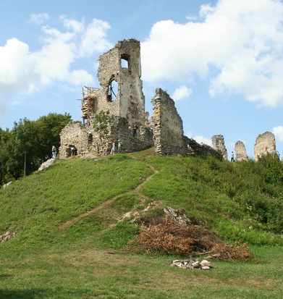
Kapušany Castle
extends on a rock protuberance of hill Zámčisko
built in 13th century
in 16th century the Castle was reconstructed and fortified

Slide 10
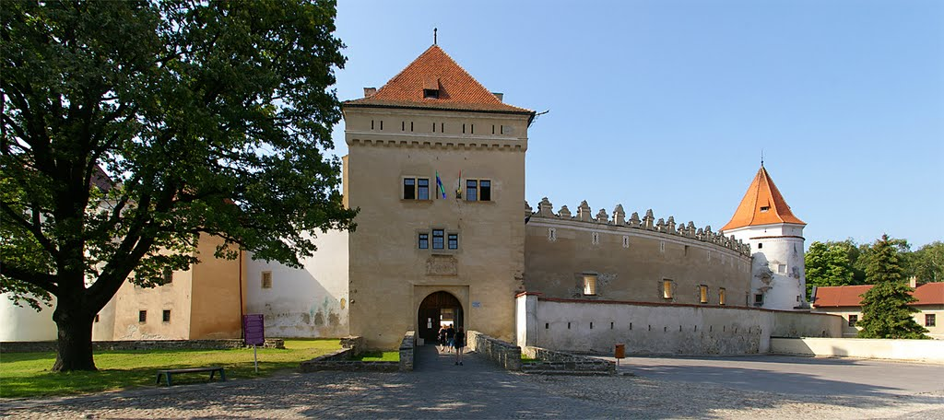
Kežmarok Castle
lies in the town centre
construction started in 1462
Since 1931 - City Museum

Slide 11
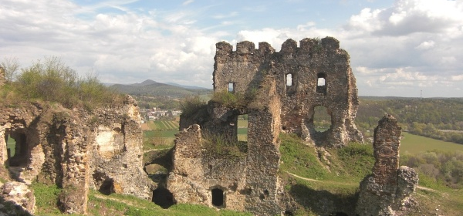
Čičava Castle
built during the years 1309-1316
In past – important trade route
1711 – imperial army blow it up

Slide 12
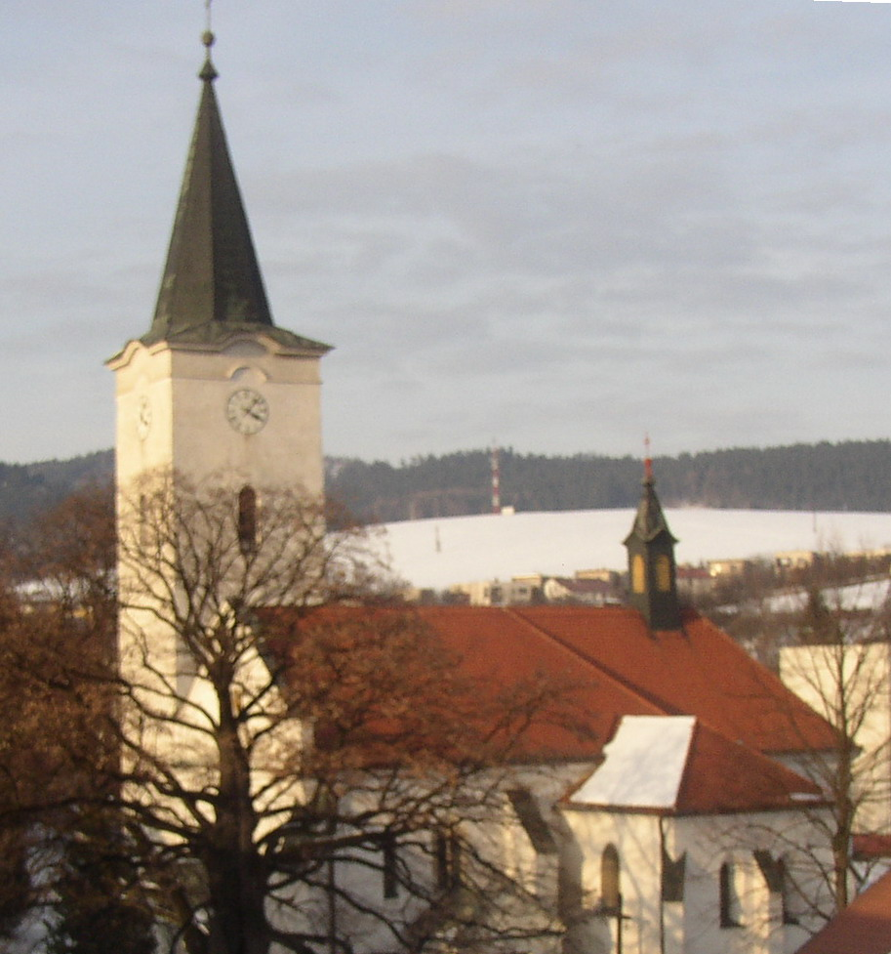
Lipany, Church of St. Martin
built in the 13th century
founder was Rikolfa II.
the altar is from the workshop of Master Pavol
the oldest part of the interior is decorated with wood carving y

Slide 13
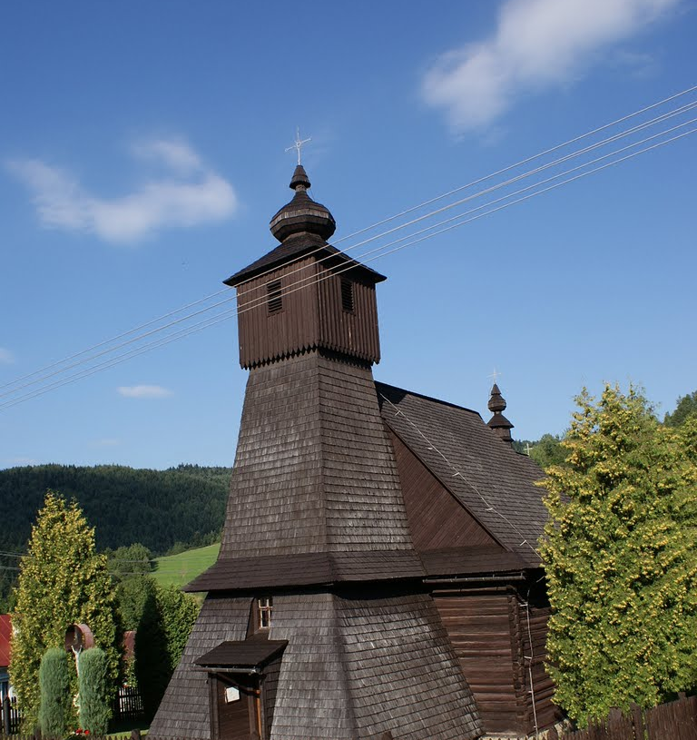
Hraničné, Wooden Church
wooden church of Immaculate Conception of the Virgin Mary from 1785
was built in 1727
dedicated to St. Luke the Evangelist
has three parts, three spaces, one tower and two crosses

Slide 14
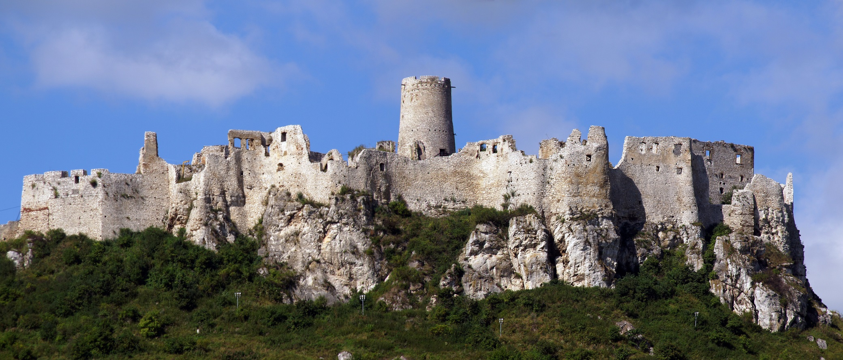
Spiš castle
largest castle in central Europe
UNESCO
13th centrury – castle was expanded
1780 - the castle was burnt down

Slide 15
Sources:
http://en.wikipedia.org/wiki/Kamenica,_Sabinov_District
http://sarisskaspacirka.sk/portal/index.php?lng=en
https://encrypted-tbn0.gstatic.com/images?q=tbn:ANd9GcQmAuHlLHIuYm3iGewA9oRJFBztTjfXAuRvGnZ7A1am6cIlKz4y
http://mw2.google.com/mw-panoramio/photos/medium/31125327.jpg
http://2.bp.blogspot.com/-tl4FZ1qIE9k/UKgcwMNXgfI/AAAAAAAACLs/2qTmsn4NwzM/s1600/Blansko%252C%2BStratena%252C%2BSlovensky%2BRaj%252C%2Betc%2B251.JPG
http://www.drevenechramy.sk/media/big/galery_image_341.jpg
http://www.staralubovna.sk/resources/App/200612022011190.osvetleny_hrad_01.jpg
http://www.slovenskyportal.sk/images/kamenica.jpg
http://www.infoglobe.cz/res/data/154/017639.jpg?seek=1233336676
http://sarisskaspacirka.sk/portal/img/9.jpg
http://ipravda.sk/res/2008/02/23/thumbs/25000-hrad-kamenica-clanok.jpg
http://hiking.sk/dev/gallery/photos/048f4d5569d8126705cc8b580e3b9ca7.jpg
http://www.hrady-zriceniny.cz/img/foto/2004/Pict1392.jpg
http://upload.wikimedia.org/wikipedia/commons/thumb/a/a4/Hrani%C4%8Dn%C3%A9.Holzkirche.JPG/220px-Hrani%C4%8Dn%C3%A9.Holzkirche.JPG
http://www.youtube.com/watch?v=mOLyT9ztsUM
http://www.youtube.com/watch?v=mOLyT9ztsUM
http://www.youtube.com/watch?v=fC-BXeycFjM&index=1&list=PLJa1f8897Axy-JEY7ybaEHMEHdNRDovFl

