Slide 1
Samuel Karabinoš
3.B GJAR

Slide 2
Content
Story
Skis
Technologies
Materials
Construction

Slide 3
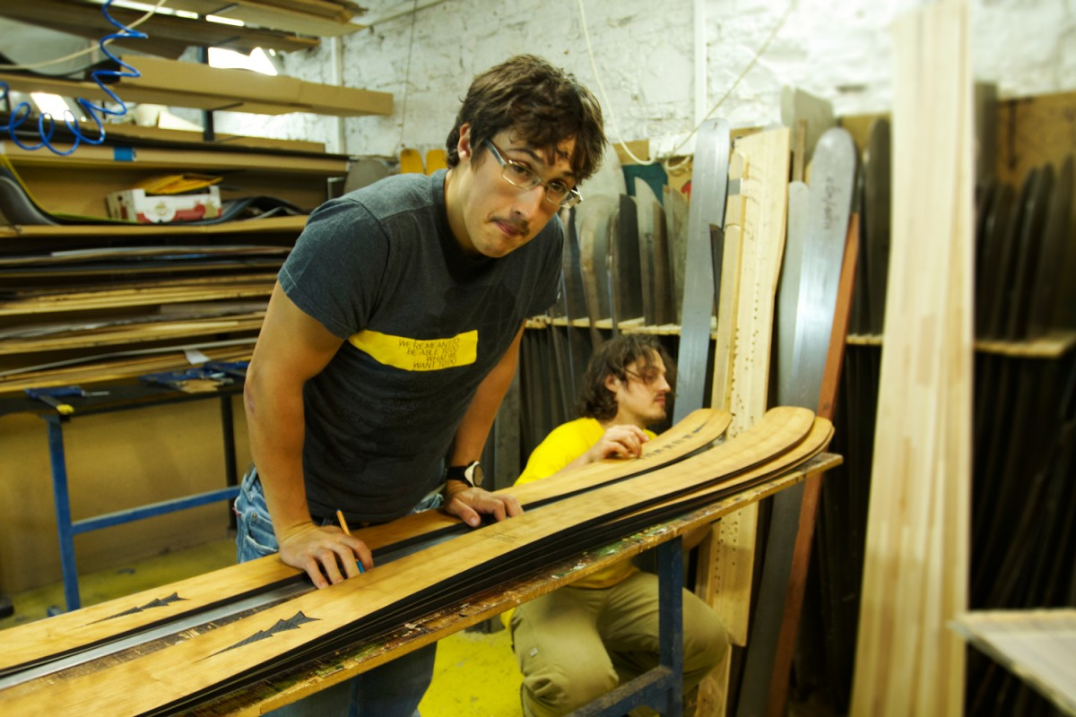
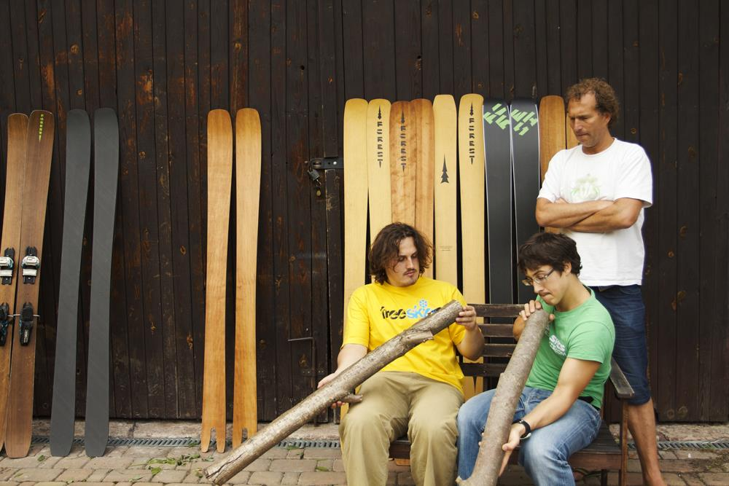
Story
The only one company in SK producing Skis
Company about two brothers : Jakub and Viktor Devečka
Freeskiers who study in Tech Universities
Informations from schools are used in production

Slide 4
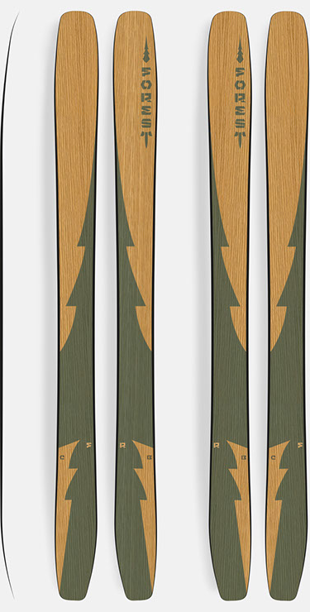
Skis video
ORKAN PERUN FROST LOTOR

Slide 5
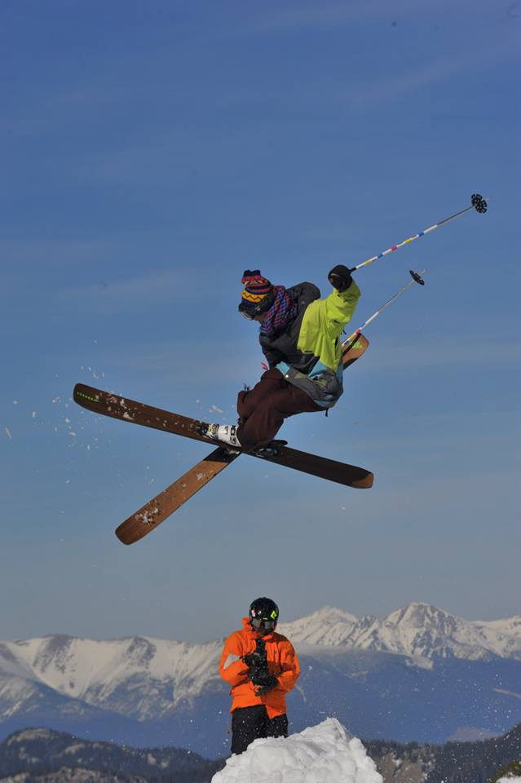
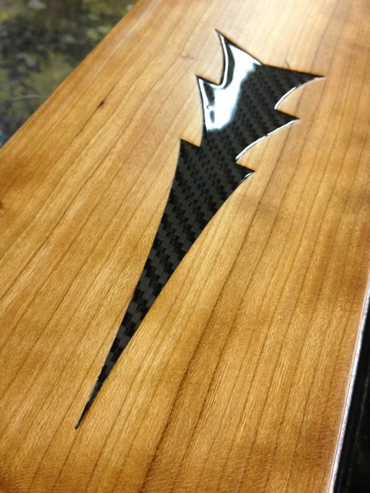
Technologies
Classic but also difficult process – wet lamination
Simplicity
Ecology
Kevlar, glass fibers
Dyneema

Slide 6
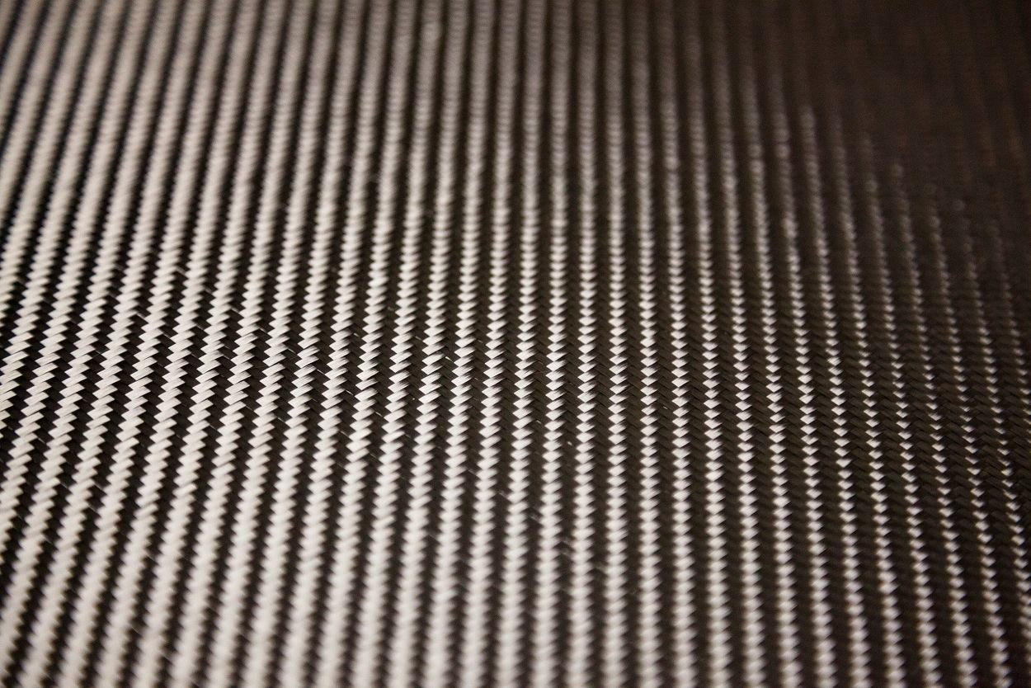
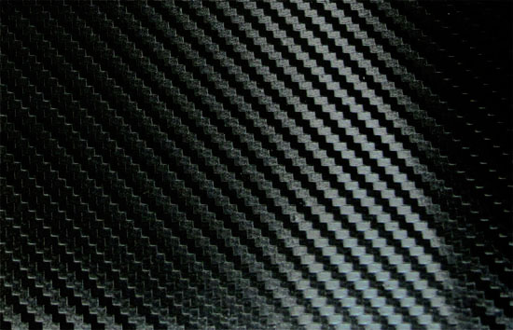
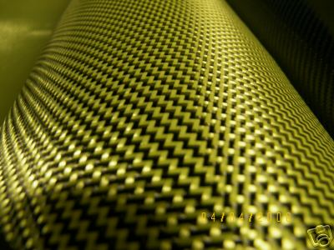
Materials
Dyneema
Carbon fiber
Kevlar fiber
Aspen wood core
Glass fiber

Slide 7
Construction
Shapes play a huge role
You can choose your own style
Different types of tails
Twin tip Alpine Swallowtail BC

Slide 8
THANK YOU FOR YOUR ATTENTION

