Slide 1
Animals

Slide 2
 |  |  |  |  | 1.
 |  |  |  |  | 4. 5.
 |  |  |  |  | 7.
8.
 | 9.
10.
11.
14.
15.
B E E
2.
P I G
3.
R O O S T E R
D U C K
Sounds:
1.
2.
3.
4.
5.
6.
7.
8.
9.
10.
11.
12.
13.
14.
15.
S H E E P
6.
L I O N
F R O G
E L E P H A N T
W O L F
M O N K E Y
G O A T
12.
M O S Q U I T O
13.
H O R S E
T I G E R
S Q U I R R E L
Birds of a feather ...

Slide 3
Choose only 2 words and fine the sentence ...
FART
TOGETHER
HELMET
FARMING
STAND
FLOCK
LEATHER
MOTHER
Birds of a feather ...
flock together

Slide 4
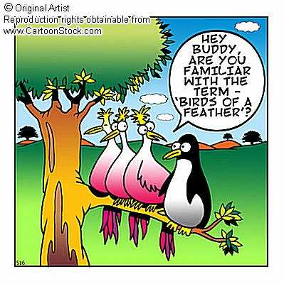

Slide 5
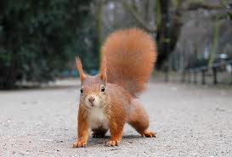
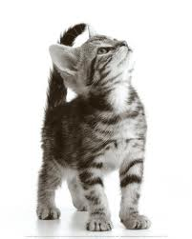
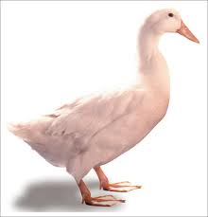
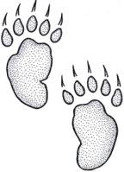
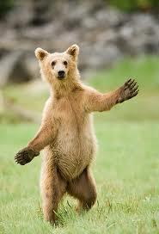
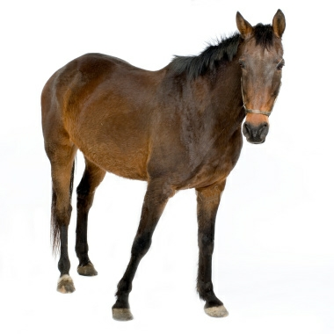
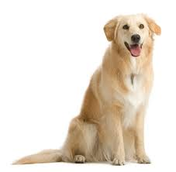
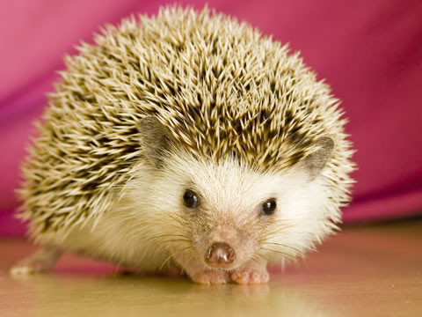
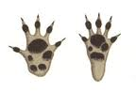
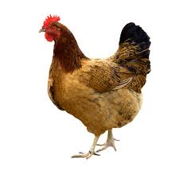

Slide 6
Thank you for your attention!

