Slide 1
SPORT
Jakub Stašák
Ondrej Pribula

Slide 2
CONTENT
FOOTBALL
HOCKEY
WORLD CHAMPIONSHP 2002
OLYMPIC GAMES
PAVOL DEMITRA
MAREK HAMŠÍK
MIROSLAV ŠATAN
PETER SAGAN

Slide 3
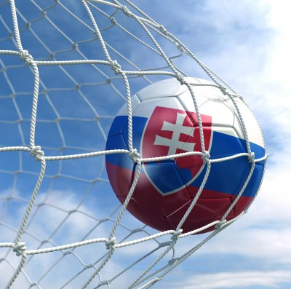
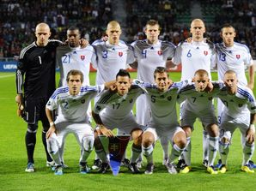
FOOTBALL
Czechoslovakia 1976
Once in Africa
EURO 2016
Slovan Bratislava
Notes:
The biggest success of slovak football was in 1976 in Belehrad when Czechoslovakia won European Football Championship,beating Germany in final round 3:2.The most memorable moment of this tournament was when Antonin Panenka scored the winner by converting a penalty kick. In era of independence ,Slovakia qualified only once in Africa. In spite of problems in the beginning when we drew against New Zeland and lost against Paraguay, when no one trusted us, we won the hardest match against Italy, that was previous World cup champion,in my opinion we played one of the greatest match in the era of independence.We qualified to round of 16, but we lost against later runner-up, Netherlands. Nowdays, we are very close to qualify in EURO 2016 from the first place in group, after beating Spain and Ukraine at their own stadium.In club history Slovakia has never achieved some bigger success.I only should mention Slovan Bratislava winning Cup Winners' Cup which is analogy of today UEFA europa ligue.

Slide 4
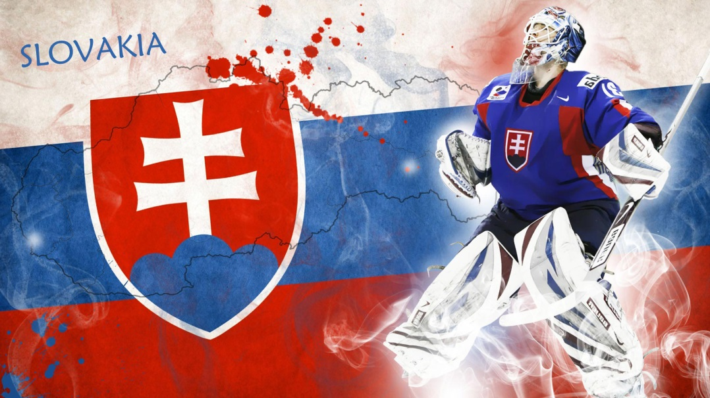
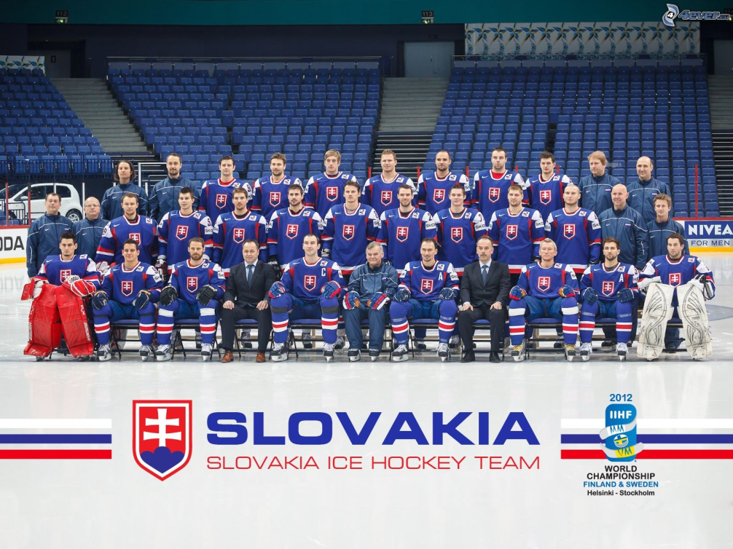
HOCKEY
Championship 6 times
Bronze in czech
World record
Notes:
Hockey is most popular sport in Slovakia.Before deviding of Czechoslovakia our hockey team won Ice Hockey World Championship 6 times.In home ground in Prage we stopped winnig streak of USSR by winnig first place.It was great success becuase USSR have been unbeaten for 9 years.Than after deviding of Czechoslovakia we were wrongfully relegated to C group even if Czech stayed in A group. But just in 2 years we have fought our way back to A group and at the beginning of 21 century we cauptured our first slovak medal.3 years after we won bronz medal in Czech republic.In present we call this medal „bronz which has value of gold“.We were unlucky in olympic games 2010 whenWe were playing amazing hockey.We defeated Russia and Sweden but unfortunately we ended our way on fourth place.In 2012 nobody expected that Vladimir Vujtek could create team that can be successful. We had lost 2 important matches but our team raised up and qualfied to final where we lost only against the strongest russian. Also i want mention that women hockey team hold world record of most goals in profesional match.They trashed bulgaria 82:0

Slide 5
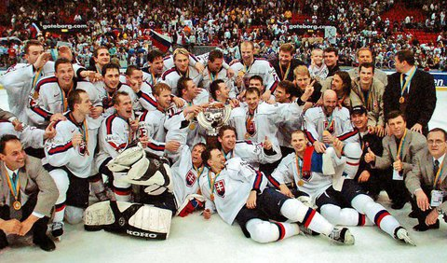
ICE HOCKEY WORLD CHAMPIONSHP 2002
Little expectations
Goteborg
Biggest success
Notes:
After huge fail in olympic games in salt lake city Slovak hockey team was very frustrated.Before the tournament we didnt have big expectations moreover we played average hockey in group stage,ending on second place after loss against finland.But we steeled for and we havent lost any other match.In quaterfinal against Canada, we were 2:0 down, but in last second of second period peter bondra circeled the net and scored a magnificant goal. Then Miro Satan scored the equaliser.And finally Peter Bondra scored the winner and he proved that we were better team.In semifinal we defeated Sweden in shootout when Palfy and Lintner hit the pock under the bar. So we bought new televisions, we ordered places in alehouses,coffees,in our friend houses.Final match took place on 11th.may.2002 at Goteborg.We were winnig 3:1 and everything looked that we are absolutely going to win,but than maxin sushinski equalised.But 17 seconds before the end Peter Bondra took responsibility for team and fired a shoot that hit the post and ended in the net.We won the first and only gold medal in history of slovakia.It was the biggest success of hockey and we hope it will happen again.

Slide 6
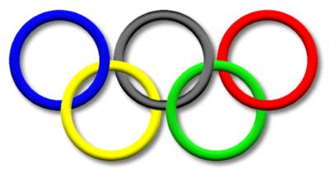
OLYMPIC GAMES
Winter
Summer
Since 2006 successful
5 medals
Biathlonist
Much more successful
23 medals
Canoeists
Notes:
In olympic games 1994,1998,2002 Slovakia won no medals but since 2006 Slovkia was more successful because we won 5 medals.Our first medal was won by Radoslav Židek.He gained silver medal.The most successful Winter Olympic games for Slovakia were in 2010,they took place in Vancouver because we gained all types of medals.Two most valuable won our best achiever of winter olympic medals,Anastazia Kuzminova.Our first bronz medal was won also by biathlonist,Pavol Hurajt.Last year, OG werent so successful but we have won 1 gold medal by Anastazia Kuzminova again.
Summer olympic games were much more successful.In our history we won 23 medals(7gold,9silver,7bronze).All gold medals were won by canoeists. The biggest amount of gold medals have Peter and Pavol Horschornerovci(3). Biggest amount of every medal owns Michal Martikán(5) .

Slide 7
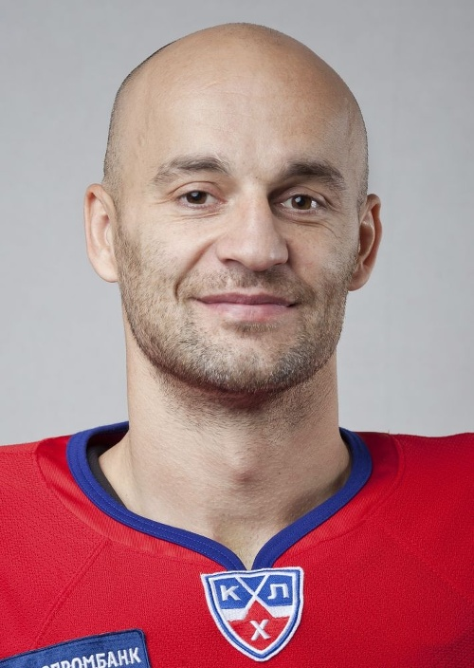
PAVOL DEMITRA
1974
Ottawa Senators
St.Louis Blues
Notes:
He was born in 1974.He was so good that when he was in 5th grade he played with 9th grade players.And sometimes he trained so hard and so long that he had no time for doing ENGLISH and other homeworks so his sisters had to do it instead of him.His proffesional career began in Dukla Trenčín.When he was 18 he was drafted to NHL by Ottawa senators. But he was affiliated to AHL team.He spent there 3 years,but he was sick of this leage and he wanted to go home.But fortunetaly St.Louis Blues engaged him. He created there „slovak line“ with Handzus and Bartecko. When he turned back to Trencin because of lockout in NHL, he created the best line with Gaborik and Hossa. But they lost with slovan because of referee faults.In NHL he dindt notice any bigger success but he helped Slovakia with third place by great winning goal. He ended his national career after failing in World cup in our home ground.In last years of his career he decided to play one season in KHL.Whole slovak nation cried when we found out that our hockey legend died.

Slide 8
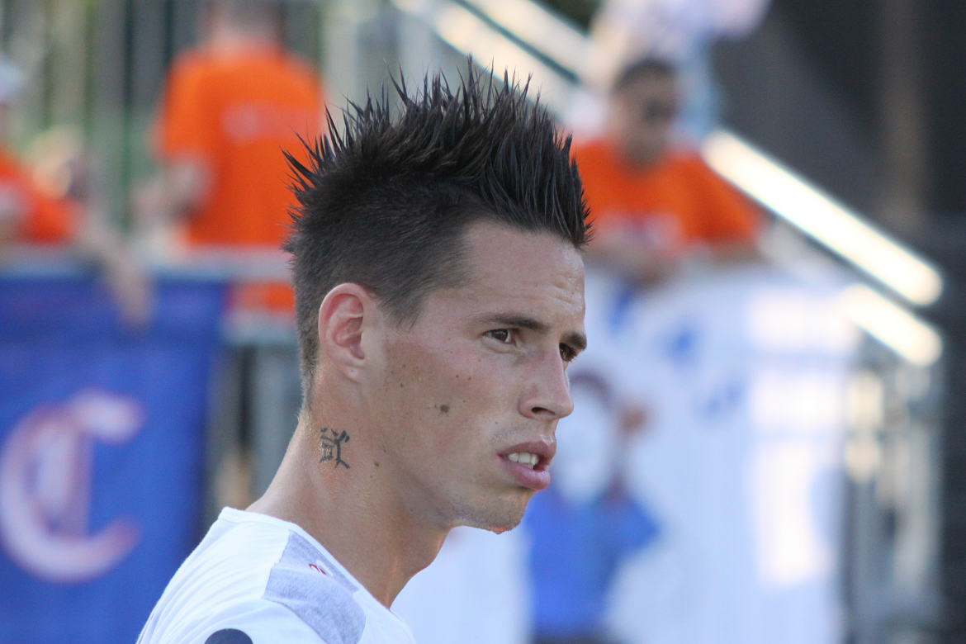
MAREK HAMŠÍK
Slovan Bratislava
80 goals in Napoli
Notes:
3times Slovak player of the year, Marek Hamšik, was born in Banska bystrica. His parents had to sell their Felicia, because hamsik didnt have any money to train. He started playing in professional way in Slovan Bratislava. When he was 17, he started playing in Brescia. His team had financial problems, so Hamsik decided to transfer to Napoli. Marek played there with Edinson Cavani and Ezechiele Lavezzi. He scored 80 goals in Napoli. In national kit, nowdays he is considered as the best player, and he is one of the captains of Slovak national team.

Slide 9
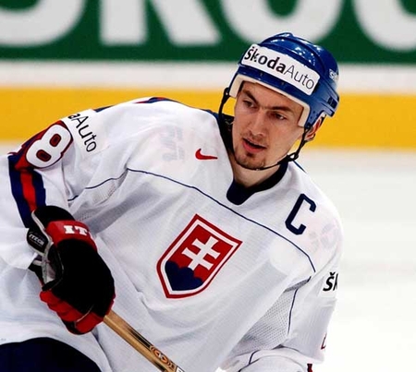
MIROSLAV ŠATAN
1974
Dukla Trencin
NHL
Pittsburgh Penguins
Stanley Cup
Notes:
Miroslav Satan was born in 1974. He is one of a products of Dukla Trencin young hockey academy. He was also drafted to NHL in very young age. After two years in affiliated team he fought his way to NHL and at the beginning of his nhl career he scored a hattrick. In NHL his greatest succes happened in 2009 with Pittsburgh Penguins. He won there Stanley cup. He is also very succesful with national team. He had won every medal as a capitain, he could. As his greatest success in national kit is considered gold medal in 2002 he won as a capitain too. His career ended because he havent been playing long time because of unlucky injury. He is the topscorer in slovak national kit, he also has most goals and assists, and most matches.

Slide 10
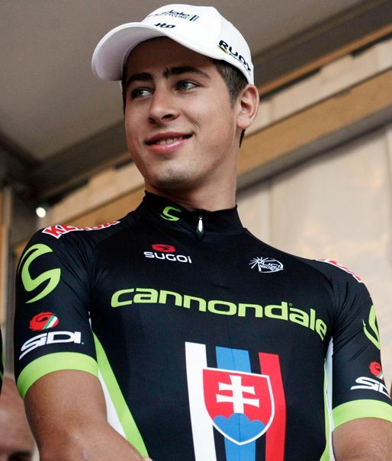
PETER SAGAN
1990
Liquigas Cannondale
3 times green shirt
Notes:
Sportsman of the year, Peter Sagan 2013 was born in Žilina. When he was a child, he used to be a footballer, but later he gave up football and started to be a cyclist. 7 years old Peter won his first race, in Lesopark Žilina. After that, his parents realised, that he could be excellent in cycling , and they were supporting him. 2 years later he joined his first cycling club. He had shocked whole czechoslovakia, when he was 16, by winning race in czech and beating 3years older racers. When he started professional carrer He joined club Liquigas cannondale, and he have won there green shirt in Tour de France since 2014 three times. He won tour de Pologne, and 2 times his favourite race- Tour de California.

Slide 11
THANK YOU FOR YOUR ATTENTION

