Slide 1
MUSICIANS IN OUR REGION
Tatiana Bučková
II.D

Slide 2
KATKA KNECHTOVÁ
Prešov (GJAR,Philosophy)
Keyboard, guitar
Prešovčatá
IMT Smile
Peha band
2005 - Aurel award
2007 -OTO award
Since 2008 - solo career

Slide 3
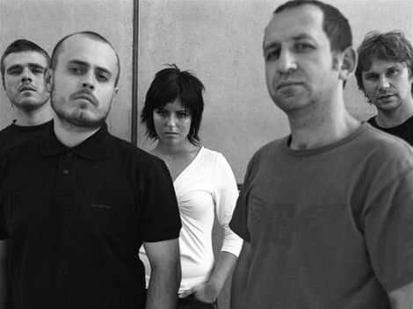
PEHA
Members: Karol Sivák, Marek Belanský, Juraj Ondko, Martin Migaš
Poprock
2006 -Aurel award
2007-Slávik
Albums: Niečo sa chystá, Krajinou, Experiment, Best Of, ...

Slide 4
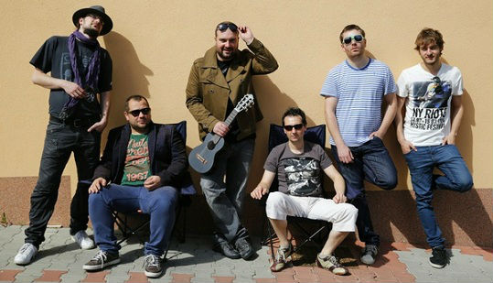
IMT Smile
Prešov (1992)
Poprock, Alternative
Members: Ivan Tásler(vocals),Miro Tásler(keyboard), Lukáš Kolivoška(bass),Dano Šoltis(drums),Tomáš Slávik(guitar)
Albums: Klik-Klak, Valec, Nech sa páči, IMT Smile, Diamant,Exotica, Universal Komplet Box

Slide 5
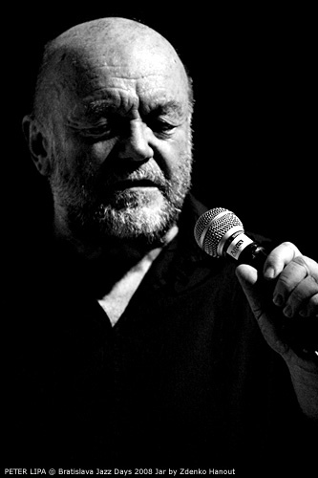
PETER LIPA
Prešov
Father of Slovak Jazz
blues, soul, mainstream classical, funk, rock
1998-2012 – Slávik
2005 – Aurel award

Slide 6
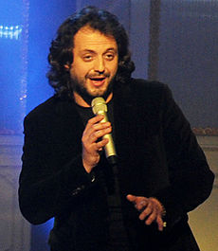
MARIÁN ČEKOVSKÝ
Humenné
Pop, rock, jazz, hip-hop, music for children
2011 - singer of the year
2012 - song of the year (Branči Kováč)

Slide 7
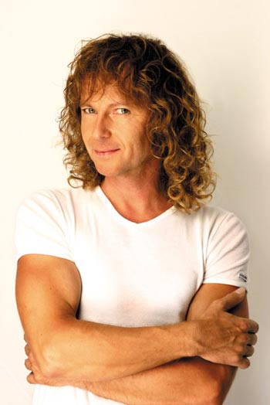
PETER NAGY
Prešov
Slovak singer, songwriter, record producer and photographer
1982 ( „Profesor Indigo“)
band Indigo
1984- debut album „Chráň svoje bláznovstvá“
ART PHOTO NAGY (since 2000)

Slide 8
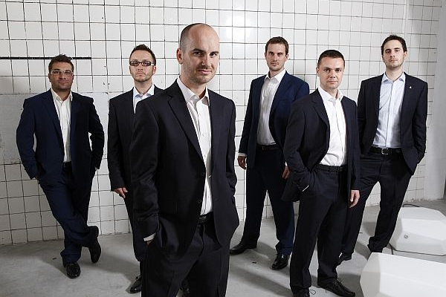
NO NAME
1996, Košice
Members: Viliam Gutray (bass), Igor Timko (vocals), Roman Timko (guitar),Ivan Timko (drums), Dušan Timko (guitar), Zoltán Šallai (keyboard)

Slide 9
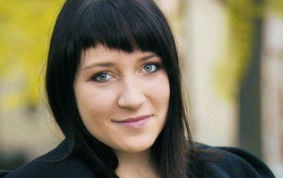
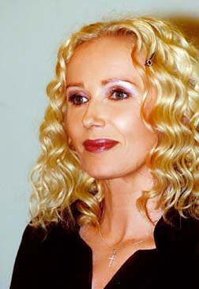
Others...
KATARÍNA KOŠČOVÁ
BEÁTA DUBASOVÁ
MARIKA GOMBITOVÁ
TINA

Slide 10
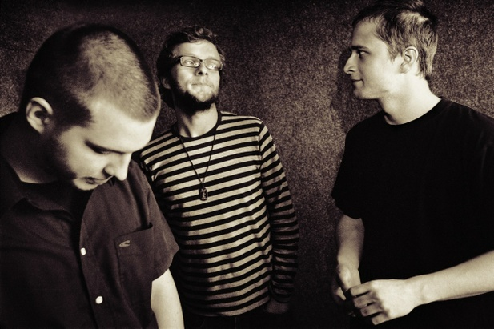
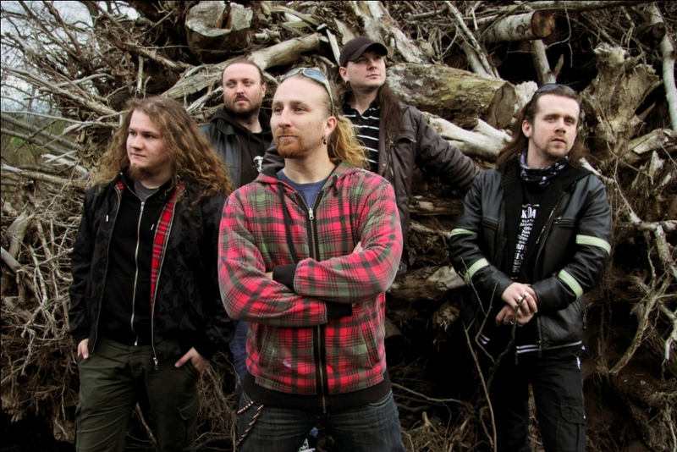
Others...
KOMAJOTA
HELENINE OČI

Slide 11
SOURCES
http://www.no-name.sk/
http://www.katarinaknechtova.com/
http://sk.wikipedia.org/wiki/Peha_(hudobn%C3%A1_skupina)
http://pehaweb.sk/
http://www.imtsmile.com/uvod
http://www.peterlipa.com/?id=132

Slide 12
THANKS FOR YOUR ATTENTION!

