Slide 1
Sports in Prešov
Tatiana Čirčová I.A

Slide 2
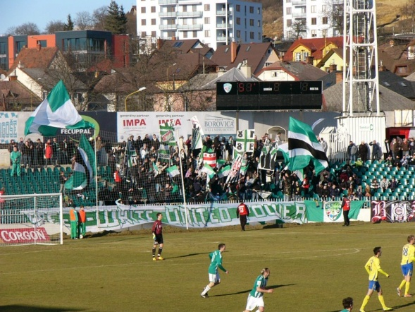
FOOTBALL – 1. FC TATRAN PREŠOV
the oldest football team in Slovakia
founded on 25 May 1898
nicknames: Koňare / Zeleno-bieli
club colors: green, white
stadium: Štadión Tatran (5410 seats)
league: 2nd league
honours:
Slovakian Cup
Winner: 1992
Czechoslovakian Cup
Winner: 1953
Mitropa Cup
Winner: 1981
InterCup
Winner: 1978
Notes:
www.1fctatran.szm.sk , http://en.wikipedia.org/wiki/1._FC_Tatran_Pre%C5%A1ov , http://www.futbalsfz.sk/reprezentacia/sr-16/spravy/novinka/nominacia-timu-sr-16-na-kontrolny-zraz-v-senci-1.html

Slide 3
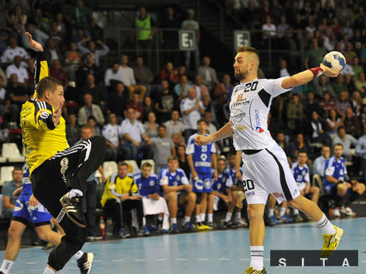
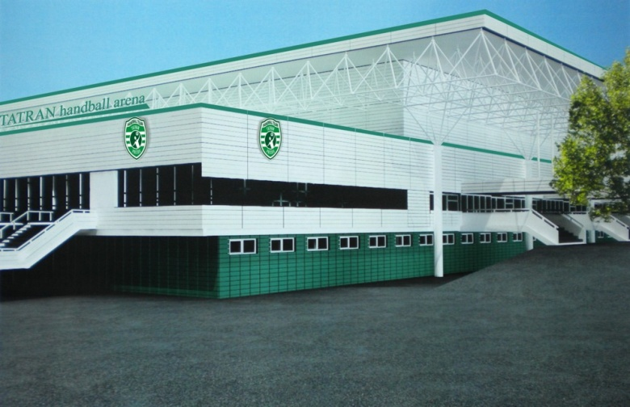
HANDBALL – HT TATRAN PREŠOV
the best handball team in Slovakia
founded on 1952
club colors: green, white
arena: City Hall Prešov (3,870 seats)
honours:
Slovak cup:
Winner: 1971, 1974, 1975, 1976, 1978, 1981, 1982, 2002, 2004, 2005, 2007, 2008, 2009, 2010, 2011, 2012, 2013, 2014
Extraleague:
Winner: 2004, 2005, 2007, 2008, 2009, 2010, 2011, 2012, 2013, 2014
Notes:
http://en.wikipedia.org/wiki/HT_Tatran_Pre%C5%A1ov , http://tatranpresov.sk

Slide 4
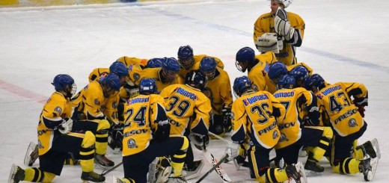
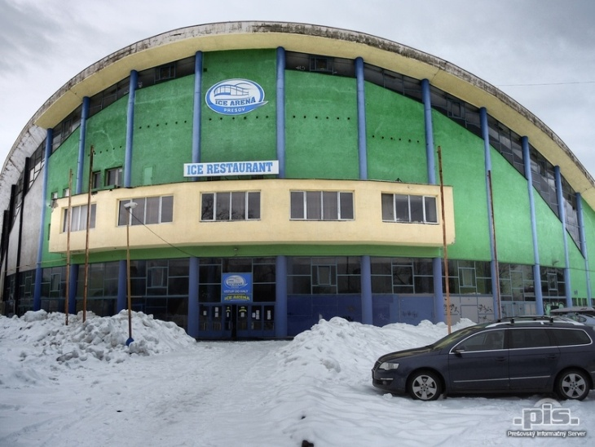
ICE HOCKEY – PHK 3B PREŠOV
founded on 1928
club colors: yellow, blue
arena: Ice arena (4200 seats)
honours: Slovak league:
Winner: 1932
Notes:
http://www.phkpresov.sk/ , http://sk.wikipedia.org/wiki/PHK_3b_Pre%C5%A1ov ,

Slide 5
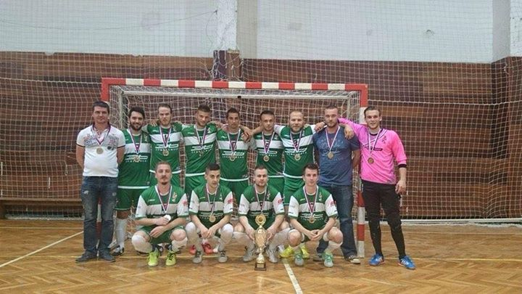
FUTSAL – FK SLOVANET PREŠOV
founded on 1.8. 2011
arena: Mladosť gym/ Handball hall on Baštová street
club colors: green, white
23 players
2nd after this season
Notes:
http://www.fkpresov.sk/

Slide 6
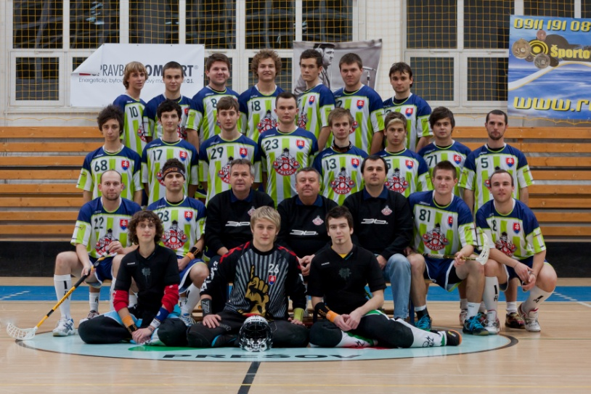
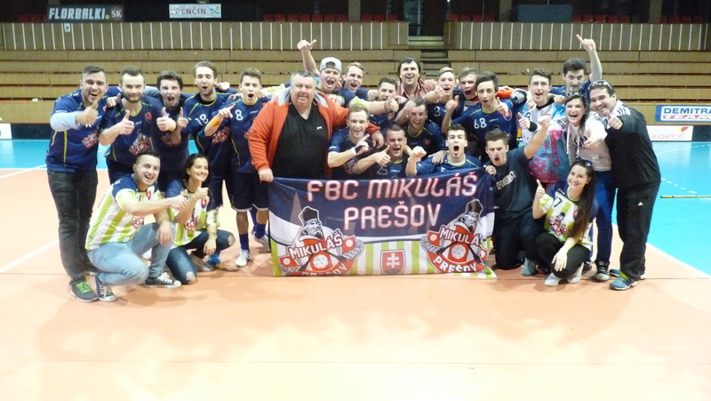
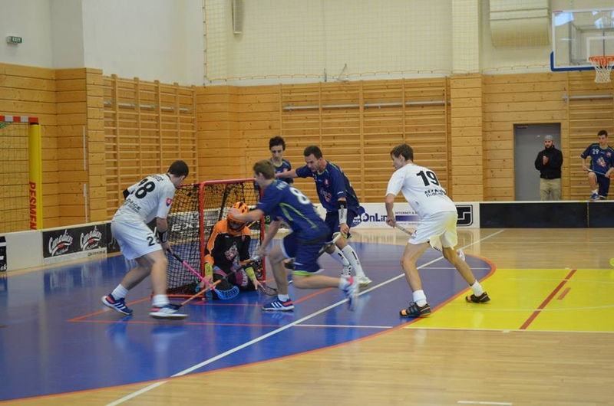
FLOORBALL – HBC MIKULÁŠ PREŠOV
founded on 2009
arena: ZŠ Sibírska gym
motto: Bavíme florbal, florbal nás baví!!!
club colors: blue, green, white, red
4th place this season in Salming league

Slide 7
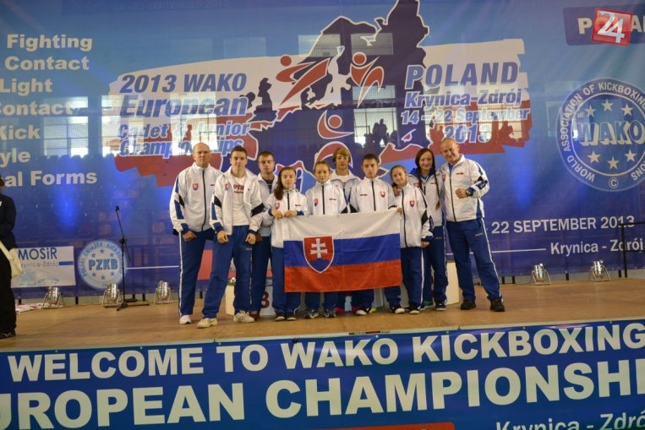
KICKBOX – KICKBOX CLUB PANTER PREŠOV
founded on 1993
this club makes good reputation for Prešov and Slovakia
6 medals from the last World Championship ( 2x gold, 2x silver, 2x bronze)- the most successful club in Slovakia

Slide 8
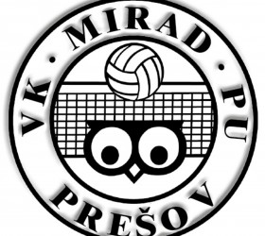
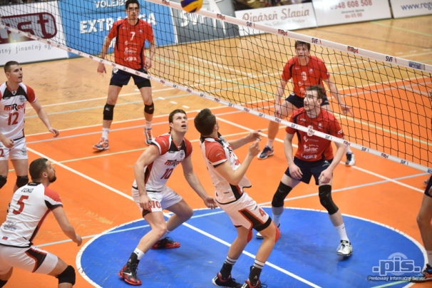
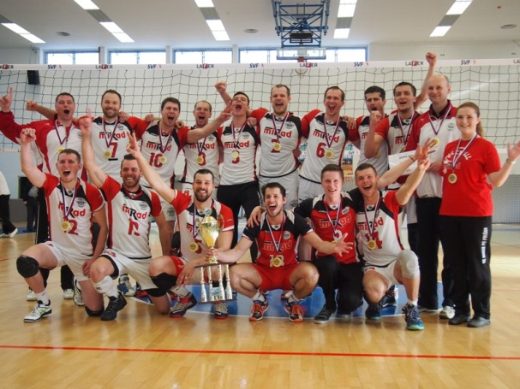
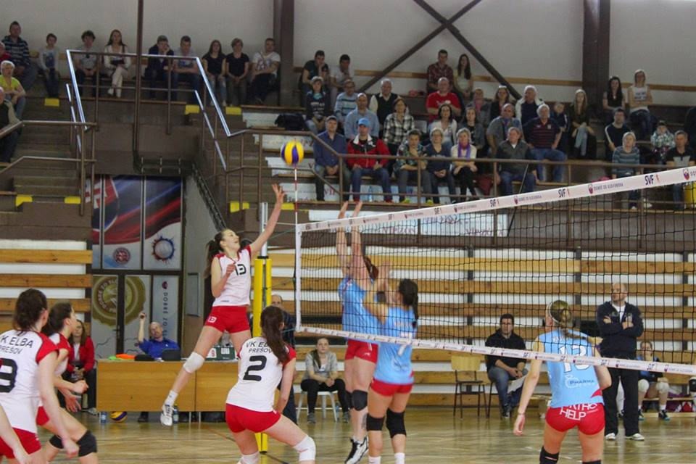
VOLLEYBALL
VK Mirad PU Prešov
VK ELBA Prešov
main area: SH/PU Športová 10
club colors: red, white
honours: Slovak league: Winner- 2005, 2015
main area: high school ELBA
club colors: white, blue, red
honours: Winner of Eastern Slovakia

Slide 9
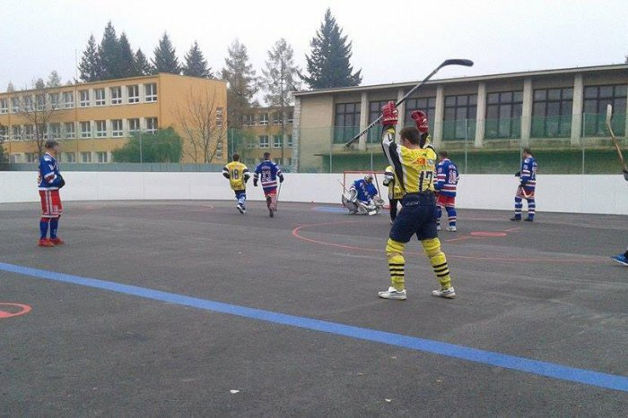
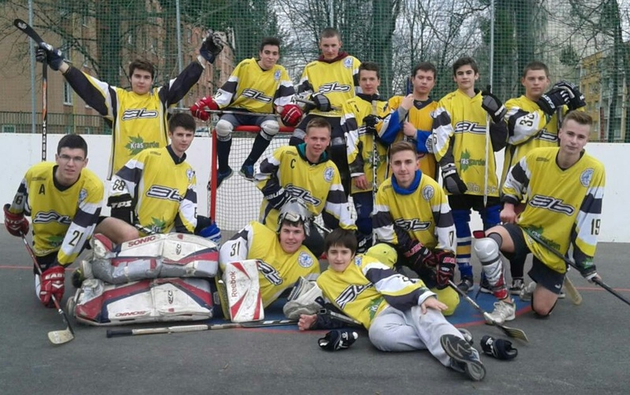
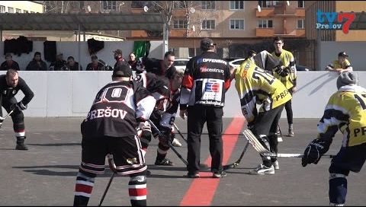
HOCKEYBALL
main area: ZŠ Čsl. Armády
league starts again after 12 years (in 2011)
TEAMS:
HBC TORNADO
HBC FANY SPORT
HBC PALUTO
HBC PANTHERS
HBC PIRATES
HBC ŠINDLIAR
HBC JUNIORS U16

Slide 10
FONTS:
http://www.1fctatran.sk/
http://tatranpresov.sk/
www.phkpresov.sk
www.fkpresov.sk
https://sk-sk.facebook.com/mikulaspresov
http://presov.korzar.sme.sk/c/6064063/panter-club-vychovava-mlade-kickboxerske-talenty.html
http://www.presovska-hokejbalova-liga.estranky.sk/
http://www.vkmiradpupresov.sk/
http://www.elbaci.sk/ssog/index.php?option=com_content&view=section&layout=blog&id=10&Itemid=97
https://www.facebook.com/pages/%C5%A0K-ELBA-Pre%C5%A1ov/289522797875754?fref=ts

Slide 11
THANK YOU FOR YOU ATTENTION
☺

