Slide 1
Prešov Region
Veronika Jusková

Slide 2
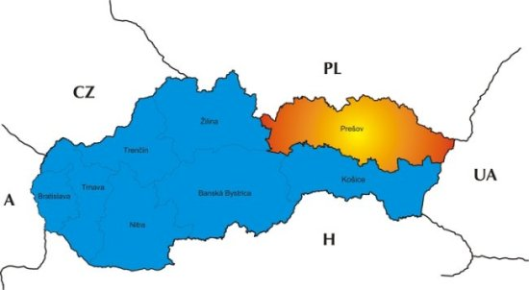
Some information
Area: 8 974 km²
The population: 814 527
Density of population: 89 people/km²
Average age: 33,67 years
Number of districts: 13
Number of cities: 23
Number of municipalities: 666

Slide 3
Bardejov
Area:937 km²
The population: 76 691pople
The famous monuments:
-Bazilika svätého Egídia
-2 Bells
- Bardejov Spa

Slide 4
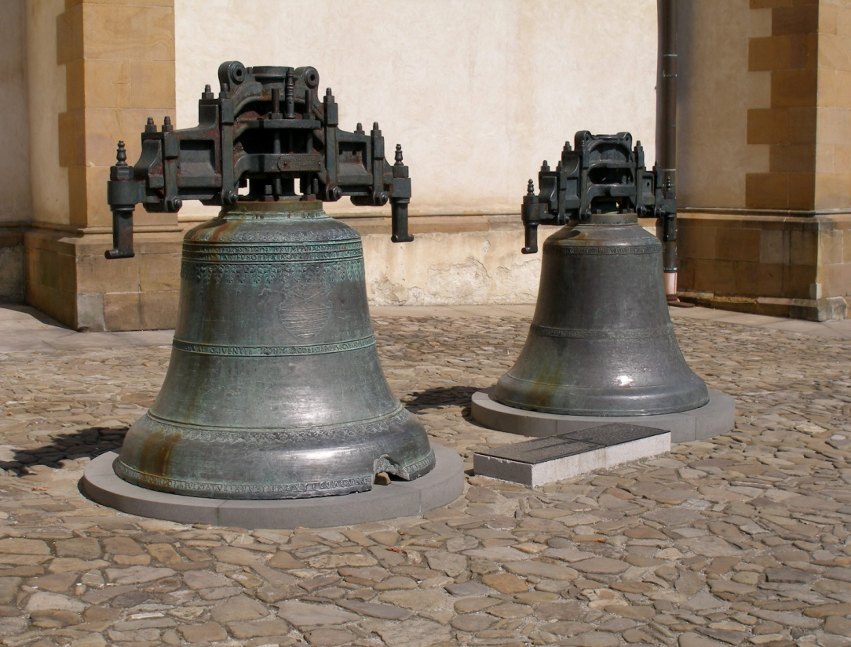
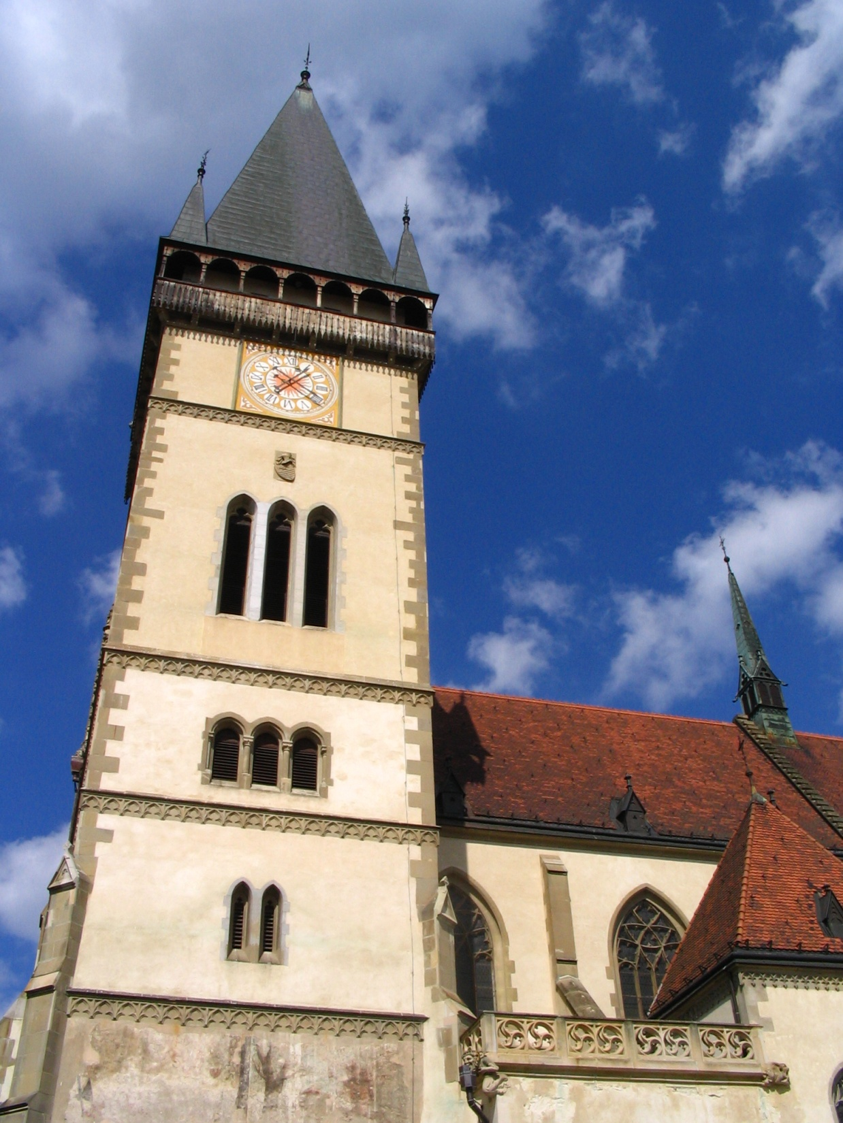
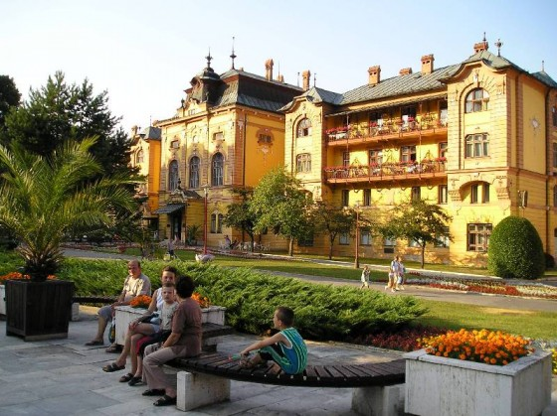

Slide 5
Bardejov spa
There are three swimming pools at Wellness SPA:
1. Relaxation swimming pool (21 m x 11 m, water dept: 1,20 m, water temperature 32 ºC)
Water bowl
Water cannon
Hydromassage jets
Whirlpool
Countercurrent flow
LED lighting
Water temperature: 36 ºC
2. Whirlpool swimming pool (4m x 11 m, water dept: 1,20m)
3. Children´s swimming pool (6,5 m x 2,5 m, water depth 0,20 m) with its attractions:
Slide
Water hedgehog
Water bell

Slide 6
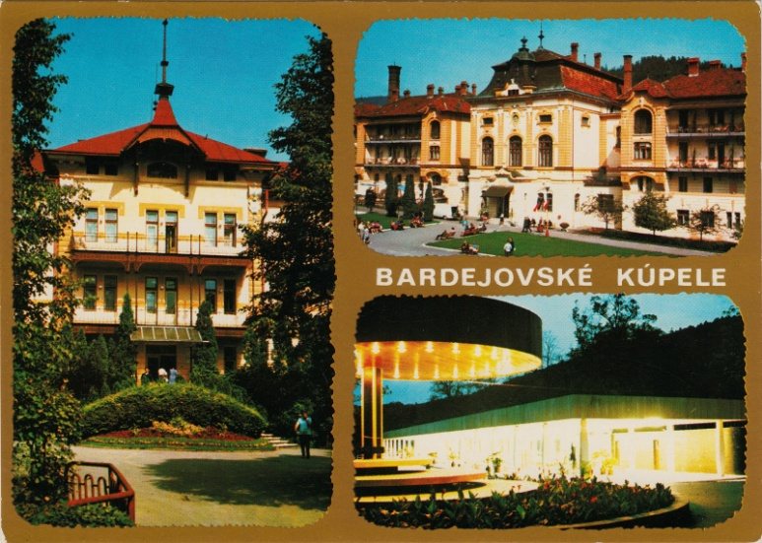
Bardejov Spa
Water temperature: 32 ºC
Pool are made of stainless steel, their surface is therefore smooth, without any gaps. Safety guarantee: non-slip bottom, rounded edges and optically visualized scale stairs.
Saunas:
Finnish sauna (dry sauna)
Steamsauna
Inhalationsauna
Infrasauna
Relax zone with saunas includes also Kneipp water treatment, tepidarium, ice-cold water tub and different showers
OPENING HOURS:
Swimming pools: Monday - Friday 13.00 a.m. - 21.00 p.m., Saturday -Sunday 11.00 a.m. -21.00 p.m.
Saunas: daily 13.00 a.m. - 21.00 p.m.
FITNESS, MASSAGES, SOLARIUM: Wednesday - Sunday 13.00 a.m. - 21.00 p.m.
Night time swimming at WELLNESS SPA
Every first Friday in each month our swimming pools and saunas are open from 21:00p.m. till midnight. Special bonus for each client: wellness drink.

Slide 7
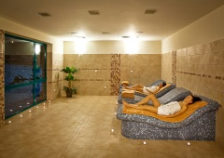
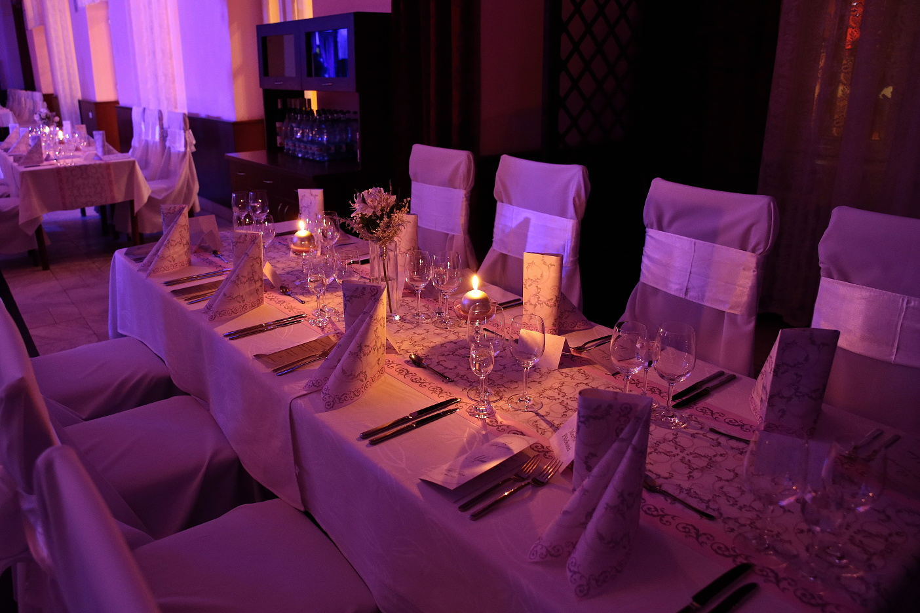
http://www.kupele-bj.sk/en/pobyt/hotely

Slide 8
SABINOV Area:484 km² The population:56 329 people

Slide 9
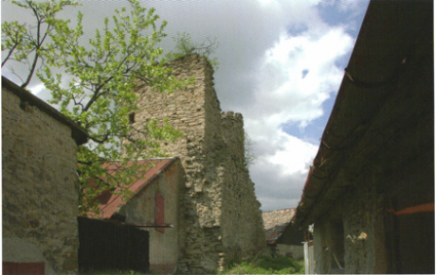
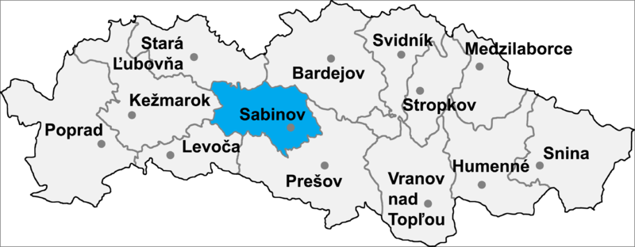
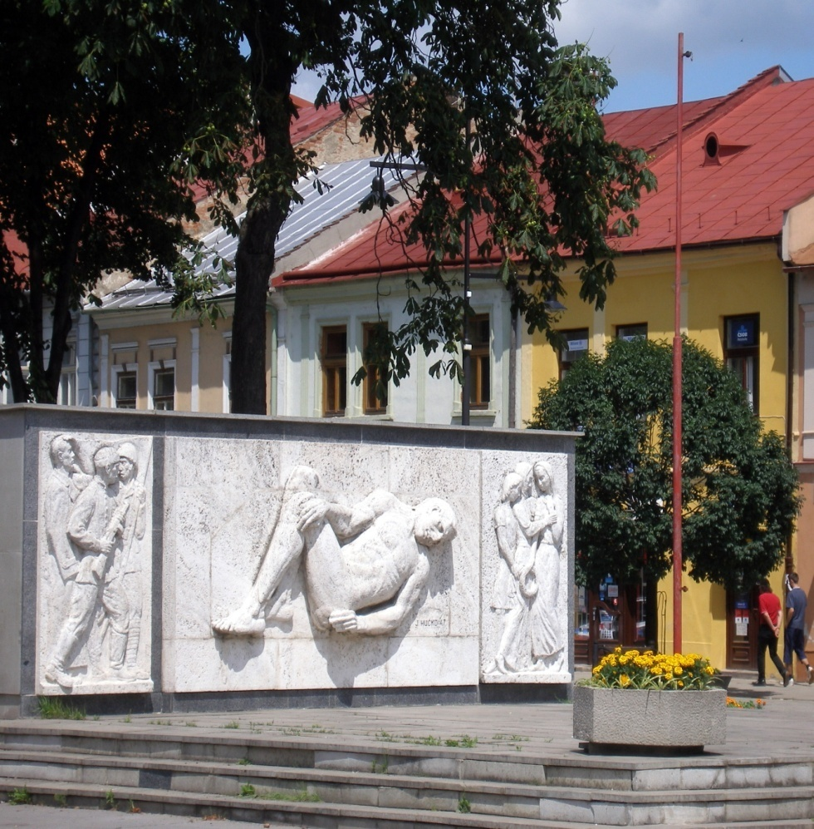
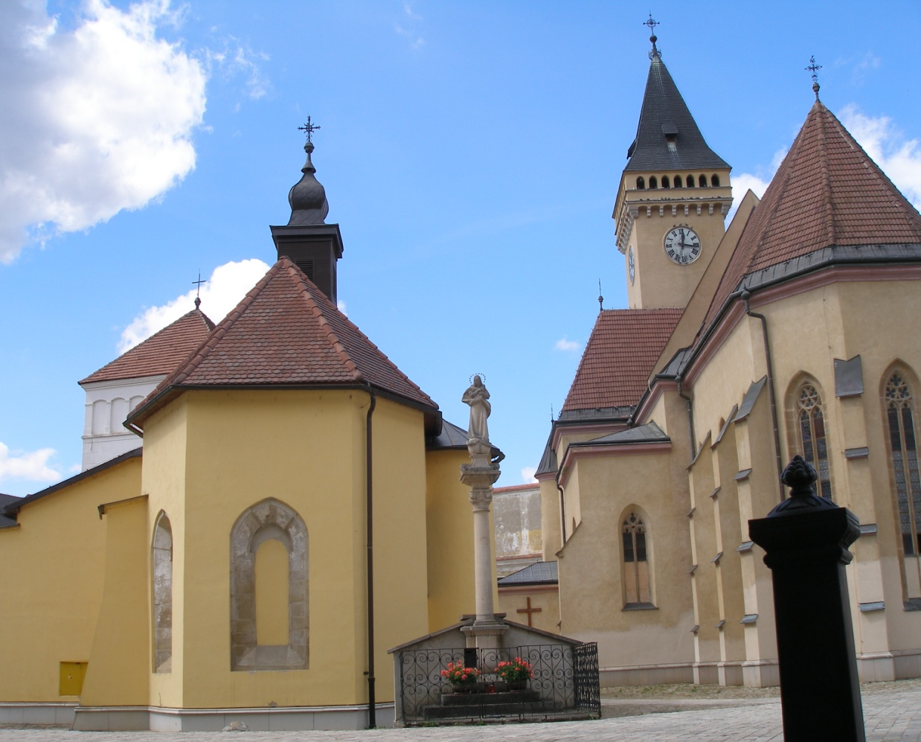

Slide 10
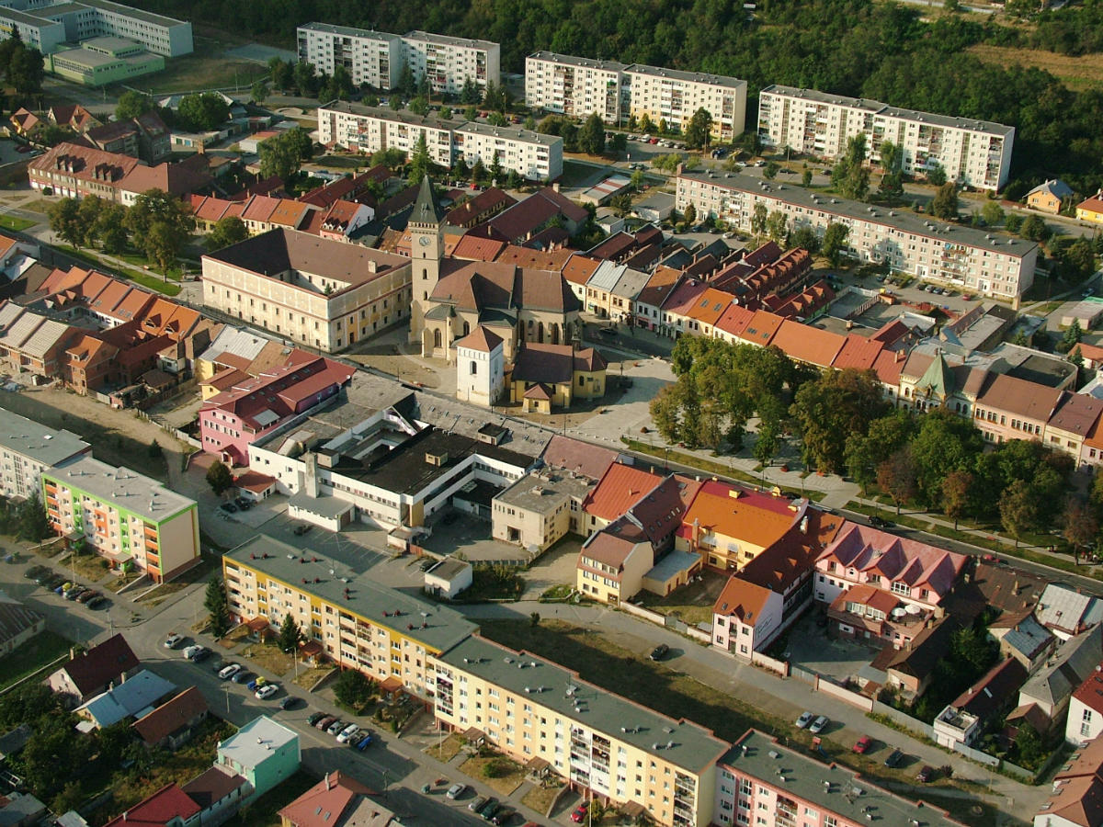
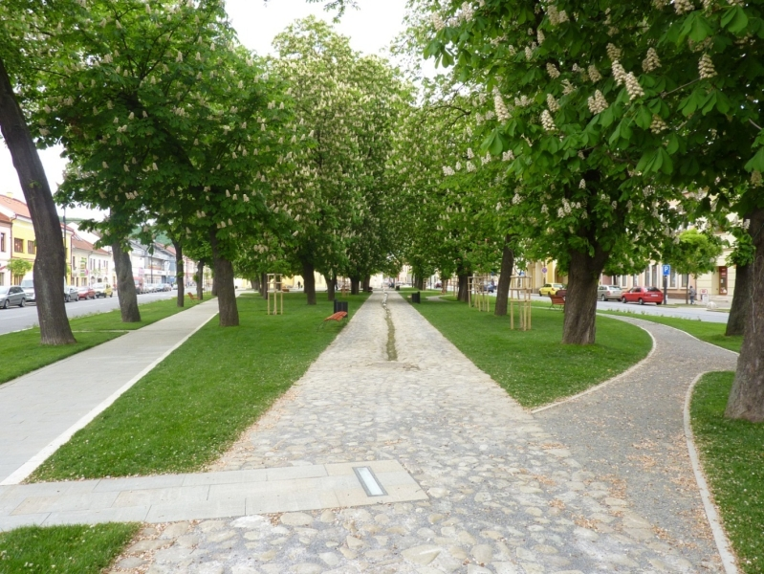

Slide 11
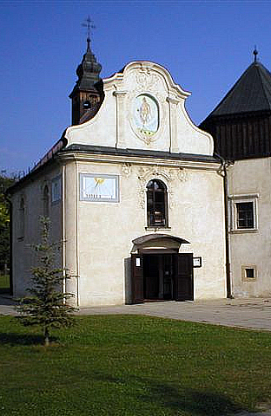
http://www.obce.info/slovensko/presovsky-kraj/okres-sabinov

Slide 12
http://www.po-kraj.sk/sk/fakty/zakladne-informacie/
http://www.kupele-bj.sk/en/pobyt/hotely

Slide 13
Thanks for your attention ☺

