Slide 1
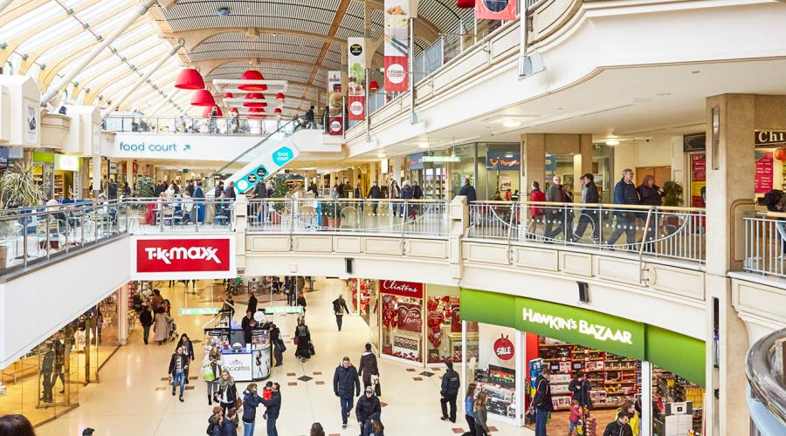
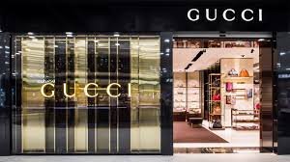
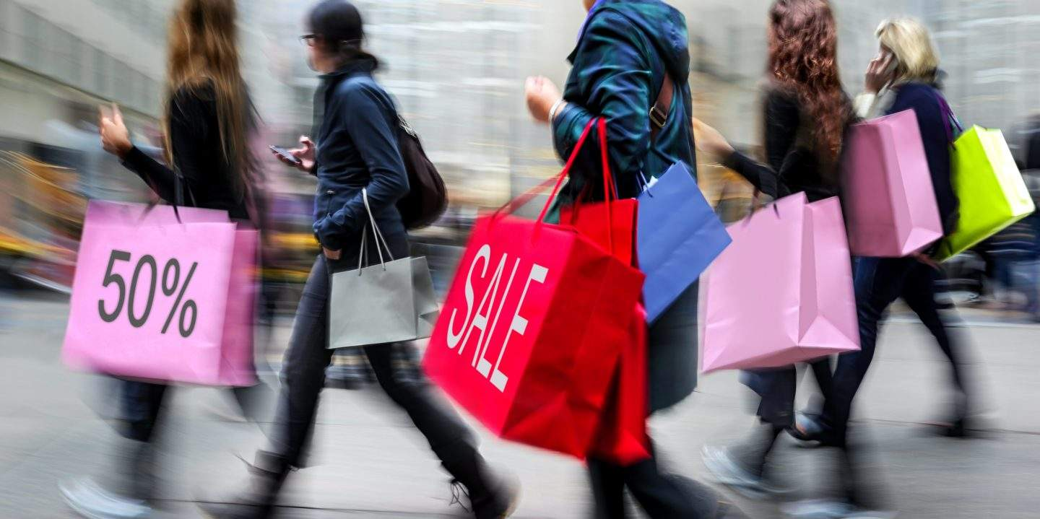
SHOPPING
Zuzana Bilá 3.A

Slide 2
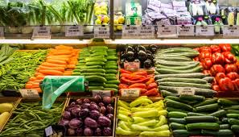
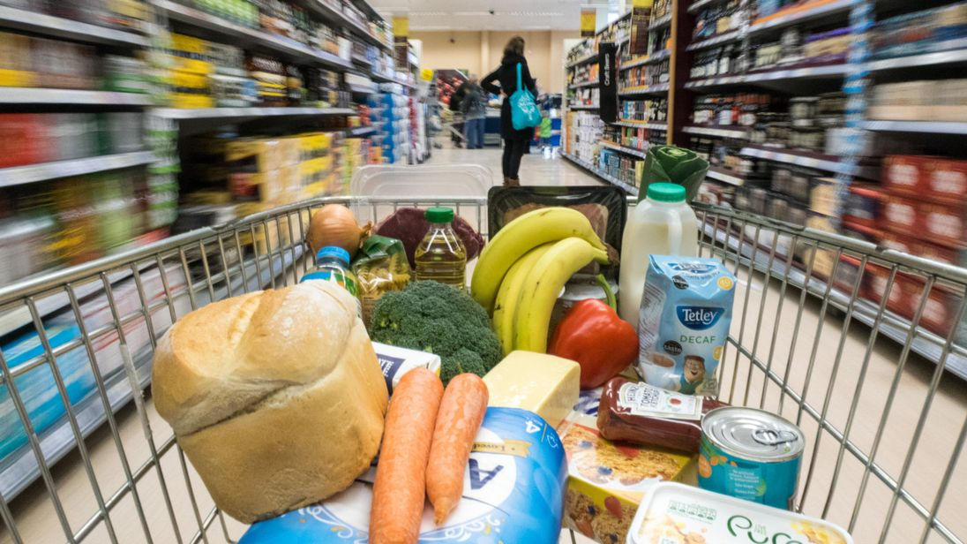
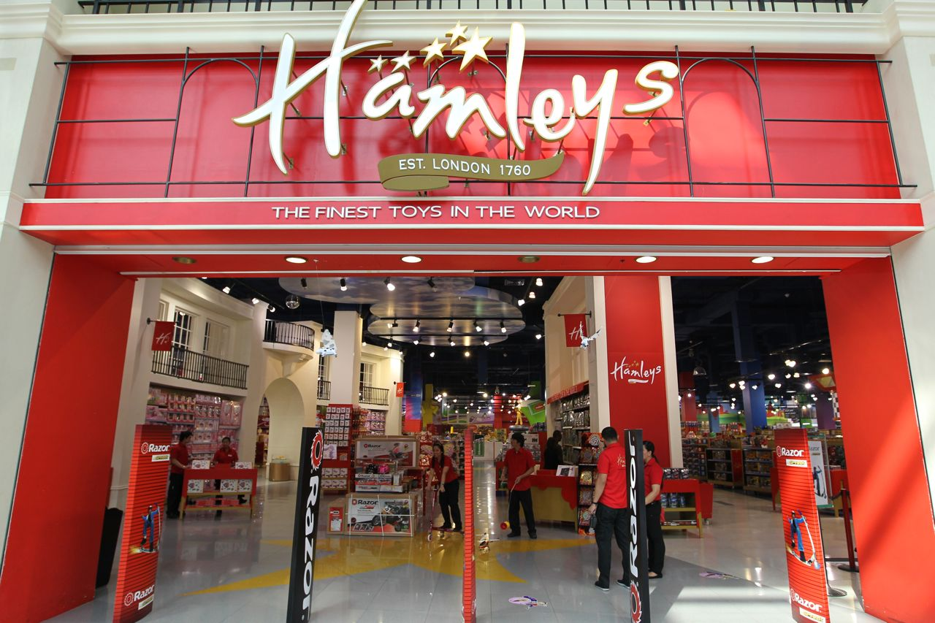
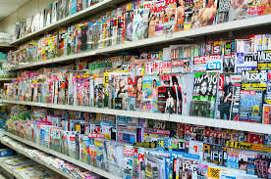
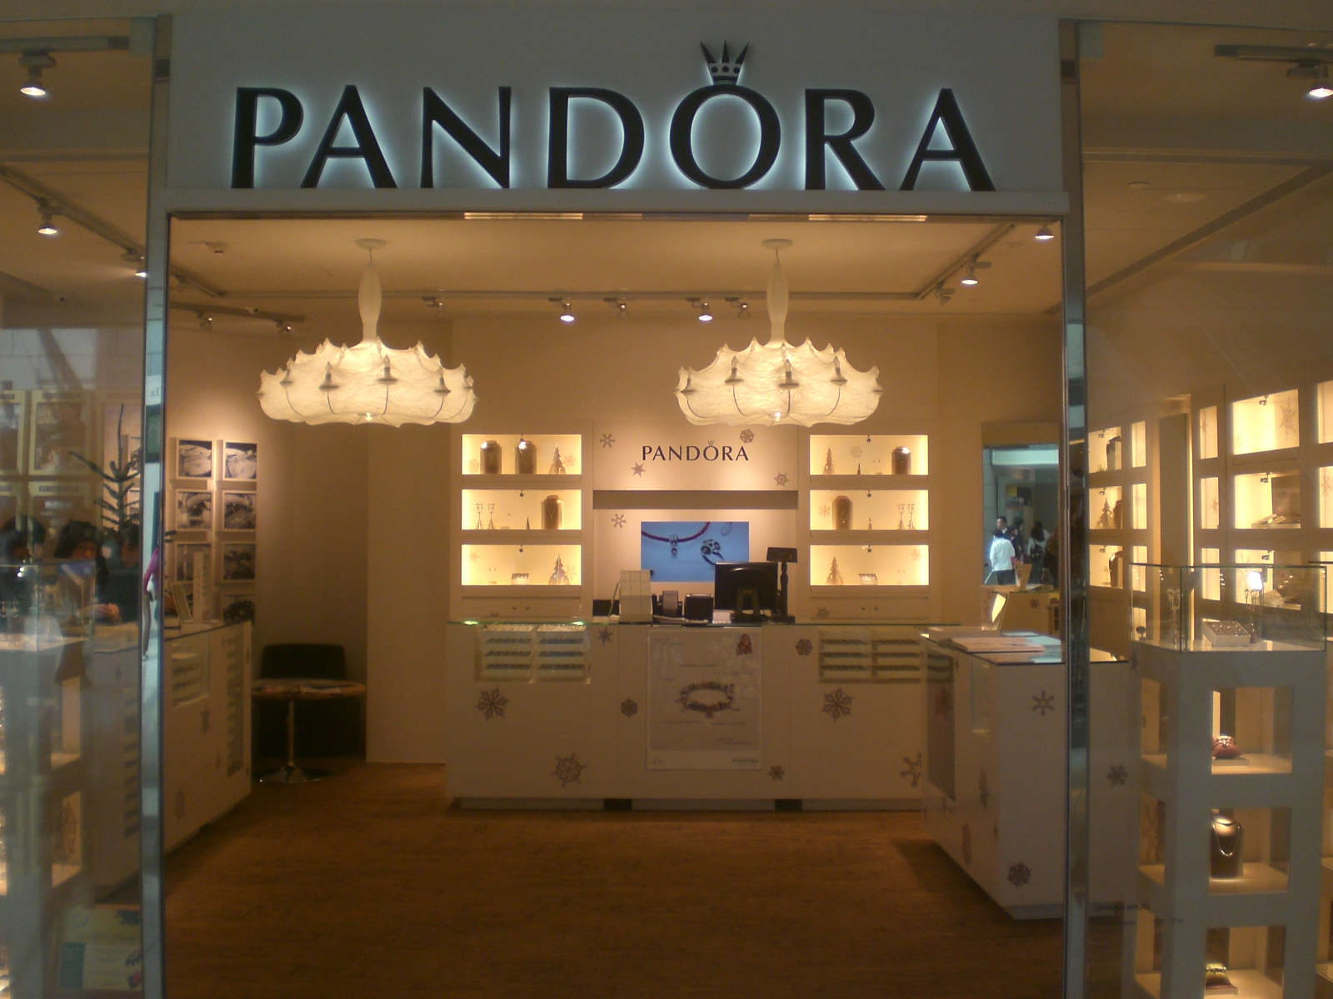
TYPES OF SHOPS
There are lots of different types of shops:
Supermarkets
Greengrocers
Toy shops
Clothes shops
Jewellery shops
Newsagent's shop

Slide 3
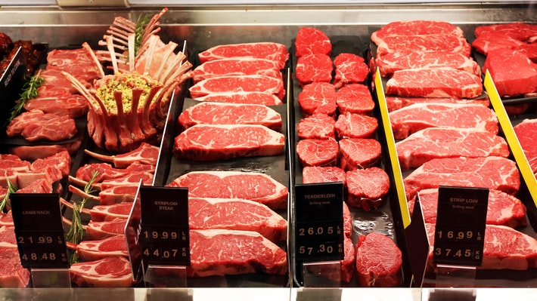
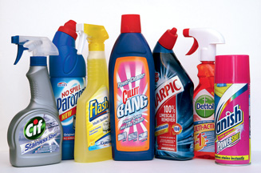
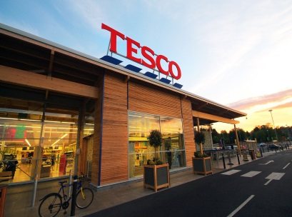
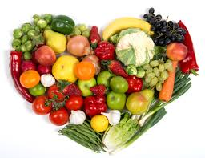
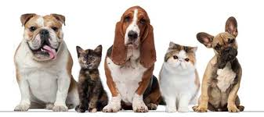
SUPERMARKETS
Supermarkets are big shops that sell food and other things for your house.
We can buy meat, dairy products, sweets, cleaning products, fruit and vegetables, medicine and pet foods in supermarkets.
Lidl, Tesco and Billa are supermarkets.
Sometimes supermarkets also sell clothes and toys.
What is your favourite supermarket?

Slide 4
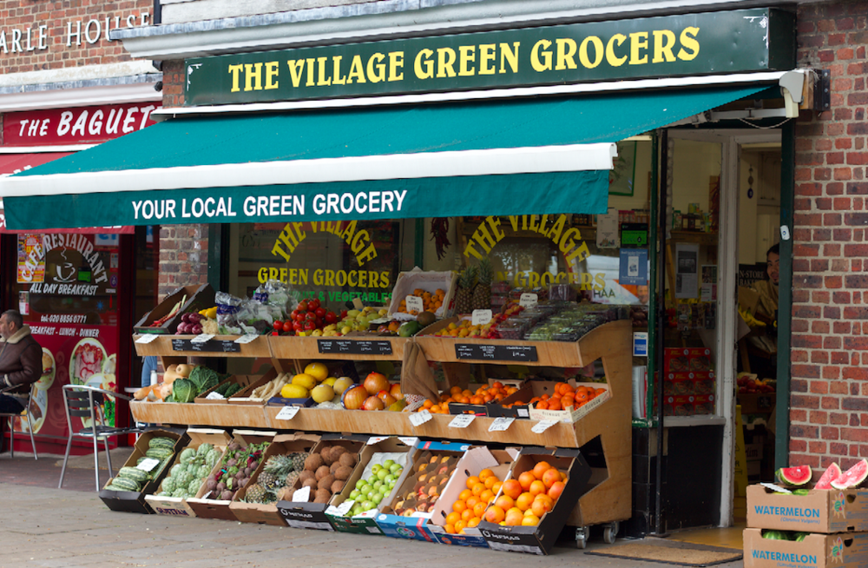
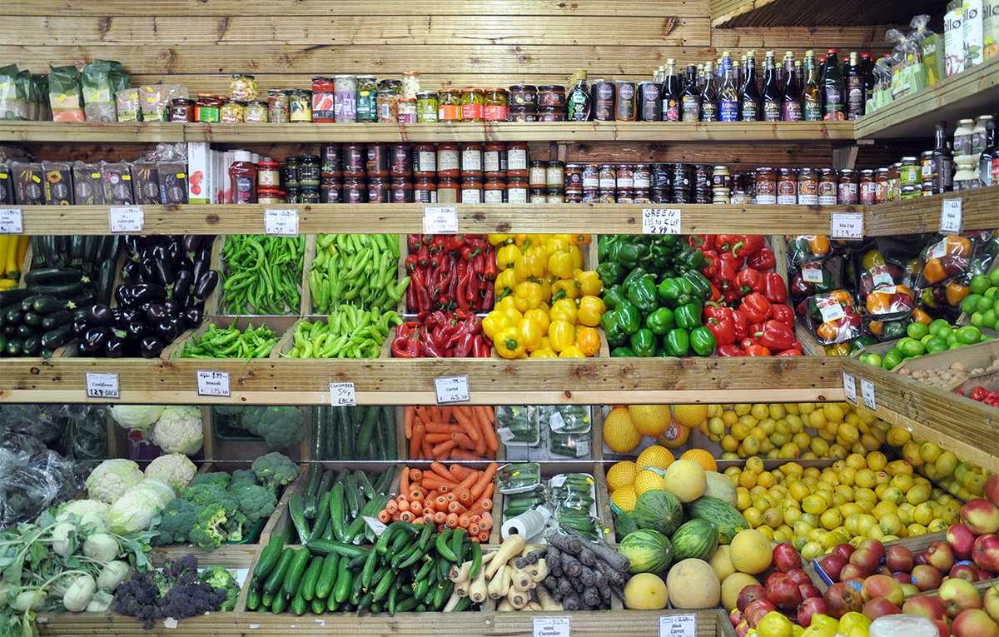
GREENGROCERS
A greengrocer, also called a produce market or fruiterer, is a retail trader in fruit and vegetables that is, in green groceries.
Greengrocer is primarily a British and Australian term, and greengrocers' shops were once common in cities, towns and villages.
They have been affected by the dominant rise of supermarkets, but many can be found managing small shops or stores in towns and cities and in some villages.
Greengrocers can also be found in street markets and malls, or managing produce departments at supermarkets. Such traders typically handle the entire business of buying, selling, and book-keeping themselves.

Slide 5
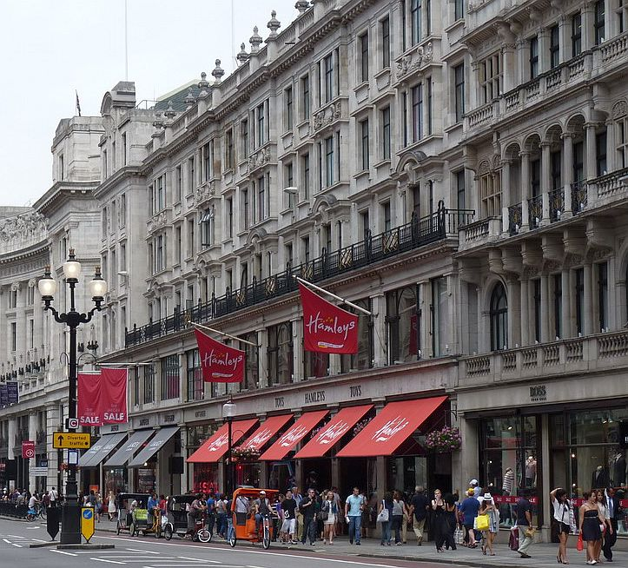
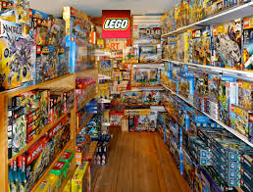
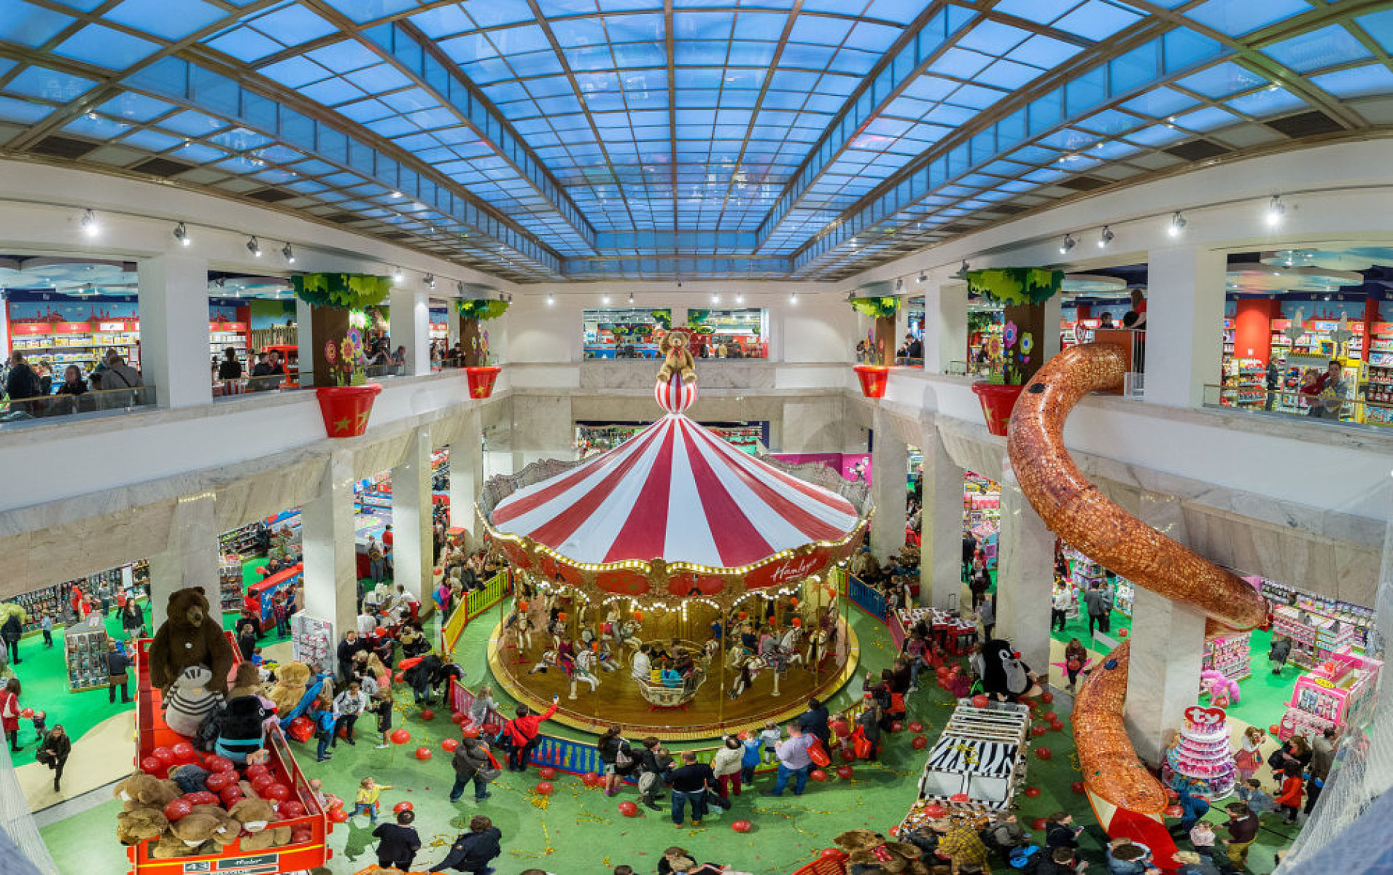
Toy shops https://www.youtube.com/watch?v=xkhUSTRFRoE
A toy store or toy shop, is a retails business specializing in selling toys.
No longer held to the limitations of a physical outlet, many toy stores now transact business over the Internet in addition to shops on the street. Many department stores also have toy sections.
The flagship store of Hamleys in London is the world's largest toy shop.

Slide 6
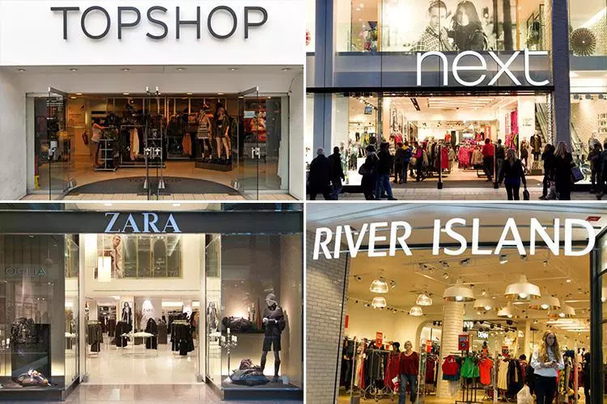
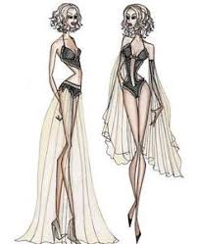
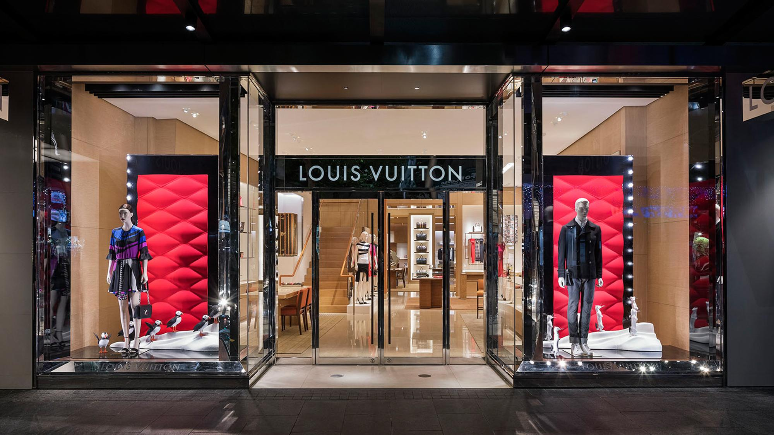
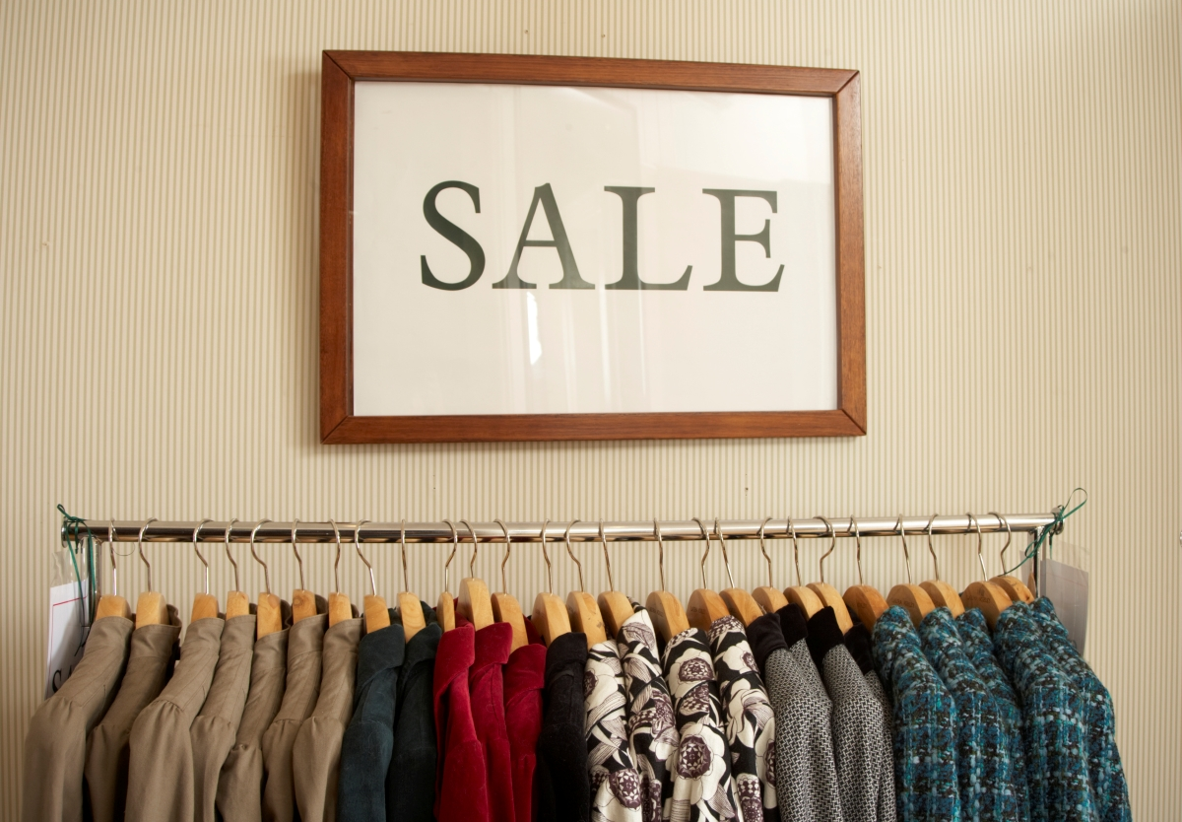
Clothes shops
A clothes shop or clothes store is any shop which sells items of ready-made clothing.
A small shop which sells expensive or designer clothing may be called a boutique. A shop that sells clothes for a narrowly-restricted market such as school uniforms or outdoor sports may be called an outfiter.
A boutique is "a small store that sells stylish clothing, jewelry, or other usually luxury goods. The word is French for "shop", which derives ultimately from the Greek or "storehouse".

Slide 7
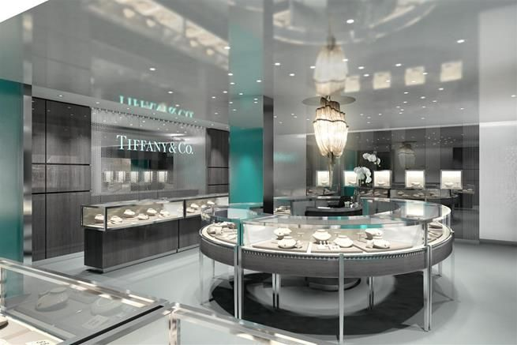
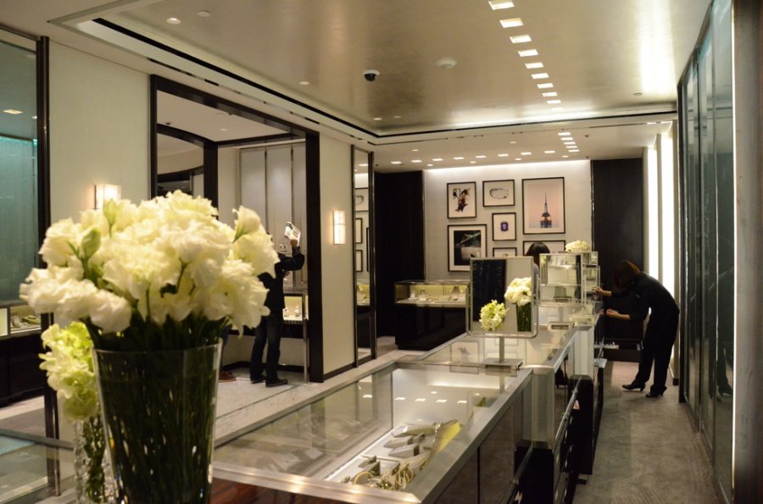
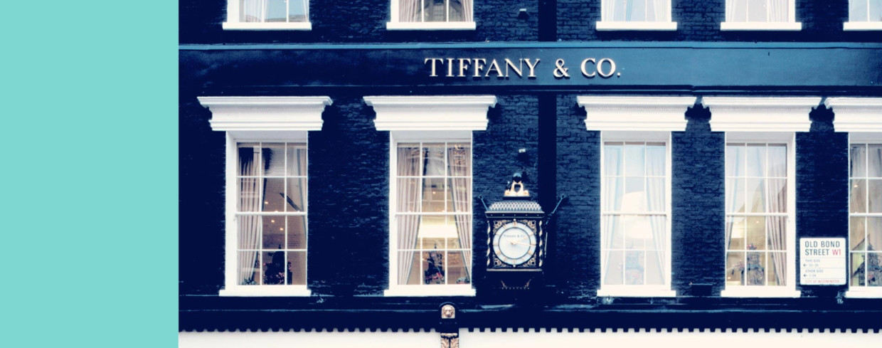
Jewellery shops
A jewellery store is a retail business establishment, that specializes in selling (and also buying) jewellery and watches. Jewellery stores provide many services such as repairs, remodeling, restoring, designing and manufacturing pieces.

Slide 8
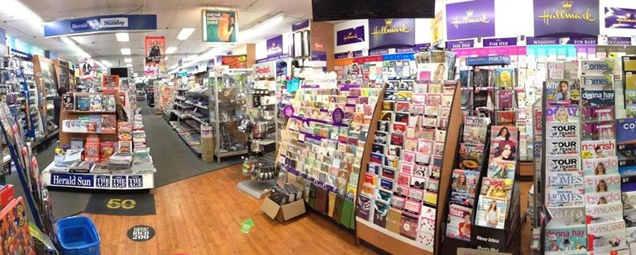
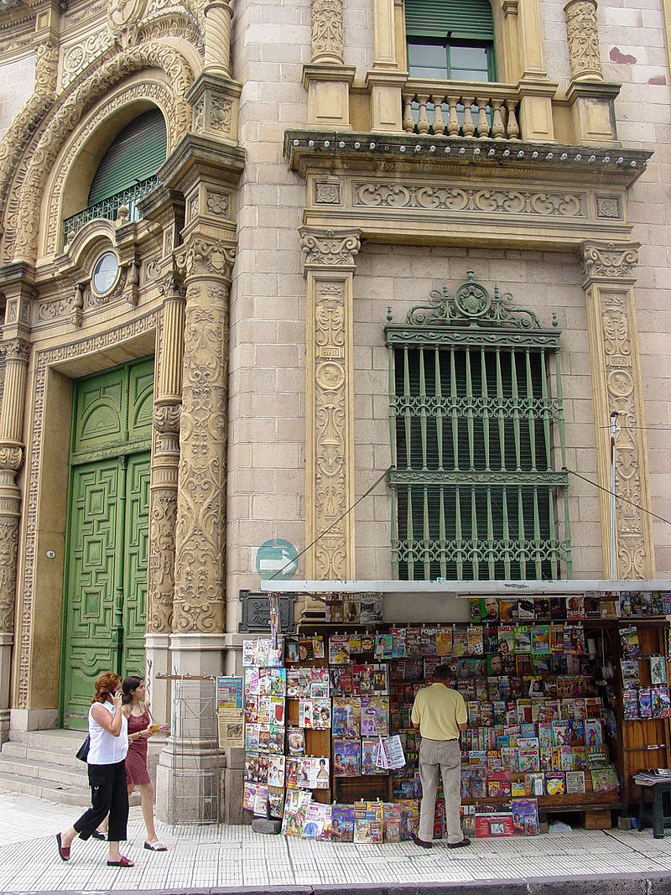
Newsagent's shop
A newsagent's shop or simply newsagent's is a business that sells newspaper, magazines,cigarettes, snacks and often items of local interest.
Newsagents typically operate in busy public places like city streets, railway station and airports.
The physical establishment can be either freestanding or part of a larger structure.
In Canada and the United States, newsstands are often open stalls in public locations such as streets, or in a transit terminal or station (subway, rail, or airport).

Slide 9
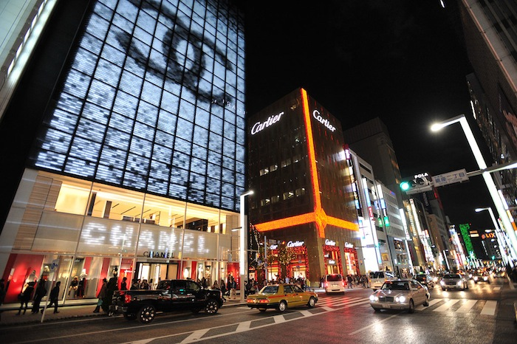
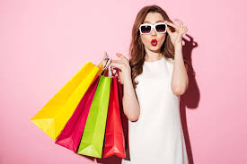
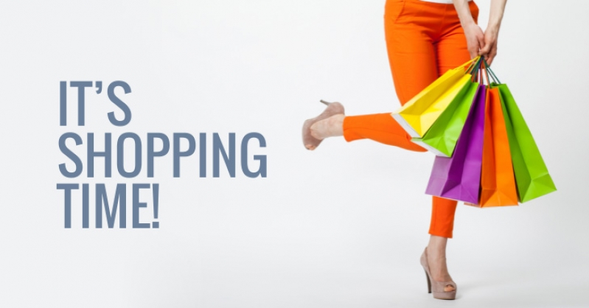
THANKS FOR YOUR ATTENTION!

